Slide 1
Serological tests
Part 2

Slide 2
There are several Serological methods including:
Immunodiffusion (ID)
Enzyme-linked immunosorbent assay (ELISA)
Latex Agglutination
Complement-fixation (CF)

Slide 3
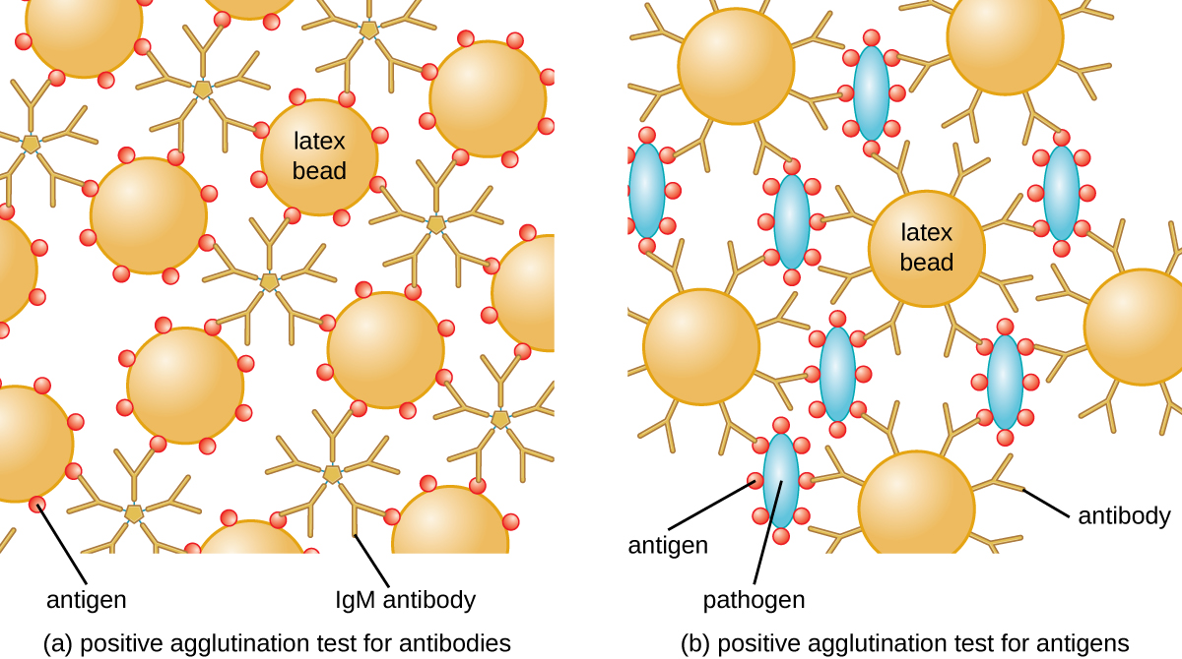
Latex Agglutination test
A rection between an antigen and an antibody (which is specific to the Ag) to form visible clumping. This clumping is called Agglutination.
Principle
Latex beads coated with an antigen will agglutinate when mixed with patient serum if the serum contains antibodies against the antigen.
(b) Latex beads coated with antibodies will agglutinate when mixed with patient serum if the serum contains antigens specific to the antibodies.

Slide 4
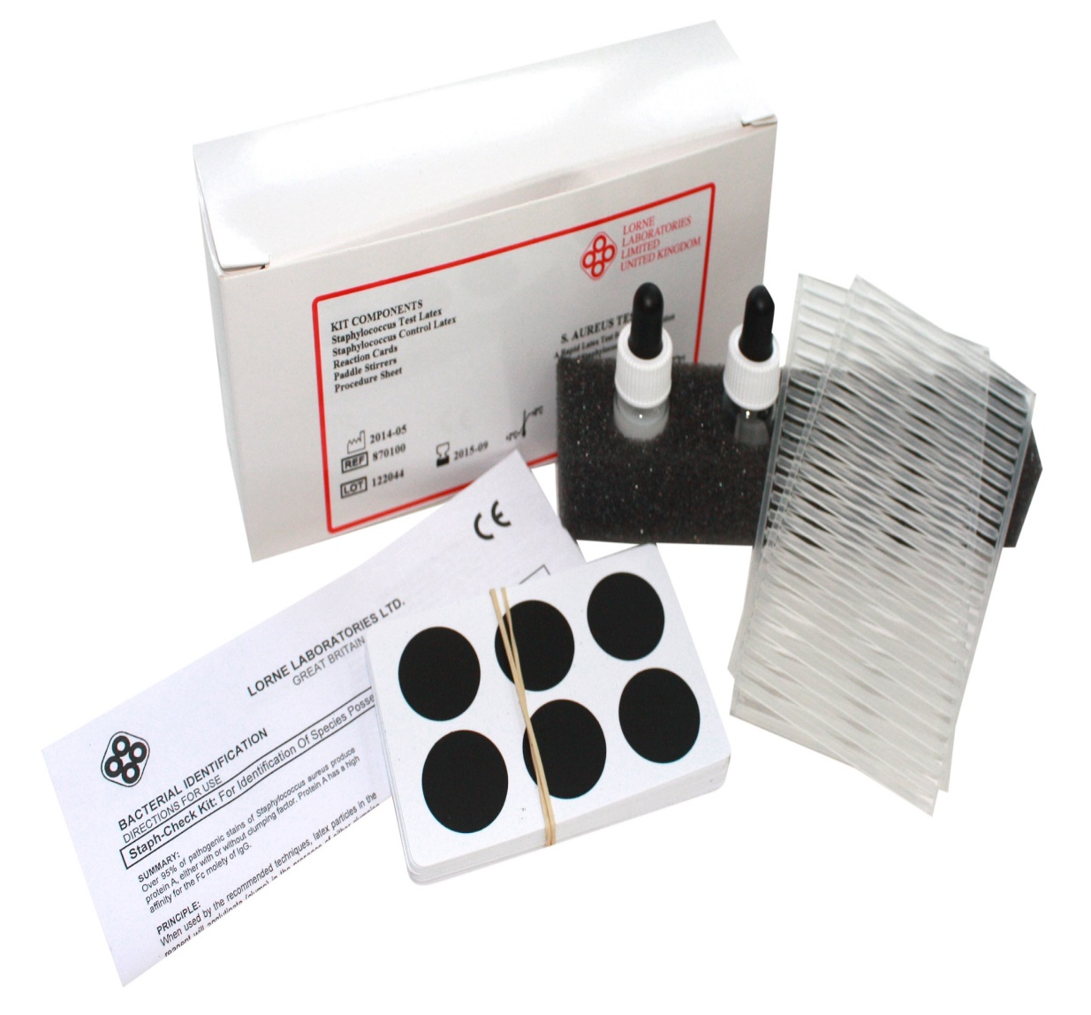
(8) Agglutination assay to detect antigens - Multi-Lingual Captions - YouTube
Latex Agglutination kit
Positive Control beads ( beads coated with fungal antigens or coated with Abs specific for the Ag
* Negative Control beads

Slide 5
Result interpretation of the agglutination test:
positive (heavy precipitate with clear background)
(2) positive (heavy precipitate with clear background)
(3) positive (light precipitate with clear background
(4) positive 1+ (light flocculent precipitate with clear background
(5) negative (no precipitate, cloudy homogeneous background)

Slide 6
Concentration of samples 4 to 8 folds has been shown to increase assay sensitivity.
False negative result may occur if the sample contains excessive antibody or antigen resulting in a prozone
effect.
Serial dilution of the sample with normal saline is necessary to obtain true positive result
(8) Latex Agglutination - Part 4 - YouTube

Slide 7
Method | Fungal diseases detected | Pro (+) | Cons (-)
Latex Agglutination test Detect: Ag or Ab | Ex1: Cryptococcosis ** Caused by Cryptococcus spp (Ag) Ex2: Sporotrichosis (Ab) | Rapid testing (1 h) High specificity Low–medium laboratory technician training Low cost | Interpretation issues in weak positive results Prozone effect can cause false negative

Slide 8
Cryptococcosis
** is a potentially fatal fungal infection of mainly the lungs, presenting as a pneumonia, and brain, where it appears as a meningitis.
Caused by the fungi Cryptococcus neoformans or less commonly Cryptococcus gattii
Can be acquired by breathing in the spores from the air
These fungi are found in soil, birds droppings
Generally, Cryptococcus neoformans infects people with HIV/AIDS and those on immunosuppressant drugs and does not usually affect fit and healthy people
Cryptococcus gattii can infect immunocompetent

Slide 9
Complement fixation test
is an immunological test, which uses complement to detect the presence of specific antibody in patient’s serum
Complement :
proteins
Only binds to Ag-Ab complex (Complement Fixation/nonreactive)
When Free, it has lytic properties : the ability to lyse antibody-coated sheep red blood cells.

Slide 10
Do not produce any visible precipitation that can be observed. Therefore, the indicator system*** is needed
*** indicator system:
Complement
Sheep red blood cells (RBC)
Anti- Sheep red blood cells antibody
Requires serial dilution of the patient’s serum

Slide 11
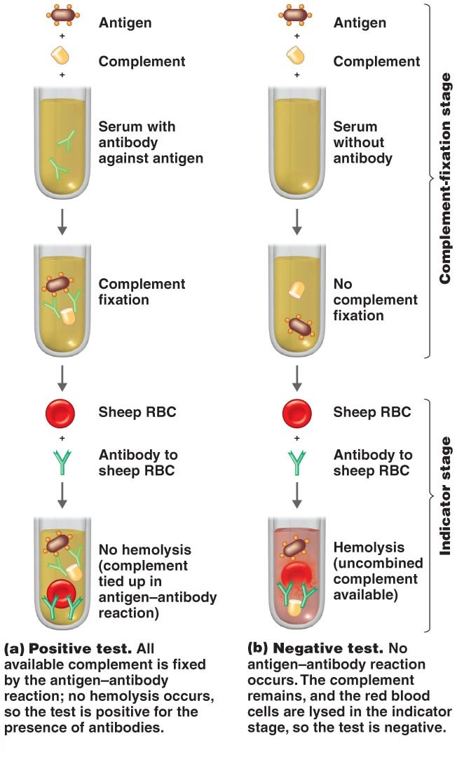
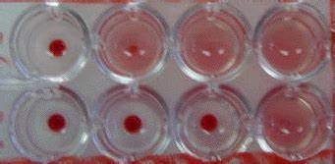

Slide 12
Antigen and antibody interact with each other, to form a complex called antigen-antibody (Ag-Ab ) complex.
The complex then interacts with complement protein and gets fixed with it.
Positive test
1-Antibody in sample + Antigen (added) + Complement → Ag-Ab Complex Fixed with Complement
2-Complement fixed Ag-Ab + Indicator System → No change (No hemolysis)
Negative test
1-Sample with no antibody + Antigen (added) + Complement → Free Complement
2- Free Complement + Antibody in indicator system (On RBC) → Hemolysis

Slide 13
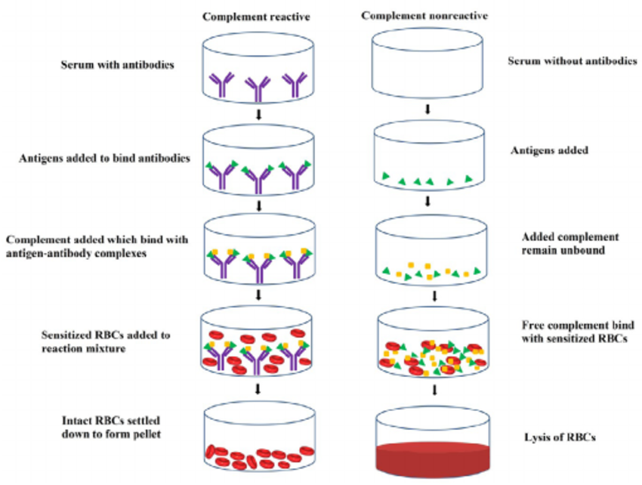
(8) Serology: Complement Fixation Test - YouTube

