Slide 1
Lab 5 :
Purification and Simple stain

Slide 2
Culture
The organism growing on the media plate is called as culture
Colony
The number of cells of any organism living together

Slide 3
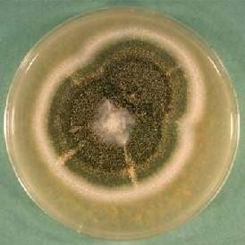
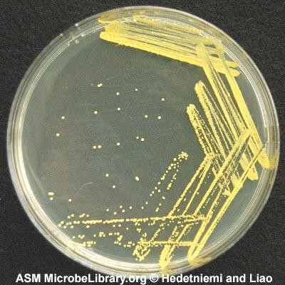
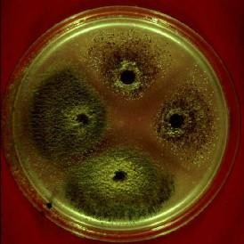
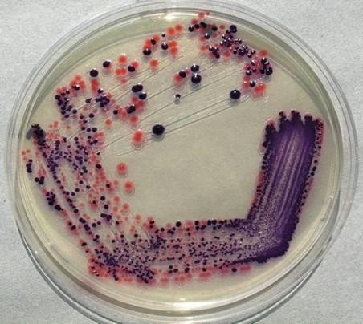
Types of Culture
2-Contaminated culture
More than one type of organism growing on the media plate
1-Pure Culture
Only one type of microorganism growing on the media plate

Slide 4
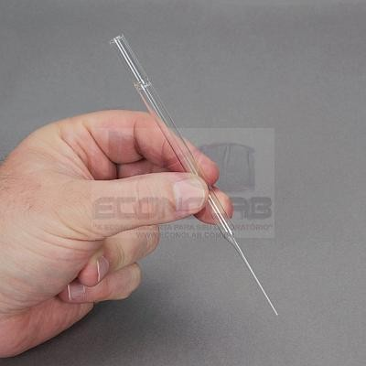
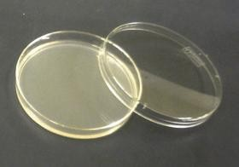
Purification of Fungi:
Use a pasture pipet.
Flame the pipet using alcohol 70% and allow to cool.
Cut a discs from the edge of an actively growing fungal colony.
Inoculate it (surface facing down) on the center another media plate with the help of flamed forceps
Incubate it for 3-5 days
Pure culture of the organism will grow.

Slide 5
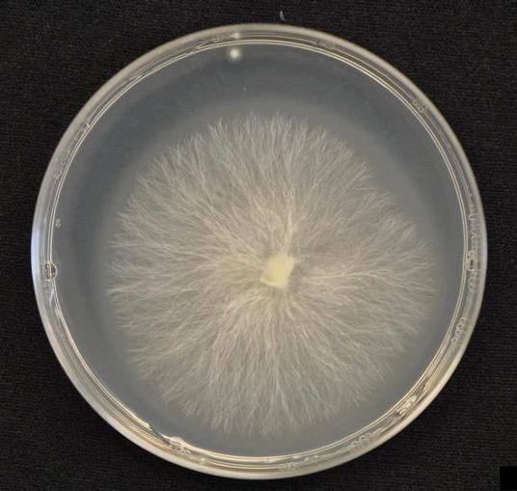
Result

Slide 6
Purification of Bacteria :
Streak plate Method
Streak inoculum onto one portion of the plate
Sterilize the loop
Streak through the first inoculum and spread into second section
Repeat several times
Incubate it for 24 h. ,
a single colony will be observed .

Slide 7
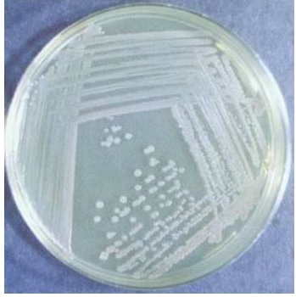
Result
1
2
4
3

Slide 8
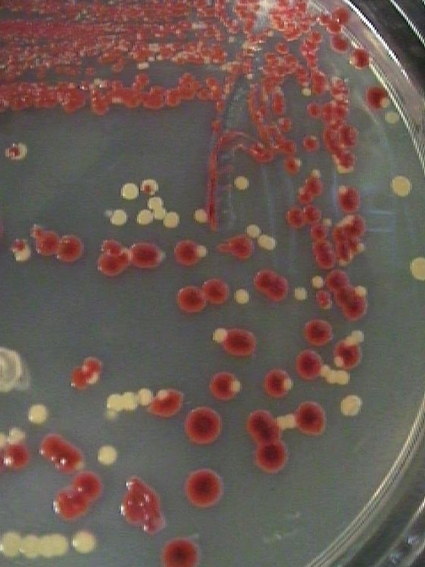
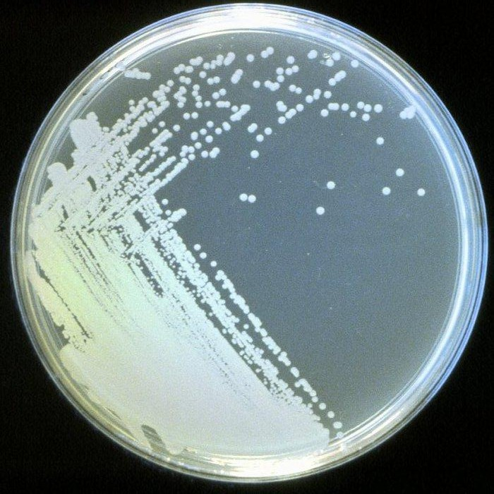
Which streak plate culture started as a pure culture. How can you tell?
_{An}swer: the one on the right, because all colon^{ies look alike.}

Slide 9
Watch
https://www.youtube.com/watch?v=_1KP9zOtjXk

Slide 10
Characters of colony
Form
What is the basic shape of the colony? For example, circular,
filamentous, etc.
Margin
What is the magnified shape of the edge of the colony?
Elevation
What is the cross sectional shape of the colony? Turn the Petri dish on end.
Surface
How does the surface of the colony appear? For example, smooth, rough, dull , wrinkled etc.
Pigmentation
For example, white, red, purple, etc.

Slide 11
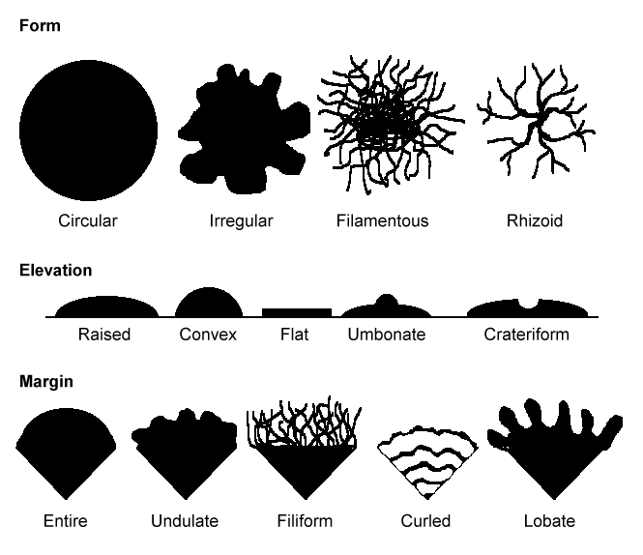

Slide 12
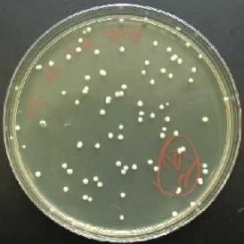
Most bacterial colonies appear white, cream, or yellow in color, and fairly circular in shape.

