Slide 1
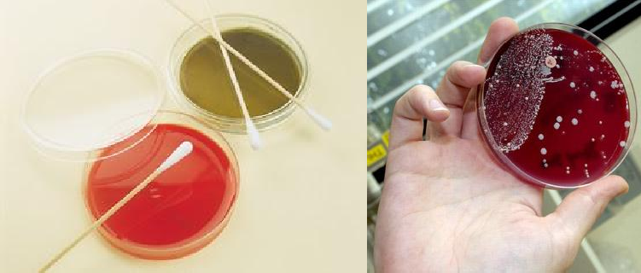
140 Micro
Lab 4: Isolation of microbes

Slide 2
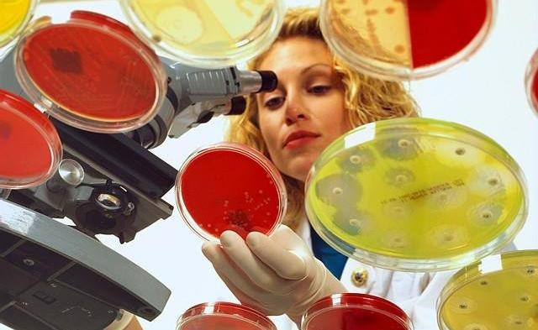
The Aim
Isolation of micro organisms from various
environments

Slide 3
steps :
Isolation – introduction of a sample into a container of media to produce a culture of observable growth.
2. Inoculation
Incubation – conditions that allow growth e.g., temperature ,humidity etc..
Inspection
Identification.

Slide 4
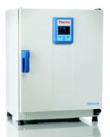
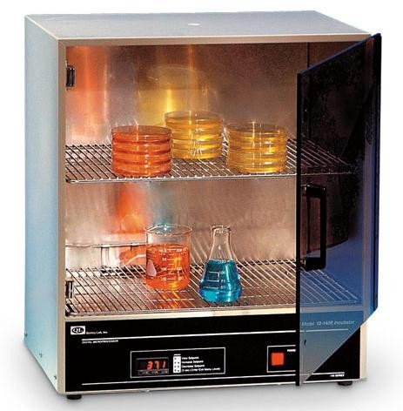
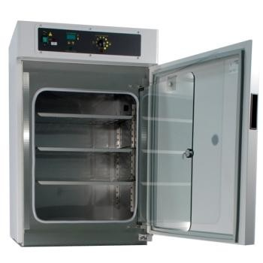
Incubator
In biology, an incubator is a device used to grow and maintain microbiological cultures or cell cultures.
The incubator maintains optimal temperature, humidity and other conditions such as the carbon dioxide (CO2) and oxygen content of the atmosphere inside.

Slide 5

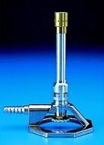
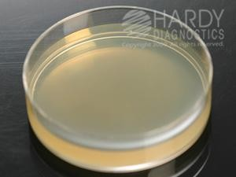
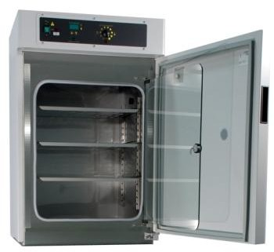
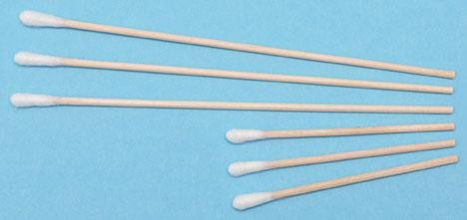
Materials and methods
Dettol 50%+Cotton
Benzene burner
Petri plate with media :
- NA (for bacteria ) – PDA (for fungi).
Cotton swap
Samples : Soil ,Rotten fruit ,Yoghurt , Mouth swab etc.
Incubators

Slide 6
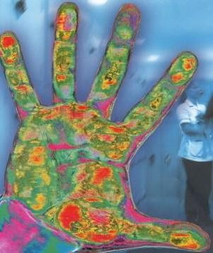
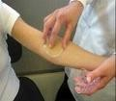
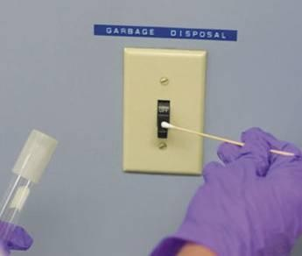
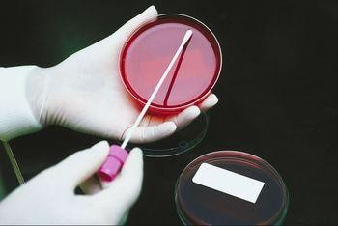
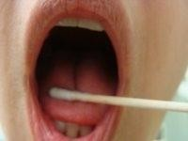

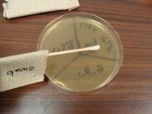
Samples
Environmental Sample
Normal Flora Samples
Surface samples are normally taken using sterile swabs
Applying oral sample to surface of agar

Slide 7


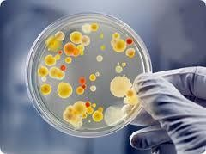
Various sources of isolation of :
Bacteria
Fungi

Slide 8

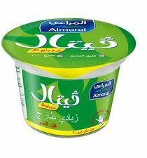






Isolation of Bacteria
Put a drop of diluted yoghurt on the solid media plate of bacteria .
Incubate at 37 °C for 1 day.
Yoghurt
Take some saliva with the help of a cotton swab.
Inoculate it on the media and incubate.
Mouth
Hand
Touch the surface of the solid media plate .
Incubate 37 °C for 1 day. .

Slide 9
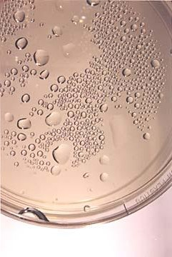
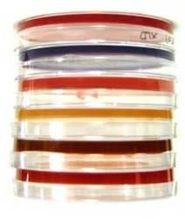
Agar plates are stored upside down to prevent condensation.

Slide 10
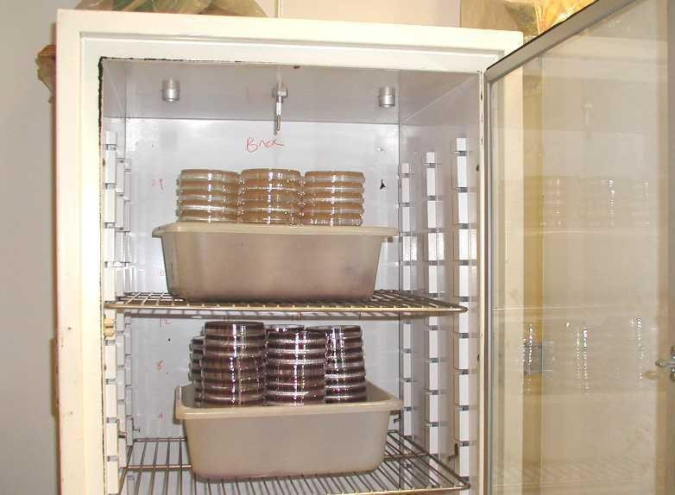
These plates of bacteria will be incubated at 37° C for 24 hours and then stored at refrigerator until next week when you will observe for results.

Slide 11


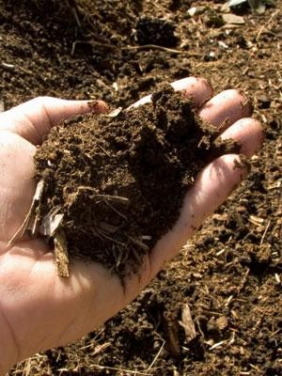

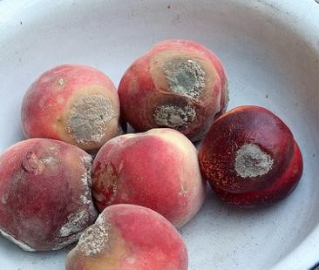
Isolation of Fungi
Expose the prepared plate of solid media in air for 10 min
Close the lid and incubate at 28 °C.
After 2-5 days fungus observe for grow
Air
Soil
Sprinkle a pinch of soil on the solid media plate
Close the lid and incubate at 28 °C
After 2-3 days fungus observe for growth.
fruit
Clean the rotten part of fruit with alcohol
Cut a piece and inoculate it on the media plate
Then incubate ,after 2-5 days fungus will grow

Slide 12
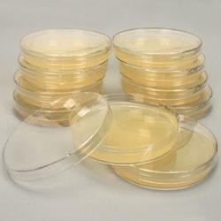
These plates of fungus will be incubated straight at 28° C for 2-5 days and then stored at refrigerator until next week when you will observe for results.

Slide 13


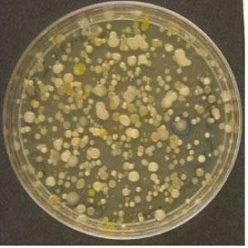
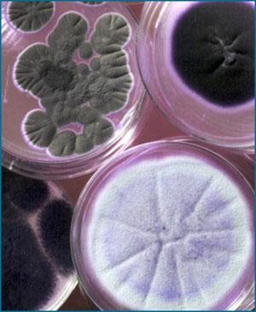
Fungi
Result
Bacteria
Write a report

