Slide 1
Antigen – Antibody Reaction
Complement Fixation Test
CFT

Slide 2
Complement Fixation Test
CFT
is an immunological test, which uses complement to detect the presence of specific antibody in patient’s serum
Complement :
proteins
Only binds to Ag-Ab complex (Complement Fixation)
When Free, it has lytic properties : the ability to lyse antibody-coated sheep red blood cells.
Notes:
Complement Fixation Test

Slide 3
**Do not produce any visible precipitation that can be observed. Therefore, the indicator system*** is needed
*** indicator system:
Complement
Sheep red blood cells (RBC)
Anti- Sheep red blood cells antibody
Requires serial dilution of the patient’s serum

Slide 4
Materials And Reagents
The test requires five reagents and is carried out in two steps. Test System
❖ Antibody: Human serum (May or may not contain Antibody towards specific Antigen)
❖ Antigen
❖ Complement: It is pooled serum obtained from 4 to 5 guinea pigs. It should be fresh or specially preserved (Why?) as the complement activity is heat labile (stored at - 30 °C in small fractions).
Indicator System (Haemolytic system)
❖ Erythrocytes: Sheep RBC
❖ Amboceptor (Anti- Sheep red blood cells antibody): Rabbit antibody to sheep red cells prepared by inoculating sheep erythrocytes into rabbit under standard immunization protocol.

Slide 5
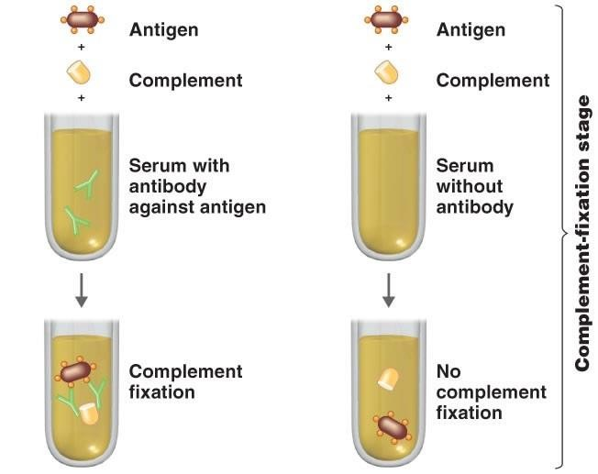
Complement fixation stages

Slide 6
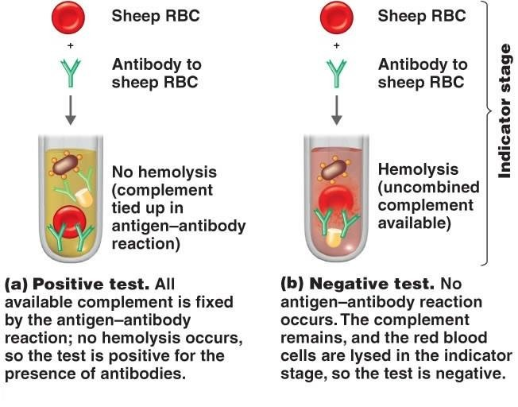
Complement fixation stage
Notes:
If no hemolysis occurs the test is negative

Slide 7
Complement fixation stage
First step
01
02
A known antigen and inactivated patient’s serum are incubated with a standardized, limited amount of complement.
patient’s serum is heated at 56°C for 30 minutes to inactivate endogenous complement which may disturb the test calibration.
03
04
However, if there is no antibody in the patient’s serum, there will be no formation of antigen-antibody complex, thus complement will not be fixed but will remain free (In the indicator stage this complement will react with RBC coated with antibody to sheep RBC ).
If the serum contains specific complement activating antibody, the complement will be activated or fixed by the antigen-antibody complex.

Slide 8
Indicator Stage
Second step
01
The second step detects whether complement has been utilized in the first step or not. This is done by adding the indicator system.
02
If the complement is fixed in the first step owing to the presence of antibody there will be no complement left to fix to the indicator system. There won’t be any lysis of RBCs
03
However, if there is no specific antibody in the patient’s serum, there will be no antigen-antibody complex, therefore, complement will be present free or unfixed in the mixture. This unfixed complement will now react with the anti body- coated sheep RBCs to bring about their lysis.
Notes:
In complement fixation test, If no hemolysis occurs the test is negative

Slide 9
Positive Test
• Step 1:
Antigen + Antibody + Complement (from serum)
• Step 2:
At 37°C
1 Hour
Complement gets fixed
At 37°C
1 Hour
Fixed Complement complex + Haemolytic system
No haemolysis

Slide 10
Negative Test
• Step 1:
Antigen + Antibody absent + Complement
At 37°C
1 Hour
Complement not fixed
• Step 2:
Free Complement + Haemolytic system
At 37°C
1 Hour
Haemolysis

Slide 11
+
Interpretation
In the positive test : The available complement is fixed by Ag-Ab complex and no hemolysis of sheep RBCs occurs.
So the test is positive for presence of antibodies.
-
In the negative test : No Ag-Ab reaction occurs and the com plement is free. This free complement binds to the complex of sheep RBC and it’s antibody to cause hemolysis, causing the development of pink color.

Slide 12
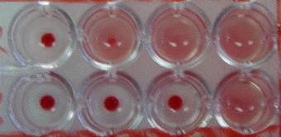
Results and Interpretations:
1 2 3 4
A
 | 1 | 2 | 3 | 4
A | POSITIVE No haemolysis | POSITIVE No haemolysis | NEGATIVE Haemolysis | NEGATIVE Haemolysis
B | POSITIVE No haemolysis | POSITIVE No haemolysis | POSITIVE No haemolysis | NEGATIVE Haemolysis
B

Slide 13
Advantages and disadvantages of CFT
Advantages
1. Ability to screen against a large number of viral and bacterial
infections at the same time.
2. Economical.
Disadvantages
1. Time consuming and labor intensive
2. Sometimes is non-specific e.g. cross-reactivity between HSV and VZV

