Slide 1
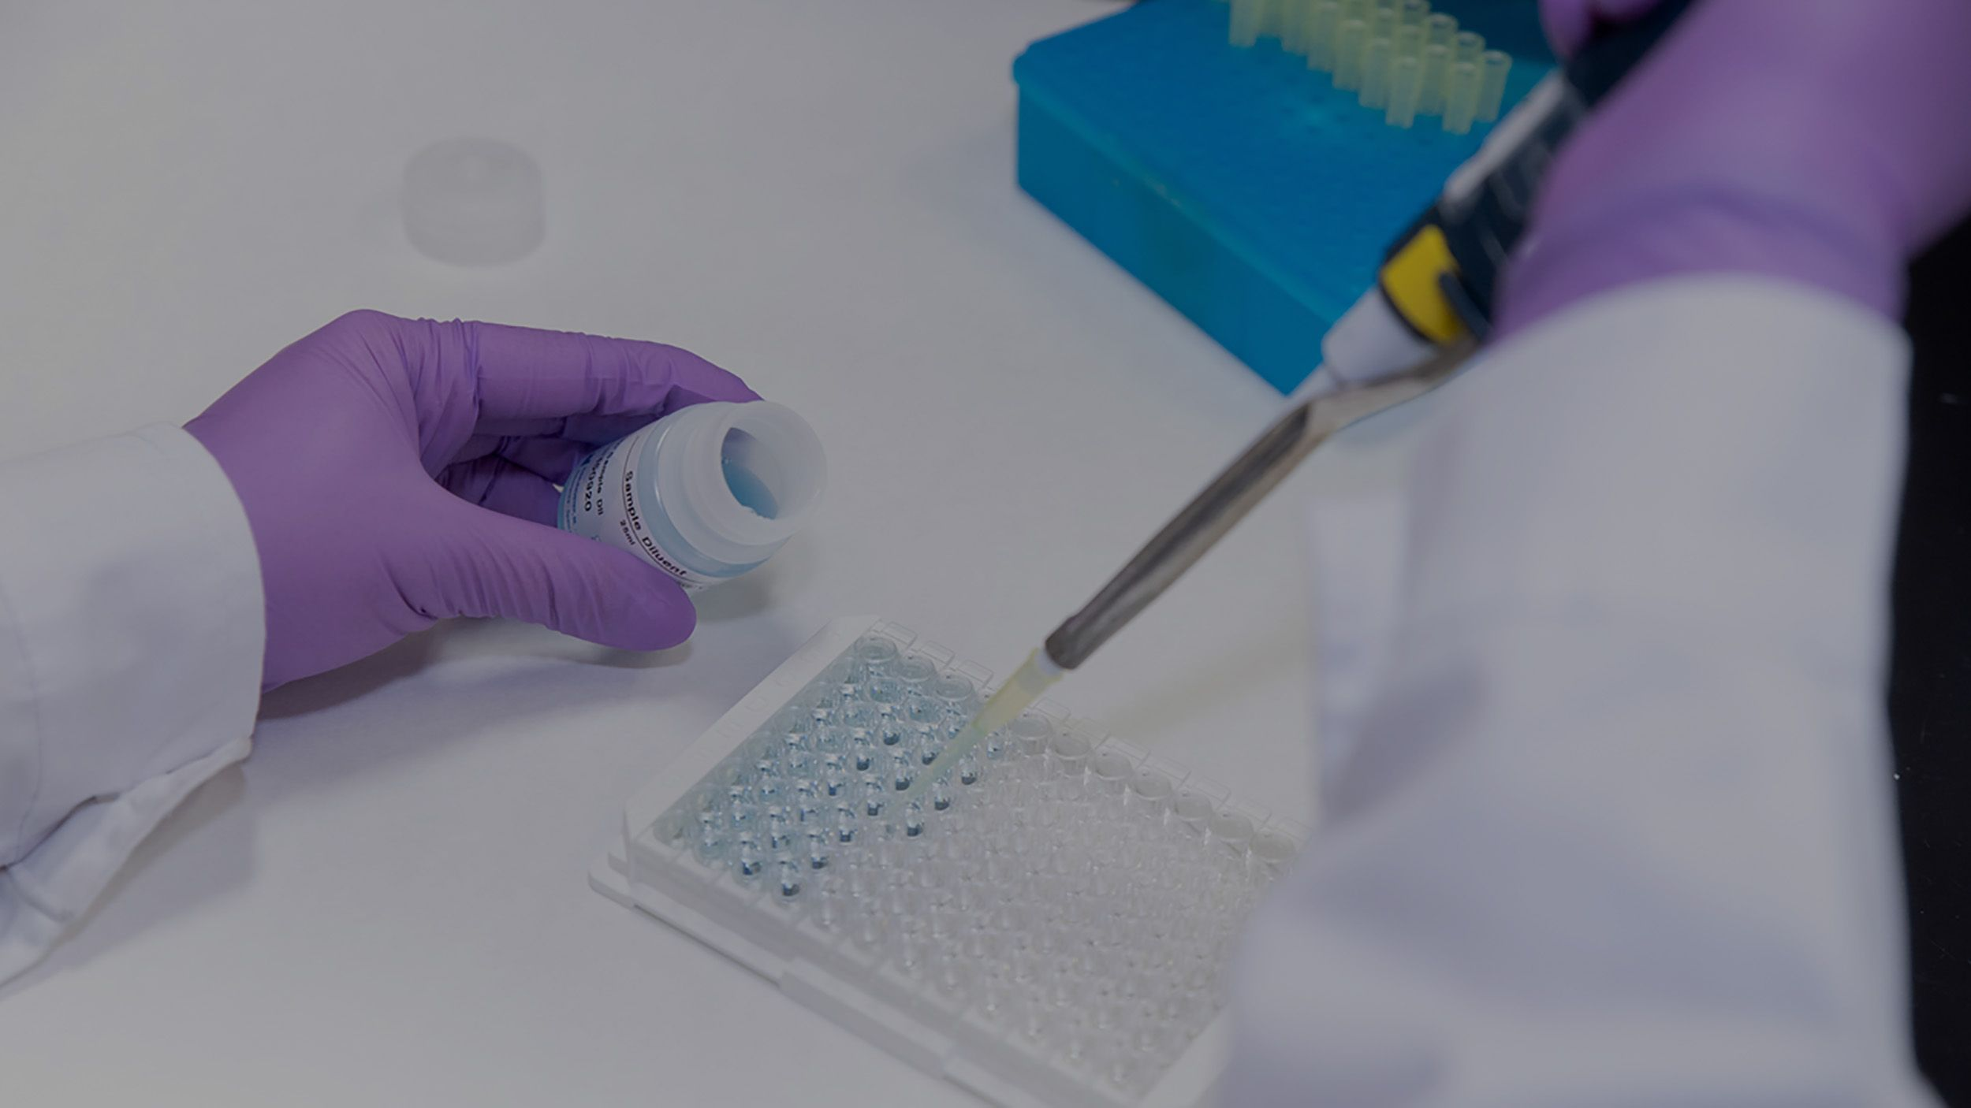
Medical Mycology
Serological tests
Lab 4

Slide 2
Systemic Fungal infection
Most systemic fungal infections are caused by Opportunistic fungal** pathogens
**Fungi that are nonpathogenic in the immunocompetent host, mostly exist as part of the normal flora in the upper respiratory tract.
Common in immunocompromised hosts.
Disease can also occur in immunocompetent individuals if the exposure dose is high

Slide 3
The main organisms isolated most frequently from immunocompromised patients are :
Aspergillus spp (cause Aspergillosis)
Candida spp.
Cryptococcus spp

Slide 4
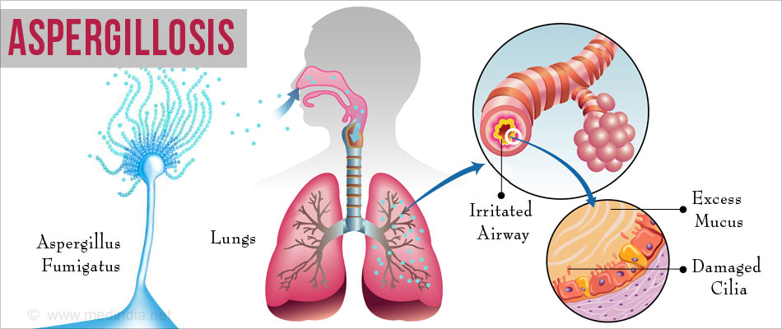
Aspergillosis
Infection caused by Aspergillus
Almost 200 species have been described, such as: Aspergillus fumigatus, Aspergillus flavus, Aspergillus niger.
The infection, usually affects the respiratory system and may lead to breathing problems.
Cough
Wheezing
Coughing up blood
Shortness of breath
Chest pain
Skin lesions

Slide 5
Aspergillosis
Galactomannan (GM) aspergillus specific antigen (polysaccharide,) found in the cell wall and released during the growth phase of invasive aspergillosis
Can be detected in serum samples
Highly immunogenic antigen (immunogen)***
***Antigens that are capable of inducing an immune response via inducing Ab production ( and/or cell-mediated immune response rather than immunological tolerance**.
The key difference between the antigen and the immunogen is that an immunogen is necessarily an antigen, but an antigen may not necessarily be an immunogen.
**Immunological tolerance= do not elicit any immune response mechanism

Slide 6
Serological tests

Slide 7
Serological tests:
Diagnostic methods/approaches, that involve the detection of antibodies (Ab),or the detection of specific fungal antigens (Ag).
Antibodies
Specialized proteins made by specialized immune cells called B cells and ach antibody binds to a specific antigen to neutralize and tag it so other immune cells can recognize it.
Antigens
Foreign substance which induces an immune response in the body, especially the production of antibodies.

Slide 8
Serological tests:
Useful in diagnosing systemic mycoses but less so in diagnosing other fungal infections.
Fungal polysaccharides or proteins may be shed into body fluids during the course of infection, which can be detected using specific antibodies
Require patient’s body fluid such as: Blood, Cerebrospinal fluid CSF, Urine, Bronchoalveolar Lavage fluid (BALF)

Slide 9
Ab detection
Diagnosis of systemic mycoses
Assess prognosis of the disease
Assess the response to treatments
Ag detection
Useful during the early stage of infection (before producing Abs)
Useful in patients with impaired immune system- Why?
*the immune system in those patients often failed to produce antibodies

Slide 10
Why Serology?
Ags and Abs are easier to detect compared to finding the organism directly
Ags and Abs are produced in large quantities and can be found in body fluids such as: Blood, Cerebrospinal fluid CSF, Urine, Bronchoalveolar Lavage fluid (BALF)
Rapid test, as the result can be obtained within few hours.
(culture is usually time consuming and insensitive due to the low concentration of the organism in the tissue).
Notes:
Why Serology?

Slide 11
There are several Serological methods including:
Immunodiffusion (ID)
Latex Agglutination
Complement-fixation (CF)
Enzyme-linked immunosorbent assay (ELISA).

Slide 12
Immunodiffusion Assay (ID)
Positive samples
Ser+2?
Ser+1?
visible precipitation lines (antigen-antibody
Complex)
Ser+
(Ab+)
Ag+
Ser+
(Ab+)
Negative samples
Ser+3?
Ser+4?
Falsely negative results may be obtained when testing immunocompromised patients?

Slide 13
Immunodiffusion Assay (ID)
Goal: Used to detect the presence of antibodies to Aspergillus (using serum samples only)
Positive
Principle: When antigens and homologous antibodies are placed in adjacent wells cut into suitable diffusion media such as agar or agarose, they diffuse towards one another and produce visible precipitation lines along the interface of optimal relative concentrations.
Ser?2
Ser?1
(antigen-antibody
complex
Ser+
Ag+
Ser+
Ser+ =positive control serum sample (provided in commercial kits)
contains Abs specific for the Ag+ so they can diffuse toward each other
The development of precipitin lines in control tests is used to confirm reagent and plate performance.
Ser?4
Ser?3
Agar gel immunodiffusion assay (AGID) – YouTube
Start at 2.45
Negative

Slide 14
Enzyme-linked immunosorbent assay (ELISA): (Sandwich ELISA):
Used to detects galactomannan (Ag) in human serum or BALF (Supernatant)
Procedure:
The plate wells are pre-coated with capture antibody (has an affinity towards the Ag/GM)
The sample containing the antigen is added to the wells.
incubation period to allow the interaction between capture Abs and Ag
wash to remove free/ unbound antigens
Then a secondary detection antibody (Enzyme linked Ab) is added, which binds to another epitope/site on the Ag.
The wells are washed to remove any free/ unbound secondary antibodies.
Enzyme is added which binds to the antigen-antibody complex
The wells are washed to remove any free/ unbound secondary antibodies.
Substrate solution is then added and color develops in proportion to the amount of Human GM.
The reaction is terminated by addition of acidic stop solution and absorbance is measured.

Slide 15
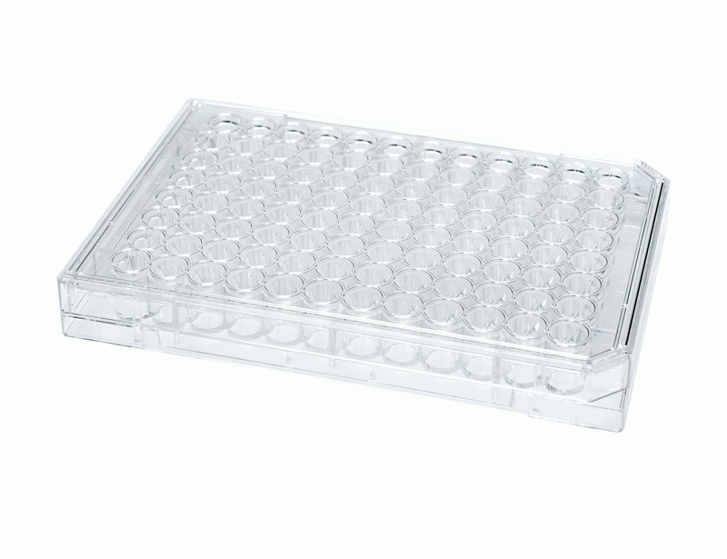
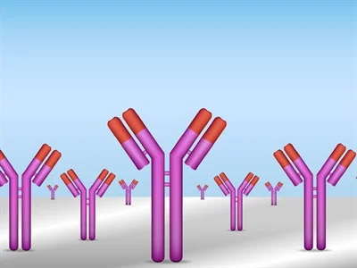
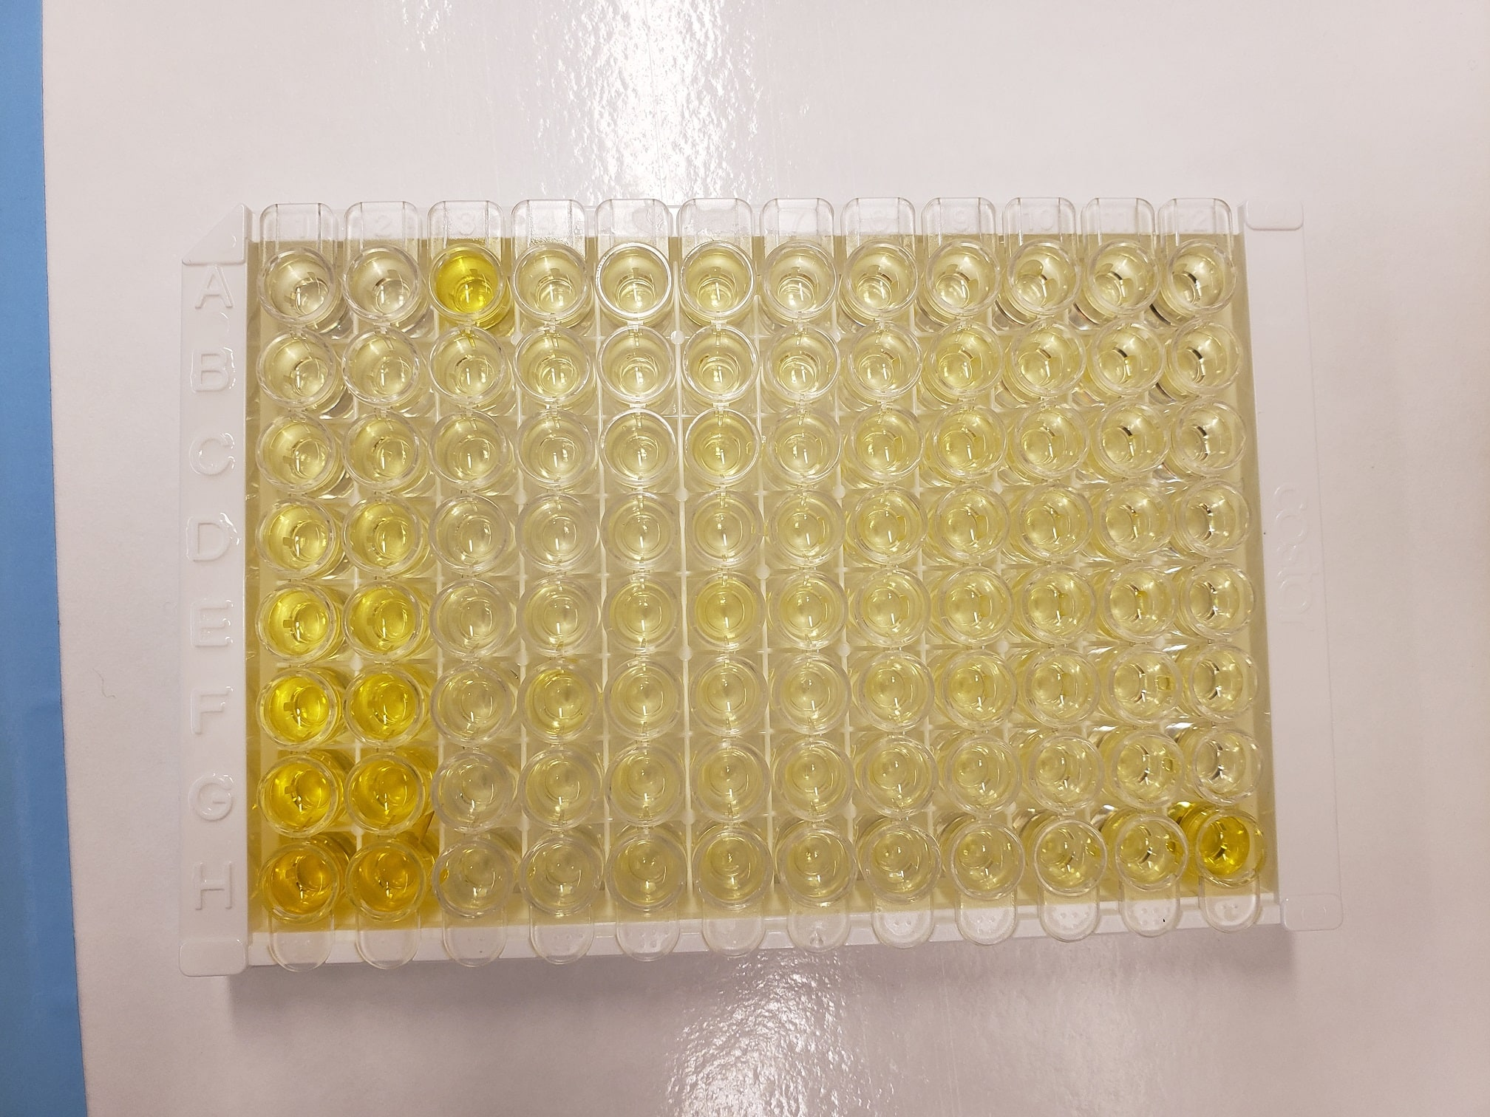
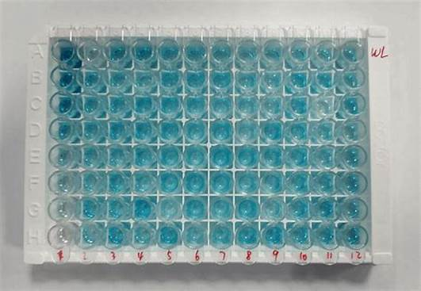
3-Detection Ab
2-Sample (Serum/BALF)/contains Ag
Y
Ag (GM)
Ag (GM)
Y
Y
Y
Incubate
then wash (using wish buffer)
Y
Incubate
then wash (using wish buffer)
Y
1-wells, pre-coated with capture antibody)
4-Enzime (E)
4-Substrate solution S ( to develop a color)
E
E
Y
Y
S
Ag (GM)
S
Ag (GM)
S
E
E
E
Y
E
Y
Y
E
Y
E
Y
Y
Stop solution

Slide 16
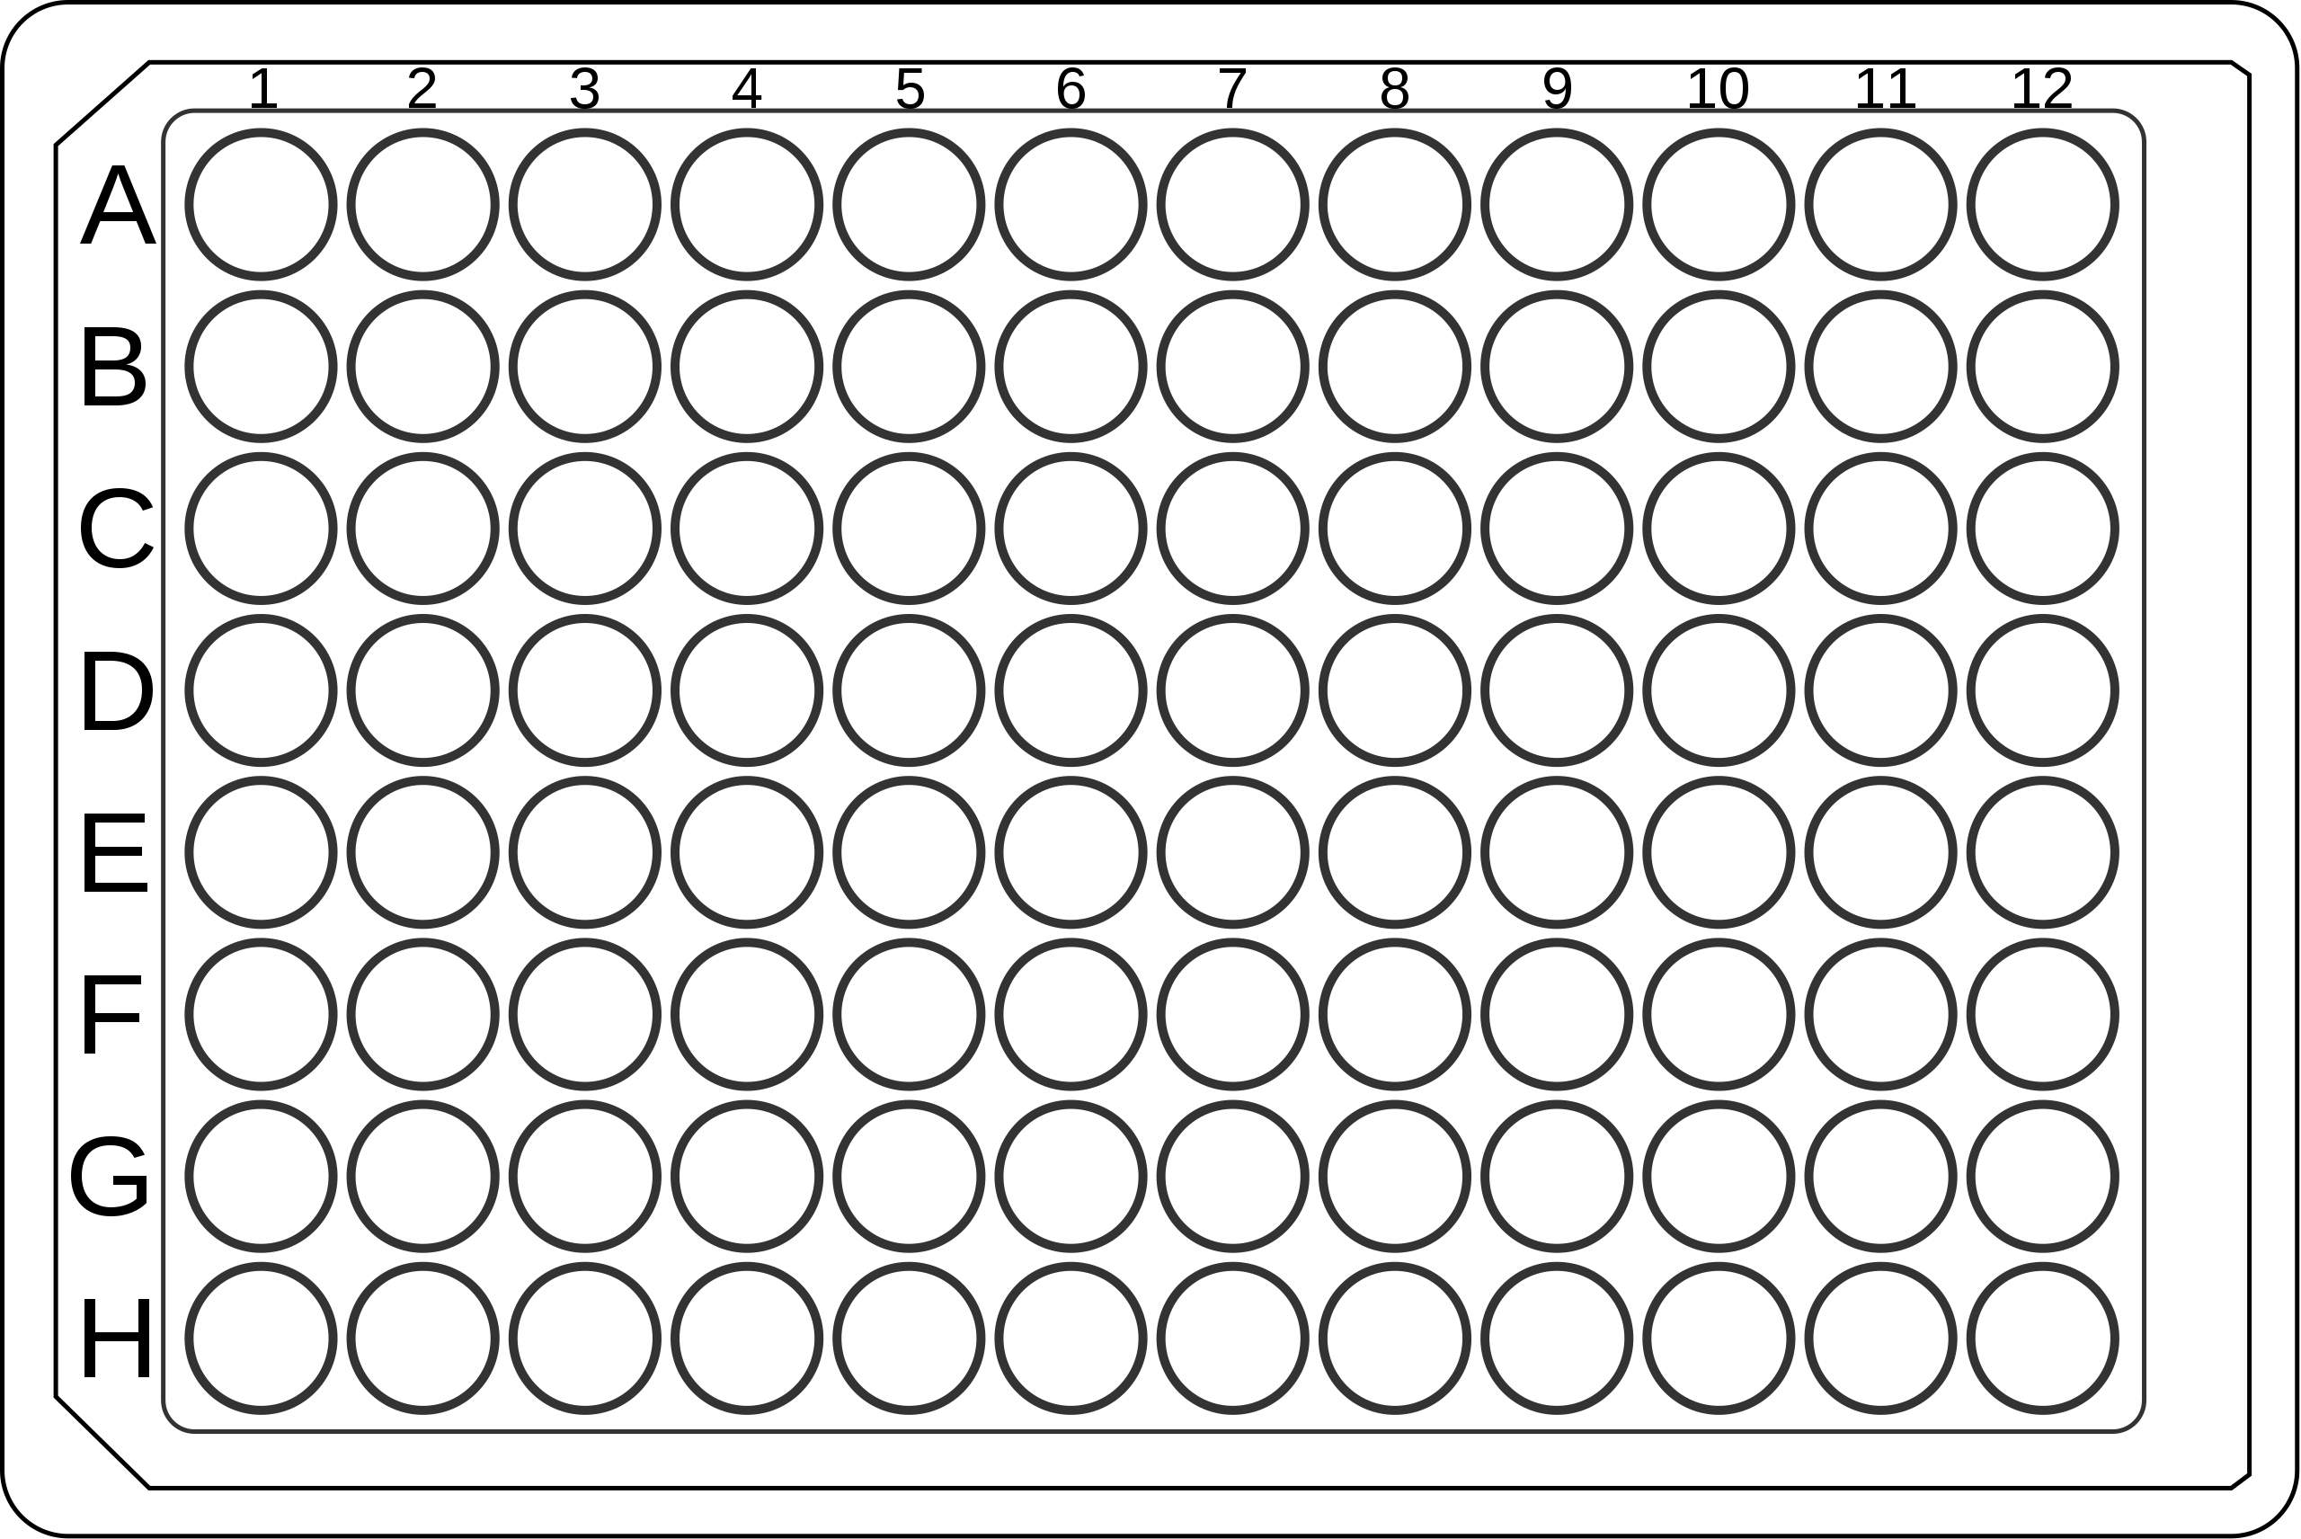
When running an Elisa test
Must include Standard solution (provided inside the kit) (purified antigen)
making serial dilutions of standard with known concentration
Ex: high concentration is 500 pg/ml
Make 500 - 250 – 125 – 62.5 – 31.5- 15.6- 7.8 (using assay diluent provided inside the kit
Add 100-200 ul of the samples (in duplicates)
500
500
SA1 SA2
Serial dilutions of the Standard solution (in duplicates)
Must be added when adding the serum samples
250
250
SB1 SB2
Blank= assay diluent
B
B
Notes:
SA1 SA2

Slide 17
1-Use Microplate reader with 450 ± 10nm wavelength filter
your data will be exported as an excel file
absorbance values for Standard curve (St)
3-Subtract the blank to minimize the background absorbance
2-Average for the St
4-Create St curve using excel

Slide 18
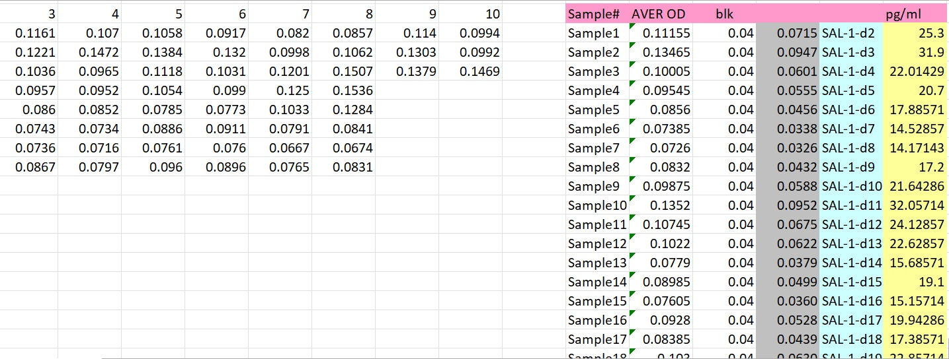
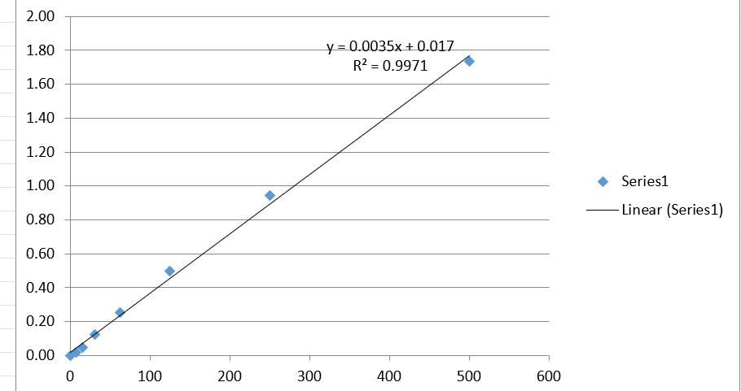
Calculation of Result
5- OD-Blank
=Y
Y= (Average OD-blK) =
Y=0.0035X + 0.017
Y= aX+b
X= concentration
X=Y+b/a
Concentration (X)=(Y+ 0.017)/0.0035

