Slide 1
BCH 462- Biotechnology & Genetic engineering [Practical]
Lab (3) Extraction and Determination of Bacterial Proteins

Slide 2
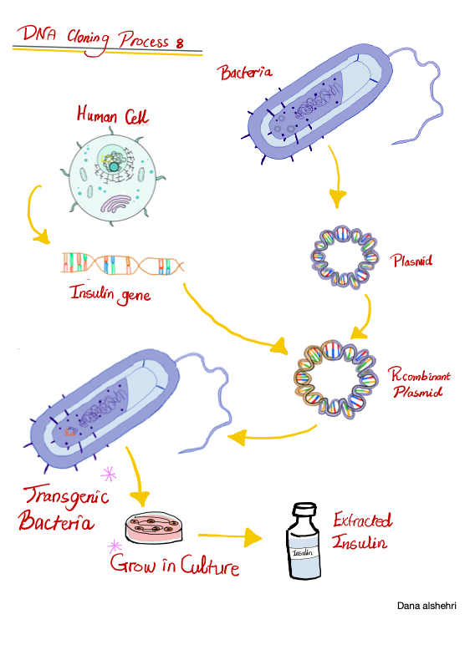
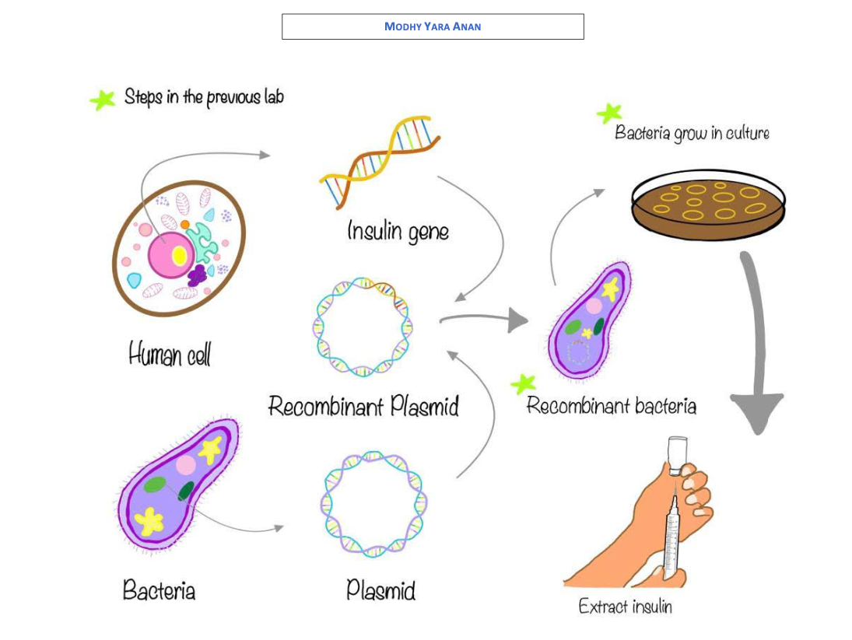
Molecular cloning
*
Figure 1. Schematic representation of recombinant insulin production

Slide 3
Bacterial proteins
Bacterial protein is a protein which is either part of the bacterium structure or produced by bacterium as a part of its life cycle.
Proteins are very essential for most of the bacterial metabolic functions as well as for cell integrity.
Bacterial protein can be:
1. Toxic, causing illness or death in an organism which has been infected including humans.
2. Used as a model to gather data about the proteins associated with larger organisms.

Slide 4
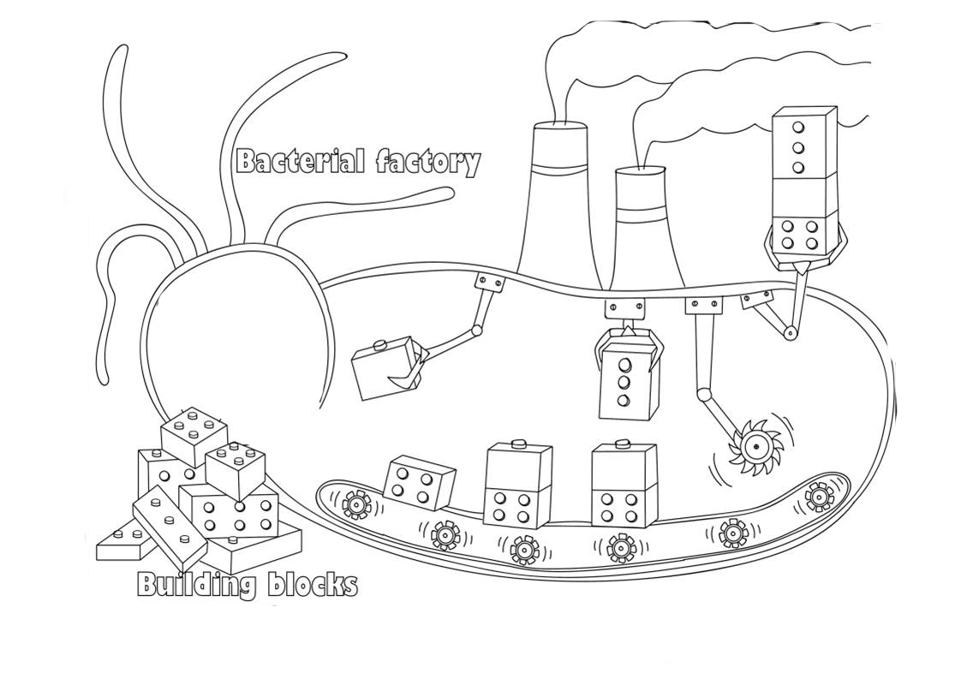
Bacteria as biological factories
Bacteria can produce foreign proteins from introduced gene using their own gene expression machinery.
Scientists routinely clone the gene that encodes ‘their’ protein of interest and express large amounts of it in bacteria and other organisms.
Many medicines and drugs are produced, for instance;
Proteins hormones.
Insulin (for treating diabetes).
Erythropoietin (for treating anemia).
Growth hormones (for treating growth disorders).
Antibiotics, vaccines and enzymes.
💡 Pause and Think why scientist tend to lean toward protein therapy rather than gene therapy?

Slide 5
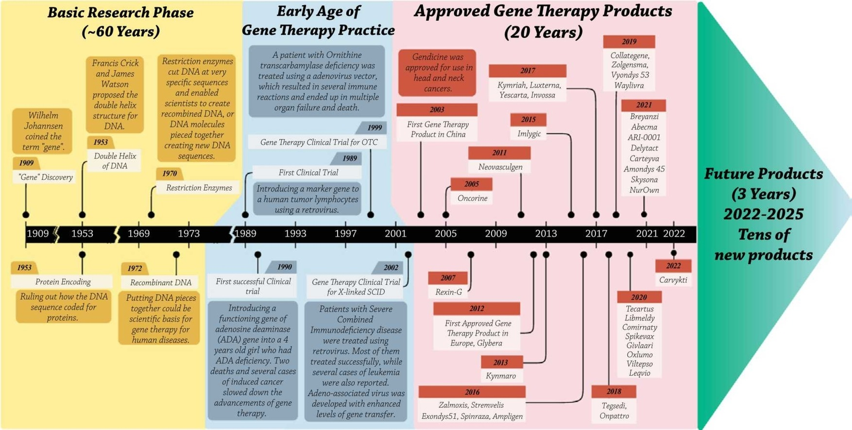
Ref: Arabi, F., V. Mansouri, and N. Ahmadbeigi, Gene therapy clinical trials, where do we go? An overview.
Biomedicine & Pharmacotherapy, 2022. 153: p. 113324.

Slide 6
Review
Steps | Lab #1 [Plasmid Isolation] | Lab #2 [Transformation of Competent Cells] |  | Lab #3 [Estimation of Protein Concentration]
1 | Growth of the bacterial culture.
2 | Harvesting of the bacteria by centrifugation.
3 | -Lysis of the bacteria -Purification of plasmid DNA. | -Using CaCl2 solution and brief heat shock to transform the competent cells. | -Using CaCl2 solution and brief heat shock to transform the competent cells. | -Lysis of the bacteria -Estimation of protein concentration using Bradford’s method.

Slide 7
Practical Part 🧬

Slide 8
Practical part
Aims:
Extraction of total bacterial proteins.
Determination of bacterial proteins using Bradford’s assay.
Principle:
Isolation of bacterial proteins involves several steps:
Growth and induction of bacterial cultures.
Lysis of cells in a suitable buffer which achieved by sonication ( 20 kHz) for 30–60s.
DNase and RNase treatment for the removal of the nucleic acids.
Determine the protein concentration using suitable method (Bradford’s assay).
Passage of the extract through an affinity resin and finally elution of proteins.
Notes:
file:///Users/emtenanalkhudair/Downloads/Recombinant%20His-tagged%20Protein%20production.htm
http://www.ispybio.com/search/protocols/Recombinant%20His-tagged%20Protein%20production.htm

Slide 9
Practical part
Sonication refers to the process of applying sound energy to agitate particles in a liquid.
Ultrasonic frequencies (>20 kHz) are usually used, so the process is also known as ultrasonication.
The method uses pulsed, high frequency sound waves to agitate and lyse cells.
Notes:
http://wolfson.huji.ac.il/expression/procedures/cell_lysis/Sonication_of_bacterial_samples.html MUST check !

Slide 10
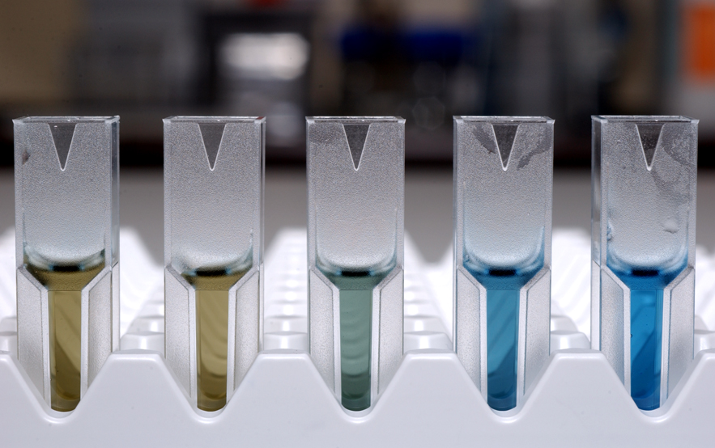
Practical part
Principle:
Bradford method is used to determine the protein concentration, using standard curve of concentrations.
The Bradford protein assay is based on the observation that the absorbance maximum for an acidic solution of Coomassie Brilliant Blue G-250 (reddish brown) shifts from 465 to 595 nm when binding to protein occurs (blue form).
The intensity of the colored product is linearly proportional to the concentration of protein present in the solution.
Notes:
https://www.thermofisher.com/sa/en/home/life-science/protein-biology/protein-assays-analysis/protein-assays/bradford-assays.html?ef_id=Cj0KCQiA09eQBhCxARIsAAYRiykU3YQKd5b4rLoRXVkRYi2IGCJBCgZE5VMCOB2SJCsyV9AaznQbrDYaAhjAEALw_wcB:G:s&s_kwcid=AL!3652!3!555178769899!e!!g!!bradford%20assay&cid=bid_pca_sbu_r01_co_cp1359_pjt0000_bid00000_0se_gaw_nt_pur_con&gclid=Cj0KCQiA09eQBhCxARIsAAYRiykU3YQKd5b4rLoRXVkRYi2IGCJBCgZE5VMCOB2SJCsyV9AaznQbrDYaAhjAEALw_wcB

Slide 12
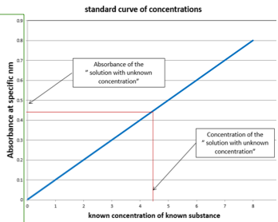
Practical part
Results:
Test tube | Distilled water [µl] | Stock BSA solution (62.5mg/L) [µl] | Sample [µl] | Protein concentration [mg/l]
Blank | 200 | -
A | 180 | 20
B | 150 | 50 | -
C | 100 | 100 | -
D | 50 | 150 | -
E | - | 200 | -
F (Unknown soluble proteins) | - | - | 200 | ?
F' | 100 | - | 100 | ?
G (Unknown insoluble proteins) |  |  | 200 | ?
G' | 100 |  | 100 | ?

Slide 13
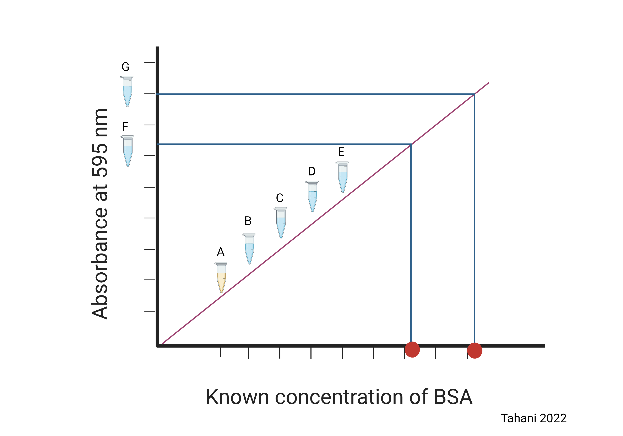

Slide 14
Homework
Questions:
Bacteria can be used as “ proteins factory” give one of its applications.
List 4 different methods in which bacterial cell wall can be disrupted. “check references books”

