Slide 1
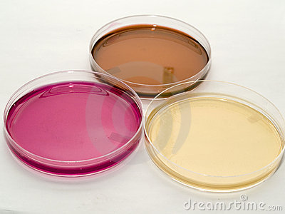
140 micro
بسم الله الرحمن الرحيم
Lab 3: Culture Media

Slide 2
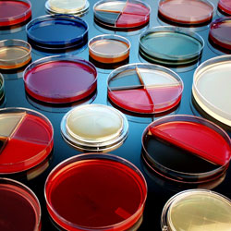
Microorganisms need food to grow
Primary ingredients required by all living organisms include:
a carbon source, water, minerals, and
a nitrogen source.
These nutrients together make a media.
Different microbes need different amounts of these nutrients.

Slide 3
TYPES OF CULTURE MEDIA :
- Culture media can be classified according to:
A - Physical state ( consistency ) of the media
B. According to the use of media

Slide 4
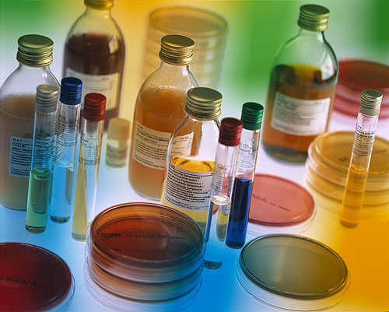
A- Types of culture media based on the physical state
•Liquid medium:
–Without agar.
–for the proliferation of bacteria.
•Solid medium:
–1.5-2.5% agar.
–for the isolation and identification of bacteria
–e.g., slant, Petri dishes/plates.
•Semisolid medium:
–0.3-0.5% agar.
–for the observation of bacterial motility and preservation of bacteria.

Slide 5
B- Types of culture media According to the use of media
1)Simple or basal media:
e.g. Nutrient Agar and Nutrient Broth.
They are used for the cultivation of common microorganism
2)special-purpose media: e.g. enriched, selective, differential, transport, sensitivity test, etc…
ENRICHED MEDIA :-Simple media enriched with appropriate substance ,e.g. Blood ,glucose ,serum and ascetic fluid ,most commonly used to cultivate fastidious microorganism like streptococci.

Slide 6
:Culture Media for Bacteria
Nutrint Agar :
A complex medium for the growth of heterotrophic bacteria :
Components:
-Pepton 5g
-Beef extract 3g
-Sodium chloride 8g
- Agar 15g
- Water 1 liter

Slide 7
:Culture Media for Fungi
1- Potato Dextrose Agar (PDA):
It is a general purpose media for isolation of fungi and molds.
Components:
- Potatoes 200g
- Agar 15-20g
- Dextrose 15g
- Distilled Water 1000ml

Slide 8
:Culture Media for Fungi
2-Malt Extract Agar (MEA):
Components:
-Malt Extract 20g
- Agar 20g
- Glucose 20g
-Sucrose 200g
- Distilled Water 1000ml

Slide 9
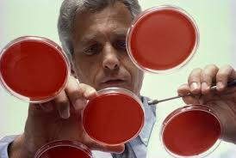
Aim
To prepare solid and Liquid media

Slide 10
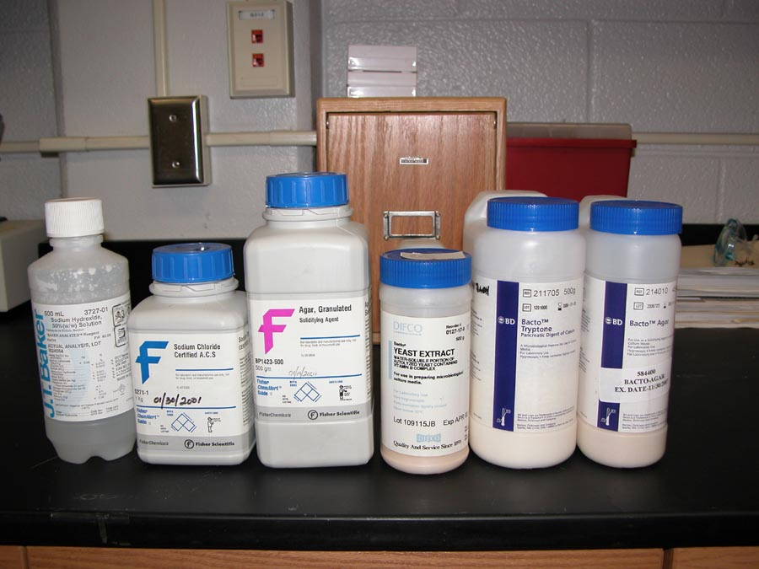
Requirement
Deffrent media :
Nutreint broth - Nutrient agar - PDA/malt extract

Slide 11
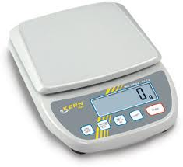
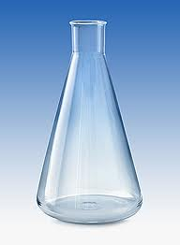
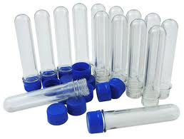
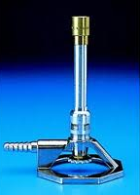
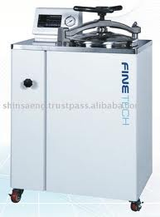
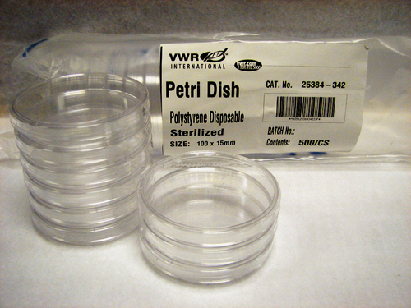
Requirement
2- Balance
3- Distil water
5- Test tubes
6- Petri plates
7- Flasks
7- Burners
8- Autoclave

Slide 12
Procedure
1- Weigh
2- Dissolve
3- Sterilize
4- cool
5- refrigerate till use

Slide 13
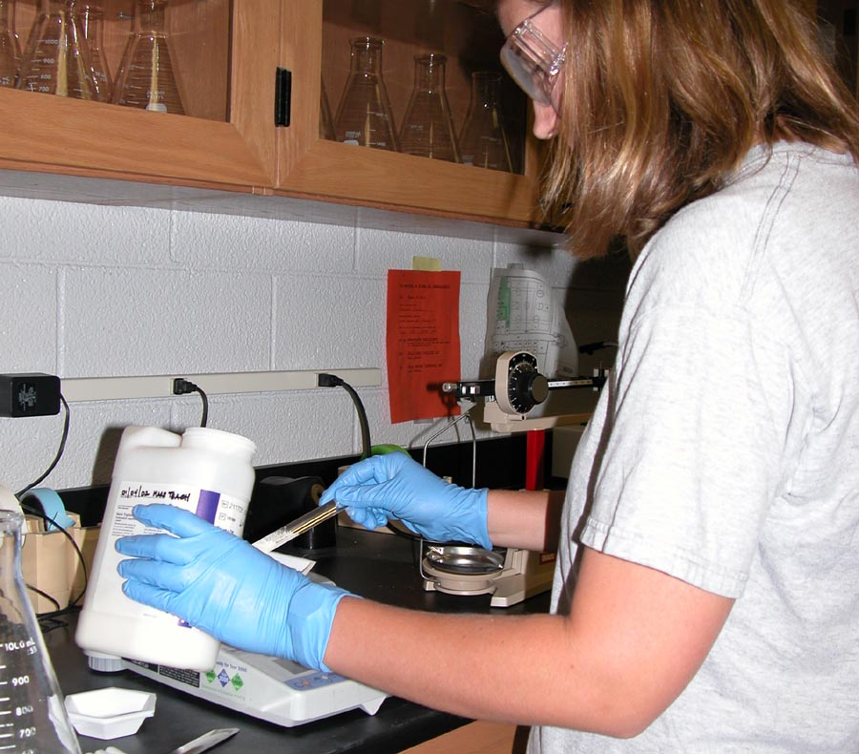
1- Weigh

Slide 14
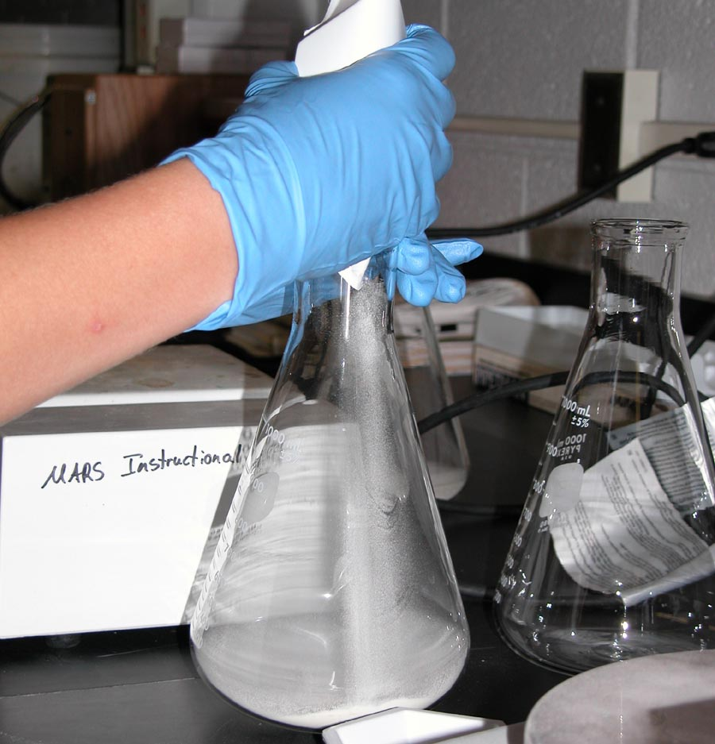
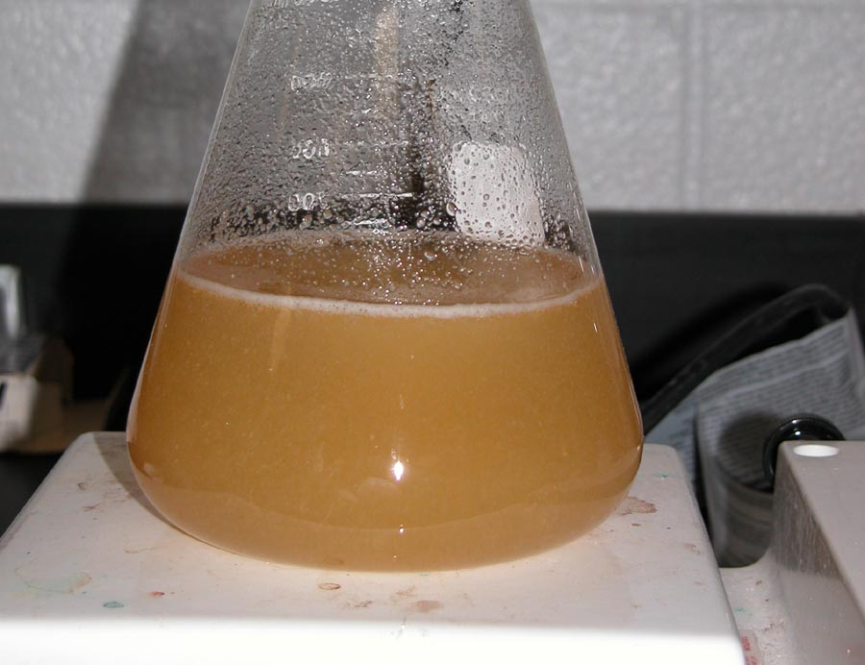
2- Dissolve

Slide 15
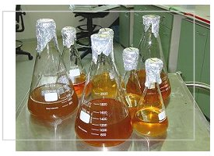
3- Sterilize

Slide 16
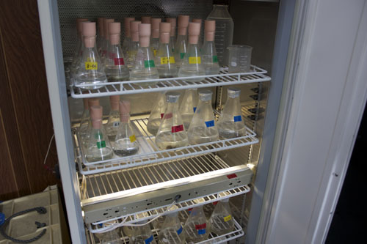
4- cool
5- refrigerate till use

Slide 17
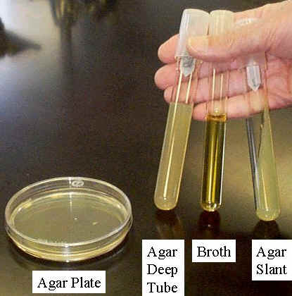
Who to make …….?

Slide 18
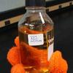
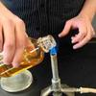
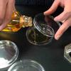
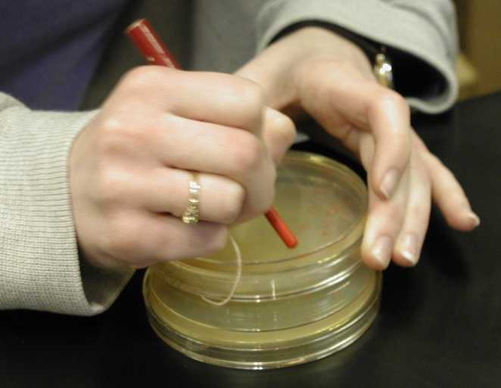
Pouring of Solid media : - Petri plates
Remove the lid slightly
Pour the media near bunsen burner
Invert the plate
Write date and time on the sides of plates

Slide 19
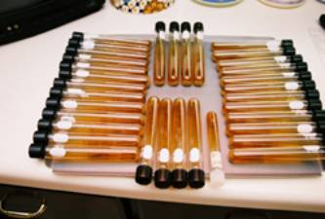
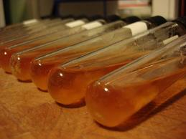
In tubes
- Making of Slants:
After boiling, pour media in test tubes
Autoclave
Place in slant position till the media solidifies.

Slide 20
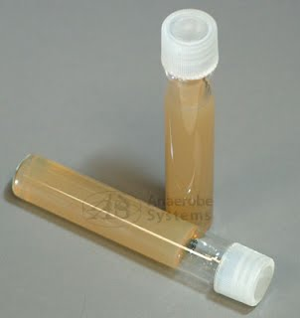
- Agar deep tube :
After boiling, pour media in test tubes
Autoclave
Place in vertical position till the media solidifies.

Slide 21
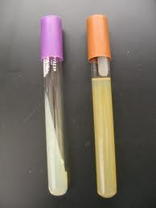
Slant agar - Deep agar

Slide 22
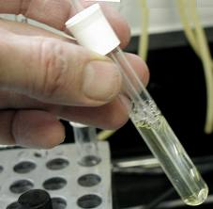
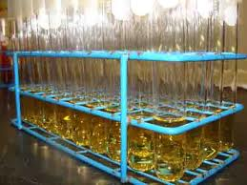
- Making of test tubes with broth media :
Place the test tube near a burner and remove the cap
Pour the media in the tube and close the cap at once
Place the tube in upright position in the test tube stand.

Slide 23
Video
https://youtu.be/cneascR3OEc

Slide 24
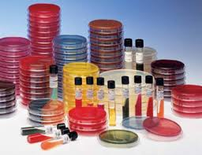
Thank you ….

