Slide 1
140MIC: Microbiology
Lecture-9
Microbial cell structure Prokaryotes-2

Slide 2
Prokaryotes, cell structure
All cells have the following in common:
Cell wall and cytoplasmic membrane
Cytoplasm
Ribosomes
Genetic materials

Slide 3
Prokaryotes, cell structure Cytoplasm
semifluid substance inside the cell membrane.
4/5 of the cytoplasm is water. The remaining 1/5 substances dissolved or suspended in the water (e.g. enzymes, proteins, carbohydrate, lipids and inorganic ions)
Many chemical reactions occur in the cytoplasm
Cytoplasm is thick, aqueous, semitransparent and elastic .
The major structures in the cytoplasm of prokaryotes are nucleoid and ribosomes.
Prokaryotic cytoplasm lacks certain features of eukaryotic cytoplasm such as cytoskeleton .

Slide 4
Ribosoms
Prokaryotes, cell structure Ribosomes
Ribosomes:
Consist of RNA and Protein.
Abundant in the cytoplasm of prokaryotes.
Polyribosomes= chains of ribosomes in one cell
Nearly spherical, stain densely.
It contains a large subunit and small subunit.
Site for protein synthesis.
The size is determine by measuring their sedimentation rates
Expressed in terms of Svedberg unit (S) unit.

Slide 5
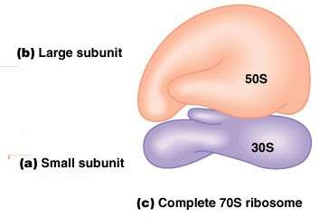
Prokaryotic ribosomes are 70S ribosomes ,and the subunits are 30S and 50S.
Prokaryotes ribosome.

Slide 6
Nuclear region.
Genetic materials
Genetic materials
o Nucleoid of nuclear region consists of DNA, has some RNA and protein associated with it
.
The dsDNA is single one circular chromosome. However, some bacteria contain
two circular chromosomes (e.g. Rhodobacter sphaeriodes and Vibrio cholerae).
Plasmids
are small circular molecules of dsDNA. Extrachromosomal genetic elements.
Often, the genes carried in plasmids provide bacteria with genetic advantages, such as antibiotic resistance.
They are not essential for the bacterium.

Slide 7
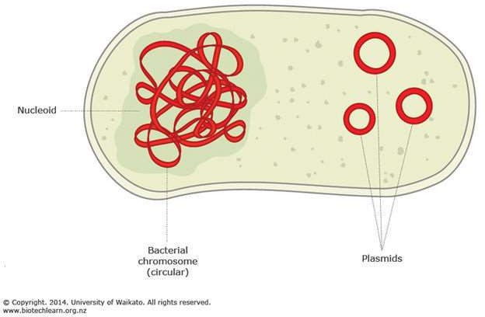
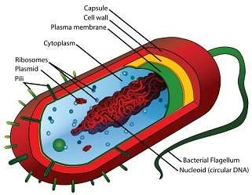
Not required
1

Slide 8
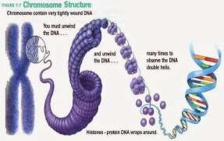
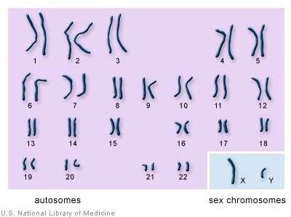
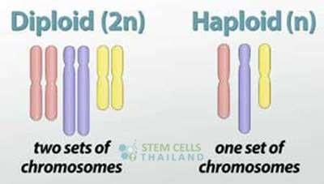
Genetic materials = Genome
A cell’s full complement of genes
Eukaryotic
DNA is linear and found within the nucleus
Associated with proteins that help in folding of the DNA
Usually more than one chromosome
Typically two copies of each chromosome
During cell division, nucleus divides by mitosis
During sexual reproduction, the genome is halved by meiosis
These three photos are not required

Slide 9
Prokaryotes, cell structure
NOTE:
Other internal and external structures may exist
Additional internal and external structures
Chromato phores. In photosynthetic bacteria, contain the pigments used in photosynthesis.
Cell Inclusions: such as Granules (contain glycogen or polyphosphate), Vesicles (gas-filled vacuoles)
Endospores: vegetative cells of some bacteria produce resting stages called endospores. Examples are Bacillus
and Clostridium. Bacteria produce one endospore while fungi produce high number of spores (usually external).
Flagella: The primary function of a flagellum is that of locomotion
Capsule: it enhances the ability of bacteria to cause disease (e.g. prevents phagocytosis).
Fimbriae: is used to attach the bacterium to a surface.
A pilus (plural: pili) is a hair-like appendage found on the surface of many bacteria and archaea. Conjugative pili
allow for the transfer of DNA between bacteria.

Slide 10
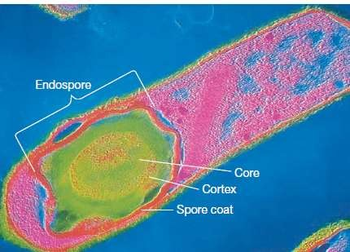
Endospore
A colorized electron microscopy graph of an endospore within a Clostridium perfringens cell

Slide 11
Overview of prokaryotic
The DNA is not enclosed within a membrane and usually a singular circularly arranged chromosomes.
The DNA is not associated with histones
The lack membrane- enclosed organelles
The cell wall contain complex polysaccharide peptidoglycan
They divide by binary fission.

Slide 12
Prokaryotes
Size, shape and arrangement
SIZE
Prokaryotes are among the smallest of all organisms.
3
Range from 0.5-2.0 µm in diameter.
HOWEVER, Bacteria have a large (surface : volume) ratio. e.g. spherical bacteria with a
diameter of 2µm have a surface area of ~ 12µm² and a volume of ~ 4µm³

Slide 13
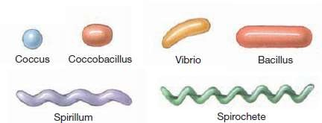
Prokaryotes
Size, shape and arrangement
SHAPES
Bacteria: come in 3 basic shapes:
Spherical: called Coccus (plural:cocci)
Rod like: called Bacillus (plural: Bacilli)
Some bacteria called coccobacilli
3. Spiral: variety of curved shapes.
Vibrio: a curved-rod (comma) shape
Spirillum: rigid wavey shape
Spirochete: corkscrew-shape
NOTES
Some bacteria do not fit in any of the previous categories.
Even bacteria of the same kind may vary in size and shape depending on the nutrients and environmental conditions.
Some bacteria vary widely in form even within a single culture. Known as pleomorphism.

Slide 14
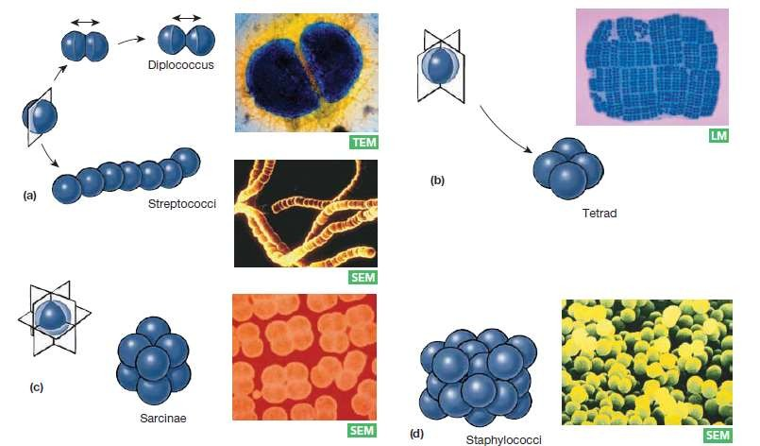
Size, shape and arrangement
Arrangement
Bacterial cells can be found in distinct arrangements.
5
In cocci bacteria: Arranged cells divide without separating.
Division in one plane produces cells in pairs (diplo), or chains (strepto-)
Division in random planes produce grapelike clusters (staphylo-).
Bacilli divide in only one plane= can be connected end-to-end
Spiral bacteria are not generally grouped together.

Slide 15
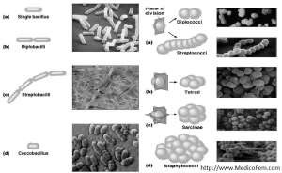
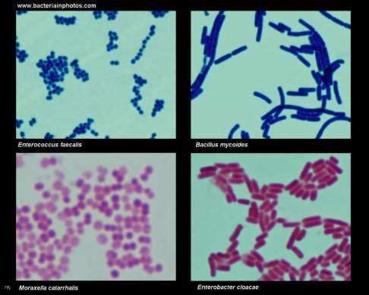
Not required
5

