Slide 1
140MIC: Microbiology
Lecture-8
Microbial cell structure Prokaryotes-
Part1

Slide 2
Microbial cell structure
140MIC: Microbiology
Domains of living cells
Principles of microbial cell structure
  Elements of Microbial cell Structure
  Eukaryotes
  Prokaryotes & chemistry of cellular components

Slide 3
Principles of microbial cell structure
All cells have the following in common:
Cytoplasmic membrane
Cytoplasm
Ribosomes
Genetic materials
Eukaryotic vs. Prokaryotic Cells
Eukaryotes
DNA enclosed in a membrane-bound nucleus Cells are generally larger and more complex Contain organelles
Prokaryotes
No membrane-enclosed organelles, no nucleus Generally smaller than eukaryotic cells

Slide 4
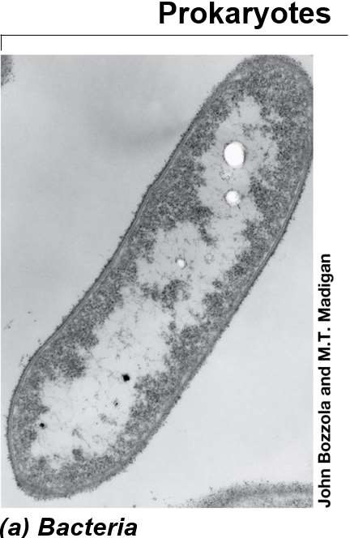
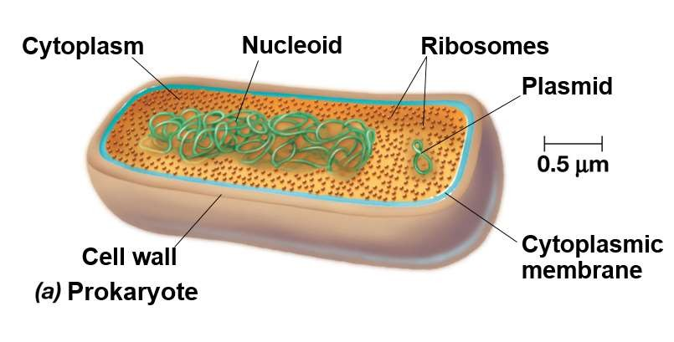
Prokaryotic cells consist of:
Cell wall
Cytoplasmic membrane (cell membrane) Cytoplasm
Ribosomes
Genetic materials
Other internal and external structures may exist
© 2012 Pearson Education, Inc.
4

Slide 5
Prokaryotes, cell structure
Cell wall
Cell wall in prokaryotes is complex , semi rigid structure surrounds the cytoplasmic membrane .
The Cell wall play an important role :
Maintains the characteristic shape of the cell.
prevents the cell from bursting when fluids flow into the cell by osmosis.

Slide 6

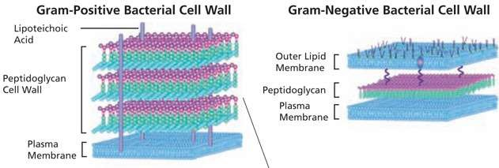
Components of cell wall:
gram positive (+ve) gram negative (-ve)
Peptidoglycan (many layers ) | Peptidoglycan
- | Outer membrane (bilayer membrane)
Plasmic space | Plasmic space

Slide 7
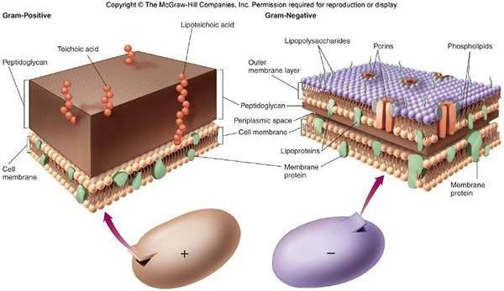
Not required

Slide 8
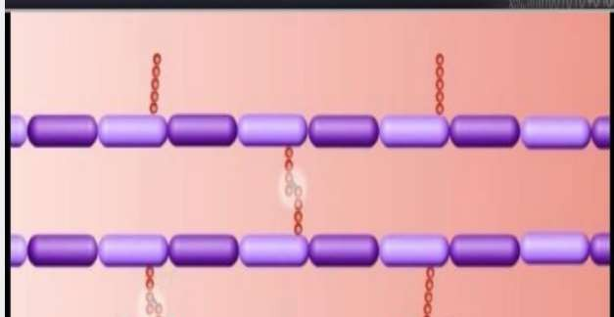
cell structure
Peptidoglycan (murein):
oThe most important component in bacterial cell wall.
oA large polymer consist of the following molecules:
N-acetylglucosamine (gluNAc)
N-acetylmuramic acid (murNAc)
cross linked by tetrapeptides (chains of four amino acids)

Slide 9
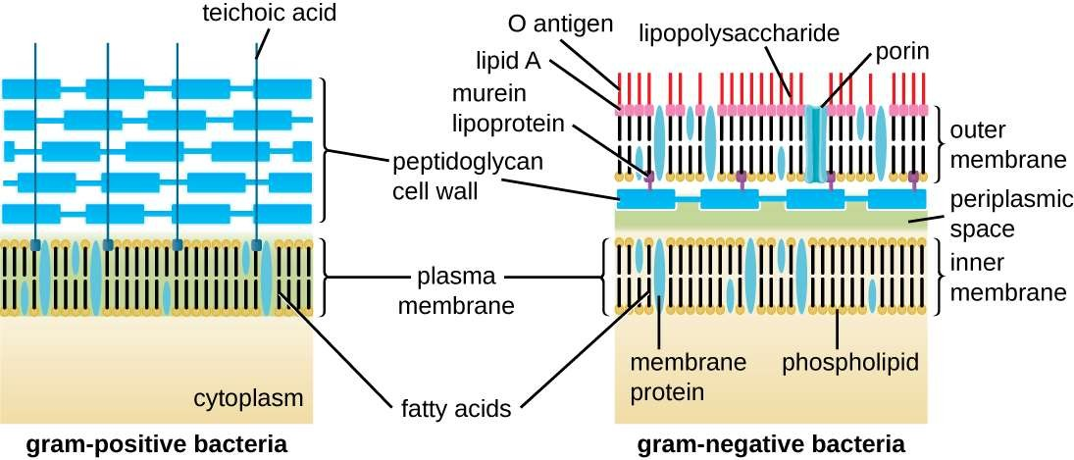
Gram-positive cell walls
oThe cell wall consists of many layers of peptidoglycans
oThick and rigid structure.
oThe cell walls of +ve bacteria contain teichoic acids and phosphate .
oTeichoic acid provide much of the wall’s antigenic specificity .

Slide 10
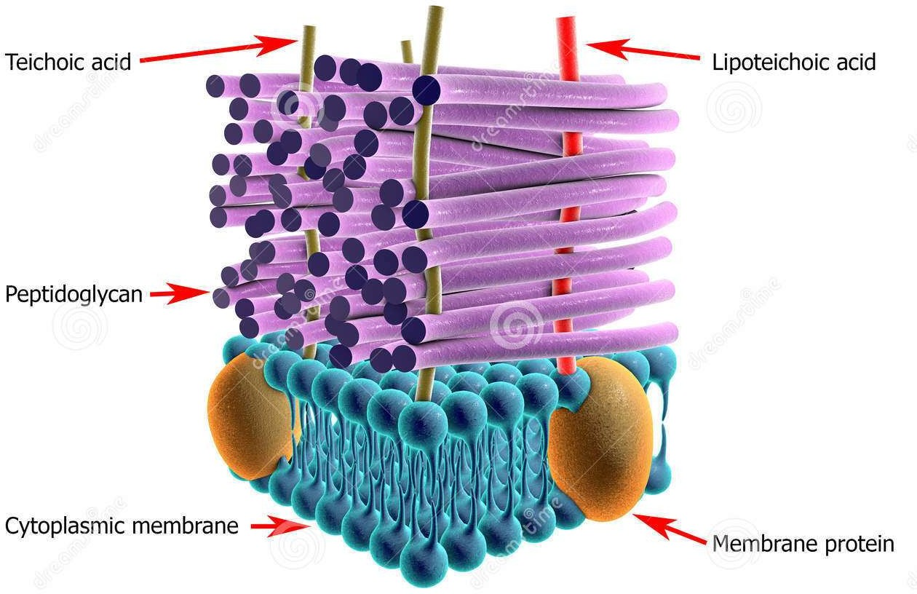
Not required
Gram-positive cell walls

Slide 11
Gram-negative Cell walls
Outer membrane:(Primarily in gram -ve bacteria)
Outer membrane is bilayer membrane attached covalently to the peptidoglycan by a layer of lipoprotein molecules.
Outer membrane is consists of:
lipoproteins
phospholipids
lipopolysaccharides (LPS) also called endotoxin.
lipopolysaccharides consists of
polysaccharides
O polysaccharide
lipid A (which is responsible for the toxic properties)
**-ve bacteria cell wall do not contain teichoic acids.
FUNCTION: controls the transport of certain proteins. Example: protects gram -ve bacteria from penicillin by inhibiting its entrance into the cell.

Slide 12
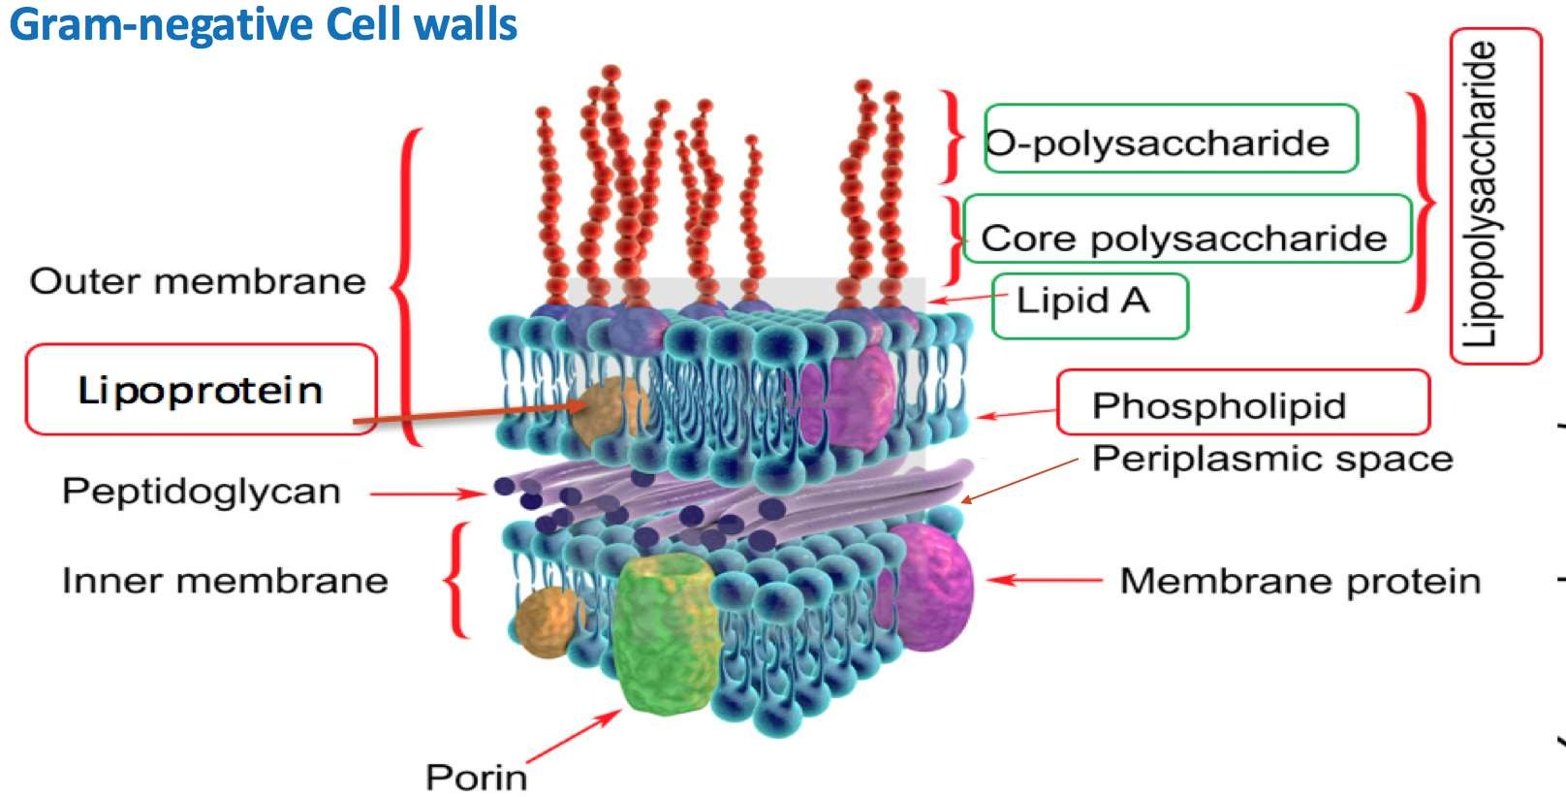
Not required

Slide 13
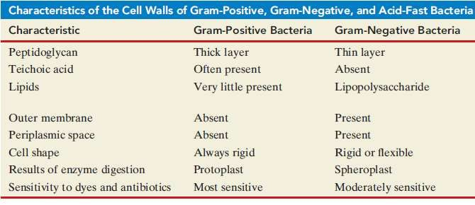
Periplasmic space.
o A gel-like fluid between the cell membrane and the cell wall.
oObserved by electron microscopy of gram-ve bacteria, rarely observed in gram+ve bacteria.
FUNCTIONS:
active area of cell metabolism. Contains: digestive enzymes and transport proteins.

Slide 14
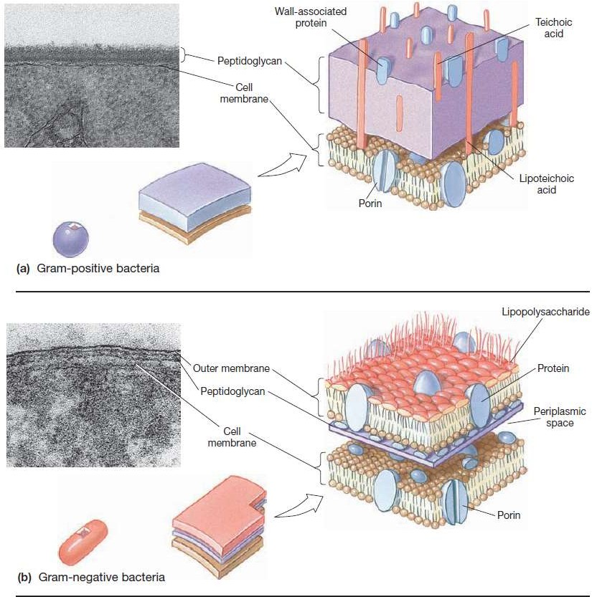
Overall view of cell wall component in gram-positive (up) and gram-negative bacteria

Slide 15
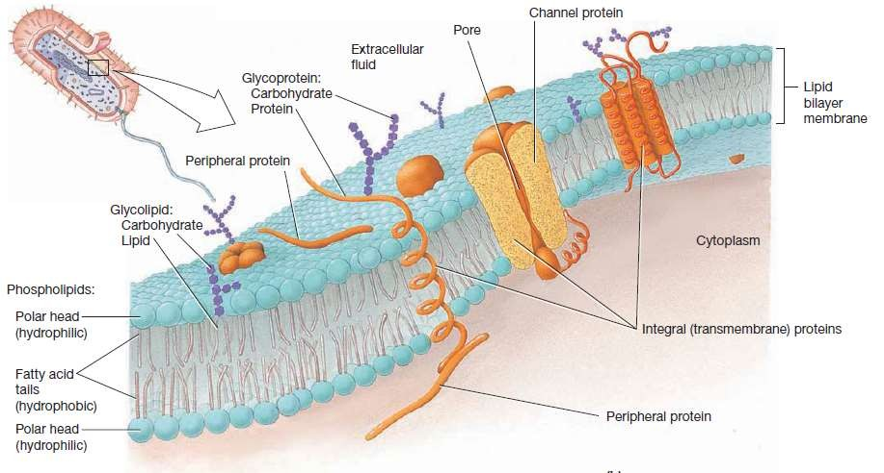
Cell membrane (Called also cytoplasmic membrane)
Cell membrane is a living membrane forms the boundary between a cell and its environment.
Consist mainly of phospholipids and proteins.
Membrane phospholipids form a bilayer (two layers).

Slide 16
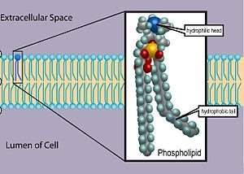
Membrane phospholipids
Each layer has phosphate ends of the lipid molecules extend toward the membrane surface and fatty acid ends extend inward.
The phosphate group and glycerol ends are hydrophilic (love water)→ interact with the watery environment.
The fatty acid ends are hydrophobic (hate water)→ forms a
barrier between the cell and environment.
16

Slide 17
Cell membrane proteins
O The protein molecules in the membrane can be peripheral proteins and integral protein .
O The peripheral protein can easily removed. It function as an enzyme that catalyze the reactions or scaffold for sport the membrane shape .
O Integral protein difficult to remove, It function as channels that make pore which the substances enter
through it .

Slide 18
Cell membrane function
The most important function of plasma membrane is to serve as a selective barrier through which materials enter and exit the cell .
In this function , plasma membrane have selective permeability.
Plasma membrane in bacteria contain enzymes capable to catalyzing the chemical reactions that break down nutrients and produce ATP.

