Slide 1
140MIC: Microbiology
Lecture-6
Microscopes

Slide 2
Microscopes
Microscopes and microbiology → linking advance
The microscope is the microbiologist’s most basic tool .
Microscopes use lenses to magnify object’s images.
There are many types of microscopes (look at the next slide) but the most common include two
types:- :
Light microscopes (5 types)
Electron microscope (2 types)
Light microscope used to examine cells at relatively low magnifications
electron microscope used to look at cells and cell structure at very high magnification.

Slide 3
Light Microscopy
Compound light microscope uses visible light to illuminate cells
Many different types of light microscopy:
Brightfield
Darkfield
Phase-contrast
Differential interference contrast (DIC)
Fluorescence

Slide 4
Some Principles of Light Microscopy
1-Bright-field microscope
Specimens are visualized because of differences in contrast (density) between specimen and surroundings.
oContrast differences arise because cells absorb or scatter light to varying degrees.
oTwo sets of lenses form the image
Objective lens and ocular lens (compound )
Total magnification = objective magnification X ocular magnification
Maximum magnification is ~2,000X

Slide 5
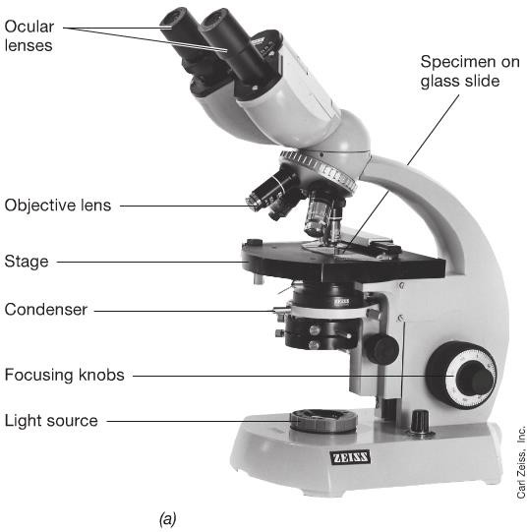

Slide 6
Some Principles of Light Microscopy
Magnification is not the limiting factor in the ability of seeing small things but also we need a good resolution which is the ability to distinguish two adjacent objects .
Magnification can be increased with out limit but resolution cannot because it is the function of
physical properties of light.
Light microscopy limits resolution is about 0.2µm , electron microscope resolution is greater than of light microscope .

Slide 7
Some Principles of Light Microscopy
Resolution: the ability to distinguish two adjacent objects as separate and distinct
Resolution is determined by the wavelength of light used and numerical aperture of lens
Methods to Improve contrast to generate a better final image?
Staining
Dyes are organic compounds that bind to specific cellular materials
Examples of common stains are methylene blue, safranin, and crystal violet
Differential stains: Gram stain
Differential stains separate bacteria into groups
Bacteria can be divided into two major groups: gram-positive and gram-negative
Gram-positive bacteria appear purple and gram-negative bacteria appear red after staining

Slide 8
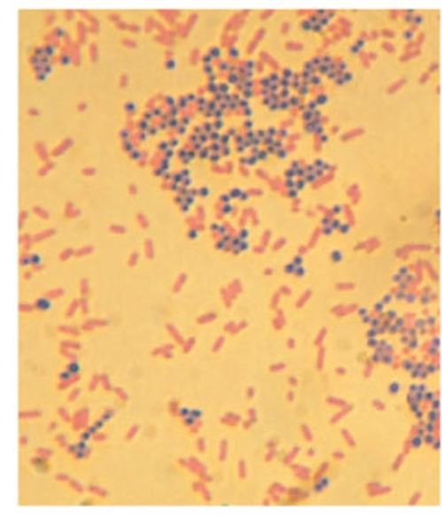
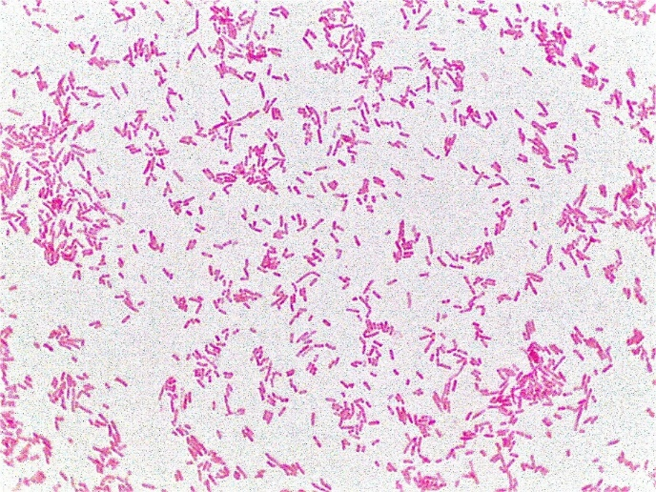
Microscopic observation of gram-positive (purple) and gram- negative (red) bacteria .

Slide 9
2-Phase-contrast and 3-Dark-felid Microscopy
Two form of light microscopy improve image without using staining.
Phase –contrast microscopy is based on the principle that cells differ in refractive index from their surroundings .
Phase –contrast microscopy resulting a dark image on light background
The dark-fielded microscopy is a light microscope in which the light reaches the specimen from
the sides only . Thus the specimens appears light on a dark background.
The dark-fielded microscopy used in observed microbial motility .

Slide 10
Fluorescence Microscopy
Used to visualize specimens that fluoresce – emit light of one color following absorption of light of another color
Cells fluoresce either :
Contain naturally fluorescent substances such as chlorophyll
Because cells have satin with fluorescent dye .
DAPI (4`,6-diamidino-2-phenyl indole) is widely used fluorescent dye staining cell`s DNA .

Slide 11
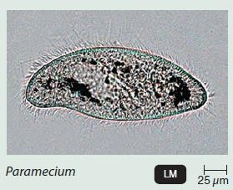
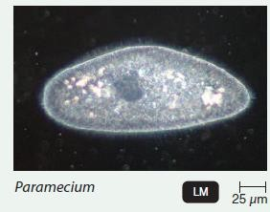
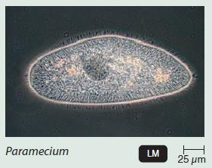
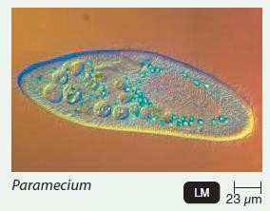
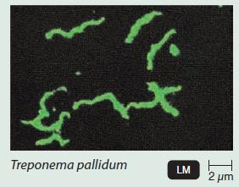
Brightfield Microscope
Darkfield Microscope
Phase-contrast Microscope
Differential interference contrast (DIC) Microscope
Fluorescence Microscope
1-Uses visible light as a source of illumination;
2-cannot resolve structures smaller than about 0.2 µm;
3- specimen appears against a bright background.
4-Inexpensive and easy to use.
1-Uses a special condenser with an opaque disk that blocks light from entering the objective lens directly;
2-light reflected by specimen enters the objective lens, and the specimen appears light against a black background
No staining required
1-Uses a special condenser containing an annular (ring- shaped) diaphragm. The diaphragm allows direct light to pass through the condenser, focusing light on the specimen and a diffraction plate in the objective lens
Direct and reflected or
diffracted light rays are brought together to produce the image.
No staining required
Uses an ultraviolet or near-ultraviolet source of illumination that causes fluorescent compounds in a specimen to emit light.
Like phase-contrast, uses differences in refractive indexes to produce images.
Uses two beams of light separated by prisms;
the specimen appears colored as a result of the prism effect.
No staining required.

Slide 12
Electron Microscopy (EM)
Electron microscopes use electrons instead of photons(visible light) to image cells
and structures.
Electromagnets function as lenses in EM , whole system operates in a vacuum.
EM are fitted with cameras to allow a photograph to be taken
Two types of electron microscopes:
Transmission electron microscopes (TEM)
(need thin section),negative stain
Scanning electron microscopes (SEM)
Coat with heavy metal

Slide 13
Electron Microscopy
Transmission electron microscopy is used to examine cells and cell structure at very high
magnification and resolution , even enabling one to view structures at the molecular level .
This is because the wavelength of electrons is much shorter than the wavelength of visible light and wavelength affects resolution .
Unlike visible light , electron beams can not penetrate very well. So, special techniques of thin sectioning are needed to prepare specimens before observing them .
To obtain sufficient contrast, the preparation are treated with stains such as osmic acid , permanganate , uranium , lanthanum ; because these substances are composed of atoms of high atomic weight , they scatter electrons well and thus improve contrast.
** Save translation
تتكون من ذرات ذات وزن ذري كبير، وتقوم بتشتيت الإلكترونات بشكل جيد وبالتالي تحسين التباين.

Slide 14
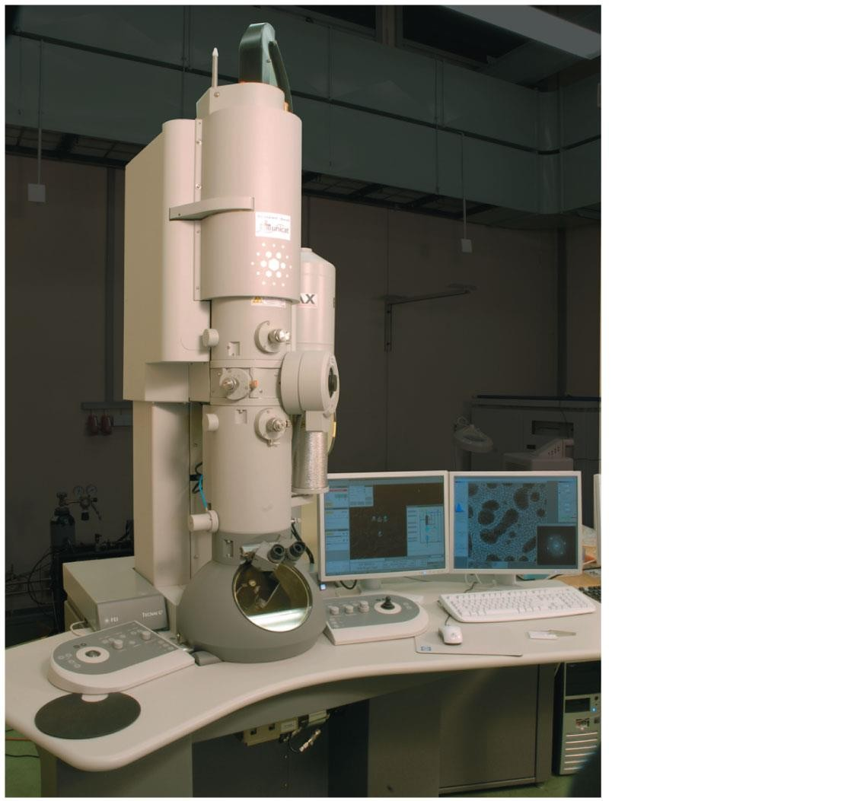
Electron
source
Figure 2.9
Evacuated chamber
Sample port
Viewing screen
© 2012 Pearson Education, Inc.

Slide 15
Electron Microscopy
Scanning electron microscopy used to observed external features of an organisms or cell .
No need for thin sections
The specimen is coated with a thin film of a heavy metal such as gold .
An electron beam then scans back and forth across the specimens.
Electrons scattered from the metal coating are collected and activate a viewing screen to produce an image.

Slide 16
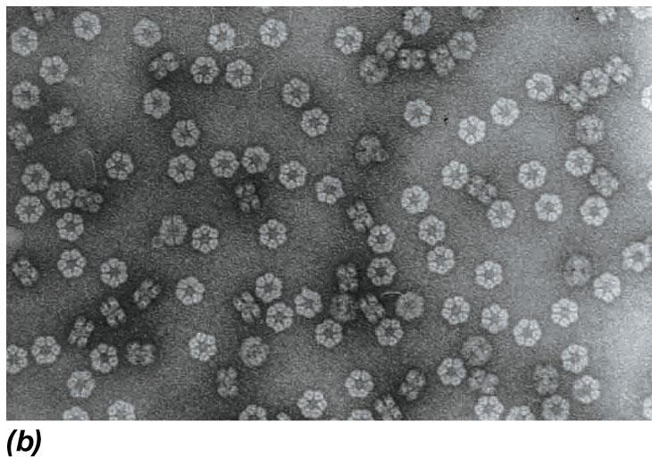
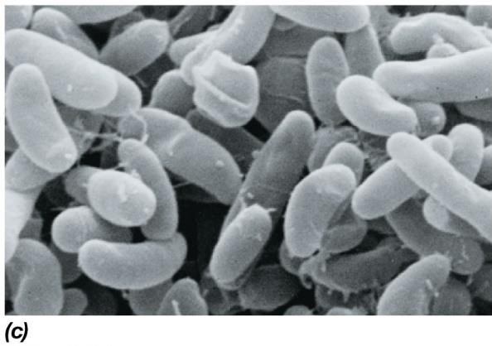
Cytoplasmic membrane
_{Septum}Cell wall
DNA
(nucleoid)
Note that:-
Electron micrographs taken either TEM or SEM are black and white images .
Some false color is added to these images to boost their artistic appearance.
© 2012 Pearson Education, Inc.

Slide 17
Home work Black board
-Differentiate between the 4 types of light microscopy. Provide examples of images produced by each type.
-Explain the difference between the 2 types of electron microscope. Provide examples of images produced by each types
3-Is there any other types of microscopies?

Slide 18
Brightfield
Darkfield
Phase-contrast
Differential interference contrast (DIC)
Fluorescence
1-Light
2-Confocal
Uses a single photon to illuminate one plane of a specimen at a time
Uses two photons to illuminate a specimen.
3-Two-Photon
Microscope Type
Uses a sound wave of specific frequency that travels through the specimen with a portion being reflected when it hits an interface within the material.
4-Scanning Acoustic
1-Transmission (TEM) 2-Scanning (SEM)
5-Electron
Uses a thin metal probe that scans a specimen and produces an image.
Resolving power is much greater than that of an electron microscope.
No special preparation required.
1-Scanning tunneling
6-Scanned-Probe
2-Atomic force
Uses a metal-and-diamond probe.
Produces a three-dimensional image.
No special preparation required.

