Slide 1
Lecture-5
History of microbiology (Part-2)
140MIC: Microbiology

Slide 2
History of microbiology Content
140MIC: Microbiology
History of microbiology (part-1)
Microbiology in the Islamic era (Arabic content).
Pathways of discovery in microbiology
The historical roots of microbiology
Pasteur and the defeat of spontaneous generation
Koch, infectious disease, and pure culture microbiology.
History of microbiology (part-2)
o The rise of microbial diversity
o The modern era of microbiology

Slide 3
The rise of microbial diversity
Microbial Diversity
Field that focuses on nonmedical aspects of microbiology (soil , water)
Martinus Beijerinck (1851–1931)
Developed enrichment culture technique
Microbes isolated from natural samples in a highly selective techniques by adjusting nutrient and incubation conditions to favor a particular metabolic group of organisms
Example: nitrogen-fixing bacteria, sulfate –reducing bacteria , sulfur- oxidizing bacteria, aerobic nitrogen –fixing bacteria.

Slide 4
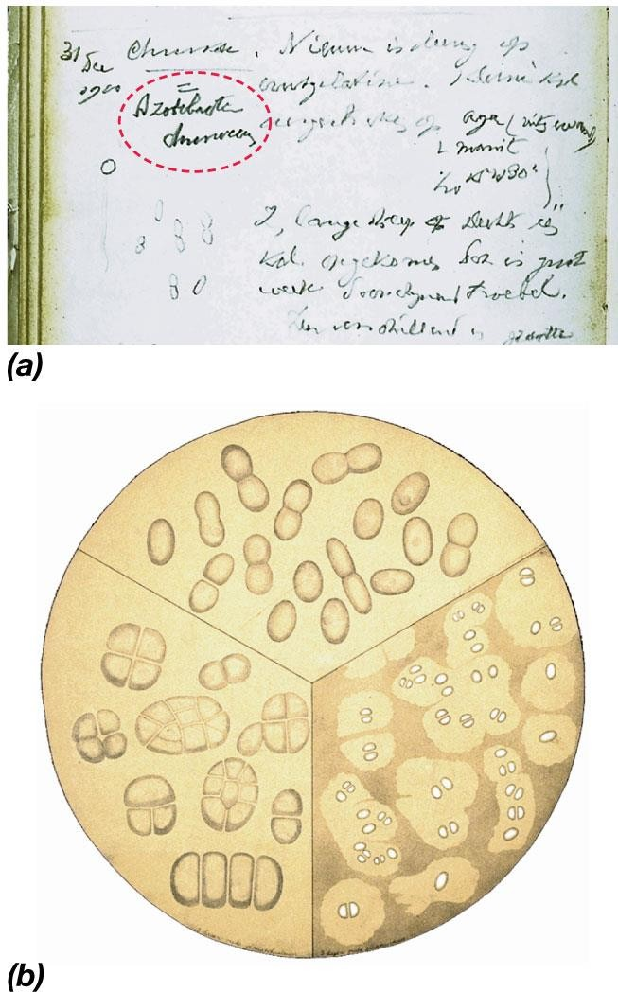
A page from the laboratory notebook of M.Beijerinck in 1900 describing the aerobic nitrogen-fixing bacterium Azotobacter chroococcum ( shown in red)
A painting by M.Beijerinck’s sister showing cells of the same bacteria .
© 2012 Pearson Education, Inc.

Slide 5
The rise of microbial diversity
Sergei Winogradsky (1856–1953)
The Concept of Chemo- litho-trophy
Demonstrated that specific bacteria are linked to specific biogeochemical transformations (e.g., S & N cycles)
Proposed concept of chemolithotrophy
Oxidation of inorganic compounds linked to energy conservation

Slide 6
Autotrophs
CO₂
Carbon source
Heterotrophs
Reduced organic molecule from other organisms
Phototrophs
Light
Energy source
Chemotrophs
Oxidation of organic and
nonorganic molecule
Lithotrophs
Reduce nonorganic
molecule
Electron source
Not
required
Organotrophs
From organic molecule
6

Slide 7
The Modern Era of Microbiology
The major subdisciplines of microbiology
subdiscipline
Focus
1- Basic emphases
Microbial physiology
Study of the nutrients that microbes require for metabolism and growth and the products that they generate
Microbial genetics
Study of Genes , heredity and genetic variation
Microbial biochemistry
Study of microbial enzymes and chemical reactions
Microbial systematics
The science of grouping and classification and nomenclature
Molecular biology
Study Nucleic acids and protein
Microbial ecology
Study microbial diversity and activity in natural habitats
Virology
Study viruses and subviral particles

Slide 8
The Modern Era of Microbiology
The major subdisciplines of microbiology
subdisciplines | Focus
2- Applied emphases
Medical Microbiology | Infectious disease
Immunology | Immune systems
Agricultural /soil microbiology | Microbial diversity and processes in soil
industrial microbiology | Large-scale production of antibiotics ,alcohol and other chemicals
Biotechnology ** | Production of human proteins by genetically engineered microorganisms
Aquatic Microbiology | Microbial processes in waters and wastewaters, drinking water safety.

Slide 9
The Modern Era of Microbiology
Molecular Microbiology
** Biotechnology
Manipulation of cellular genomes
DNA from one organism can be inserted into a bacterium and the proteins encoded by that DNA harvested
Genomics: study of all of the genetic material (DNA) in living cells
Transcriptomics: study of RNA patterns.
Proteomics: study of all the proteins produced by cells.
Metabolomics: study of metabolic expression in cells.

