Slide 1
Lecture-4
History of microbiology (Part-1)
140MIC: Microbiology

Slide 2
History of microbiology Content
140MIC: Microbiology
History of microbiology (part-1)
Microbiology in the Islamic era (Arabic content).
Pathways of discovery in microbiology
The historical roots of microbiology
Pasteur and the defeat of spontaneous generation
Koch, infectious disease, and pure culture microbiology.
History of microbiology (part-2)
o The rise of microbial diversity
o The modern era of microbiology

Slide 5
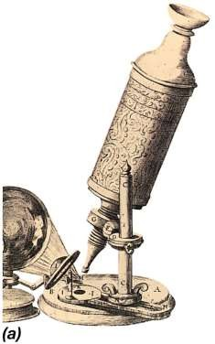
The Historical Roots of Microbiology
Microbiology began with the microscope
Robert Hooke (1635–1703)
Antoni van Leeuwenhoek (1632–1723)
Ferdinand Cohn (1828–1898)
Louis Pasteur (1822–1895)
Robert Koch (1843–1910)
A drawing of the microscope used by Robert Hooke in 1664 .

Slide 6
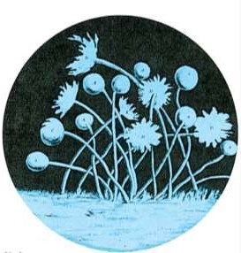
The Historical Roots of Microbiology
140MIC: Microbiology
Microbiology began with the microscope
Robert Hooke (1635–1703):
The first description of microorganisms
Illustrated the fruiting structures of molds

Slide 7
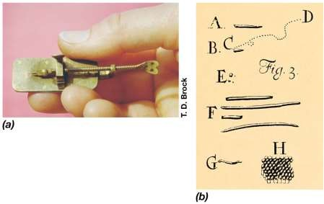
The Historical Roots of Microbiology
Microbiology began with the microscope
Antoni van Leeuwenhoek (1632–1723)
The first to describe bacteria.
Further progress required development of more powerful microscopes

Slide 8
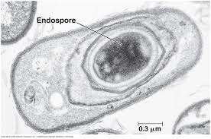
The Historical Roots of Microbiology
Microbiology began with the microscope
Ferdinand Cohn (1828–1898):
Founded the field of bacterial classification and bacteriology .
Discovered bacterial endospores (heat resistance bacteria )

Slide 9
Pasteur and the Defeat of Spontaneous Generation
Louis Pasteur (1822–1895).
Discovered that alcoholic fermentation was a biologically mediated
process (originally thought to be purely chemical)
Disproved theory of spontaneous generation.
Led to the development of methods for controlling the growth of microorganisms (aseptic technique)or sterilization.
Developed vaccines for anthrax, fowl cholera, and rabies

Slide 10
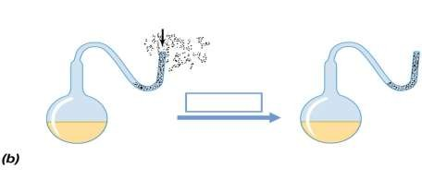
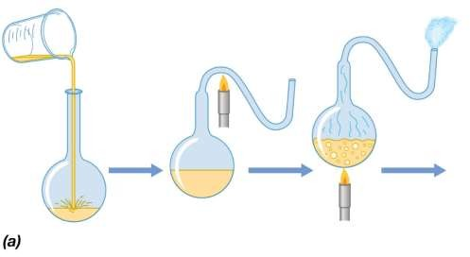
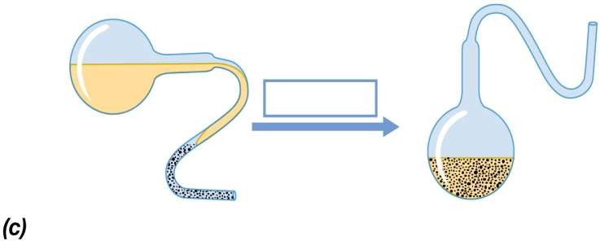
Pasteur's experiment that defeated the spontaneous generation theory
Dust and microorganisms trapped in bend
Open end
Steam, forced out open end
Long time
Liquid cooled slowly
Liquid remains
sterile indefinitely
Nonsterile liquid
poured into flask
Neck of flask
drawn out in flame
Liquid sterilized
by extensive heating
Short time
Flask tipped so microorganism-laden dust contacts sterile liquid
Liquid putrefies
© 2012 Pearson Education, Inc.

Slide 11
Figure 1.16c
Short time
Flask tipped so microorganism-laden dust contacts sterile liquid
Liquid putrefies
© 2012 Pearson Education, Inc.

Slide 12
Koch, Infectious Disease, and the Rise of Pure Cultures
Robert Koch (1843–1910)
Demonstrated the link between microbes and infectious diseases
Identified causative agents of anthrax and tuberculosis
Developed techniques (solid media) for obtaining pure cultures of
microbes, some still in existence today
Awarded Nobel Prize for Physiology and Medicine in 1905
Koch’s postulates ( Next slide)

Slide 13
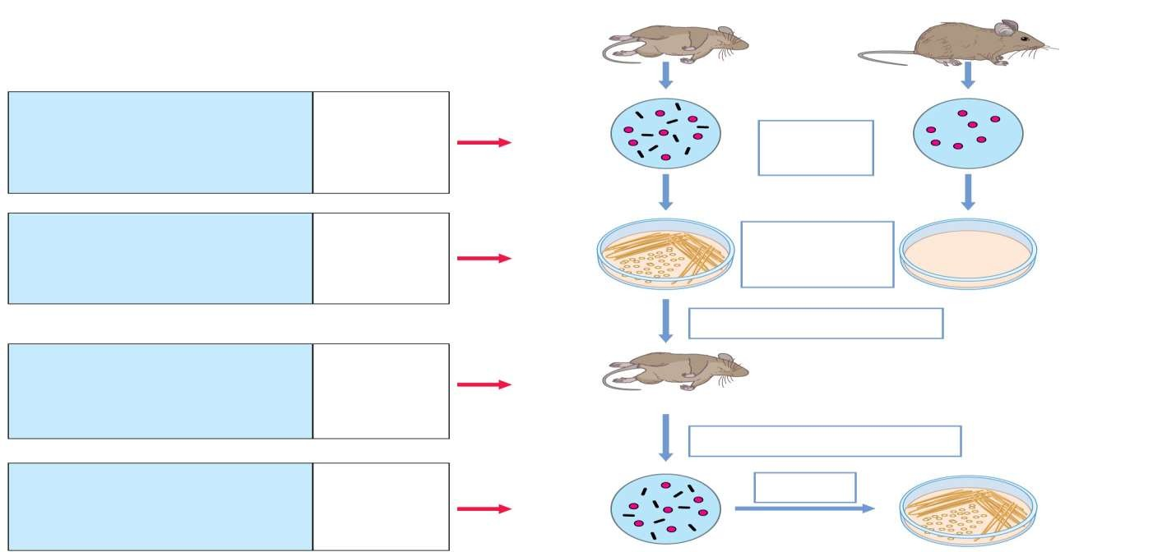
KOCH’S POSTULATES
Diseased animal
Healthy animal
The Postulates:
1. The suspected pathogen must be present in all cases of the disease
and absent from healthy animals.
Tools:
Microscopy, staining
Red blood cell
Observe blood/tissue under the microscope
Red blood cell
Suspected
pathogen
2. The suspected pathogen must be grown in pure culture.
Laboratory culture
Streak agar plate with sample from either diseased or healthy animal
No organisms present
Colonies of suspected pathogen
Inoculate healthy animal with cells of suspected pathogen
3. Cells from a pure culture of the suspected pathogen must cause disease in a healthy animal.
Experimental animals
Diseased animal
Remove blood or tissue sample and observe by microscopy
4. The suspected pathogen must be reisolated and shown to be the same as the original.
Laboratory reisolation and culture
Suspected pathogen
Laboratory culture
Pure culture (must be same organism as before)
© 2012 Pearson Education, Inc.

Slide 14
Koch, Infectious Disease, and the Rise of Pure Cultures
Koch’s Postulates Today
Koch’s postulates apply for diseases that have an appropriate animal model
Remain “gold standard” in medical microbiology, but not always possible to satisfy all postulates for every infectious disease
Animal models not always available
For example, cholera, rickettsias, chlamydias
Koch and the Rise of Pure Cultures
Discovered that using solid media provided a simple way of obtaining pure cultures
Began with potato slices, but eventually devised uniform and reproducible
nutrient solutions solidified with gelatin and agar

