Slide 1
Principles Of Microbiology (Part-2)
140MIC: Microbiology

Slide 2
140MIC: Microbiology
Principles of Microbiology Content
1.1 Microbiology and Microorganisms
The importance of microorganisms
1.2 Microbial Cells
Cell chemistry and key structure
Characteristics of living systems
Cell functions: coding and metabolism.
1.3 Microorganisms and Their Environments
Microbial interaction
1.4 The Impact of Microorganisms on Humans
Microorganisms as disease agents
Microorganisms and agriculture
Microorganisms and food
Microorganisms, energy and there environment
Microorganisms and their genetic resources
Microbiology as a career

Slide 3
1.3 Microorganisms And Their Environments
Microorganisms in nature live in populations of interacting assemblages called microbial communities.
A population is a group of cells derived from a single parental cell by successive cell divisions.
The environment in which a microbial population lives is its habitat
Ecosystem refers to all living organisms plus physical and chemical constituents of their
environment (aquatic , terrestrial , other organisms such as plant)
Microbial ecology is the study of microbes in their natural environment

Slide 4
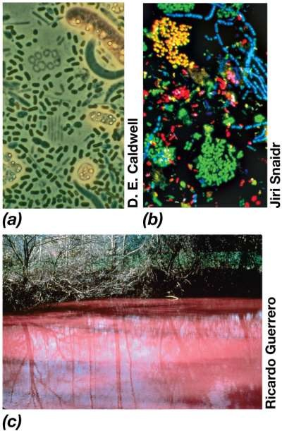
Different Bacterial Communities:
a)- from depth of small lake
showing cells of green and purple phototrophic bacteria
b)- sewage sludge sample
C)- purple sulfur bacteria formed a bloom .

Slide 5
1.3 Microorganisms And Their Environments
Diversity and abundances of microbes are controlled by
1-resources (nutrients , food )
2-environmental conditions (e.g., temperature , pH, O₂)
2. The activities of microbial communities can affect the chemical and physical properties of their habitats.

Slide 6
1.3 Microorganisms And Their Environments
Microbes also interact with their physical and chemical environment
Ecosystems greatly influenced (if not controlled) by microbial activities
Microorganisms change the chemical and physical properties of their habitats through their activities
  For example, removal of nutrients from the environment and use them to build new cells
  At the same time , they excrete waste products back into the environment.
Microbial ecosystems expand and contract depending on the resources and conditions available.

Slide 7
The Impact Of Microorganisms On Humans
Microorganisms As Disease Agents
Microorganisms can be both beneficial and harmful to humans
Emphasis typically on harmful microorganisms (infectious disease agents which known as pathogens).
  Pathogens pose a major threat to human’s life in developing countries
  Some disease caused by microorganisms include:
    Malaria, tuberculosis, cholera, African sleeping sickness, measles, pneumonia and other respiratory diseases and diarrheal syndromes.
  Emerging infectious diseases are of particular importance because they spread quickly
    Such as Ebola, bird flu and Middle East respiratory syndrome-related coronavirus (MERS-CoV)
Many more microorganisms are beneficial than are harmful
  Microbial flora: In microbiology, collective bacteria and other microorganisms in a host are known as flora
  Normal microbiota: The microorganisms that colonize a host without causing disease; also called normal flora.

Slide 8
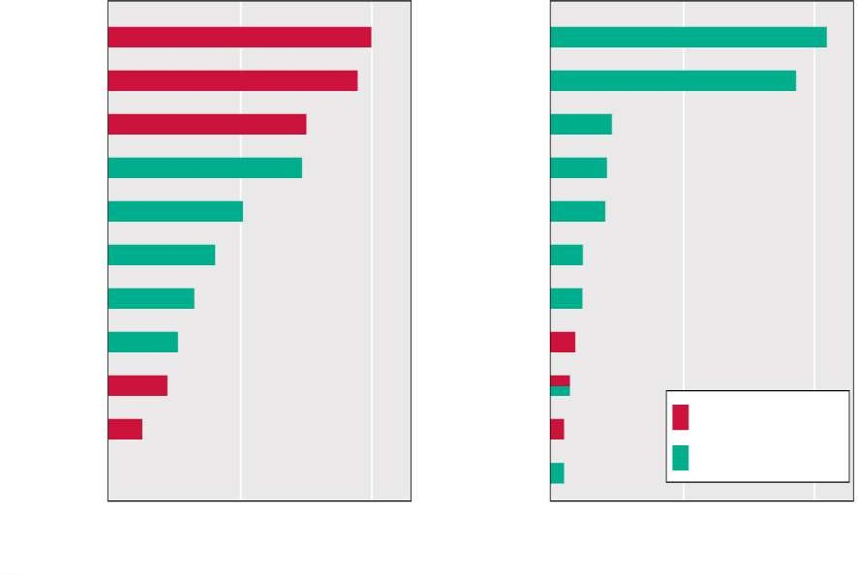
The Impact of Microorganisms on Humans
Microorganisms as disease agents
1900
Today
Influenza and
pneumonia
Tuberculosis
Gastroenteritis
Heart disease
Heart disease
Cancer
Stroke
Pulmonary disease
Accidents
Diabetes Alzheimer’s
disease
Influenza and pneumonia
Kidney disease
Septicemia
Stroke
Kidney disease
Accidents
Cancer
Infant diseases
Infectious disease
Nonmicrobial disease
100 200
Deaths per 100,000 population
Diphtheria
Suicide
0
100 200
Deaths per 100,000 population
0
© 2012 Pearson Education, Inc.

Slide 9

The Impact of Microorganisms on Humans
Microorganisms and agriculture
Many aspects of agriculture depend on microbial activities. There are positive and negative impacts
per as the following table:-
Positive impacts
  Microbes to fix chemical components in the soil (Nitrogen, Sulfate)
  cellulose-degradation microbes in the rumen
  regeneration of nutrients in soil and water
Negative impacts
They can cause diseases in plants and animals plants and animals used for human food cause major economic losses in the agricultural industry .
discussed in the next 2 slides

Slide 10
Some Details About The Positive Impacts Of Microbe In Griculture.
1. Microbes to fix chemical components in the soil (Nitrogen, Sulfate)
Number of major crop plants are legumes which live in close association with bacteria that form a structure called nodules on their roots.
In the root nodules , the bacteria convert atmospheric nitrogen N2 into ammonia (NH3) that the plants use as a nitrogen source for growth.
These bacteria called a nitrogen -fixing bacteria such as Rhizobium.
Other Bacteria cycle sulfur compounds , oxidizing toxic sulfur species such as:
hydrogen sulfide (H2 S) into sulfate SO4 ²⁻ which is an essential plant nutrient.

Slide 11
Some Details About The Positive Impacts Of Microbe In Griculture.
cellulose-degradination microbes in the rumen
  Microorganisms that inhabit ruminant animals such as cattle ,sheep and goat play an important role also.
  These animals have a characteristic digestive vessel called rumen in which large populations of microorganisms digest and ferment cellulose , the major component of plant cell walls at neutral pH.
  Without these symbiotic microorganisms , cattle and sheep could not thrive on cellulose –rich food such as grass and hay
3. regeneration of nutrients in soil and water
As example:- Some microbes can make the decomposition of organic matter and mineralization of organic N, S, and P.

Slide 12
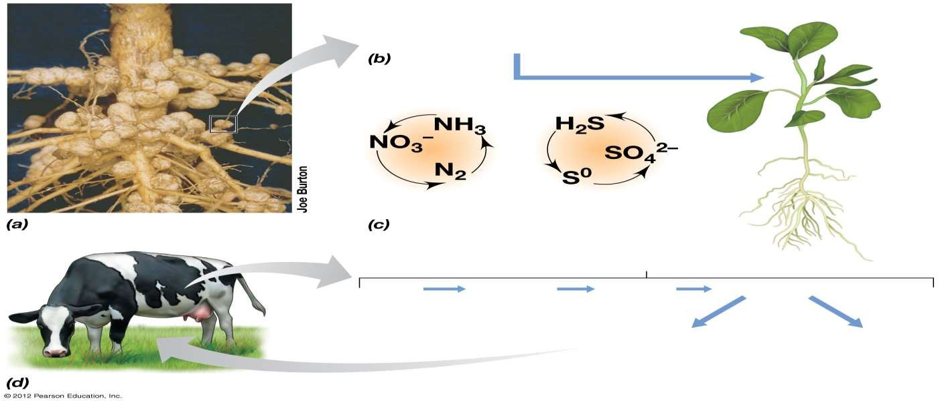
N₂ + 8H
2NH₃ + H₂
Soybean plant
N-cycle
S-cycle
Rumen
Glucose
Grass
Cellulose
Microbial fermentation
Fatty acids
(Nutrition for animal)
CO₂ + CH₄
(Waste products)
© 2012 Pearson Education, Inc.

Slide 13
The Impact of Microorganisms on Humans
Microorganisms and food
Microorganisms and Food
– Negative impacts
  Food spoilage by microorganisms cause economical loss
→ requires specialized preservation of many foods (caning , frozen and dried food )
  Food poisoning due to microbial contamination (Salmonella / Escherichia coli (E.coli)
→ Requires constant monitoring to ensure food safety.

Slide 14
The Impact of Microorganisms on Humans
Microorganisms and food
– Positive Impacts
  microbial transformations (typically fermentations) yield
    many dairy products depend on the activities of microorganisms (e.g., cheeses, yogurt)
    many baked goods rely on the fermentation activities of yeast which generate co2 to raise the
dough .
    other food products (e.g., sauerkraut, pickles, leavened breads, vinegar)

Slide 15
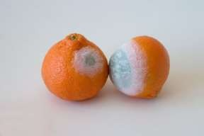
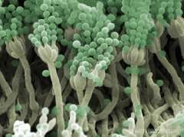
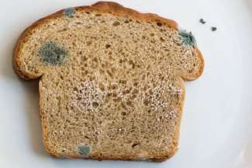
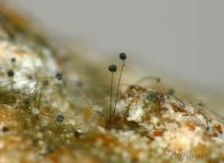
The Impact of Microorganisms on Humans
Microorganisms and food (NEGATIVE IMPACT)
Penicillium sp.
ELECTRON MICROSCOPE
LIGHT MICROSCOPE
Rhizopus sp.

Slide 16

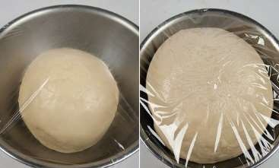
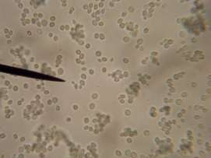
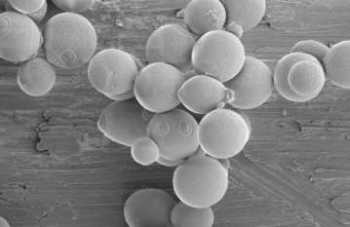
The Impact of Microorganisms on Humans
Microorganisms and food (POSITIVE IMPACT)
Saccharomyces cerevisiae

Slide 17
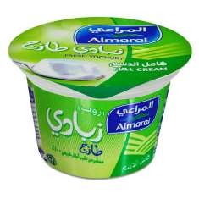
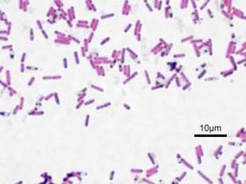
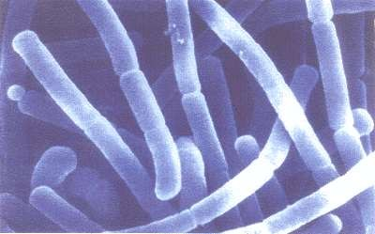
The Impact Of Microorganisms On Humans
Microorganisms And Food (POSITIVE IMPACT)
Lactobacillus delbrueckii subsp. bulgaricus

Slide 18
The Impact Of Microorganisms On Humans
Microorganisms, Energy, And The Environment
The role of microbes in biofuels production . For example:
Methane: a natural gas , which is a product of anaerobic degradation of organic matter by methanogenic bacteria.
Ethanol:, which is produced by microbial fermentation of glucose .
Industrial microbiology: Growing microorganisms in large scales to make products of low commercial value. e.g. antibiotics and various chemicals (such as citric acid).

Slide 19
The Impact Of Microorganisms On Humans Microorganisms, Energy, And The Environment
The role of microbes in cleaning up pollutants (bioremediation).
- There are 2 ways:
By introducing specific microorganisms to a polluted environment
By adding nutrients that stimulate preexisting microorganisms to degrade the pollutants.

Slide 20
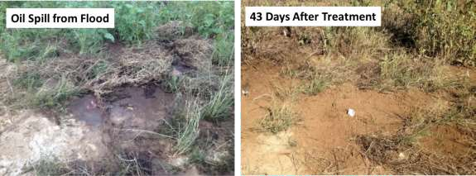
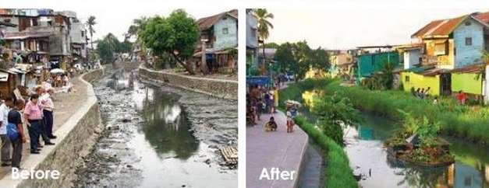
The Impact of Microorganisms on Humans
Microorganisms, Energy, and the Environment
............. ةبعشلا
Oil spill –bioremediation treatment
Sewerage spill – bioremediation treatment

Slide 21
The Impact Of Microorganisms On Humans
Microorganisms And Their Genetic Resources
Biotechnology employs genetically engineered microorganisms to generate products of high value to humans, such as insulin and human proteins.
Microbiology as a Career:
Clinical medicine
Research and development – pharmaceutical, chemical/biochemical, biotechnology
Microbial monitoring in food and beverage industries, public health, government.

