Slide 1
Lecture-2 Principles Of Microbiology (Part-1)
140MIC: Microbiology

Slide 2
Principles of Microbiology Content
1.1 Microbiology and Microorganisms
The importance of microorganisms
1.2 Microbial Cells
Cell chemistry and key structure
Characteristics of living systems
Cell functions: coding and metabolism.
1.3 Microorganisms and Their Environments
Microbial interaction
1.4 The Impact of Microorganisms on Humans
Microorganisms as disease agents
Microorganisms and agriculture
Microorganisms and food
Microorganisms, energy and there environment
Microorganisms and their genetic resources
Microbiology as a career

Slide 3
Introduction
Microbiology is the study of microscopic organisms, such as bacteria, viruses, archaea, fungi and protozoa. This discipline includes fundamental research on the biochemistry, physiology, cell biology, ecology, evolution and clinical aspects of microorganisms, including the host response to these agents. (https://www.nature.com/subjects/microbiology)
What is Microbiology about?
Microbiology is about microbial cells and how they work .
Microbiology is about diversity and evolution of microbial cells.
It is about what microorganisms do in the world , soil , water , human body , animal , plant ..etc.
Microorganisms can affect and support all other forms of life, and considered the most fundamental of the biological sciences.

Slide 4
Microbiology and Microorganisms
The science of microbiology revolves around two themes:
Understanding basic life processes of microscopic organisms (basic biological science).
Microbes are excellent experimental systems for understanding cellular processes in unicellular and multicellular organisms.
Applying that knowledge to the benefit of humans, animals and plant (applied
biological science)
Microbes play important roles in medicine, agriculture, and industry.

Slide 5
Microbiology and Microorganisms
The importance of microorganisms
Oldest and smallest form of life
Largest mass of living material on Earth
Carry out major processes for biogeochemical cycles
Can live in places unsuitable for other organisms
Other life forms require microbes to survive

Slide 6
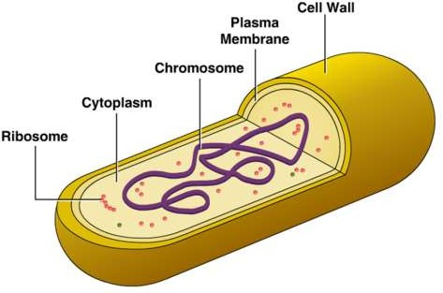
1.2 Microbial Cell
A Cell كيان
The Cell is A Dynamic Entity That Forms The Fundamental Unit Of Life
Contains 4 Chemical Components, Form 95% Of Dry Weight Of The Cell:
Proteins
Nucleic acids
Lipids
Polysaccharides
Nucleus
A bacterial cell as example of microbial cell

Slide 7
1.2 Microbial Cell
Cell wall
Present in some types of microbial cells
confers structural strength
prevents the cell from osmotic bursting.
Nucleus
Cytoplasmic cell membrane ((or inner membrane)
Barrier that separates the inside of the cell from the outside environment.

Slide 8
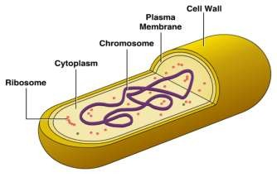
1.2 Microbial cell
Nucle
us
Cytoplasm:
The fluid inside the cell contains various structures and chemicals
Ribosomes (consisting proteins)
All eukaryotic and prokaryotic cells contain ribosomes, where protein synthesis takes place.
Nucleus of a eukaryote and nucleoid of a prokaryote:
Nucleus is (the largest structure in the cell, and contains almost all of the cell’s hereditary information (DNA). Some DNA is also found in mitochondria and in the chloroplasts of photosynthetic organisms.
The nucleoid (meaning nucleus-like) contains the DNA of the bacterial chromosome. Bacteria can also contain plasmids, which are circular, extrachromosomal DNA molecules

Slide 9
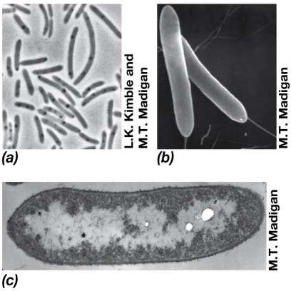
1.2 Microbial cell
Bacterial cells and some cell structure:
Rod-shaped cells bacteria (light microscope)
Scanning electron micrograph of the same bacteria
Electron micrograph of the same bacteria.

Slide 10
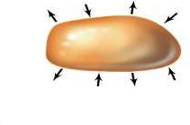
1.2 Microbial Cell Characteristics Of Living Systems
1- Metabolism:
-A cell is a compartment that takes up nutrients from the
environment, transforms them into new cell materials, and
releases wastes into the environment.
-The cell is thus an open system.
Cell
Environment
2-Growth
Chemicals from the environment and new metabolic products are turned into new cells under the genetic direction of pre-existing cells.

Slide 11
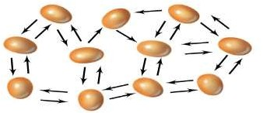
1.2 Microbial cell
Characteristics of living systems
3- Differentiation
Some cells can form new cell structures such
as a spore, usually as part of a cellular life cycle to
survival.
Spore
4- Communication
Many cells communicate or respond to chemical signals in their environment including those produced by other cells of either the same or different species and, which can trigger new cellular activities.

Slide 12
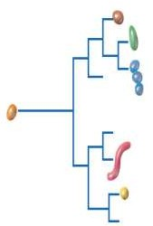
1.2 Microbial Cell Characteristics Of Living Systems
5- Motility
-Some cells are capable of self-propulsion.
- Motility allows cells to
1- move away from danger or
2- unfavorable conditions
3-to exploit new resources.
6- Evolution
-Cells contain genes and evolve to display new biological properties.
-Evolution is typically a slow process but can occur rapidly in microbial cells .
-Phylogenetic trees show the evolutionary relationships
between cells.
Distinct species
Ancestral cell
Distinct
species

Slide 13
1.2 Microbial Cell Cells As Catalysts And As Coding Devices
The routine activities of cells are is in two ways :
Catalytic functions : carrying out the chemical reactions and metabolism
Genetic functions:
Cells store and process information that is eventually passed on to offspring during reproduction through DNA and evolution.
DNA processing include two main events :
Transcription: DNA produces RNA (production of RNAs)
Translation: RNA makes protein (production of proteins)
Replication , transcription and translation are the key molecular process in cells.

Slide 14
1.2 Microbial Cell Cells As Catalysts And As Coding Devices
Cells coordinate their catalytic and genetic functions to support cell growth.
In the events that lead up to cell division, all substances and material in the cell are double.
This required:
The cell's catalytic machinery
Enzymes: protein catalysts of the cell that accelerate chemical reactions
Energy conservation
Supply precursors for biosynthesis of all cell components.
And that its entire complement of genes replication

Slide 15
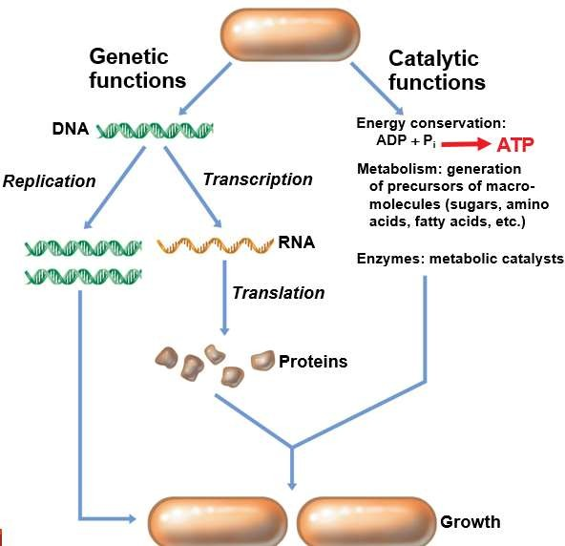
The catalytic and genetic functions of the cell.
For a cell to reproduce itself there must be energy and precursors to the synthesis of new macromolecules,
the genetic instructions must be replicated and genes must be expressed (transcribed and translated) to produce proteins and other macromolecules.

Slide 16
REMEMBER
You can always ask questions through our discussion board on
www.lms.ksu.edu.sa

