Slide 1
Lecture-16
Viruses

Slide 2
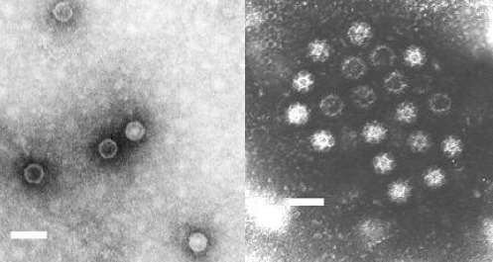
Viruses General properties
Viruses are Infectious agents
Obligate intracellular parasitic microorganisms which are smaller than bacteria and so could pass through bacterial filters.
They form groups which infect other living systems such as humans, animals , insects , plants , bacteria and fishes .
A transmission electron microscopy (TEM) images of the Polio virus (left), and the Calicivirus (right). Notice the identifiable differences in appearance between the two types of viruses. Bars = 50 nm (1)
Viruses can be classified on the basis of the hosts they infect:
Bacterial viruses (bacteriophages)
Archaeal viruses
Animal viruses
Plant viruses
Other viruses

Slide 3
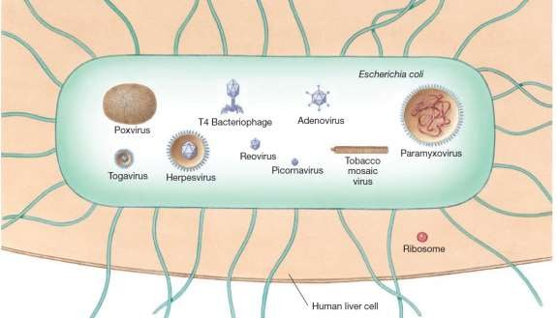
Viruses General properties
The largest ones coming somewhat closer to the smallest bacterium .
These viruses are highly selective and specific to their hosts.
They are known to be responsible for several diseases of man, animal, plant, etc.

Slide 4
Viruses General properties
Viruses have both living and nonliving characteristics.
Living characteristics of viruses
They reproduce at high rates, but only in living host cells.
They can mutate.
Nonliving characteristics of viruses
They do not contain cytoplasm or cellular organelles.
They do not carry out metabolic reactions on their own. They don't grow and divide
They must replicate using the host cell's metabolic machinery. New viral
components are synthesized and assembled within the infected host cell.
The majority of viruses possess either DNA or RNA but not both.

Slide 5
Nature of viruses
Viruses cannot be grown on artificial media.
They can only grow in living organisms or tissue cells which are kept
alive in suitable medium.

Slide 6
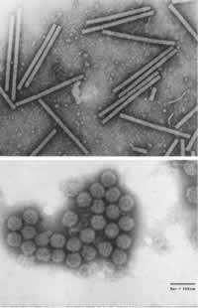
Morphology of Virus
According to the shape, viruses can be classified into the following groups :
Spherical. With a size ranging from 18 to 150 μm This includes , as example , the viruses of influenza.
Rod-shaped. They are 300 μm in length and 15 μm in width. It is represented by the tobacco mosaic virus.
Cuboid. With a size ranging from 210 to 305 μm.This form is found in cowpox and canary pox viruses.
Complex-shaped. The size varies from 10 to 225μm. This form is characteristic of phages.

Slide 7
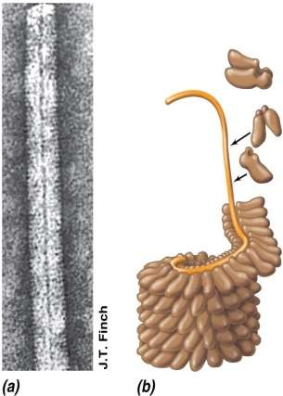
Viruses Structure
Capsid: the protein shell that surrounds the genome of a virus particle Composed of a number of protein molecules arranged in a precise and highly repetitive pattern around the nucleic acid
Capsomere: subunit of the capsid
Smallest morphological unit visible with an electron microscope
18 nm
Structural subunits (capsomeres)
Virus RNA
Nucleocapsid : complete complex of nucleic acid and protein packaged in the virion
Enveloped virus: virus that contains additional layers around the nucleocapsid
© 2012 Pearson Education, Inc.

Slide 8
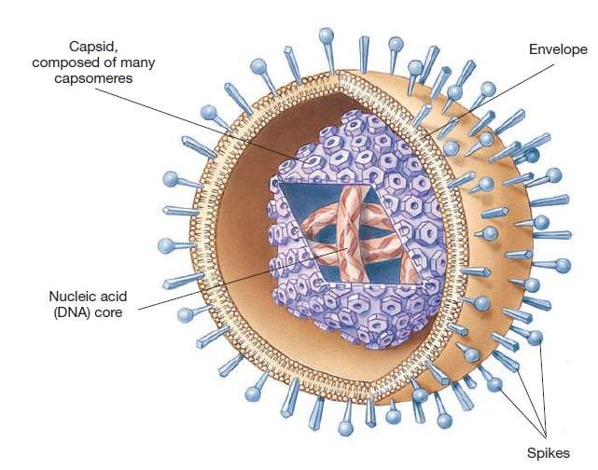
Viruses Structure
© 2012 Pearson Education, Inc.

Slide 9
Mechanism of virus infection ( Reproduction )
Adsorption of the virus : The infective virus has to be bound at first to certain receptors on the outer surface of the host cell.
Penetration: There are two views concerning this phase :
The whole virus contain nucleic acid and protein penetrates into the cell , although the protein part has no role on the further steps of infection.
Only the nucleic acid part penetrates into the cell,

Slide 10
Mechanism of virus infection ( Reproduction )
Blocking of cell information :The introduction of viral nucleic acid in the host cell inhibits and blocks the original genetic information in the DNA of the chromosomes, and the nucleus has no longer any control on the cell activity.
Synthesis of virus components. the viral nucleic acid forces the cell to replicate the virus components ( nucleic acid and protein ) . This new synthesis is completed in few hours.
Release of the virus : the release in some virus by lysis of the cell, while in others
by exocytosis .

