Slide 1
140MIC: Microbiology
General microbiology
Lecture-14 Microbial diversity and groups

Slide 2
Content
oArchaebacteria oFungi
oAlgae oViruses

Slide 3
Domain Archaea
Archaea share many characteristics with both Bacteria and Eukarya.
Bioenergetics and metabolism of Archaea are similar to those found in Bacteria.
Some major characteristics of Archaea include the absence of peptidoglycan in cell walls and the presence of ether-linked lipids.
Archaea are very interesting group of prokaryotes and highly diverse.
Include roods, cocci and helixes but some are very unusual morphology.
Some are gram-positive , others are gram-negative.
Some may divide by binary fission , others by fragmentation or budding .

Slide 4
Domain Archaea
Physiologically , archaea are found under extreme environmental conditions and No known pathogenic archaea.
Extremophiles they include halophiles , thermophiles and acidophiles
Archaea are split into two major groups:
Euryarchaeota ايوري اركيوتا
Crenarchaeotaكرين اركيوتا

Slide 5
1- Euryarchaeota
Types of Euryarchaeota:
Extremely Halophilic Archaea. Have a requirement for high salt
concentrations.
Methanogenic Archaea. Microbes that produce CH₄
Thermoplasmatales. Thermophilic and/or extremely acidophilic, Chemoorganotrophs.

Slide 6
1- Euryarchaeota
Types of Euryarchaeota:
Thermococcales and Methanopyrus. Indigenous to anoxic thermal
waters, Highly motile.
Archaeoglobales. Hyperthermophilic
Nanoarchaeum and Aciduliprofundum One of the smallest cellular organisms (~0.4 µm), Contains one of the smallest genomes known.

Slide 7
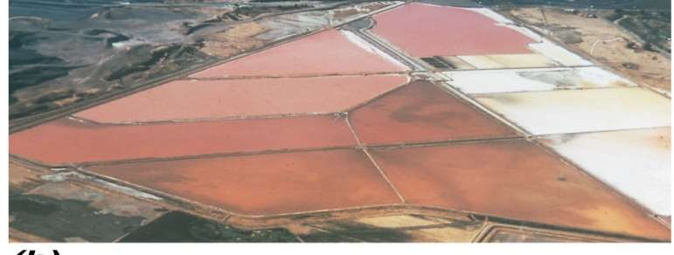
1. Extremely Halophilic Archaea
Have a requirement for high salt concentrations. Typically require at least 1.5 M (~9%) NaCl for growth

Slide 8
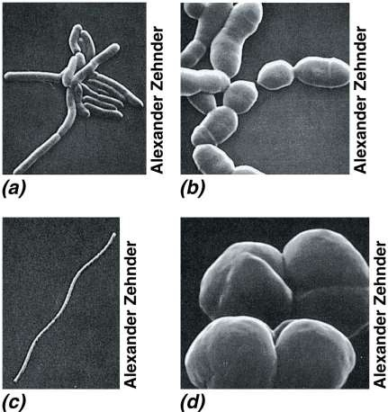
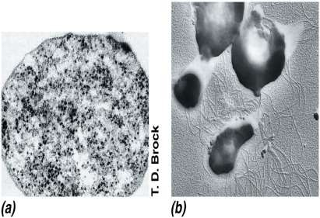
2. Methanogenic Archaea ميثانوجينيك اركيا
3. Thermoplasmatales
ثيرموبلازماتالس

Slide 9
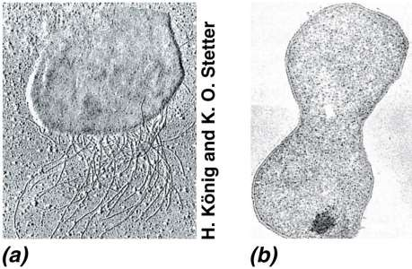
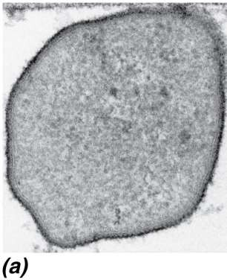
4. Thermococcales and Methanopyrus ثيرموكوكالس و ميثانوبيرس
5.Archaeoglobales
اركيوجلوبالس
© 2012 Pearson Education, Inc.

Slide 10
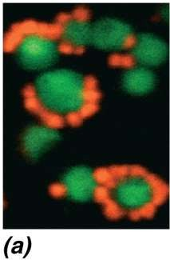
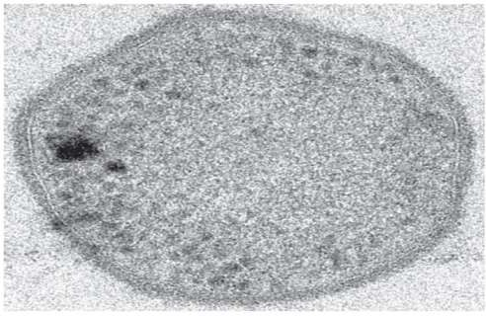
6. Nanoarchaeum and Aciduliprofundum نانو اركيم و اسيدو ليبرو فندم
© 2012 Pearson Education, Inc.
Notes:
نانو اركيم و اسيدو ليبرو فندم

Slide 11
2-Crenarchaeota
Inhabit temperature extremes
Most cultured representatives are hyperthermophiles
Found in extreme heat environments, other representatives found in extreme cold environments
© 2012 Pearson Education, Inc.

Slide 12
