Slide 1
Lecture-13
Microbial classification
Content
Definitions
Taxonomy
Systematics
Phenotypic Analysis
Genotypic Analysis
Classification and Nomenclature

Slide 2
Definitions
Taxonomy
The science of identification, classification, and nomenclature
Systematics
The study of the diversity of organisms and their relationships
Links phylogeny with taxonomy
The polyphasic approach to taxonomy uses three methods:
Phenotypic analysis
Genotypic analysis
Phylogenetic analysis

Slide 3
Approaches in taxonomy
The polyphasic approach to taxonomy uses three methods:
Examines the morphological, metabolic, physiological, and chemical characters of the cell
1. Phenotypic analysis
2. Genotypic analysis
3. Phylogenetic analysis
© 2012 Pearson Education, Inc.

Slide 4
Approaches in taxonomy
The polyphasic approach to taxonomy uses three methods:
Several methods of genotypic analysis are available:
DNA–DNA hybridization
DNA profiling
Multilocus sequence
typing (MLST)
GC ratio
1. Phenotypic analysis
2. Genotypic analysis
3. Phylogenetic analysis
© 2012 Pearson Education, Inc.

Slide 5
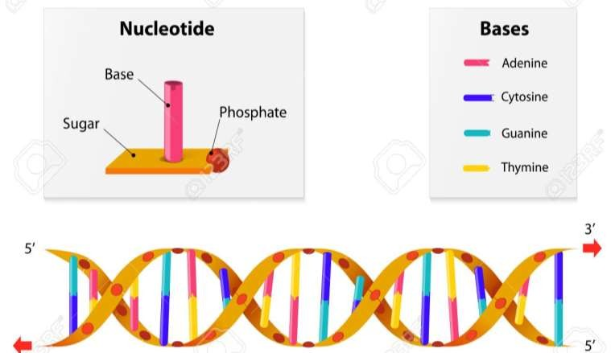
Genotypic analysis

Slide 6
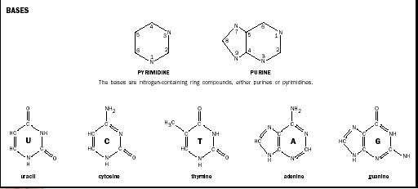

Slide 7
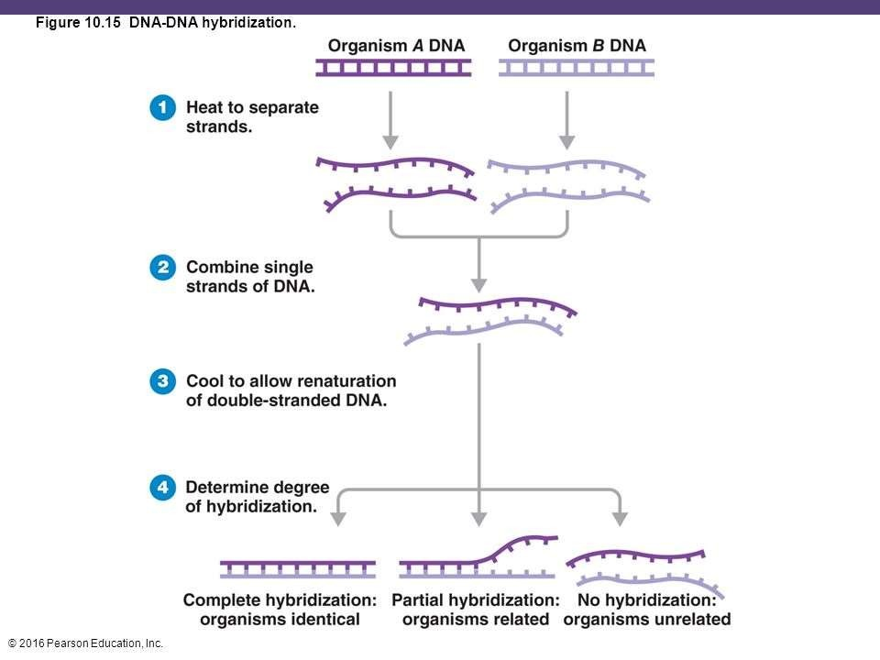
DNA–DNA hybridization

Slide 8
GC ratio

Slide 9
Approaches in taxonomy
The polyphasic approach to taxonomy uses three methods:
The means of estimating the
relationships between microorganisms
16S rRNA gene sequences are useful in taxonomy; serve as “gold standard” for the identification and description of new species
Whole-genome sequence analyses are
becoming more common
Genome structure: size and number of chromosomes, GC ratio, etc.
Gene content
Gene order
1. Phenotypic analysis
2. Genotypic analysis
3. Phylogenetic analysis
** 16SrRNA is a component of the 30S subunit of a prokaryotic ribosome
© 2012 Pearson Education, Inc.

Slide 10
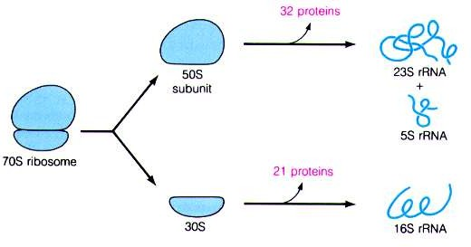
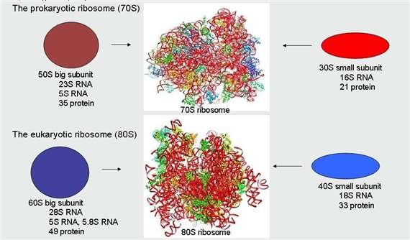
** 16SrRNA is a component of the 30S subunit of a prokaryotic ribosome
The smaller (30S) subunit is composed of 16-S rNA and about 21 proteins.

Slide 11
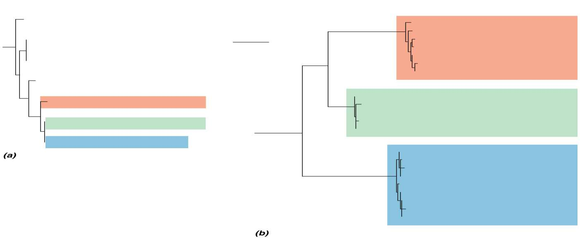
16S rRNA Gene Tree
Multigene Tree
Photobacterium damselae
FS-2.1
FS-4.2
FS-3.1
FS-5.1
50 changes
Photobacterium phosphoreum
Photobacterium leiognathi
Photobacterium mandapamensis
FS-2.2
ATCC 11040^{T}
FS-5.2
Photobacterium angustum
Photobacterium phosphoreum
ATCC 51761
NCIMB 13476
NCIMB 13478
NCIMB 13481
ATCC 51760^{T}
Photobacterium iliopiscarium
Photobacterium iliopiscarium
Photobacterium kishitanii
chubb.1.1 ckamo.3.1 canat.1.2 hstri.1.1 calba.1.1
BAA-1194^{T}
apros.2.1
ckamo.1.1 vlong.3.1
Photobacterium kishitanii
© 2012 Pearson Education, Inc.

Slide 12
Classification and Nomenclature
Classification
Organization of organisms into groups on the basis of either phenotypic similarity or evolutionary
relationship
Prokaryotes are given descriptive genus names and species epithets following the binomial system of nomenclature used throughout biology
Assignment of names for species and higher groups of prokaryotes is regulated by the International Code
of Nomenclature of Bacteria
Major references in bacterial diversity:
Bergey’s Manual of Systematic Bacteriology
The Prokaryotes
© 2012 Pearson Education, Inc.

