Slide 1
General microbiology
140MIC: Microbiology
Lecture-12 Microbial growth (Part-2)

Slide 2
Content
oBacterial Cell Division
Cell Growth and Binary Fission
oPopulation growth
The Concept of Exponential Growth
The Microbial Growth Cycle
oMeasuring Microbial Growth
oEnvironmental Factors Affecting Growth
Temperature
Acidity and Alkalinity
Osmotic Effects on Microbial Growth
Oxygen and Microorganisms
Toxic Forms of Oxygen

Slide 3
Measuring Microbial Growth
Microscopic Counts
Viable Counts
Turbidimetric Methods

Slide 4
Measuring Microbial Growth
1-Microscopic Counts
Microbial cells are enumerated by microscopic observations
Results can be unreliable
Limitations of microscopic counts
Cannot distinguish between live and dead cells without special stains
Small cells can be overlooked
Precision is difficult to achieve ( Not accurate)
Phase-contrast microscope required if a stain is not used
Cell suspensions of low density (<10⁶ cells/ml) hard to count
Motile cells need to immobilized
Debris in sample can be mistaken for cells

Slide 5
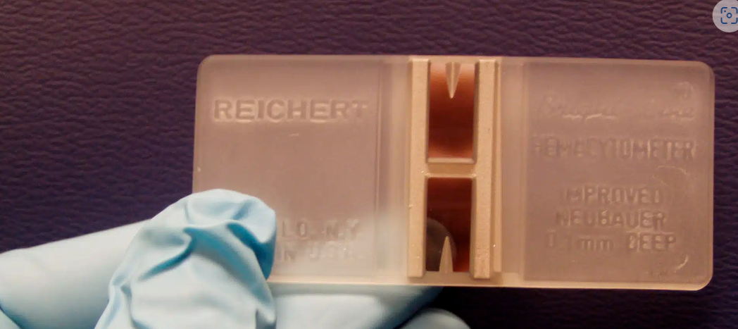
(37) Counting Cells with a Hemocytometer - YouTube
Ridges that support coverslip
To calculate number per milliliter of sample:
12 cells ✕ 25 large squares ✕ 50 ✕ 10³
Coverslip
Number/mm² (3 ✕ 10²)
Microscopic observation; all cells are counted in large square (16 small squares): 12 cells. (In practice, several
large squares are counted and the numbers averaged.)
Number/mm³ (1.5 ✕10⁴)
Number/cm³ (ml) (1.5 ✕ 10⁷)
Hemocytometer
Notes:
12X25=300 (3X10²⁾

Slide 6
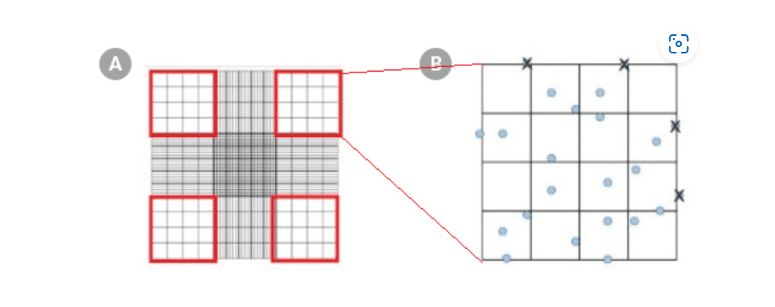
(37) Counting Cells with a Hemocytometer - YouTube
1- 10 ul sample (cell suspension)+10 ul trypan blue (=> total vol=20)
DF= total vol/sample vol= 20/10=2
1
2
3
4
2- if the cell counts for each of the four outer squares were 20, 12, 22, and 18 ➔the average cell count would be (20 + 12 + 22 + 18) ÷ 4 = 18
3-Total number of cells/mL = average cell count x dilution factor x 10⁴
=18 X 2 X 10⁴
=360000 cells /ml
Using a Hemocytometer for Cell Counting | Protocol (stemcell.com)
Notes:
1

Slide 7
Measuring Microbial Growth
Viable Counts
Viable cell counts (plate counts):
measurement of living, reproducing population
Two main ways to perform plate counts:
Spread-plate method
Pour-plate method

Slide 8
Figure 5.16
To obtain the appropriate colony number, the sample to be counted should always be diluted.
Sample to be counted
1 ml
1 ml
1 ml
1 ml
1 ml
1 ml
9-ml broth
Total | 1/10 | 1/100 | 1/10³ | 1/10⁴ | 1/10⁵ | 1/10⁶
dilution | (10⁻¹) | (10⁻²) | (10⁻³) | (10⁻⁴) | (10⁻⁵) | (10⁻⁶)
Plate 1-ml samples
159
colonies
17 2
colonies colonies
0
colonies
Too many colonies to count
159 ✕ 10³
=
1.59 ✕ 10⁵
Cells (colony-forming units)
Plate
Dilution
count
factor
per milliliter of original sample

Slide 9
Spread-plate method
Surface colonies
Incubation
Sample is pipetted onto surface of agar plate (0.1 ml or less)
Sample is spread evenly over surface of agar using sterile glass spreader
Typical spread-plate
results
Pour-plate method
Surface colonies
Solidification
and incubation
Subsurface colonies
Sample is pipetted into sterile plate
Sterile medium is added and mixed well with inoculum
Typical pour-plate
results

Slide 10
Figure 5.16
Sample to be counted
1 ml
1 ml
1 ml
1 ml
1 ml
1 ml
9-ml broth
Total | 1/10 | 1/100 | 1/10³ | 1/10⁴ | 1/10⁵ | 1/10⁶
dilution | (10⁻¹) | (10⁻²) | (10⁻³) | (10⁻⁴) | (10⁻⁵) | (10⁻⁶)
Plate 1-ml samples
159
colonies
17 2
colonies colonies
0
colonies
Too many colonies to count
159 ✕ 10³
=
1.59 ✕ 10⁵
Cells (colony-forming units)
Plate
Dilution
count
factor
per milliliter of original sample

Slide 11
Measuring Microbial Growth
Turbidimetric Methods
oTurbidity measurements are an indirect, rapid, and useful
method of measuring microbial growth
oMost often measured with a spectrophotometer and measurement referred to as optical density (O.D.)
oTo relate a direct cell count to a turbidity value, astandard curve must first be established
oQuick and easy to perform
oTypically do not require destruction or significant disturbance of sample
oSometimes problematic (e.g., microbes that form clumps or biofilms in liquid medium)

Slide 13
Environmental Factors Affecting Growth
Temperature
Acidity and Alkalinity (pH)
Osmotic Effects on Microbial Growth
Oxygen and Microorganisms
Toxic Forms of Oxygen

Slide 14
1-Effect of Temperature on Growth
Temperature is a major environmental factor controlling microbial growth
Cardinal temperatures: the minimum, optimum, and maximum temperatures at which an organism grows.
Microorganisms can be classified into groups by their growth temperature optima.
oPsychrophile: low temperature
oMesophile: midrange temperature oThermophile: high temperature oHyperthermophile: very high temperature

Slide 15
Figure 5.20

Slide 16
2-Acidity and Alkalinity
The pH of an environment greatly affects microbial growth
Some organisms have evolved to grow best at low or high pH, but most
organisms grow best between pH 6 and 8 (neutrophiles)
Acidophiles: organisms that grow best at low pH (<6)
Some are obligate acidophiles; membranes destroyed at neutral pH
Stability of cytoplasmic membrane critical
Alkaliphiles: organisms that grow best at high pH (>9)
Some have sodium motive force rather than proton motive force
The internal pH of a cell must stay relatively close to neutral even though the external pH is highly acidic or basic
Microbial culture media typically contain buffers to maintain constant pH

Slide 17
Moles per liter of:
Figure 5.24
pH Example
_{H}+
OH⁻ ₁₀-14
1
Volcanic soils, waters ₁₀-1 | ₁₀-13
Lemon juice ₁₀₋₂ Vinegar | ₁₀-12
Increasing Rhubarb 10⁻³ | ₁₀-11
Acid soil 10⁻⁴ | ₁₀-10
American cheese 10⁻⁵ | ₁₀-9
Peas 10⁻⁶ | ₁₀-8
Neutrality _{Pure water 10}-7 | ₁₀-7
Seawater 10⁻⁸ | ₁₀-6
Very alkaline ₁₀-9 | ₁₀-5
Alkaline lakes 10⁻¹⁰ | ₁₀-4
^{alkalinity} Household ammonia 10⁻¹¹ | ₁₀-3
soda lakes 10⁻¹² Lime (saturated solution) ₁₀-13 | ₁₀-2 ₁₀-1
Acidophiles
Gastric fluids
Acid mine drainage
acidity
Peaches
Tomatoes
Cabbage
Corn, salmon, shrimp
Alkaliphiles
natural soil
Increasing
Soap solutions
Extremely alkaline
₁₀-14
1

Slide 18
3-Osmotic Effects on Microbial Growth
Typically, the cytoplasm has a higher solute concentration than the surrounding environment, thus the tendency is for water to move into the cell (positive water balance)
When a cell is in an environment with a higher external solute concentration, water will flow out unless the cell has a mechanism to prevent this
oHalophiles: organisms that grow best at reduced water potential; have a specific requirement for NaCl.
oExtreme halophiles: organisms that require high levels (15–30%) of NaCl for
growth
oHalotolerant: organisms that can tolerate some reduction in water activity of environment but generally grow best in the absence of the added solute
oNonhalophile

Slide 19
Halophile
Figure 5.25
Halotolerant
Example: Staphylococcus aureus
Extreme halophile Example: Halobacterium salinarum
Example:
Aliivibrio fischeri
Growth rate
Nonhalophile Example:
E.Coli / Escherichia coli
5
0
10
NaCl (%)
15
20

Slide 20
Oxygen and Microorganisms
Aerobes: require oxygen to live
Anaerobes: do not require oxygen and may even be killed by exposure
Facultative organisms: can live with or without oxygen
Aerotolerant anaerobes: can tolerate oxygen and grow in its presence
even though they cannot use it
Microaerophiles: can use oxygen only when it is present at levels reduced from that in air

Slide 21
Oxygen and Microorganisms
Thioglycolate broth : Complex medium that separates microbes based on oxygen requirements.
oReacts with oxygen so oxygen can only penetrate the top of the tube.
Growth versus oxygen concentration.
(a) aerobic, (b)anaerobic, ( c) facultative, (d)microaerophilic, (e) aerotolerant anaerobe

