Slide 1
Lecture-11
Microbial growth (Part-1)

Slide 2
Content
oBacterial Cell Division
Cell Growth and Binary Fission
oPopulation growth
The Concept of Exponential Growth
The Microbial Growth Cycle
oMeasuring Microbial Growth
oEnvironmental Factors Affecting Growth
Temperature
Acidity and Alkalinity
Osmotic Effects on Microbial Growth
Oxygen and Microorganisms
Toxic Forms of Oxygen
© 2012 Pearson Education, Inc.

Slide 3
Cell Growth and Binary Fission
Bacterial cell growth depends on a large number of cellular reactions :
Reactions that transform energy
Synthesize small molecules (the blocks of macromolecules)
Provide various co-factors and co-enzymes needed for enzymatic
reactions
The key reactions of cell synthesis are polymerizations that make macromolecules from monomers.
Macromolecules then assembled into new structures such as cell wall , cytoplasmic membrane , ribosomes and so on, leading to the process of cell division itself.

Slide 4
Cell Growth and Binary Fission
Growth: increase in the number of cells
Binary fission: cell division following enlargement of a cell to twice its minimum size
Generation time: time required for microbial cells to double in number
oWhen one cell eventually separates to form two cells ,we say that one generation has occurred and the time required for this process called generation time.
oDuring cell division, each daughter cell receives a chromosome and sufficient
copies of all other cell constituents to exist as an independent cell
o.
© 2012 Pearson Education, Inc.

Slide 5
Cell Growth and Binary Fission
In a growing rod-shaped cell, cell elongate twice their original length
and then form a partition that constricts the cell into two daughter cells .
This partition called septum and results from the inward growth of the cytoplasmic membrane and cell wall from opposing directions ,septum formation continues until the two daughter cells are pinched off .

Slide 6
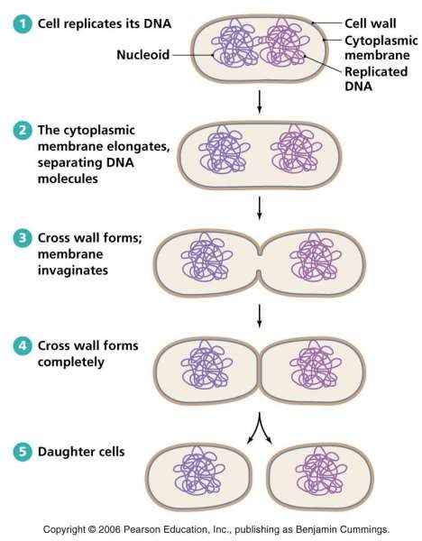
Required

Slide 7
The Concept of Exponential Growth
Most bacteria have shorter generation times than eukaryotic microbes
Generation time is dependent on growth medium and incubation conditions
Exponential growth: growth of a microbial population in which cell numbers double within a specific time interval
***During exponential growth, the increase in cell number is initially slow
but increases at a faster rate.
© 2012 Pearson Education, Inc.

Slide 8
The Concept of Exponential Growth
Batch culture: a closed-system microbial culture of fixed volume
Typical growth curve for population of cells grown in a closed system is
characterized by four phases:
Lag phase: Interval between when a culture is inoculated and when growth begins
Log or Exponential phase: Cells in this phase are typically in the healthiest state
Stationary phase: Growth rate of population is zero, either an essential nutrient is used up or waste product of the organism accumulates in the medium
Death phase: If incubation continues after cells reach stationary
phase, the cells will eventually die

Slide 9
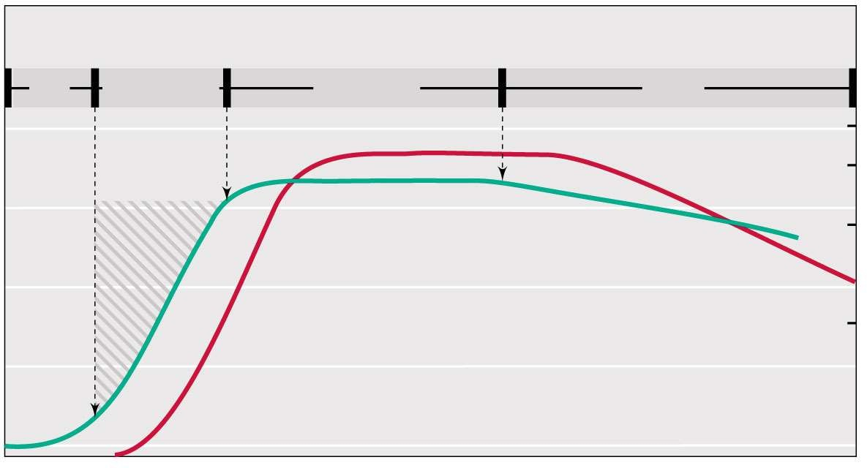
Growth phases
Required
Lag Exponential
Stationary
Death
10
1.0
Optical density (OD)
0.75
Log₁₀ viable organisms/ml
9
Turbidity (optical density)
0.50
8
Viable count
0.25
7
6
0.1
Time
© 2012 Pearson Education, Inc.
Notes:
required

Slide 10
Continuous Culture: The Chemostat
Continuous culture: an open-system microbial culture of fixed volume
Chemostat: most common type of continuous culture device
Both growth rate and population density of culture can be controlled independently and simultaneously
Dilution rate: rate at which fresh medium is pumped in and spent medium is pumped out
Concentration of a limiting nutrient
** In a batch culture, growth conditions are constantly changing; it is impossible to independently control both growth parameters.
© 2012 Pearson Education, Inc.

Slide 11
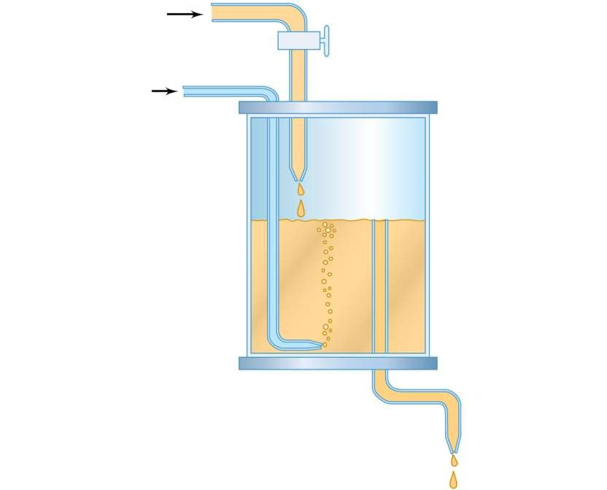
Fresh medium from reservoir
Figure 5.11
Flow-rate regulator
Sterile air or other gas
Gaseous headspace
Culture vessel
Culture
Overflow
Effluent containing microbial cells
© 2012 Pearson Education, Inc.

