Slide 1
وصف المحتوى

Slide 3
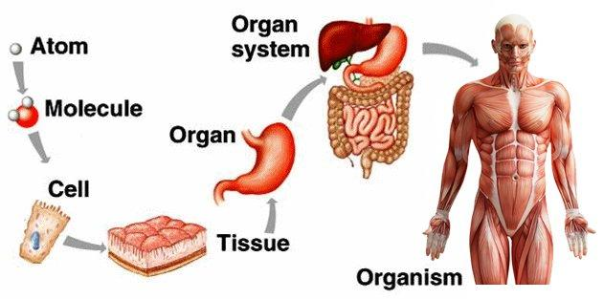
Levels of Organization
A cell is the smallest unit that can carry on all of the processes of life

Slide 4
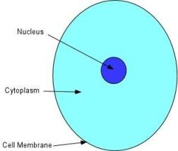

Slide 6
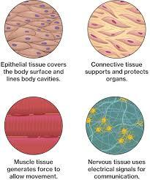
Types of Tissues
Despite its complexity, the animal body is composed of only four basic types of tissue.
Epithelial tissues.
Connective tissues.
Nervous tissues.
Muscular tissues.

Slide 7
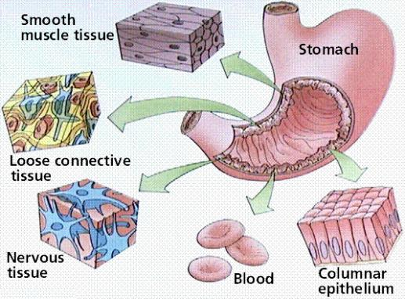
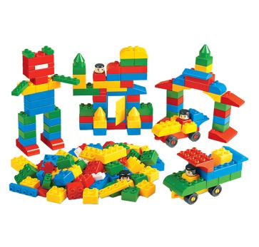
Histology = Microscopic Anatomy or Microanatomy
Histology is the describe of structural constituents (cells and extracellular matrix) of the organ tissue under microscope by standard stains (H & E), and how integrated to perform the specific function.

Slide 8
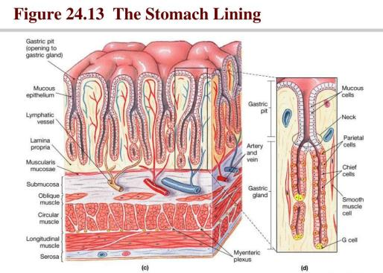
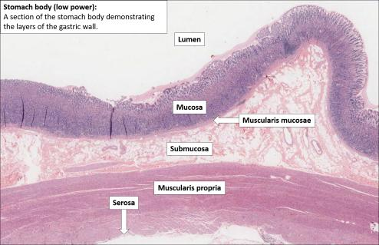

Slide 9
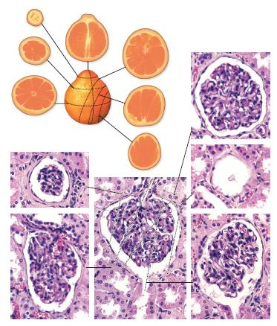

Slide 10
