Slide 1
KATO THICK SMEAR TECHNIQUE

Slide 2
In 1954, Kato and Miura were the first tointroduce a new method, the “cellophanethick-smear technique” which involved a principle of direct fecal sampling (Kato and Miura,1954).
It is different from the standard directsmear procedure in that a larger amount offecal sample is employed and cellophanestrips are used as cover slips instead of glass.After further refinement, the Kato thick smeartechnique, was adopted in control programsin Japan (Kato, 1960).
A quantitative study of helminthic infections using the Kato method was initially carried out by Martin and Beaver in 1968 for thedetection of specific helminth eggs.

Slide 3
Advantages &Disadvantages
Advantages
N.B. The ideal time for observing Schistosoma eggs is 24 hrs after preparation except in bright sunlight , the slide will clear rapidly & can be examined.
Ascaris & Trichuris eggs are visible at any time & hookworm eggs are visible 30 min after preparation .
The kato- katz template delivers 41.7 mg of faeces . The number of eggs observed is multiplied by 24 to obtain the number of eggs per gm . of faeces.

Slide 4
Advantages &Disadvantages
Advantages
The aim of this paper is to show the appearanceof the helminth eggs when malachite green is replacedwith a stain comprised of nigrosin and eosin yellow informalin.
Several field studies confirm the simplicity,quality, and cost effectiveness of the proposed modification .
a visual reference of the results of the methodcan be useful to facilitate the recognition of parasite eggs by microscopists willing to adopt this methodology.

Slide 5
Advantages &Disadvantages
Disadvantages
Take time (The Kato-Katz methods require between 1 to 2 hoursbefore the glycerin clears the background of the stoolsmear on the slide for accurate visualization of mosthelminth eggs )
The major problem of the technique isthat few hours after the preparation of the slidehookworm eggs are difficult to recognize due to overclarification by glycerin .

Slide 6
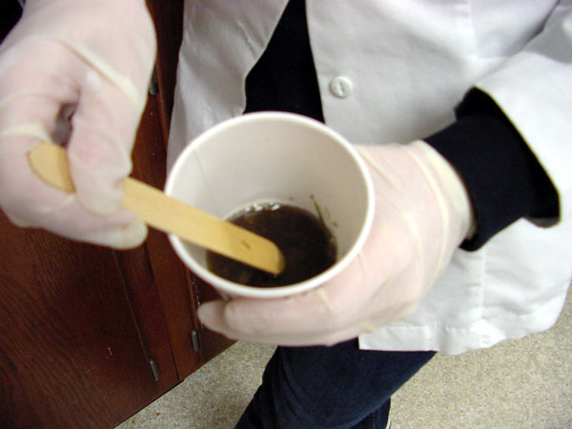
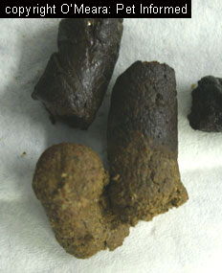
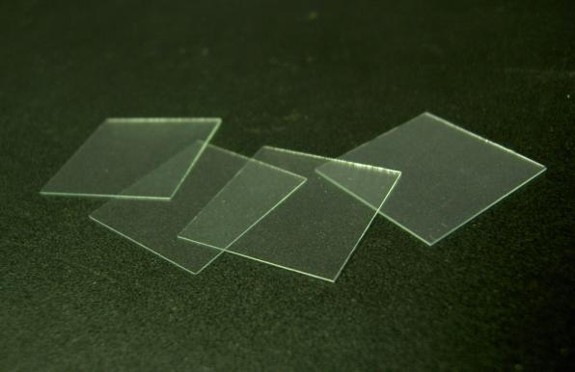
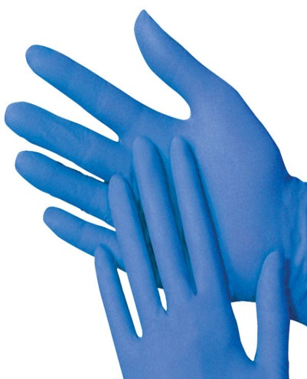
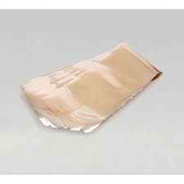
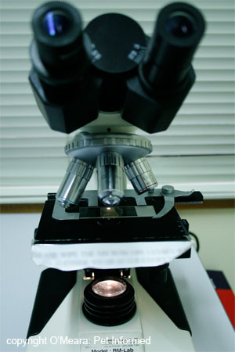
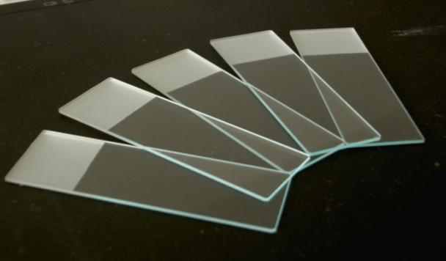
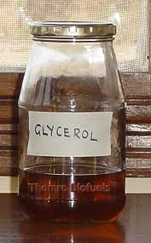
Materials
Stool samples
Glass slides
Cellophane (25×30 mm)
50% glycerol
a Piece of paper
Coverslips
Pipettes
Stick
Gloves
Microscope

Slide 7
Procedure

Slide 8
Preparation Material
Use Glass slides and Coverslips with hole

Slide 9
Transfer a small amount of faeces

Slide 10
Transfer a small amount of faeces onto a piece of paper.
Soak the cellophane strips (25×30 mm) in 50% glycerol malachite green
Solution for at least 24 hrs before use.

Slide 11
Press the screen on top of faecal specimen.
Using a plastic spatula, scrap across the upper surface of the screen to sieve the faecal sample .

Slide 12
Transfer a small amount of the sieved faecal material into the hole of the template & carefully fill the hole. Level with the applicator stick.

Slide 13
Remove the template carefully so that all the faecal material is left on the slide &none is left sticking to the template.

Slide 14
Cover the faecal sample on the slide with the glycerol-soaked cellophane strip, wipe off excess glycerol with a small piece of toilet paper.
Invert the microscope slide & press faecal sample against cellophane on a smooth surface to spread sample evenly .

Slide 15
Volatility on the other destination and then press to spread the sample

Slide 16
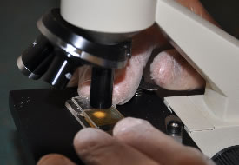
Slide ready for Examine
Examine under microscope

