Slide 1
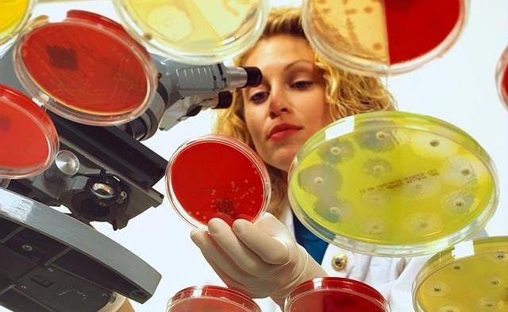
Isolation of fungus from various
environments

Slide 2
steps :
Isolation – introduction of a sample into a container of media to produce a culture of observable growth.
Incubation – conditions that allow growth e.g., temperature ,humidity etc..
Inspection
Identification.

Slide 3
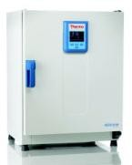
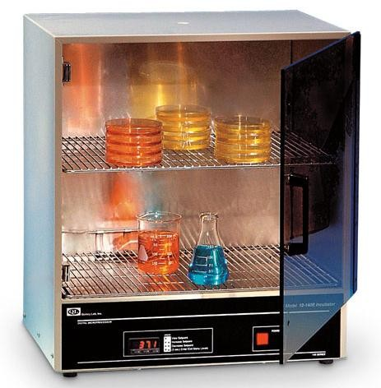
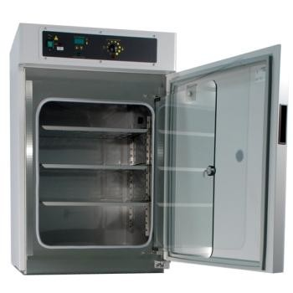
Incubator
In biology, an incubator is a device used to grow and maintain microbiological cultures or cell cultures.
The incubator maintains optimal temperature, humidity and other conditions such as the carbon dioxide (CO2) and oxygen content of the atmosphere inside.

Slide 4
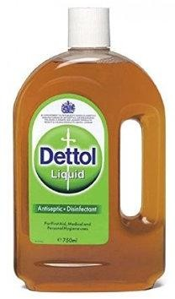
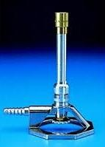
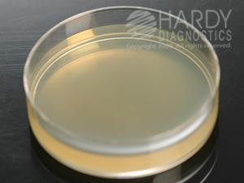
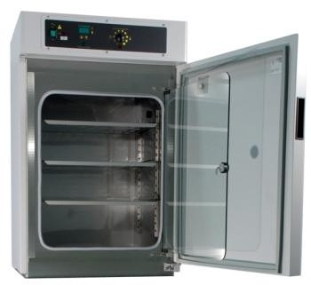
Materials and methods
Dettol 50%+Cotton
Benzene burner
Petri plate with media :
- PDA (for fungi).
Inoculation needles/loops
Samples : Soil ,Rotten fruit , Incubators

Slide 5
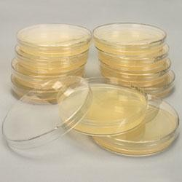
These plates of fungus will be incubated straight at 28° C for 2-5 days and then stored at refrigerator until next week when you will observe for results.

Slide 6
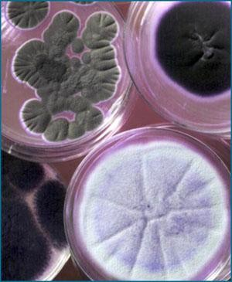
Fungi
Result
Bacteria
Write a report

Slide 7
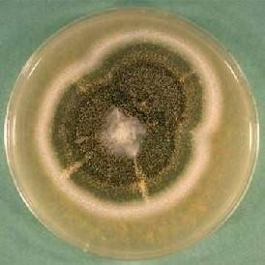
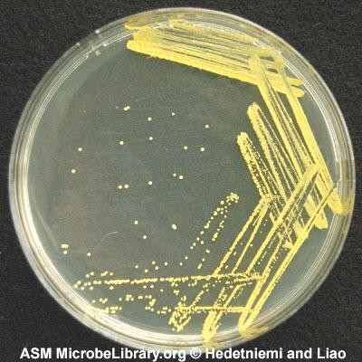
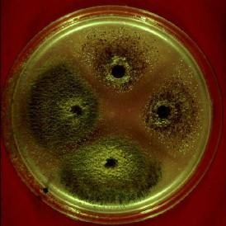
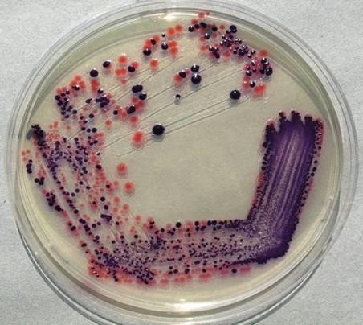
Types of Culture
Purification
2-Contaminated culture
More than one type of organism growing on the media plate
1-Pure Culture
Only one type of microorganism growing on the media plate

Slide 8
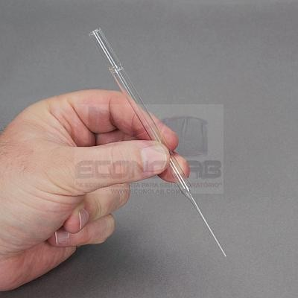
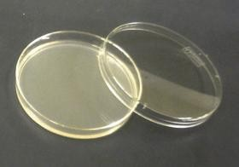
Purification of Fungi:
Use a pasture pipet.
Flame the pipet using alcohol 70% and allow to cool.
Cut a discs from the edge of an actively growing fungal colony.
Inoculate it (surface facing down) on the center another media plate with the help of flamed forceps
Incubate it for 3-5 days
Pure culture of the organism will grow.

Slide 9
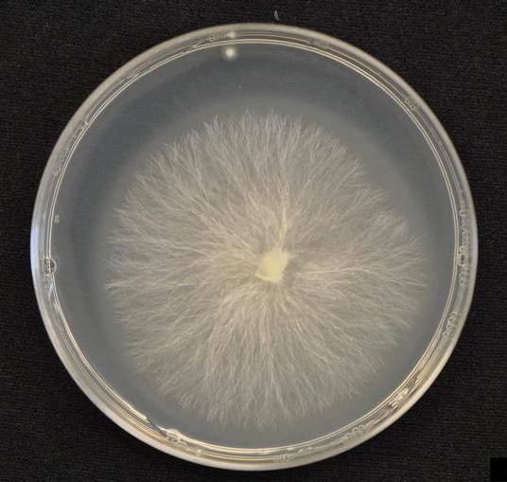
Result

Slide 10
Characters of colony
Form
What is the basic shape of the colony? For example, circular,
filamentous, etc.
Margin
What is the magnified shape of the edge of the colony?
Elevation
What is the cross sectional shape of the colony
Surface
How does the surface of the colony appear? For example, smooth, wrinkled etc.
Pigmentation
For example, white, green ,black, etc.

Slide 11
