Slide 1
INTRODUCTION
CLS 411 BACTERIOLOGY 1
LEVEL 7

Slide 2
Do Not Eat or Drink in the Laboratory

Slide 3
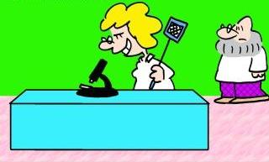
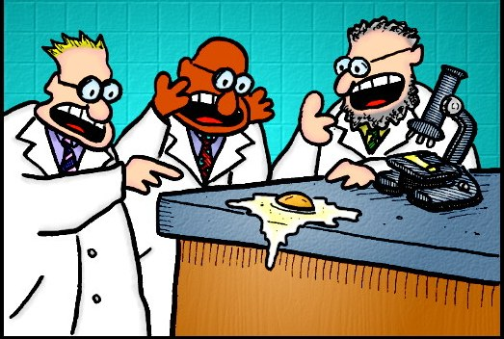
Keep your bench clean and free of extra books, papers and purses

Slide 4
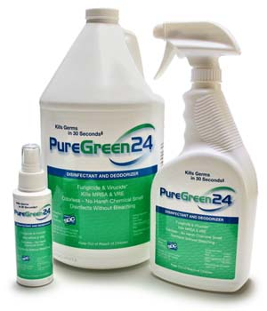
Clean up and disinfect your bench when you are finished

Slide 5
WASH YOUR HANDS WITH SOAP AND WATER BEFORE YOU LEAVE THE LAB!

Slide 6
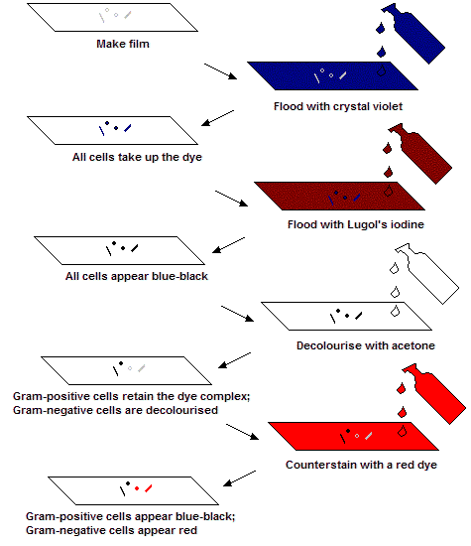
Gram Stain

Slide 8
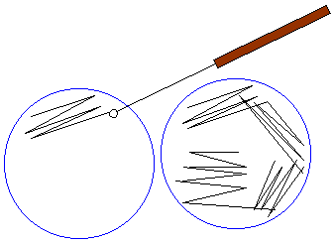
Streaking Plates

Slide 9
