Slide 1
Healthy diet

Slide 2
BMI is a better indicator of total body fat than is body weight. BMI is calculated as a person's weight in kilograms divided by their height in meters squared (kg/m2)
Underweight BMI <18.5
Normal BMI 18.5-24.9
Overweight BMI 25.0-29.0
Obesity classI BMI 30.0-34.9
Obesity classII BMI 35.0-39.9
Obesity classIII BMI ≥40

Slide 3
Obese individuals have a greatly increased risk of developing:
diabetes mellitus,
high blood pressure,
Heart attacks and strokes.
arthritis,
congestive heart failure,
Breast cancer, uterine cancer, colon cancer,
sleep apnea,
gallstones
depression.

Slide 4
Weight gain can only occur when the input energy exceeds the output energy.
input energy is the amount of food we eat.
Energy expenditure consists of our resting metabolic rate (the amount of calories we use each day for vital functions such as breathing, circulation and maintaining body temperature) and the amount of physical activity we do.

Slide 5
in order to gain a pound of fat a person must accumulate 3,500 excess calories. Only 7 excess calories per day will add up to a one pound weight gain over a period of one year.

Slide 6
What type of diet is most effective for producing weight loss?
A useful formula for estimating the initial daily calorie intake to produce a weight loss of about one pound per week is as follows:
Desired weight (lb.) X 13 – 500 = daily calorie intake

Slide 7
Most nutritionists recommend that the nutrient composition of the diet consist of approximately 50% of calories as carbohydrates, 30% of calories as fat and 20% of calories as protein
The calorie content of nutrients are as follows:
1 gram of carbohydrates = 4 calories; 1 gram of protein = 4 calories; 1 gram of fat = 9 calories.

Slide 8
Therefore if one wished to follow a 1,200 calorie per day consisting of 50% carbohydrate, 30% fat and 20% protein, one would consume approximately 150 gms of carbohydrate (600 calories), 40 gms of fat (360 calories), and 60 gms of protein (240 calories) each day.

Slide 9
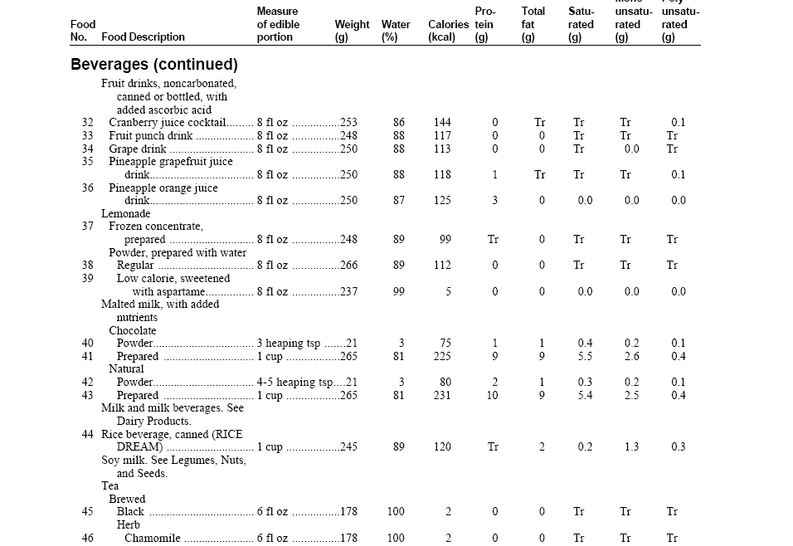

Slide 10
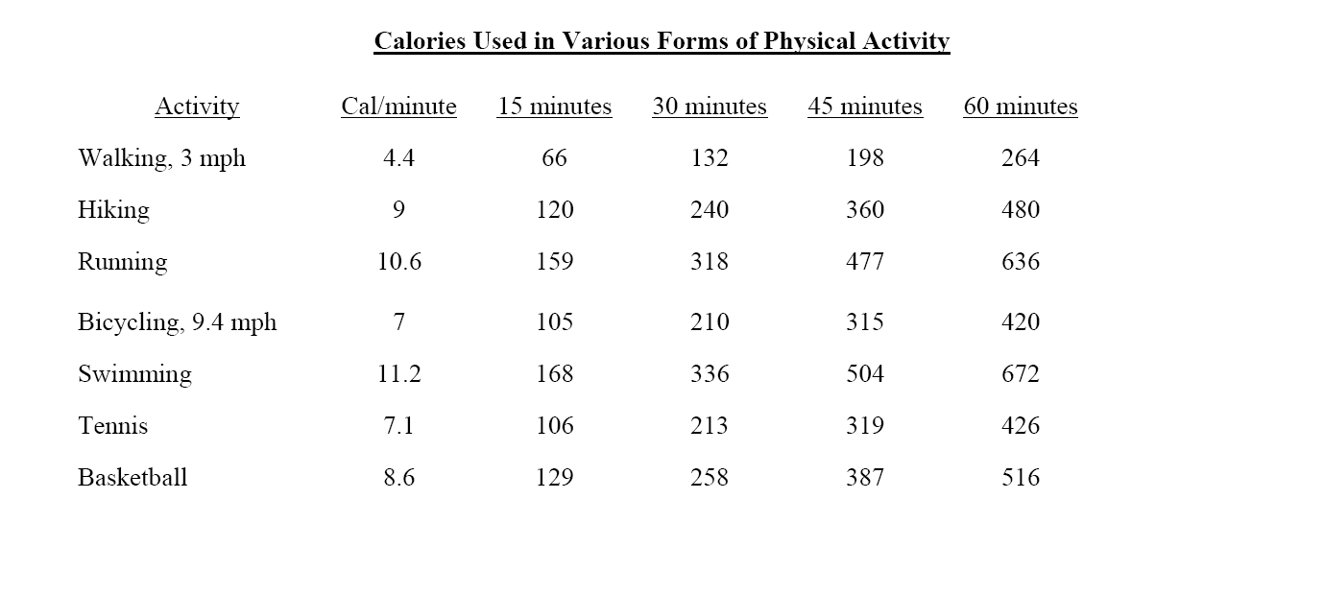

Slide 11
Assignment
Design your own regimen based on equation previously mentioned provided that girls with BMI less than 25 should not consume less than 2000 cal/day
This site would help
http://www.moh.gov.sa/HealthAwareness/Campaigns/badana/Pages/default.aspx

Slide 12
Iron deficiency anaemia

Slide 13
Iron bioavailability
It is the proportion of iron ingested that becomes available to the body for metabolic processes .
Bioavailability of haem iron is high i.e. 20- 30% is absorbed and is found in meat, seafood and chicken

Slide 14
Non-haem iron is found in:
cereals, pulses, fruits, vegetables and dairy products
Absorption of non-haem iron is highly variable. (1%–20%) depending on enhancing and inhibiting factors
calcium inhibits the absorption of not only non-haem but also haem iron. This inhibition is not reversed by ascorbic acid

Slide 15
Absorption modifiers:
Degree of effect | Food enhancer
+++ | Meat, poultry, and fish
+++ | Orange, pineapple, and guava
++ | Banana, mango, and melon
++ | Carrot, potato, beet root, pumpkin, broccoli, cauliflower,tomato and cabbage.
+ | Soy sauce

Slide 16
Degree of effect | Food inhibitor
--- | Wheat bran and oats
--- | Tea and coffee
--- | Nuts and beans
-- | Milk chocolatecabbage.
-- | Rice

Slide 17
Iron content(mg) | Food item
5.3 2.6 1.8 0.9 | Meat and poultry: 3 ounces beef liver 3 ounces sirloin steak 3 ounces hamburger 3 ounces chicken breast
3 2.6 | Shell fish: 1 oyster, breaded, fried 3 ounces clams, raw
2.9 | Legumes: 1 cup beans
2.9 2.9 2.9 | Vegetables: Spinach, 1 cup, frozen, cooked 250 ml tomato juice 1 baked potato with skin
0.9 | Eggs: 1 egg yolk
1.5 0.7 | Dried fruits: 0.25 cup apricots 0.25 cup raisins
1.8 1 0.7 | Breads and cereals: 1 ounce corn flakes cereal 1 slice whole wheat bread 1 slice white bread

Slide 18
Recommended Dietary Intakes for Iron (mg/day)⁽
Group | Age(years) | Dietary iron requirement(mg/d) Bioavailability15% | Total requirement(mg/d)
Children | 2-6 | 4.7 | 0.7
 | 6-12 | 7.8 | 1.17
Boys | 12-16 | 12.1 | 1.82
Girls | 12-16 | 21.4 | 3.21
Adult male |  | 8.5 | 1.27
Adult female:- Menstruating Post menopausal Lactating |  | 18.9 6.7 8.7 | 2.84 1.0 1.3

Slide 19
Prevention of iron deficiency:
A) Prevention by iron supplementation:
Some countries recommend iron supplementation in infancy .
Most pregnant women who do not take iron supplements to meet increased iron requirements during pregnancy cannot maintain adequate iron stores, particularly during the second and third trimesters

Slide 20
B) Food fortification:
School feeding programs provide an excellent opportunity for supplying additional iron to the diet ..
C) Dietary modification:
increase the intake of haem iron, increases the intake of vitamin C (as enhancer of iron absorption) and reduces the intake of inhibitors of iron absorption.

