Slide 1

STAT 441 (QC )
Methods and Philosophy of Quality Control
Dr. Abdulhakim Al-Babtain

Slide 2
Operations as a Transformation Process
INPUT
Material
Machines
Labor
Management
Capital
OUTPUT
Goods
Services
TRANSFORMATION
PROCESS
Feedback

Slide 3
Transformation Processes
Physical (manufacturing)
Locational (transportation/ warehouse)
Exchange (retail)
Physiological (health care)
Psychological (entertainment)
Informational (communications)

Slide 4
Why Study Operation Management?
Related to all areas of any business
No business without Operations
Employs the most number of people
Largest investment in asset
Global nature of competition
Most costs incurred in operations
Technical core of any business

Slide 5
An Integrated Value Chain
Customer
Manufacturer
Supplier
Flow of information (customer order)
Flow of product (order fulfillment)

Slide 6
J.M. Juran
Quality from the bottom of the organization up,
Quality is “fitness for use”,
The Quality Trilogy
  Planning: create a processes capable of meeting quality goals
  Control: compare actual performance to standard and take action on the difference
  Improvement: find ways to better than the standard

Slide 7
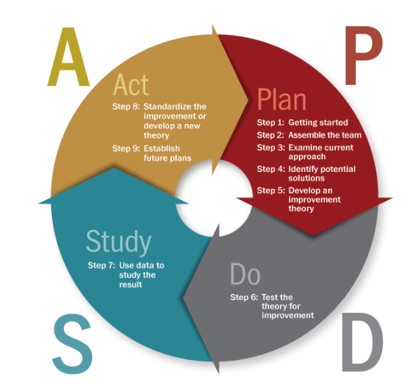
Deming PDCA Cycle
What change is needed?
What data are available?
Must a test be conducted?
Make change permanent.
Try another change
Perform test.
Analyze data.
Carry out change.
Evaluate results.
Did improvement occur?

Slide 8

Process Capability and Statistical Quality Control
Process Variation
Process Control Procedures
  Variable data
  Attribute data
Acceptance Sampling
  Process Capability
  Operating Characteristic Curve
Notes:
2

Slide 9
Basic Forms of Variation
Assignable variation is caused by factors that can be clearly identified and possibly managed.
Common variation is inherent in the production process.
Notes:
3

Slide 10
Introduction to SPC
Statistical process control is a collection of tools that when used together can result in process stability and variability reduction

Slide 11
Chance and Assignable Causes of Quality Variation
A process that is operating with only chance causes of variation present is said to be in statistical control.
A process that is operating in the presence of assignable causes is said to be out of control.
The eventual goal of SPC is reduction or elimination of variability in the process by identification of assignable causes.
Tampering can make the process variation 1.41 times worse than not doing anything!!!

Slide 12
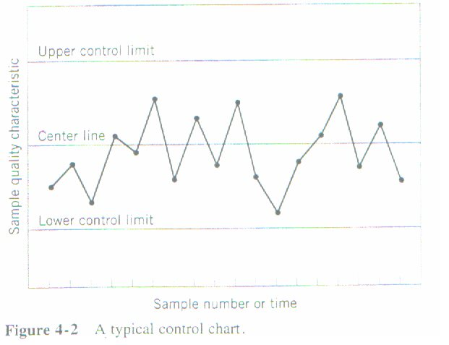
Statistical Basis of Control Chart
Basic Principles
A typical control chart has control limits set at values such that if the process is in control, nearly all points will lie between the upper control limit (UCL) and the lower control limit (LCL).

Slide 13
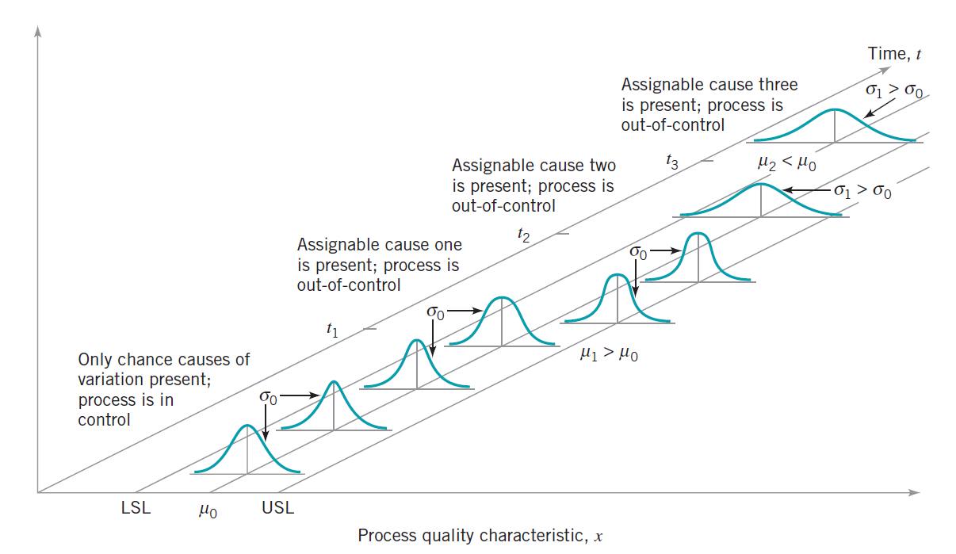
Statistical Basis of Control Chart

Slide 14
Statistical Basis of Control Chart
Out-of-Control Situations
If at least one point plots beyond the control limits, the process is out of control
If the points behave in a systematic or nonrandom manner, then the process could be out of control.

Slide 15
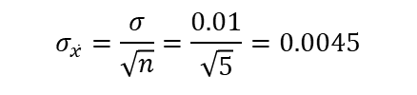

Statistical Basis of Control Chart
Relationship between hypothesis testing and control charts
We have a process that we assume the true process mean is μ = 74 and the process standard deviation is σ = 0.01. Samples of size 5 are taken giving a standard deviation of the sample average, , as
$$\bar{x}$$
$$σ_{\bar{x}}=\frac{σ}{\sqrt{n}}=\frac{0.01}{\sqrt{5}}=0.0045$$
Control limits can be set at 3 standard deviations from the mean.
This results in “3-Sigma Control Limits”
UCL = 74 + 3(0.0045) = 74.0135
CL= 74
LCL = 74 - 3(0.0045) = 73.9865

Slide 16
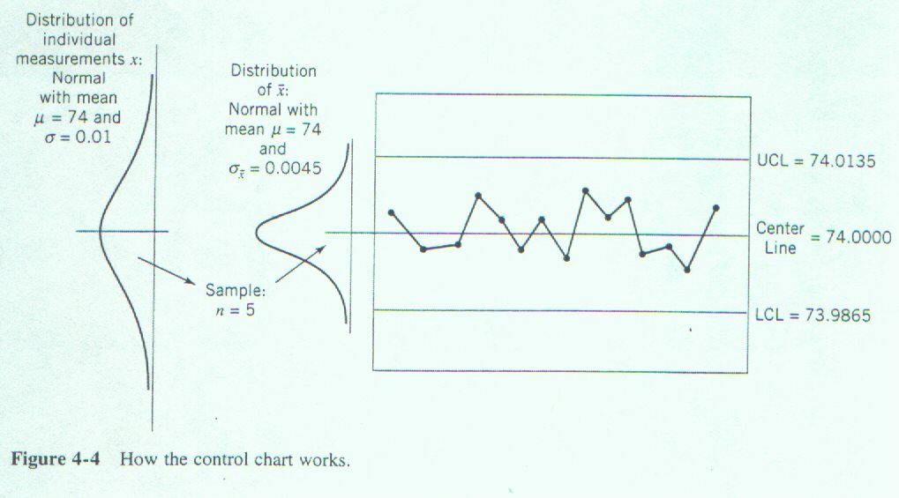
Statistical Basis of the Control Chart
H₀: μ = 74
H₁: μ ≠ 74

Slide 17
Statistical Basis of the Control Chart
Important uses of the control chart
Most processes do not operate in a state of statistical control.
Consequently, the routine and attentive use of control charts will identify assignable causes. If these causes can be eliminated from the process, variability will be reduced and the process will be improved.
The control chart only detects assignable causes. Management, operator, and engineering action will be necessary to eliminate the assignable causes.
Out-of-control action plans (OCAPs) are an important aspect of successful control chart usage.
Refer to the process improvement cycle.

Slide 18
Statistical Basis of the Control Chart
Types the control chart
Variables Control Charts
  These charts are applied to data that follow a continuous distribution (measurement data).
  X-bar chart, R chart, S chart, …
Attributes Control Charts
  These charts are applied to data that follow a discrete distribution.
  p chart, c chart, u chart, …

Slide 19
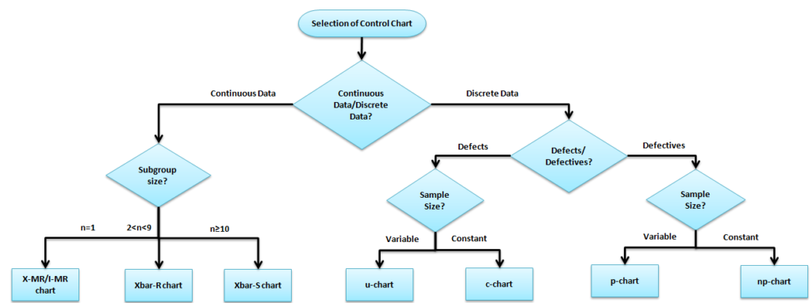
Statistical Basis of the Control Chart

Slide 20



Choice of Control Limits
General model of a control chart
where L = distance of the control limit from the center line
= mean of the sample statistic, w.
= standard deviation of the statistic, w.
$$UCL=μ_{W}+Lσ_{W} \\ Center\begin{matrix}\end{matrix}Line=μ_{W} \\ LCL=μ_{W}−Lσ_{W}$$
$$μ_{W}$$
$$σ_{W}$$

Slide 21
Choice of Control Limits
“99.7% of the Data”
If approximately 99.7% of the data lies within 3σ of the mean (i.e., 99.7% of the data should lie within the control limits), then 1 - 0.997 = 0.003 or 0.3% of the data can fall outside 3σ (or 0.3% of the data lies outside the control limits). (Actually, we should use the more exact value 0.0027).
0.0027 is the probability of a Type I error or a false alarm in this situation.

Slide 22
Choice of Control Limits
Three-Sigma Limits
The use of 3-sigma limits generally gives good results in practice.
If the distribution of the quality characteristic is reasonably well approximated by the normal distribution, then the use of 3-sigma limits is applicable.
These limits are often referred to as action limits.

Slide 23
Choice of Control Limits
Warning Limits on Control Charts
Warning limits (if used) are typically set at 2 standard deviations from the mean.
If one or more points fall between the warning limits and the control limits, or close to the warning limits the process may not be operating properly.
Good thing: warning limits often increase the sensitivity of the control chart.
Bad thing: warning limits could result in an increased risk of false alarms.

Slide 24
Sample Size and Sampling Frequency
In designing a control chart, both the sample size to be selected and the frequency of selection must be specified.
Larger samples make it easier to detect small shifts in the process.
Current practice tends to favor smaller, more frequent samples.

Slide 25
Rational Subgroups
Subgroups or samples should be selected so that if assignable causes are present, the chance for differences between subgroups will be maximized, while the chance for differences due to these assignable causes within a subgroup will be minimized.

Slide 26
Rational Subgroups
Selection of Rational Subgroups
Select consecutive units of production.
  Provides a “snapshot” of the process.
  Effective at detecting process shifts.
Select a random sample over the entire sampling interval.
  Can be effective at detecting if the mean has wandered out-of-control and then back in-control.

Slide 27
Analysis of Patterns on Control Charts
Nonrandom patterns can indicate out-of-control conditions
Patterns such as cycles, trends, are often of considerable diagnostic value
Look for “runs” - this is a sequence of observations of the same type (all above the center line, or all below the center line)
Runs of say 8 observations or more could indicate
an out-of-control situation.
  Run up: a series of observations are increasing
  Run down: a series of observations are decreasing

Slide 28
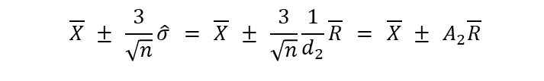


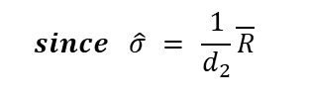


Control Charts for and R
$$\bar{x}$$
Control Limits for the chart (P. 251)
A₂ and A₃ is found in Appendix VI for various values of n (P-702).
$$\bar{x}$$
$$\text{UCL}=\bar{\bar{x}}+A_{2}\bar{R}$$
$$\text{Center}\begin{matrix}\end{matrix}\text{Line}=\bar{\bar{x}}$$
$$\text{LCL}=\bar{\bar{x}}−A_{2}\bar{R}$$
$$\overline{X} ± \frac{3}{\sqrt{n}}\hat{σ} = \overline{X} ± \frac{3}{\sqrt{n}}\frac{1}{d_{2}}\overline{R} = \overline{X} ± A_{2}\overline{R}$$
$$since \hat{σ} = \frac{1}{d_{2}}\overline{R}$$
$$\text{UCL}=\bar{\bar{x}}+A_{3}\bar{S}$$
$$\text{Center}\begin{matrix}\end{matrix}\text{Line}=\bar{\bar{x}}$$
$$\text{LCL}=\bar{\bar{x}}−A_{3}\bar{S}$$

Slide 29

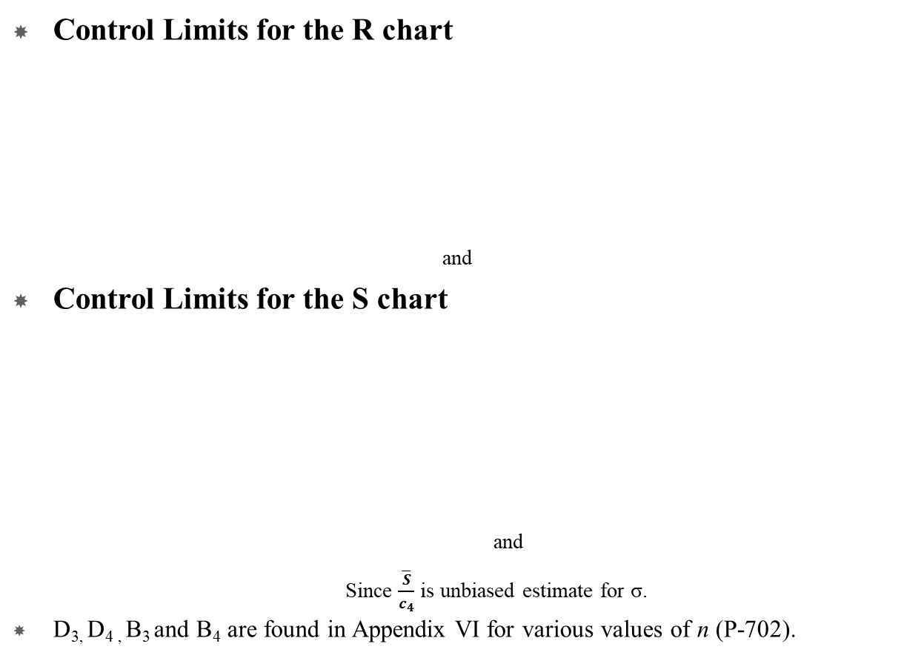





Control Charts for and R
$$\bar{x}$$
Control Limits for the R chart
and
Control Limits for the S chart
and
Since $\frac{\overline{S}}{c_{4}}$ is unbiased estimate for σ.
D_{3,} D_{4 ,} B₃ and B₄ are found in Appendix VI for various values of n (P-702).
$$\overline{R} − 3\frac{d_{3}}{d_{2}}\overline{R} = \left(1 − 3\frac{d_{3}}{d_{2}}\right)\overline{R} = \underline{D_{3}\overline{R}}$$
$$\overline{R} + 3\frac{d_{3}}{d_{2}}\overline{R} = \left(1 + 3\frac{d_{3}}{d_{2}}\right)\overline{R} = \underline{D_{4}\overline{R}}$$
$$\text{UCL}=B_{4}\bar{S}$$
$$\text{Center}\begin{matrix}\end{matrix}\text{Line}=\bar{S}$$
$$\text{LCL}=B_{3}\bar{S}$$
$$\overline{S} − 3\frac{\overline{S}}{c_{4}} Sqrt \left(1−c_{4}\right)= \left(1 − \frac{3}{c_{4}}Sqrt \left(1−c_{4}\right)\right)\overline{S} = \underline{B_{3}\overline{S}}$$
$$\overline{S} + 3\frac{\overline{S}}{c_{4}} Sqrt \left(1−c_{4}\right)= \left(1 + \frac{3}{c_{4}}Sqrt \left(1−c_{4}\right)\right)\overline{S} = \underline{B_{4}\overline{S}}$$

Slide 30
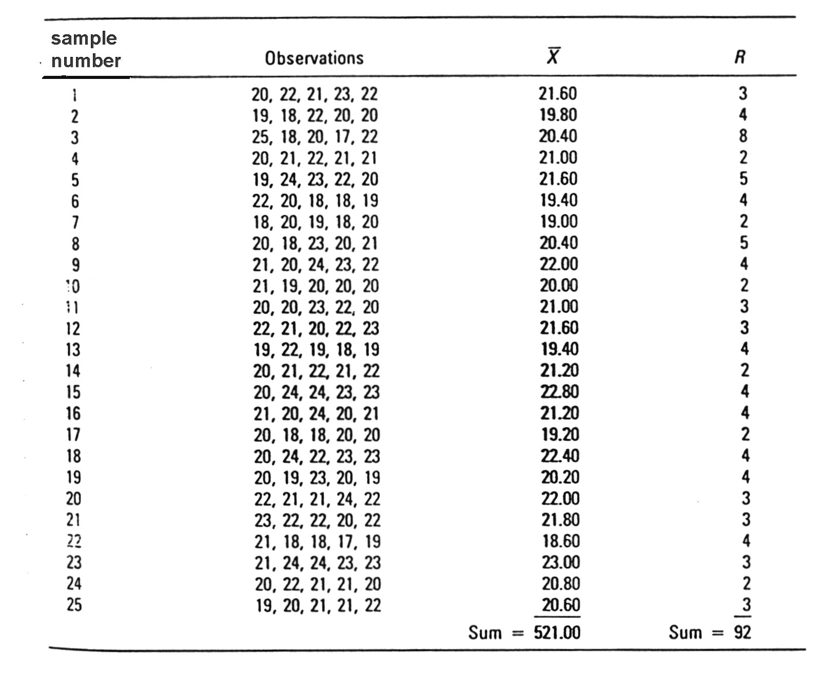
X-bar & R Charts: Example

Slide 31
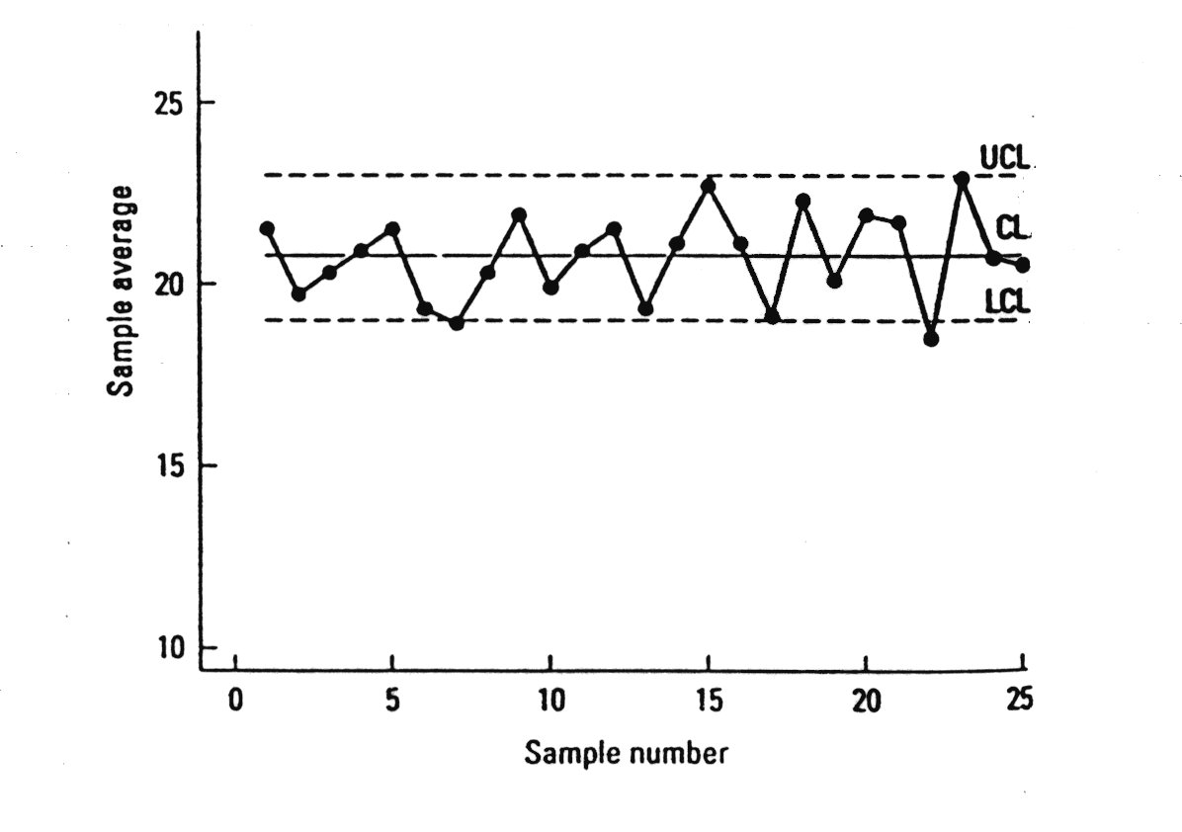
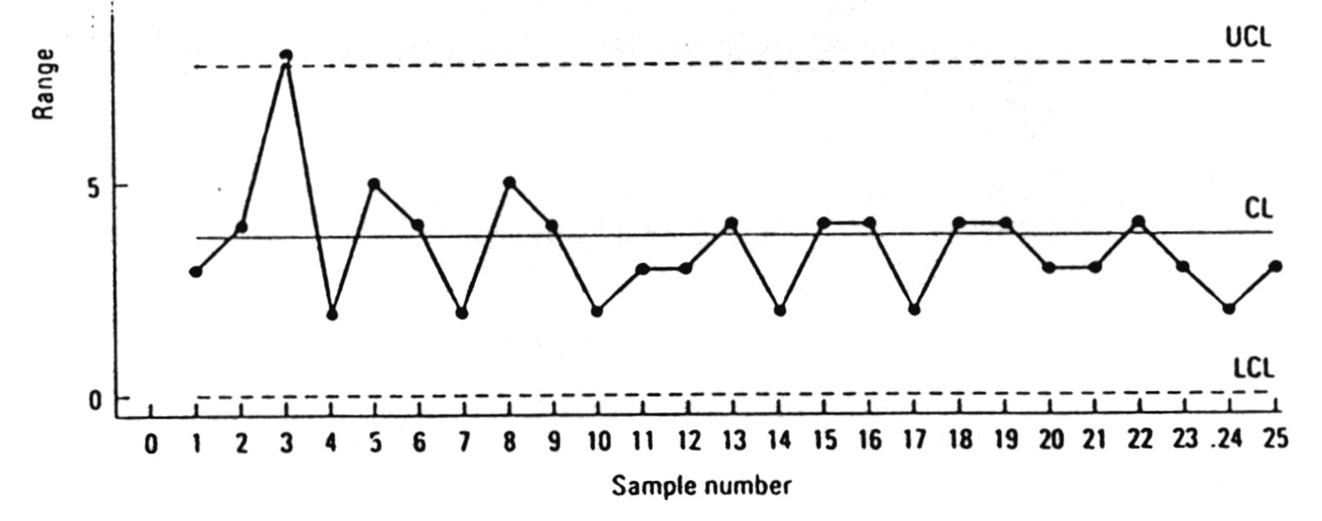
X-bar & R Charts: Example

Slide 32
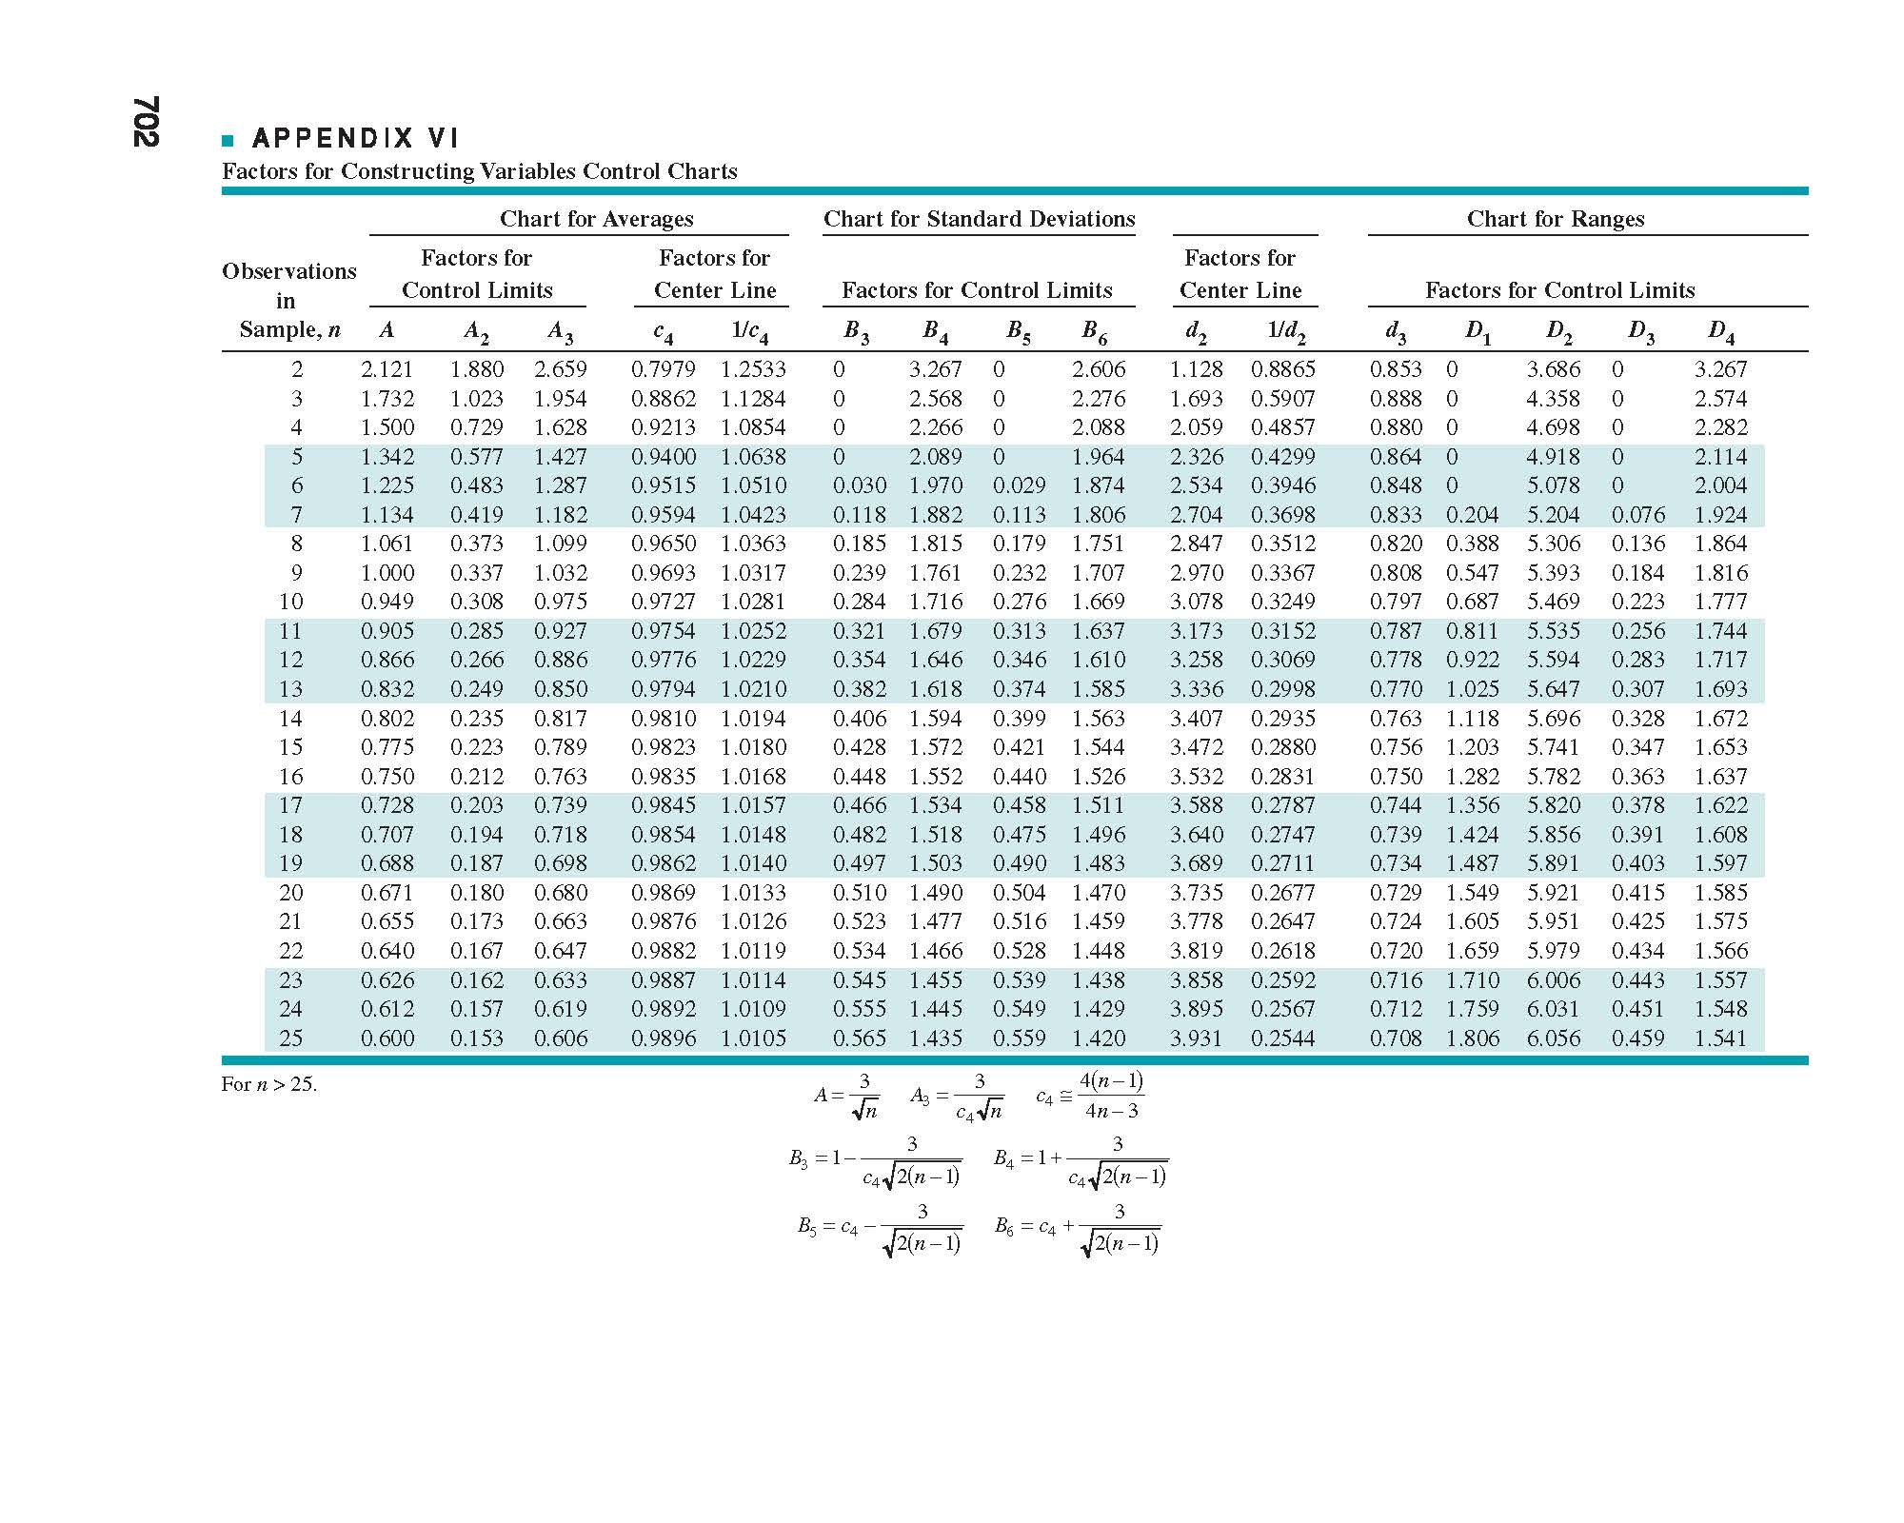

Slide 33
The Control Chart for Attributes
The cost of collecting data for attributes is less than that for the variables
There are various types of control charts for attributes:
  The p chart for the fraction rejected
  The np chart for the total number rejected
  The c chart for the number of defects
  The u chart for the number of defects per unit

Slide 34
p Chart
Type of attributes control chart
  Nominally scaled categorical data
    e.g., good-bad
Shows % of nonconforming items
Example: Count # defective chairs & divide by total chairs inspected; Plot
  Chair is either defective or not defective
Notes:
24

Slide 35
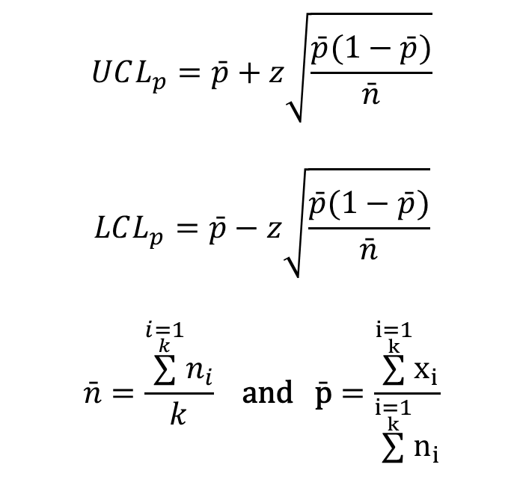
p Chart Control Limits
$$UCL_{p}=\bar{p}+z\sqrt{\frac{\bar{p}(1−\bar{p})}{\bar{n}}}$$
$$LCL_{p}=\bar{p}−z\sqrt{\frac{\bar{p}(1−\bar{p})}{\bar{n}}}$$
$$\bar{n}=\frac{\overset{\underset{k}{i=1}}{∑}n_{i}}{k} \text{and} \bar{\text{p}}=\frac{\overset{\underset{k}{i=1}}{∑}x_{i}}{\overset{\underset{k}{i=1}}{∑}n_{i}}$$
z = 2 for 95.5% limits; z = 3 for 99.7% limits
# Defective Items in Sample i
Size of sample i
Notes:
25

Slide 36
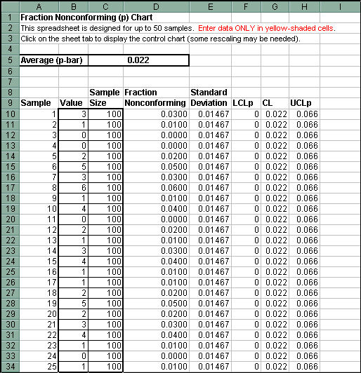

Slide 37
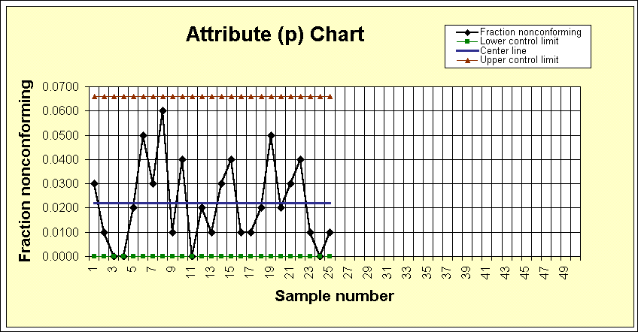

Slide 38
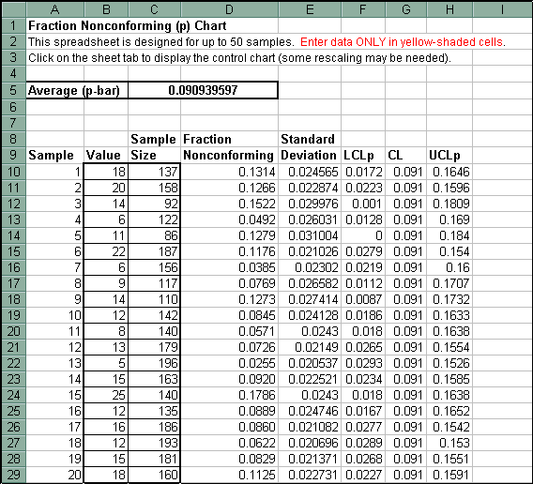

Slide 39
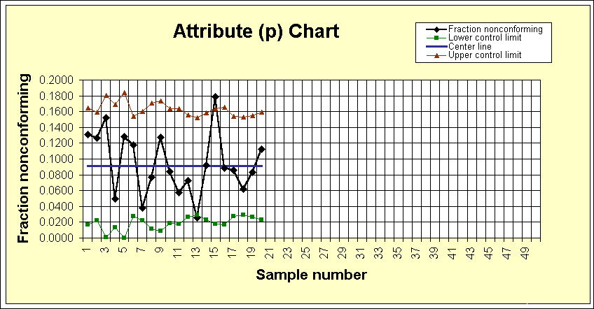

Slide 40
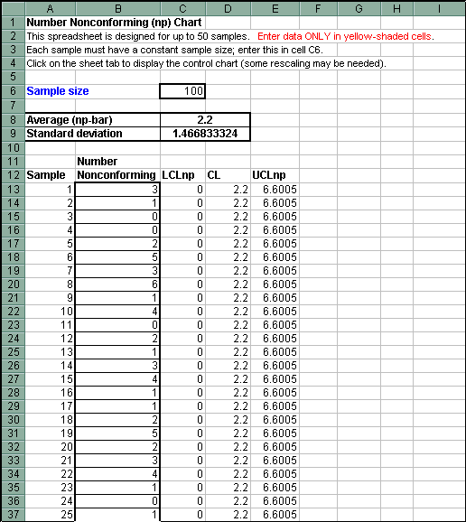

Slide 41
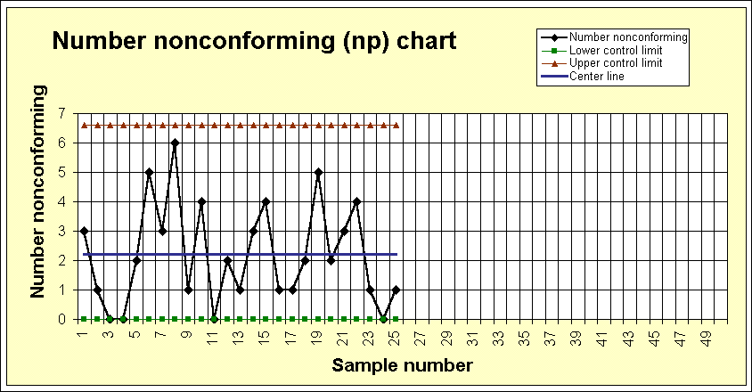

Slide 42
c Chart
Type of attributes control chart
  Discrete quantitative data
Shows number of nonconformities (defects) in a unit
  Unit may be chair, steel sheet, car etc.
  Size of unit must be constant
Example: Count # defects (scratches, chips etc.) in each chair of a sample of 100 chairs; Plot
Notes:
26

Slide 43

c Chart Control Limits
$$UCL_{\bar{c}}=\bar{c}+3\sqrt{\bar{c}}$$
$$LCL_{\bar{c}}=\bar{c}−3\sqrt{\bar{c}}$$
$$\bar{c} = \frac{\overset{\underset{k}{i=1}}{∑}c_{i}}{k}$$
Use 3 for 99.7% limits
# Defects in Unit i
# Units Sampled
Notes:
27

Slide 44
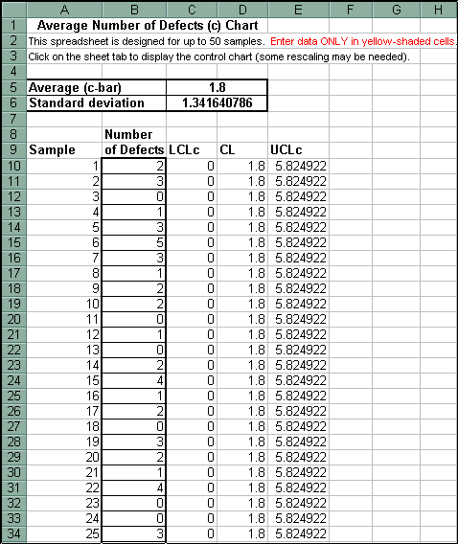

Slide 45
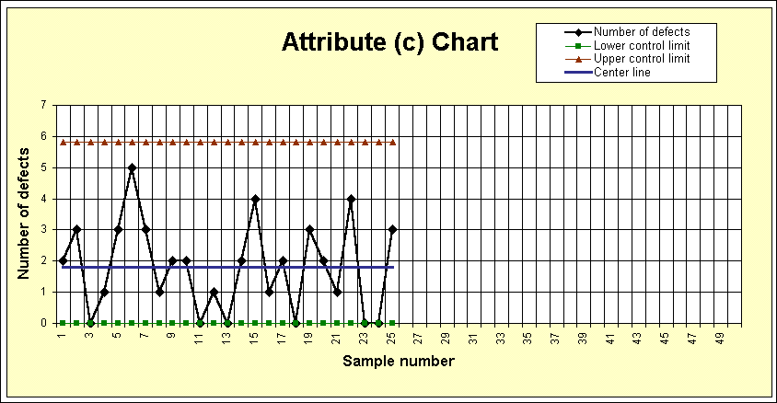

Slide 46
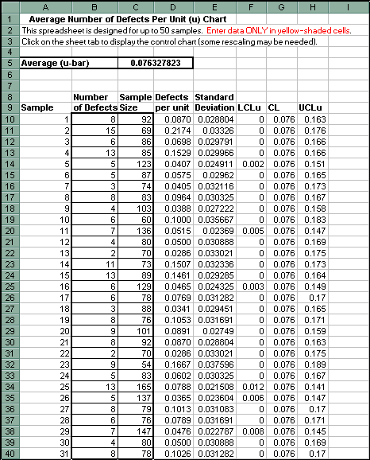
U Chart P. 314

Slide 47
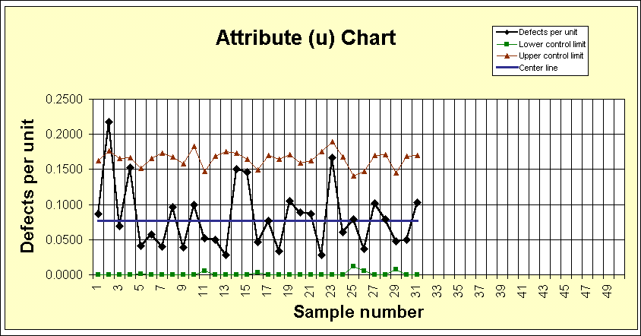
https://www.youtube.com/watch?v=p-gvwkHePaU

Slide 48
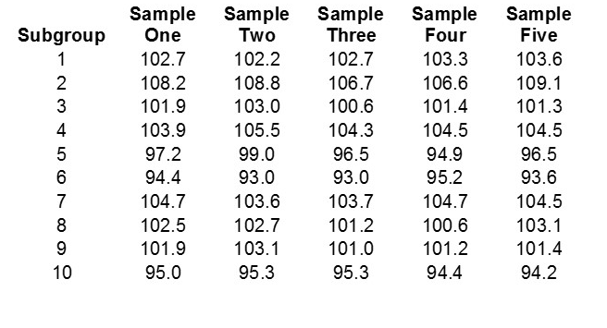
HW, X R bar Charts

Slide 49
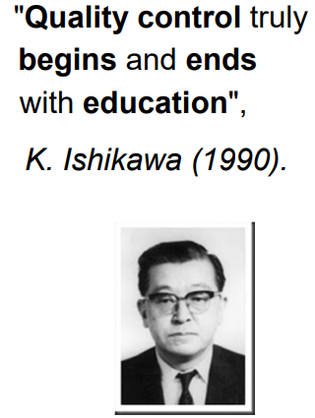
The Basic Seven (B7)
The magnificent seven
Tools of Quality
Histogram or stem-and-leaf plot
Check sheet
Pareto chart
Cause-and-effect diagram
Defect concentration diagram
Scatter diagram
Control chart
"As much as 95% of quality related problems in the factory can be solved with seven fundamental quantitative tools.“
- Kaoru Ishikawa
https://asq.org/quality-resources/seven-basic-quality-tools

Slide 50
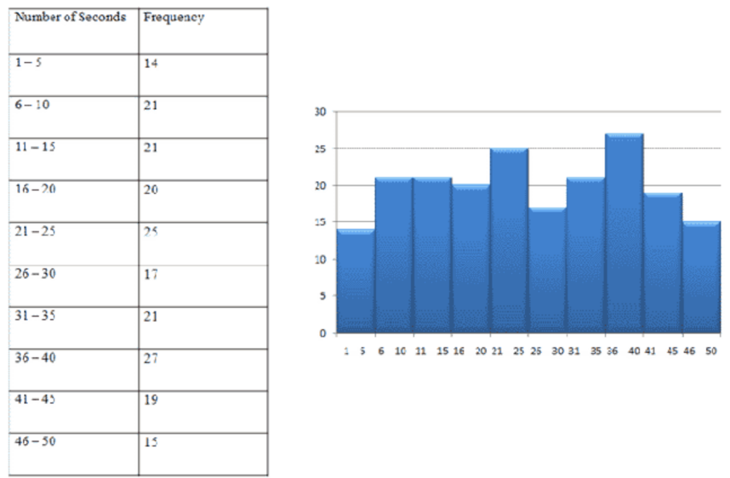
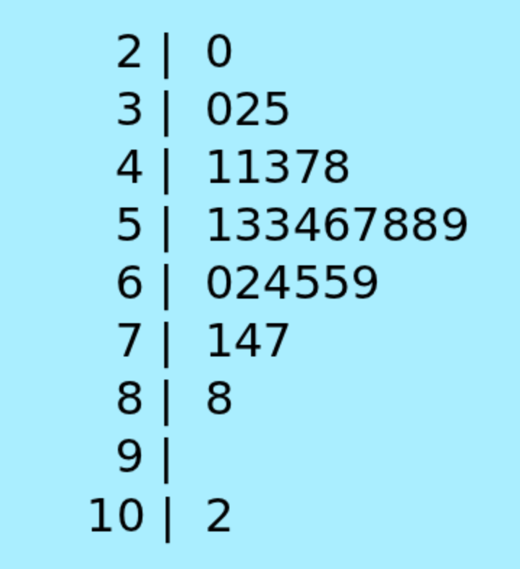
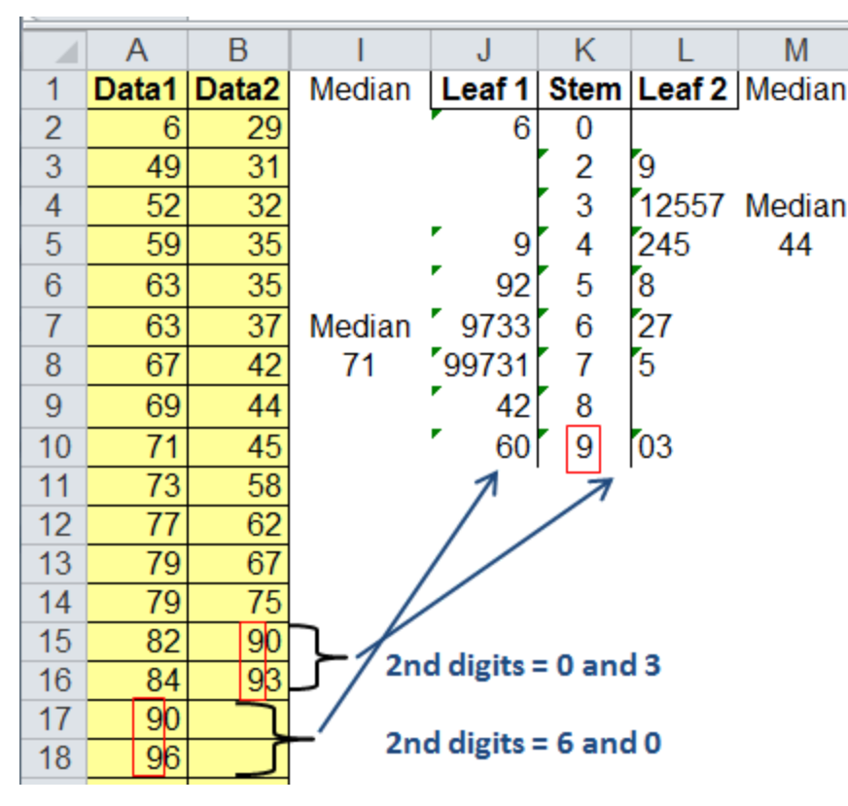
Histogram or stem-and-leaf plot

Slide 51
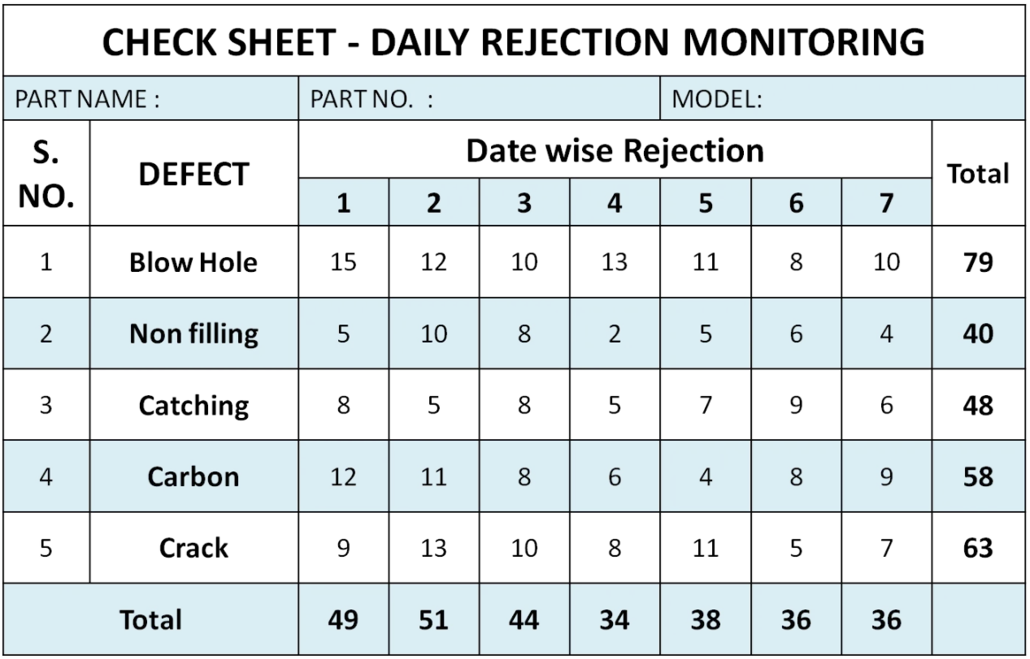
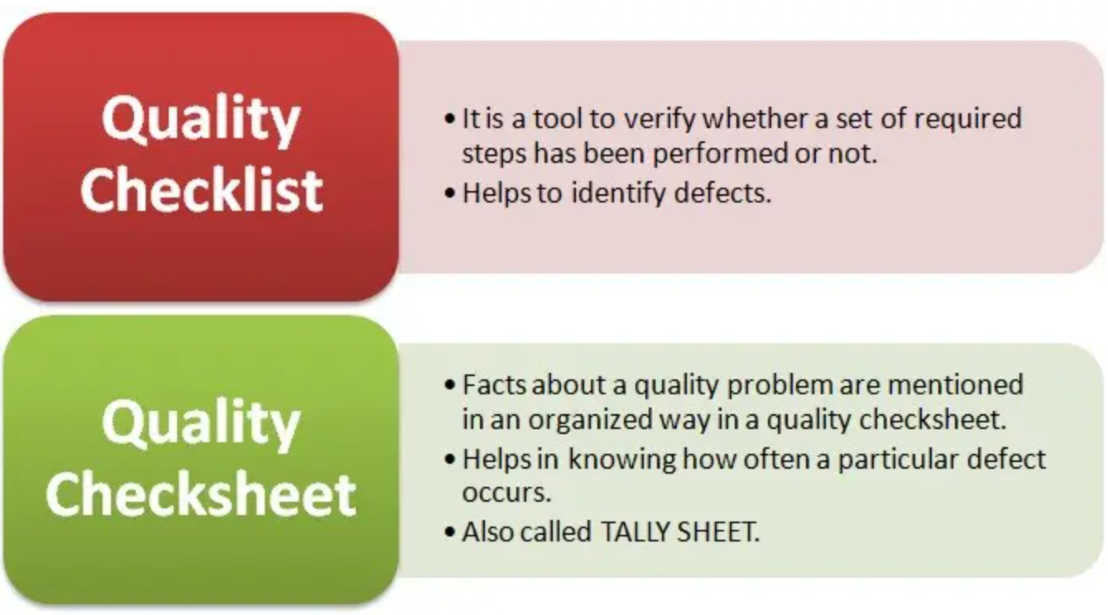
2. Check sheet

Slide 52
3. Pareto chart
Pareto Analysis
Very similar to Histograms
Use of the 80/20 rule
Use of percentages to show importance
A Pareto Chart is a graph that indicates the frequency of defects, as well as their cumulative impact. Pareto Charts are useful to find the defects to prioritize in order to observe the greatest overall improvement.

Slide 53
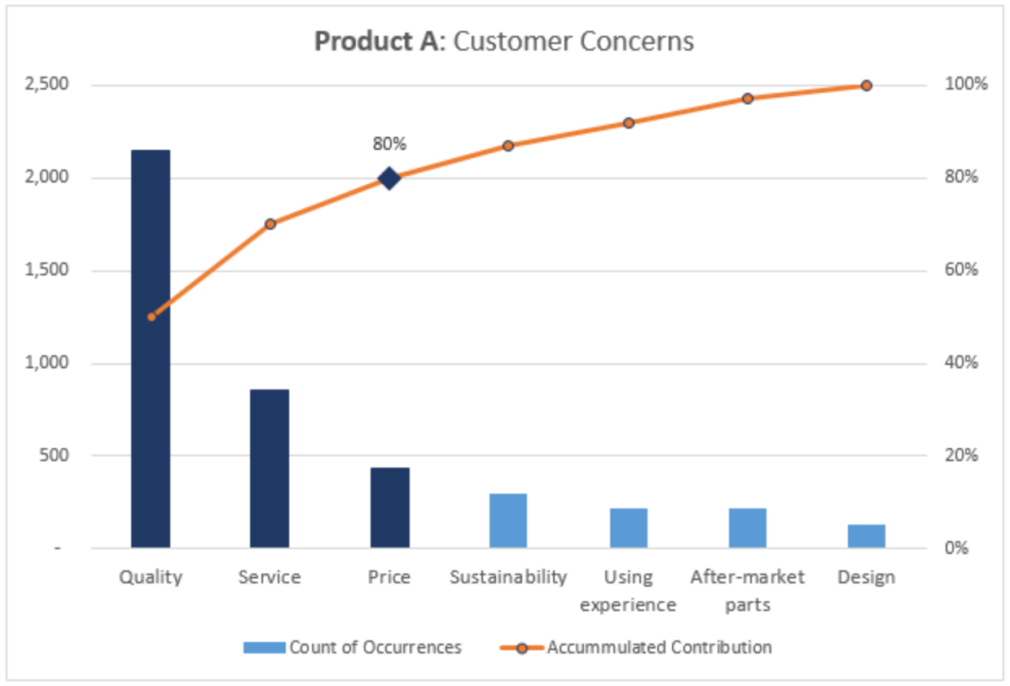
The Pareto diagram serves as a visual representation of the vital few against the trivial many.

Slide 54
4. Fishbone Diagrams
Cause-and-Effect Diagram
How to Construct,
Define the problem or effect to be analysed.
Form the team to perform the analysis. Often the team will uncover potential
causes through brainstorming.
Draw the effect box and the centre line.
Specify the major potential cause categories and join them as boxes connected to the center line.
Identify the possible causes and classify them into the categories in step 4. Create new categories, if necessary.
Rank order the causes to identify those that seem most likely to impact the problem.
Take corrective action.
Notes:
-

Slide 55
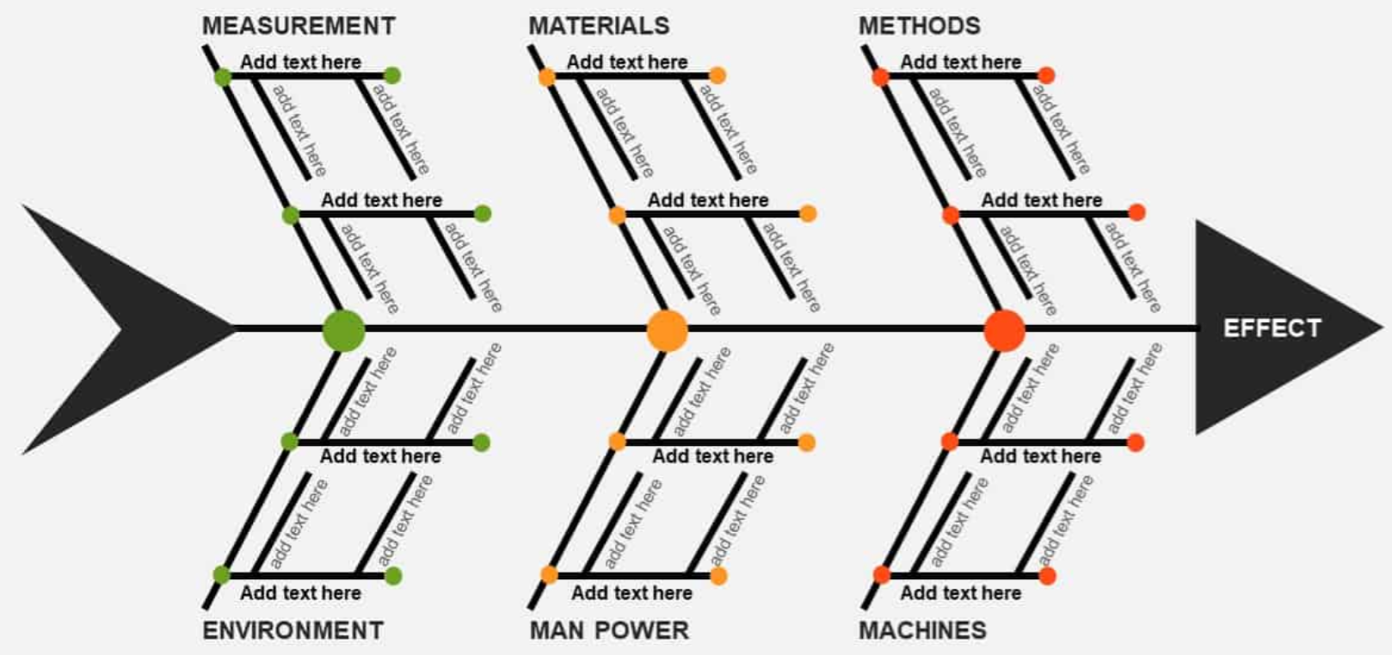

Slide 56
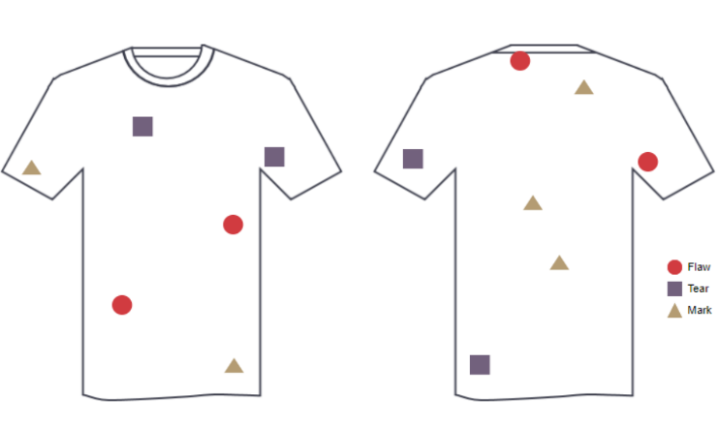
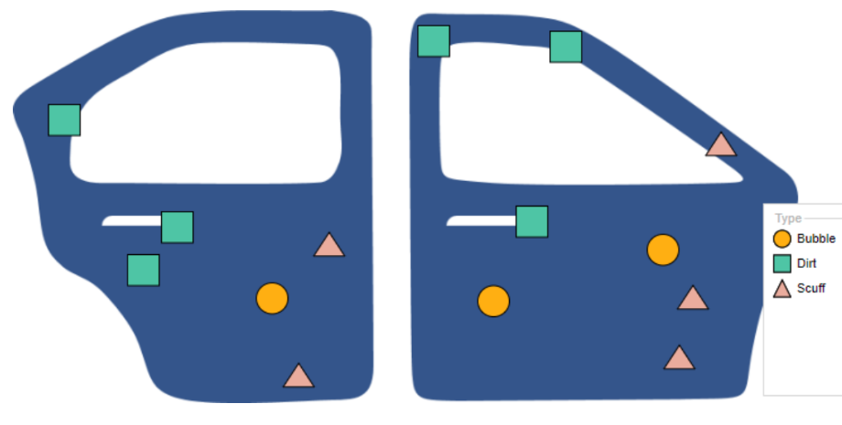
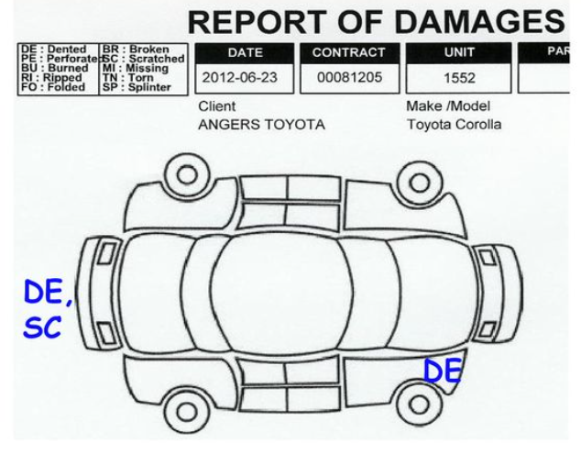
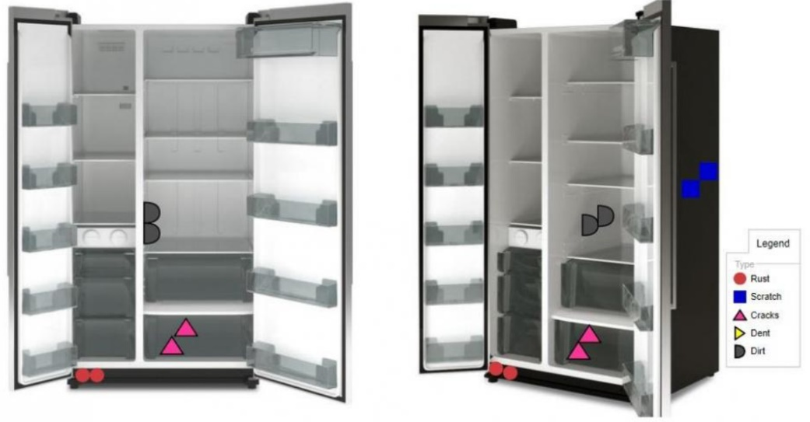
5. Defect concentration diagram

Slide 57
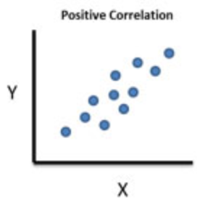
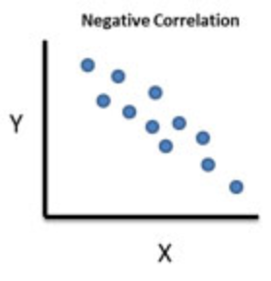
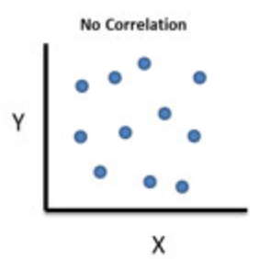
6. Scatter diagram
The scatter diagram graphs pairs of numerical data, with one variable on each axis, to look for a relationship between them. If the variables are correlated, the points will fall along a line or curve.

Slide 58
Basic Forms of Statistical Sampling for Quality Control
Sampling to accept or reject the immediate lot of product at hand (Acceptance Sampling).
Sampling to determine if the process is within acceptable limits (Statistical Process Control)
Notes:
3

Slide 59
Acceptance Sampling
Purposes
  Determine quality level
  Ensure quality is within predetermined level
Advantages
  Economy
  Less handling damage
  Fewer inspectors
  Upgrading of the inspection job
  Applicability to destructive testing
  Entire lot rejection (motivation for improvement)
Notes:
4

Slide 60
Acceptance Sampling
Disadvantages
  Risks of accepting “bad” lots and rejecting “good” lots
  Added planning and documentation
  Sample provides less information than 100-percent inspection
Notes:
5

Slide 61
Acceptance Sampling by Variables
Caution in the Use of Variables Sampling
The distribution of the quality characteristic must be known in order to use variables sampling
The usual assumption is that the parameter of interest follows the normal distribution. This is a critical assumption.
If the normality assumption is not satisfied, then estimates of the fraction defective based on the sample mean and standard deviation will not be the same as if the parameter were normally distributed.

Slide 62
Acceptance Sampling by Variables
Caution in the Use of Variables Sampling
It is possible to use variables sampling plans when the parameter of interest does not have a normal distribution.
If the form of the distribution is known, it is possible to devise a procedure for applying a variables sampling plan.

Slide 63
Design of Lot-by Lot Sampling Plans
N
n
Number
Conforming
Accept or
Reject Lot
Specify the plan (n,c) given N: for a lot size N, determine the sample size n, and the acceptance number c. (Reject lot if number of defects > c.) Specify course of action if lot is rejected.

Slide 64
Types of Sampling Plans
There are variables sampling plans and attribute sampling plans (this chapter concentrates on attributes)
  Single sampling plan
  Double-sampling plan
  Multiple-sampling plan
  Sequential-sampling

Slide 65
Acceptance Sampling: Single Sampling Plan
A simple goal
Determine (1) how many units, n, to sample from a lot, and (2) the maximum number of defective items, c, that can be found in the sample before the lot is rejected.
Notes:
7

Slide 66
A Single Sample Plan
N = lot size
n = sample size
c = acceptance number
d = observed number of defectives
Lot of N items
Sample inspected (d= number of defectives)
Random sample of size n pulled
Replace the defectives and accept the lot
Reject the lot and take corrective action
no
yes
d > c

Slide 67
Types of Error
Type I error - rejecting the null hypothesis when it is true.
Pr(Type I error) = α. Sometimes called the producer’s risk.
Type II error - not rejecting the null hypothesis when it is false.
Pr(Type II error) = β. Sometimes called the consumer’s risk.

Slide 68
Risk
Acceptable Quality Level (AQL)
the maximum percentage of nonconforming items in a batch that can be considered acceptable.
α (Producer’s risk)
  The probability of rejecting a good lot.
Lot Tolerance Percent Defective (LTPD)
percentage of nonconforming items in a lot for which the consumer wishes the probability of acceptance is a specified low value. Also know as “unacceptable quality level.”
β (Consumer’s risk)
  The probability of accepting a bad lot.
Notes:
8

Slide 69
Example: Lots of size N = 1000 fuses are inspected using an (50,3) sampling acceptance plan. Usually, the defect rate is 3% but occasionally there is a bad batch that has a 6% defect rate.
What is the producer’s risk of this sampling plan?
What is the consumer’s risk of this sampling plan?
What if the plan was changed to (50,2)? What would the relative change be between the consumer’s and producer’s risk?

Slide 70
The OC Curve
The operating-characteristic (OC) curve measures the performance of an acceptance-sampling plan.
The OC curve plots the probability of accepting the lot versus the lot fraction defective.
The OC curve shows the probability that a lot submitted with a certain fraction defective will be either accepted or rejected.

Slide 71
Operating Characteristic Curve
1
0.9
α = .05 (producer’s risk)
0.8
0.7
n = 99
c = 4
0.6
Probability of acceptance
0.5
0.4
0.3
β =.10
(consumer’s risk)
0.2
0.1
0
1
2
3
4
5
6
7
8
9
10
11
12
AQL
LTPD
Percent defective
Notes:
9

Slide 72
Example: Acceptance Sampling Problem
Zypercom, a manufacturer of video interfaces, purchases printed wiring boards from an outside vender, Procard. Procard has set an acceptable quality level of 1% and accepts a 5% risk of rejecting lots at or below this level. Zypercom considers lots with 3% defectives to be unacceptable and will assume a 10% risk of accepting a defective lot.
Develop a sampling plan for Zypercom and determine a rule to be followed by the receiving inspection personnel.
Notes:
10

Slide 73

Example: Step 1. What is given and what is not?
In this problem, AQL is given to be 0.01 and LTDP is given to be 0.03. We are also given an alpha of 0.05 and a beta of 0.10.
What you need to determine your sampling plan is “c” and “n.”
Notes:
11

Slide 74
Example: Step 2. Determine “c”
First divide LTPD by AQL.
Then find the value for “c” by selecting the value in the TN7.10 “n(AQL)”column that is equal to or just greater than the ratio above.
Exhibit TN 7.10
So, c = 6.
c
LTPD/AQL
n AQL
c
LTPD/AQL
n AQL
0
44.890
0.052
5
3.549
2.613
1
10.946
0.355
6
3.206
3.286
2
6.509
0.818
7
2.957
3.981
3
4.890
1.366
8
2.768
4.695
4
4.057
1.970
9
2.618
5.426
Notes:
11

Slide 75
Example: Step 3. Determine Sample Size
Now given the information below, compute the sample size in units to generate your sampling plan.
c = 6, from Table
n (AQL) = 3.286, from Table
AQL = .01, given in problem
n(AQL/AQL) = 3.286/.01 = 328.6, or 329
(always round up)
Sampling Plan:
Take a random sample of 329 units from a lot.
Reject the lot if more than 6 units are defective.
Notes:
13

Slide 76
Average Outgoing Quality
Outline
Average Outgoing Quality (AOQ)
Average Outgoing Quality Limit (AOQL)

Slide 77
Average Outgoing Quality
After a sample is inspected, the items which are found defective, may be
  Case 1: returned to the producer or
  Case 2: repaired or replaced by the producer.
We assume Case (2).
If a lot is rejected, it may be subjected to a 100% inspection. Such action is referred to as screening inspection, or detailing. This is sometimes described as an acceptance/rectification scheme.

Slide 78
Average Outgoing Quality
If a lot is rejected, there may again be two assumptions regarding the defective items. The defective items may be
  Case 1: returned to the producer or
  Case 2: repaired or replaced by the producer.
We assume Case 2.
So, if a lot is rejected, it will contain no defective item at all, after screening inspection. The consumer will get N good items. However, if a lot is accepted, it may contain some defective items because many of the (N-n items in a single sampling plan) items not inspected may be defective.

Slide 79
Average Outgoing Quality
Thus, if there is an average of 2% defective items, the accepted lots will contain little less than 2% defective items and rejected lots will contain no defective item at all. On average, the consumer will receive less than 2% defective items.
Given a proportion of defective, p the Average Outgoing Quality (AOQ) is the proportion of defectives items in the outgoing lots. More precise definition is given in the next slide.

Slide 80

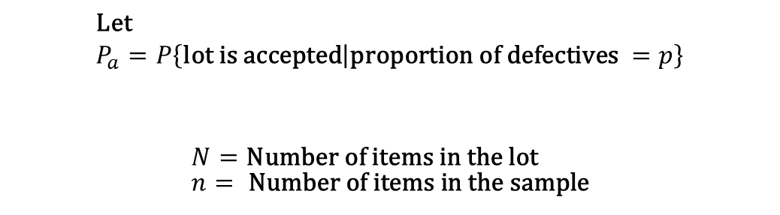
Average Outgoing Quality
$$\text{Let} \\ P_{a}=P\left\{\text{lot} \text{is} \text{accepted} | \text{proportion} \text{of} \text{defectives} =p\right\}$$
$$N=\text{Number} \text{of} \text{items} \text{in} \text{the} \text{lot} \\ n= \text{Number} \text{of} \text{items} \text{in} \text{the} \text{sample}$$

Slide 81
Average Outgoing Quality
Case 1 is not discussed in class

Slide 82
Average Outgoing Quality

Slide 83
Average Outgoing Quality
Given a proportion of defective, we can compute the Average Outgoing Quality (AOQ)
As p increases from 0.0, the AOQ values increases up to a limit called Average Outgoing Quality Limit (AOQL), after which the AOQ values descend continuously to 0.0. This is shown in the next slide.

Slide 84
AOQ Curve
0.015
AOQL
Average
Outgoing
Quality
0.010
0.005
0.01
0.02
0.03
0.04
0.05
0.06
0.07
0.08
0.09
0.10
AQL
LTPD
(Incoming) Percent Defective

Slide 85
Example: Suppose that Noise King is using rectified inspection for its single sampling plan. Calculate the average outgoing quality limit for a plan with n=110, c=3, and N=1000. (Assume that the defective items are replaced)

Slide 86
Double Sampling Plans
Take small initial sample
If # defectives < lower limit, accept;
If # defectives > upper limit, reject;
If # defectives between limits, take second sample.
Accept or reject lot based on 2 samples
Less inspection than in single-sampling

Slide 87
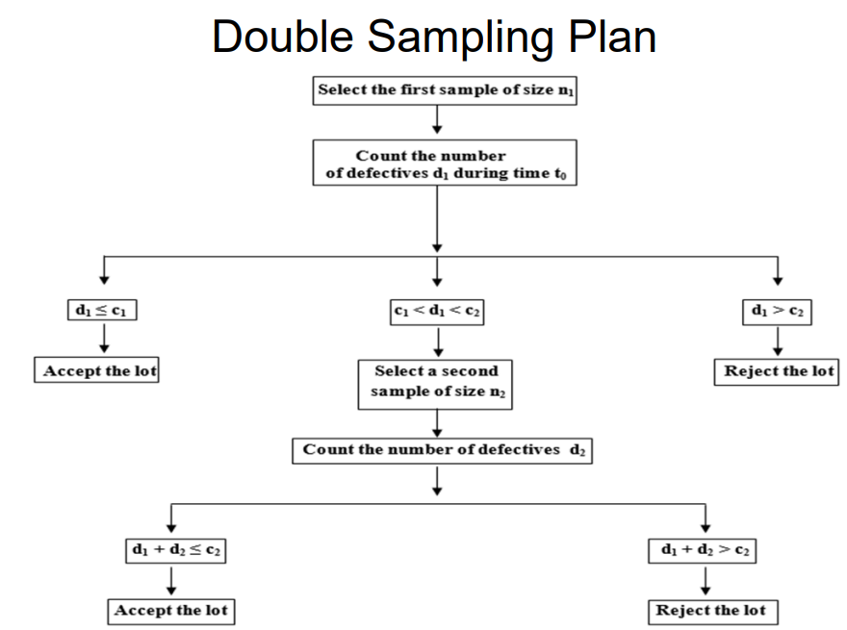

Slide 88
Process Capability
Whether a process is capable of meeting specification refers to the variability of the product in relation to the specification limits.
Specification
Limits set at:
High
Capability
Frequency
Mean
Medium
Capability
Frequency
Low
Capability
Frequency

Slide 89
The Quality Improvement Model
Define Process
Is Process Capable?
Select Measures
Purpose: Determine the adequacy of the process with respect to customer /management needs.
Collect & Interpret Data
Is
Process
Stable
?
No
Investigate & Fix Special Causes
Yes
Is
Process
Capable
?
Improve Process Capability
No
Yes
Use SPC to Maintain Current Process
Notes:
This module covers this step

Slide 90
Capable Process
A stable process that meets customer requirements.
Histogram
Control Chart
UCL
CL
LCL
2
4
6
8
10
12
14
16
18
20
22
24
26
28
30
32
Run Order
Lower Spec
Upper Spec
Target
Capability assessments for unstable processes, may not be indicative of how the process is actually performing.
Notes:
Capable process produce everything within customer specifications
Stability is a crucial prerequisite for capability

Slide 91
Assessing Process Capability
Counting Measures
  The average percent defectives.
  The average number of defects.
Instrument Measures
  Comparing both the center of the process and the process variation
Notes:
Counting Measures - Process average IS your capability
Instrument Measures - Look at the center and the variability of the process

Slide 92
Capability Assessment for Counting Measures
“Order Entry Process”
Week
1
2
3
4
5
6
7
8
9
10
11
12
13
14
15
16
17
18
19
20
Total
# Errors
15
22
18
10
13
9
27
12
24
22
8
8
26
16
20
10
16
9
15
20
320
Control Chart
35
30
UCL=28.0
Number
of Errors
25
20
15
Avg=16.0
10
5
LCL=4.0
0
5
10
15
20
Week
Is this process adequate as is?
Should it be improved?
Notes:
Process is stable - confirmed by control chart
“Is this process adequate as is?”
“What are management’s expectations for this process?”
Not all processes need to be improved right now. Others may need to be worked on first, then return to this one.
Customer focus is important, even if the customer doesn’t provide input easily. They may just say, “no errors is what I want.”

Slide 93
Measures of Process Capability
Specification Range
USL - LSL
C
p
=
=
True Process Range
6σ_{c}
C
p
< 1.0
→
Process is not capable of meeting specs
C
p
= 1.0
→
Process is marginally capable
C
p
> 1.0
→
Process is capable of meeting specs
Problem: We are assuming the process has a target that is in the center of the specification range, and that the process is in fact centered on that target.
Distance from process average
C
to closest specification limit
=
min (USL -
x
,
x
- LSL)
pk
=
1
3σ_{c}
2
True Process Range
Note: a negative result is possible if the process average is outside specifications
C
pk
< 1.0
→
Process is not capable of meeting specs
C
pk
= 1.0
→
Process is marginally capable
C
pk
> 1.0
→
Process is capable of meeting specs
Benefits:
• Optimal values are attained by running exactly
between specs.
• Can (must) be used for 1-sided specifications
Warning: Capability assessments for unstable processes, may not be indicative of how the process is actually performing.

Slide 94
Process Capability
LSL
USL
How much material is out of spec?
  In the short term?
  In the long term?

Slide 95
Process Capability Ratios
LSL
USL
Voice of The Process
Voice of The Customer
https://www.youtube.com/watch?v=H6St9mCKWuA

Slide 96
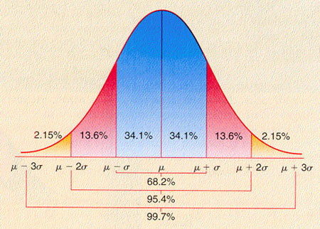

Slide 97
Process Capability - The Strategy
Centering –The Process Is On Target
Spread – Reduce The Variation
Defects
Defects
LSL
USL

Slide 98

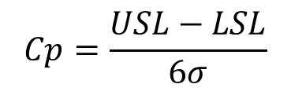

Process Capability Ratios
2 Key Metrics for Measuring Capability
$$Cp=\frac{USL−LSL}{6σ}$$
X
-
LSL
USL
-
X
C
=
Min(
,
)
pk
3
3
$$σc$$
$$σc$$

Slide 99

Process Capability Ratios - Concept
$$Cp=\frac{USL−LSL}{6σ}$$
C
=
Total Tolerance
p
Process Spread

Slide 100
C_{P} & C_{PK} Measure Short-term Capability
Is The Process
In Control ?
Is It Producing
Defects ?
A Short-term Capability study covers a relatively short period of time (days, weeks) generally consisting of 30 to 50 data points. The actual number depends on the subject under study.

Slide 101
Long Term Performance
Short term
Capability
Is The Process
In Control ?
Is It Producing
Defects ?
A long-term capability study covers a relatively long period of time (weeks, months) generally consisting of 100-200 data points. Again, the actual amount depends on the subject under study.

Slide 102
A Further Look at Capability
Compare the estimates of the process deviations from the short-term and long-term data
Descriptive Statistics
Variable N Mean StdDev
short term 30 30.6 2.23
long term 180 33.8 4.44
What is the difference between the short-term and the
long-term data?
What implication does this have in doing capability studies?

Slide 103
Measures of Process Performance
Specification Range
USL - LSL
P
p
=
=
True Process Range
6σ_{s}
P
p
< 1.0
→
Process Performance is not meeting specs
P
p
= 1.0
→
Process Performance is marginally meeting specs
P
p
> 1.0
→
Process Performance is meeting specs
Problem: We are assuming the process has a target that is in the center of the specification range, and that the process is in fact centered on that target.
Distance from process average
to closest specification limit
min (USL -
x
,
x
- LSL)
P
pk
=
1
=
3σ_{s}
2
True Process Range
Note: a negative result is possible if the process average is outside specifications
P_{pk}
< 1.0
→
Process Performance is not meeting specs
P_{pk}
= 1.0
→
Process Performance is marginally meeting specs
P_{pk}
> 1.0
→
Process Performance is meeting specs
Benefits:
• Optimal values are attained by running exactly
between specs.
• Can (must) be used for 1-sided specifications

Slide 104
Performance vs. Capability
Days Sales Outstanding for 55 Days
DSO
These data show that the process, if well controlled can perform much better than it currently is

Slide 105
Capability vs. Performance
Days Sales Outstanding for 55 Days
DSO
Capability: Only random or short term variability
(Cp & Cpk)
Process Performance: Total Variation including shifts and drifts
(Pp & Ppk)

Slide 106
Process Performance Ratios
P
=
USL - LSL
p
6σ_{s}
X
-
LSL
USL
-
X
P
=
Min(
,
)
pk
3σ_{s}
3σ_{s}
The P-family of indices are computationally the same as the C-family of ‘capability’ indices, but use the observed long-term standard deviation.

Slide 107
WARNING!!!
Statistical Assumptions Made In Capability Studies
Data Comes From a Stable Process
If not, work towards getting the process in control

