Slide 1
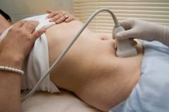
Female Pelvic Scan –RAD464 AMAL ALSOLAI

Slide 2
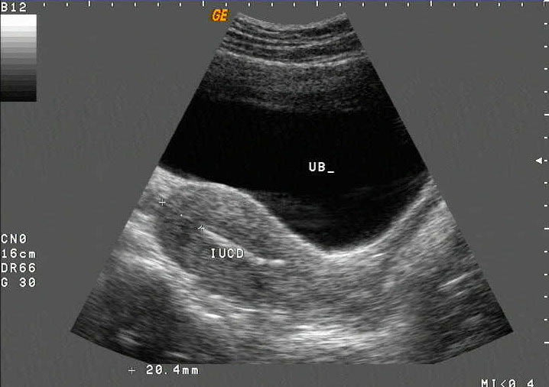
UTERUS LONGITUDINAL SCAN

Slide 3
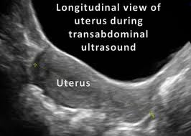
Uterus

Slide 4
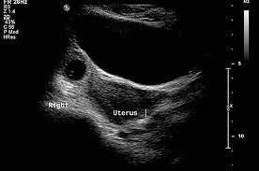
UTERUS TRANSVERS SCAN

Slide 5
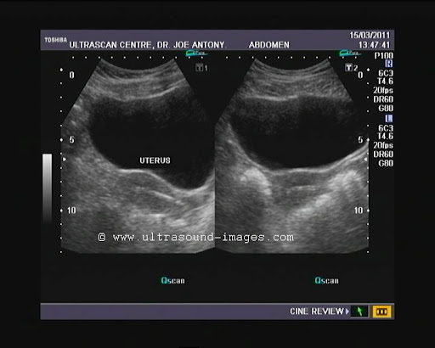
UTERUS LONG UTERUS TRANSVERUS

Slide 6
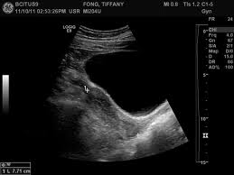

Slide 8
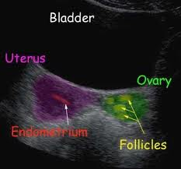

Slide 9
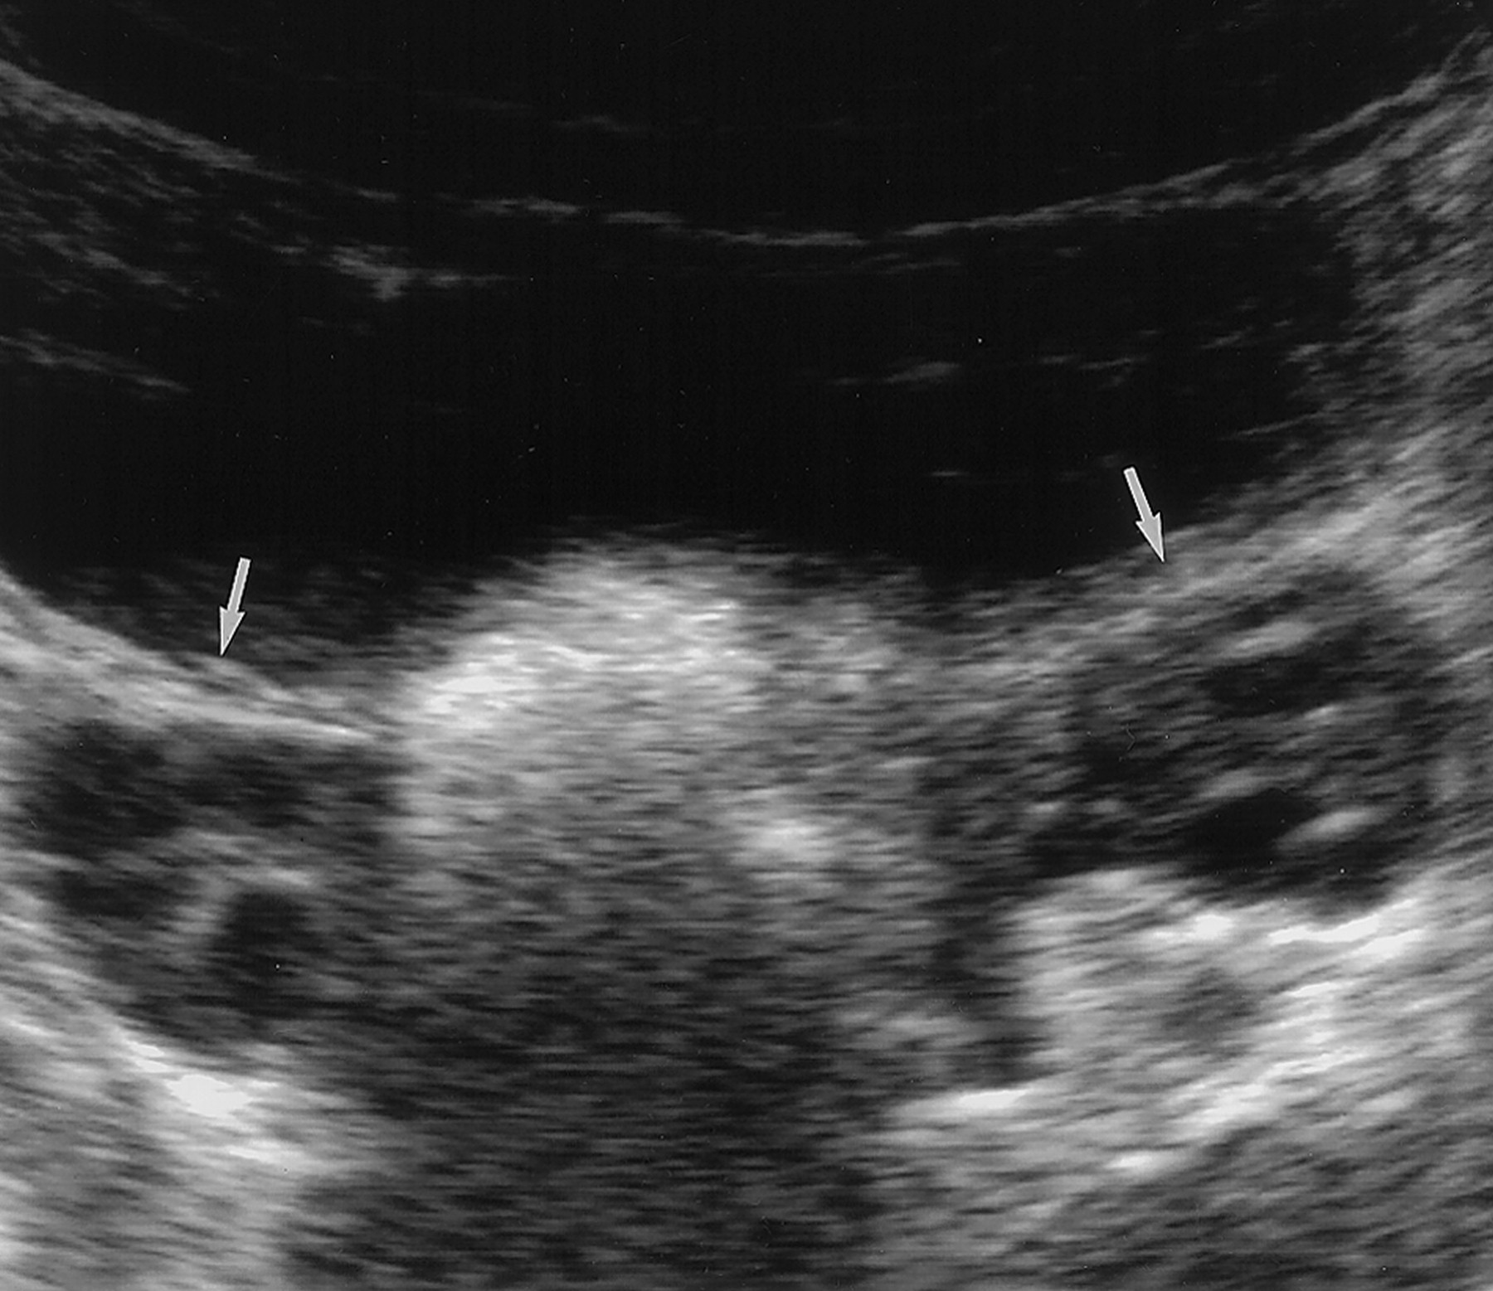
OVARIES /TRANSVERS SCAN

Slide 10
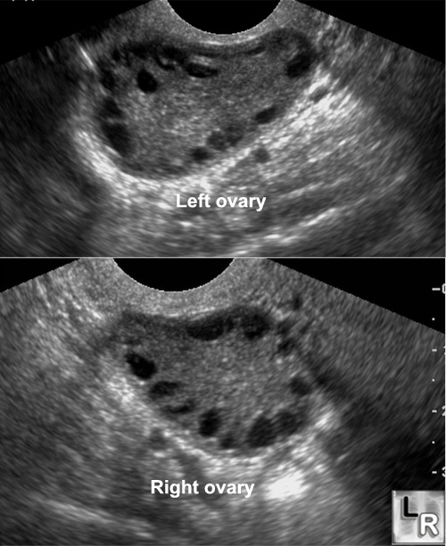

Slide 11
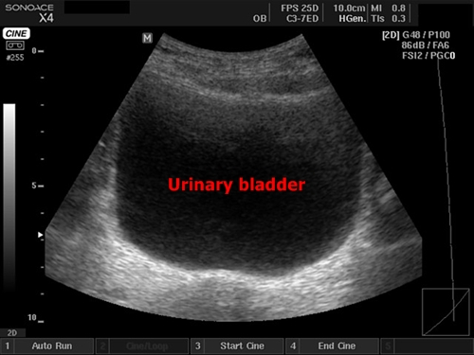
URINARY BLADDER SCAN

Slide 12
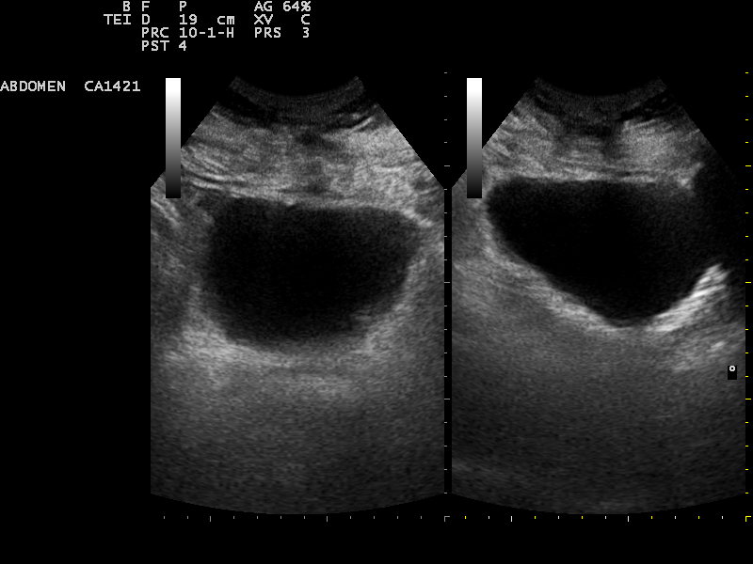
URINARY BLADDER TRANSVERSL/LONG

