Slide 1
Management of Transaction Exposure
Chapter Eight
© 2021 McGraw Hill. All rights reserved. Authorized only for instructor use in the classroom. No reproduction or further distribution permitted without the prior written consent of McGraw Hill.

Slide 2
Chapter Outline
Three Types of Exposure
Should the Firm Hedge?
Hedging Foreign Currency Receivables
Hedging Foreign Currency Payables
Cross-Hedging Minor Currency Exposure
Hedging Contingent Exposure
Hedging Recurrent Exposure with Swap Contracts
Hedging through Invoice Currency
Hedging via Lead and Lag
Exposure Netting
What Risk Management Products Do Firms Use?
Summary

Slide 3
Three Types of Exposure 1
It is conventional to classify foreign currency exposures into three types:
  1. Transaction exposure is the potential change in the value of financial positions due to changes in the exchange rate between the inception of a contract and the settlement of the contract.
  2. Economic exposure is the possibility that cash flows and the value of the firm may be affected by unanticipated changes in the exchange rates.
  3. Translation exposure is the effect of an unanticipated change in the exchange rates on the consolidated financial reports of an M N C.

Slide 4
Three Types of Exposure 2
Firm is subject to transaction exposure when it faces contractual cash flows that are fixed in foreign currencies
Example
  Suppose a U.S. firm sold its product to a German client on three-month credit terms and invoiced €1 million.
  When the U.S. firm receives €1 million in three months, it will have to convert (unless it hedges) the euros into dollars at the spot exchange rate prevailing on the maturity date, which cannot be known in advance.
Notes:
When a firm has foreign-currency-denominated receivables or payables, it is subject to transaction exposure, and those settlements are likely to affect the firm’s cash flow position.

Slide 5
Hedging Transaction Exposure
This chapter focuses on alternative ways of hedging transaction exposure using various financial contracts and operational techniques
Financial contracts
  Forward contracts, money market instruments, options contracts, and swap contracts.
Operational techniques
  Choice of the invoice currency, lead/lag strategy, and exposure netting.

Slide 6
Should the Firm Hedge?
No consensus on the question of whether a firm should hedge; Most arguments suggesting corporate exposure management will not add value to the firm hold in the case of a “perfect” capital market
While the above arguments against corporate risk management may be valid in a “perfect” capital market, one can make a case for it based on various market imperfections:
  Information asymmetry.
  Differential transaction costs.
  Default costs.
  Progressive corporate taxes.
Notes:
Information asymmetry: Management knows about the firm’s exposure position much better than stockholders. Thus, the management of the firm, not its stockholders, should manage exchange exposure.
Differential transaction costs: The firm is in a position to acquire low-cost hedges; transaction costs for individual stockholders can be substantial. Also, the firm has hedging tools like the reinvoice center that are not available to stockholders.
Default costs: If default costs are significant, corporate hedging would be justifiable because it will reduce the probability of default. Perception of a reduced default risk, in turn, can lead to a better credit rating and lower financing costs.
Progressive corporate taxes: Under progressive corporate tax rates, stable before-tax earnings lead to lower corporate taxes than volatile earnings with the same average value. This happens because under progressive tax rates, the firm pays more taxes in high-earning periods than it saves in low-earning periods.

Slide 7
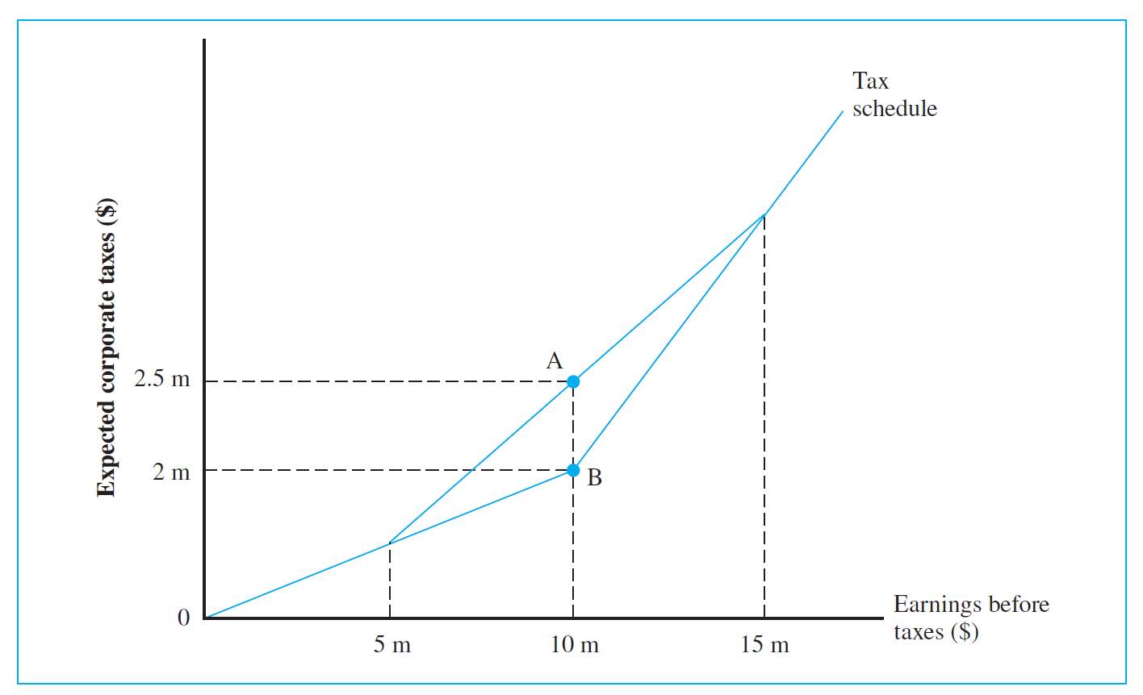
Tax Savings from Hedging Exchange Risk Exposure
Access the text alternative for slide images.
Notes:
The last point merits elaboration. Suppose the country’s corporate income tax system is such that a tax rate of 20 percent applies to the first $10 million of corporate earnings and a 40 percent rate applies to any earnings exceeding $10 million. Firms thus face a simple progressive tax structure. Now consider an exporting firm that expects to earn $15 million if the dollar depreciates, but only $5 million if the dollar appreciates. Let’s assume that the dollar may appreciate or depreciate with equal chances. In this case, the firm’s expected tax will be $2.5 million:
expected tax = (0.2*5)*0.5 + 0.5((.2*10)+(.4*5)) =$ 2.5
Now consider another firm, B, that is identical to firm A in every respect except that, unlike firm A, firm B aggressively and successfully hedges its risk exposure and, as a result, it can expect to realize certain earnings of $10,000,000, the same as firm A’s expected earnings. Firm B, however, expects to pay only $2 million for taxes. Obviously, hedging results in a $500,000 tax saving. Exhibit 8.1 illustrates this situation.

Slide 8
Hedging Foreign Currency Receivables
Suppose Boeing Corporation exported a landing gear of Boeing 737 aircraft to British Airways and billed £10 million payable in one year, with money market interest rates and foreign exchange rates given as follows:
  U.S. interest rate: 6.10% per annum.
  U.K. interest rate: 9% per annum.
  Spot exchange rate: $1.50/£.
  Forward exchange rate: $1.46/£ (1-year maturity).
When Boeing receives £10 million in one year, it will convert the pounds into dollars at the spot exchange rate prevailing at the time
Notes:
Now, we will look at the various techniques for managing this transaction exposure.

Slide 9
Forward Market Hedge 1
Most direct and popular way of hedging transaction exposure is by currency forward contracts
Sell (buy) foreign currency receivables (payables) forward to eliminate exchange risk exposure
  Boeing may sell forward its pounds receivables, £10 million, for delivery in one year, in exchange for a given amount of U.S. dollars.
  On the maturity date of the contract, Boeing will have to deliver £10 million to the bank, which is the counterparty of the contract, and, in return, take delivery of $14.6 million ($1.46/£ * £10 m), regardless of the spot exchange rate that may prevail on the maturity date.
Notes:
Refer to example provided in slide 8.

Slide 10
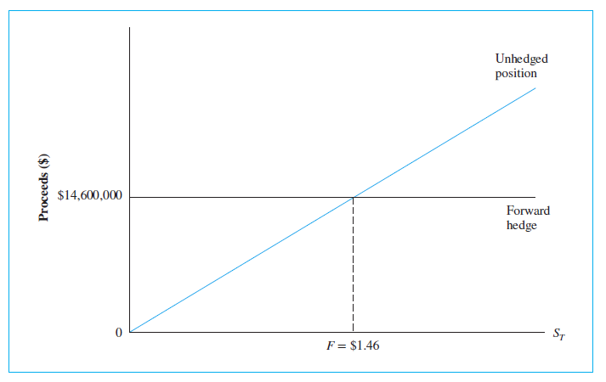
Dollar Proceeds from the British Sale: Forward Hedge versus Unhedged Position
Access the text alternative for slide images.
Notes:
Refer to example provided in slide 8.

Slide 11
Forward Market Hedge 2
Suppose that on the maturity date of the forward contract, the spot rate turns out to be $1.40/£, which is less than the forward rate, $1.46/£
  Boeing would have received $14 million instead of $14.6 million had it not entered the forward contract.
What if the spot rate had been $1.50/£ at maturity?
  Boeing would have received $15 million by remaining unhedged.
  Ex post, forward hedging would have cost Boeing $0.4 million.
Gains and losses are computed by the following:
Notes:
Refer to example provided in slide 8.

Slide 12
Gains/Losses from Forward Hedge
Receipts from the British Sale
Spot Exchange Rate on the Maturity Date (S_{T}) | Unhedged Position | Forward Hedge | Gains/Losses from Hedge_{b}
$1.30 | $13,000,000 | $14,600,000 | $1,600,000
$1.40 | $14,000,000 | $14,600,000 | $600,000
$1.46ª | $14,600,000 | $14,600,000 | 0
$1.50 | $15,000,000 | $14,600,000 | ‒$400,000
$1.60 | $16,000,000 | $14,600,000 | ‒$1,400,000
ª The forward exchange rate (F) is $1.46/£ in this example.
^{b} The gains/losses are computed as the proceeds under the forward hedge minus the proceeds from the unhedged position at the various spot exchange rates on the maturity date.
Notes:
Refer to example provided in slide 8.

Slide 13
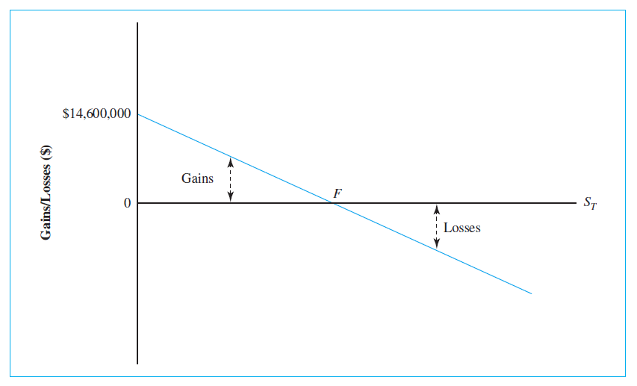
Illustration of Gains and Losses from Forward Hedging
Access the text alternative for slide images.
Notes:
As Exhibit 8.4 shows, the firm theoretically can gain as much as $14.6 million when the pound becomes worthless, which, of course, is unlikely, whereas there is no limit to possible losses.

Slide 14
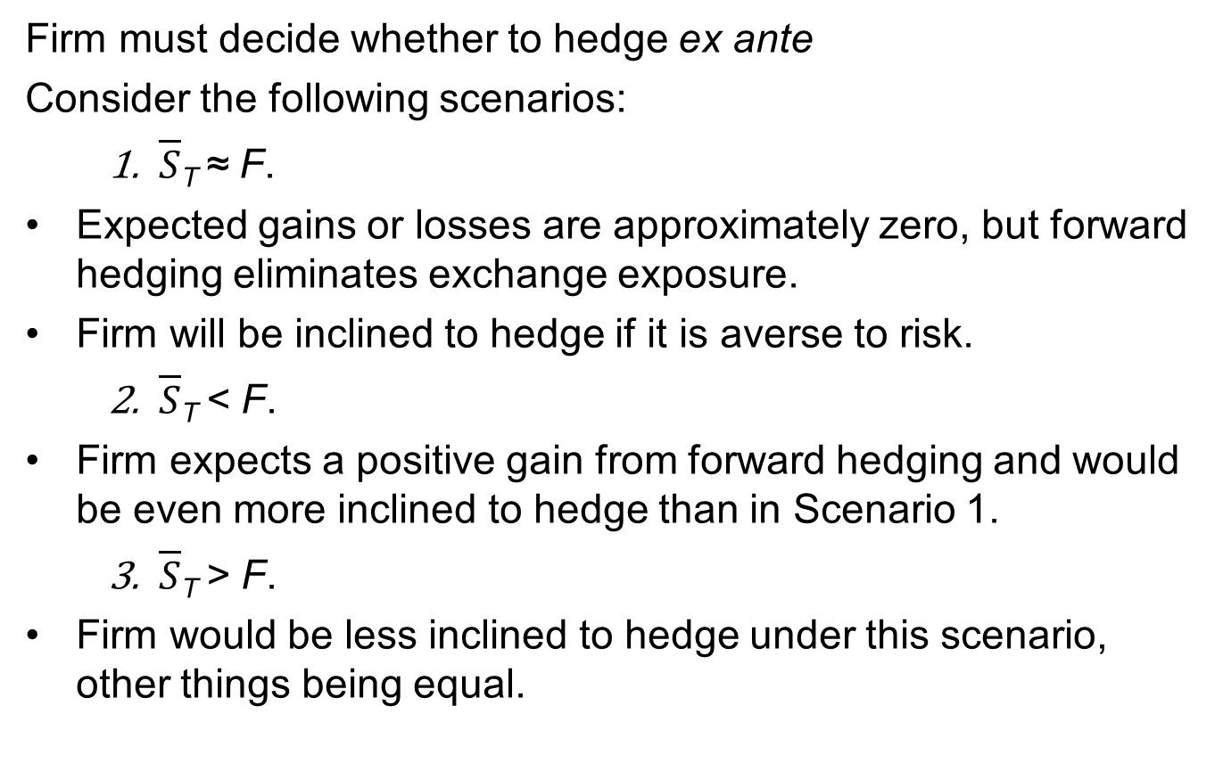
Forward Market Hedge 3
Firm must decide whether to hedge ex ante
Consider the following scenarios:
  $\overline{S}$_{T} ≈ F.
    Expected gains or losses are approximately zero, but forward hedging eliminates exchange exposure.
    Firm will be inclined to hedge if it is averse to risk.
  $\overline{S}$_{T} < F.
    Firm expects a positive gain from forward hedging and would be even more inclined to hedge than in Scenario 1.
  $\overline{S}$_{T} > F.
    Firm would be less inclined to hedge under this scenario, other things being equal.
Notes:
$\overline{S}$_{T} denotes the firm’s expected spot exchange rate for the maturity date and F represents the forward rate.

Slide 15
Currency Futures versus Forwards
A firm could use a currency futures contract, rather than a forward contract, for hedging purposes
A futures contract is not as suitable as a forward contract for hedging purposes for two reasons:
  Unlike forward contracts that are tailor-made to the firm’s specific needs, futures contracts are standardized instruments in terms of contract size, delivery date, etc.
    Thus, in most cases, the firm can only hedge approximately.
  Due to the marking-to-market property, there are interim cash flows prior to the maturity date of the futures contract that may have to be invested at uncertain interest rates.
    Again, this makes exact hedging difficult.
Notes:
Mark to market (MTM) is a method of measuring the fair value of accounts that can fluctuate over time, such as assets and liabilities. Mark to market aims to provide a realistic appraisal of an institution's or company's current financial situation based on current market conditions.
.A company that offers discounts to its customers in order to collect quickly on its accounts receivables (AR) will have to mark its AR to a lower value through the use of a contra asset account.
Future contracts >> clearinghouse (third party)

Slide 16
Money Market Hedge 1
A firm may borrow (lend) in foreign currency to hedge its foreign currency receivables (payables), thereby matching its assets and liabilities in the same currency
  Boeing can eliminate the exchange exposure arising from the British sale by first borrowing in pounds, then converting the loan proceeds into dollars, which then can be invested at the dollar interest rate.
  On the maturity date of the loan, Boeing is going to use the pound receivable to pay off the pound loan.
  If Boeing borrows a particular pound amount so that the maturity value of this loan becomes exactly equal to the pound receivable from the British sale, Boeing’s net pound exposure is reduced to zero.
  Then, Boeing will receive the future maturity value of the dollar investment.
Notes:
Refer to example provided in slide 8.

Slide 17
Money Market Hedge 2
What amount of pounds should Boeing borrow?
  Amount to borrow may be computed as the discounted present value of the pound receivable.
  £10 million/(1.09) = £9,174,312.
Step-by-step procedure of money market hedging:
  Borrow £9,174,312.
  Convert £9,174,312 into $13,761,468 at the current spot exchange rate of $1.50/£.
  Invest $13,761,468 in the United States.
  After one year, collect £10 million from British Airways and use it to repay the pound loan.
  Receive the maturity value of the dollar investment, that is, $14,600,918 = ($13,761,468)(1.061).
Notes:
Refer to example provided in slide 8.

Slide 18
Cash Flow Analysis of a Money Market Hedge
Transaction | Current Cash Flow | Cash Flow at Maturity
1. Borrow pounds | £9,174,312 | ‒£10,000,000
2. Buy dollar spot with pounds | $13,761,468
 | ‒£9,174,312
3. Invest in the United States | ‒$13,761,468 | $14,600,918
4. Collect pound receivable |  | £10,000,000
Net cash flow | 0 | $14,600,918

Slide 19
Options Market Hedge 1
One possible shortcoming of both forward and money market hedges is that these methods completely eliminate exchange risk exposure
  Ideally, Boeing would like to protect itself only if the pound weakens, while retaining the opportunity to benefit if the pound strengthens.
Currency options provide a flexible “optional” hedge against exchange exposure
  Firm may buy a foreign currency call (put) option to hedge its foreign currency payables (receivables).

Slide 20
Options Market Hedge 2
Suppose that in the O T C market, Boeing purchased a put option on £10 million with an exercise price of $1.46/£ and a one-year expiration, and assume the option premium (price) was $0.02 per pound
  Boeing paid $200,000 ($0.02 × 10 million) for the option.
  Provides Boeing with the right, but not the obligation, to sell up to £10 million for $1.46/£, regardless of the future spot rate.
Assume the spot exchange rate turns out to be $1.30 on the expiration date
  Upfront cost is equivalent to $212,200 = ($200,000 × 1.061).
  Net dollar proceeds are $14,387,800 = $14,600,000 ‒ $212,200.
  Boeing is assured of “minimum” dollar receipt of $14,387,800.

Slide 21
Options Market Hedge 3
Consider an alternative scenario where the pound appreciates against the dollar, and assume the spot rate turns out to be $1.60 per pound at expiration
  Boeing will have no incentive to exercise the option.
  Rather, it would let the option expire and convert £10 million into $16 million at the spot rate.
  Subtracting $212,200 for the option cost, the net dollar proceeds will become $15,787,800 under the option hedge.
Options hedge allows the firm to limit downside risk while preserving the upside potential, but firm must pay for this flexibility in terms of the option premium

Slide 22
Comparison of Hedging Strategies
Money market hedge versus forward hedge
  Money market hedge dominates since the guaranteed dollar proceeds from the British sale with the money market hedge exceeds guaranteed proceeds with forward hedge.
Money market hedge versus options hedge
  Options hedge dominates money market hedge for future spot rates greater than $1.4813/£, but money market hedge dominates options hedge for spot rates lower than $1.4813/£.
Options hedge versus forward hedge
  Options hedge dominates the forward hedge for future spot rates greater than $1.48 per pound, whereas the opposite holds for spot rates lower than $1.48 per pound.

Slide 23
Boeing’s Alternative Hedging Strategies for a Foreign Currency Receivable
EXHIBIT 8.8
Boeing’s Alternative Hedging Strategies for a Foreign Currency Receivable: A Summary
Strategy | Transactions | Outcomes
Forward market hedge | Sell £10,000,000 forward for U.S. dollars now. In one year, receive £10,000,000 from the British client and deliver it to the counterparty of the forward contract. | Assured of receiving $14,600,000 in one year; future spot exchange rate becomes irrelevant.
Money market hedge | Borrow £9,174,312, buy $13,761,468 spot, and invest in the United States now. In one year, collect £10,000,000 from the British client and pay off the pound loan using the amount. | Assured of receiving $13,761,468 now or $14,600,918 in one year; future spot exchange rate becomes irrelevant.
Options market hedge | Buy a put option on £10,000,000 for an upfront cost of $200,000. In one year, decide whether to exercise the option upon observing the prevailing spot exchange rate. | Assured of receiving at least $14,387,800 or more if the future spot exchange rate exceeds the exercise exchange rate; Boeing controls the downside risk while retaining the upside potential.

Slide 24
Hedging Foreign Currency Payables
Suppose Boeing imported a Rolls-Royce jet engine for £5 million payable in one year
Market condition is summarized as follows:
  The U.S. interest rate: 6.00% per annum.
  The U.K. interest rate: 6.50% per annum.
  The spot exchange rate: $1.80/£.
  The forward exchange rate: $1.75/£ (1-year maturity).
Boeing is concerned about the future dollar cost of this purchase, and it will try to minimize the dollar cost of paying off the payable

Slide 25
Foreign Currency Payables: Alternatives
Forward market hedge
  If Boeing decides to hedge this payable exposure using a forward contract, it only needs to buy £5 million forward in exchange for the following dollar amount:
$8,750,000 = (£5,000,000)($1.75/£)
Money market hedge
  P V of foreign currency payable: £4,694,836 = £5 million/1.065
  Outlay of dollars today: $ 8,450,705 = (£4,694,836 )($1.80/£).
  Future value: $8,957,747 = ($8,450,705)(1.06).
Options market hedge
  Purchase a “call” on £5 million.

Slide 26
Boeing’s Alternative Hedging Strategies for a Foreign Currency Payable
EXHIBIT 8.8
Boeing’s Alternative Hedging Strategies for a Foreign Currency Payable: A Summary
Strategy | Transactions | Outcomes
Forward market hedge | Agree today to buy £5,000,000 and sell U.S. dollars forward in one year. In one year, pay $8,750,000 and receive £5.000.000 from the counterparty of the forward contract and deliver the pounds to Rolls-Royce. | Assured of paying $8,750,000 in one year; future spot exchange rate becomes irrelevant.
Money market hedge | Borrow $8,450,705 and use the dollars to buy £4,694,836 now. Invest the pounds at the British interest rate. In one year, collect £5,000,000 and deliver the pounds to Rolls-Royce. Pay off the dollar loan with $8,957,747. | Assured of paying $8,957,747 in one year; future spot exchange rate becomes irrelevant.
Options market hedge | Buy a call option on £5,000,000 for an upfront cost of $90,000. In one year, decide whether to exercise the option upon observing the prevailing spot exchange rate. | Assured of paying at most $9,095,400 or less if the future spot exchange rate falls below the exercise exchange rate; Boeing controls the downside risk while retaining the upside potential.

Slide 27
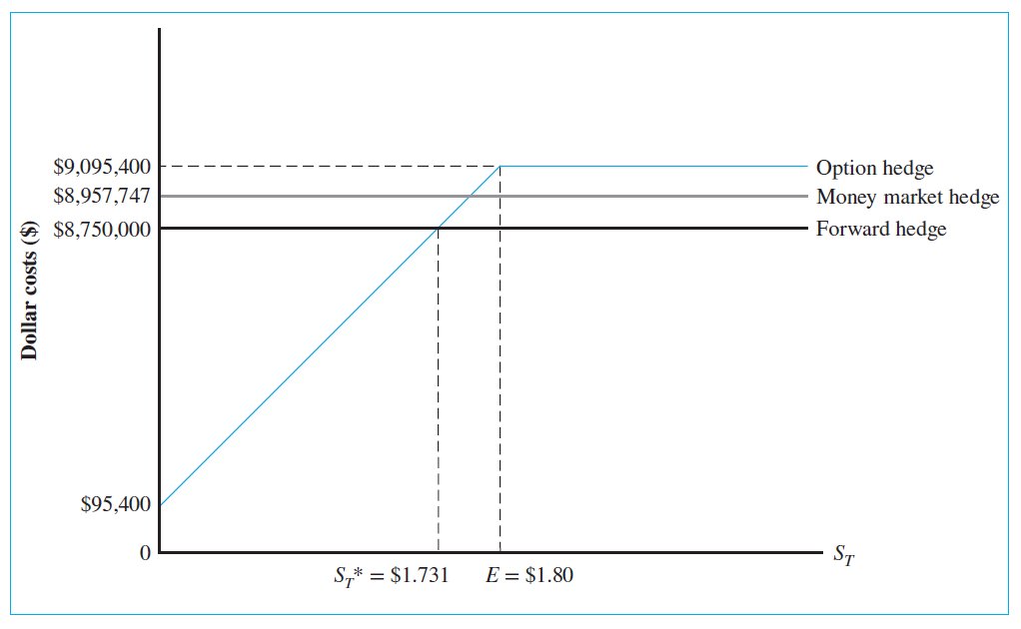
Dollar Costs of Securing the Pound Payable: Alternative Hedging Strategies
Access the text alternative for slide images.

Slide 28
Cross-Hedging Minor Currency Exposure
If a firm has positions in major currencies (for example, British pound, euro, and Japanese yen), it can easily use forward, money market, or options contracts to manage its exchange risk exposure
However, if the firm has positions in less liquid currencies (for example, Indonesian rupiah, Thai bhat, and Czech koruna), it may be either very costly or impossible to use financial contracts in these currencies
  In this situation, firms may use cross-hedging, which involves hedging a position in one asset by taking position in another asset.
Notes:
Cross hedging refers to the practice of hedging risk using two distinct assets with positively correlated price movements.

Slide 29
Hedging Contingent Exposure
Options contract can also provide an effective hedge against what might be called contingent exposure
  Contingent exposure is the risk due to uncertain situations in which a firm does not know if it will face exchange risk exposure in the future.
  Example: Suppose G E is bidding on a hydroelectric project in Canada. If the bid is accepted, which will be known in three months, G E is going to receive C$100 million to initiate the project. Since G E may or may not face exchange exposure, it faces a typical contingent exposure situation.
  Difficult to manage contingent exposure using traditional hedging tools like forward contracts, but an alternative is for G E to buy a put option on C$100million.

Slide 30
Hedging Recurrent Exposure with Swap Contracts
Firms often must deal with a “sequence” of accounts payable or receivable in terms of a foreign currency, and these recurrent cash flows can be best hedged using a currency swap contract
  Currency swap contracts are agreements to exchange one currency for another at a predetermined exchange rate, that is, the swap rate, on a sequence of future dates.
  Similar to a portfolio of forward contracts with different maturities.
  Very flexible in terms of amount and maturity, with maturity ranging from a few months to 20 years.
Notes:
For example, one party might receive 100 million British pounds (GBP), while the other receives $125 million. This implies a GBP/USD exchange rate of 1.25. At the end of the agreement, they will swap again at either the original exchange rate or another pre-agreed rate, closing out the deal.

Slide 31
Hedging through Invoice Currency
Hedging through invoice currency is an operational technique that allows the firm to shift, share, or diversify exchange risk by appropriately choosing the currency of invoice
  Example: If Boeing invoices $150 million rather than £100 million for the sale of aircraft, it does not face exchange exposure anymore. Though the exchange exposure has not disappeared, it has been shifted to the British importer.
  Another option would be for Boeing to invoice half of the bill in U.S. dollars and the remaining half in British pounds, thereby sharing the exchange exposure.
  Finally, the firm can diversify exchange exposure to some extent by using currency basket units, such as the S D R, as the invoice currency.

Slide 32
Hedging via Lead and Lag
The lead/lag strategy reduces transaction exposure by paying or collecting foreign financial obligations early (lead) or late (lag) depending on whether the currency is hard or soft
  Challenges associated with this strategy:
    If we assume Boeing would like B A to prepay £100 million, we can also assume B A would have no incentive to do so unless it received a substantial discount to compensate for prepayment.
    Pushing B A to prepay may hurt future sales efforts by Boeing.
    To the extent the original invoice price incorporated the expected depreciation of the pound, Boeing is already partially protected against depreciation of the pound.
  Strategy can be employed more effectively to deal with intrafirm payables and receivables among subsidiaries.

Slide 33
Exposure Netting: Lufthansa
“In 19 84, Lufthansa, a German airline, signed a contract to buy $3 billion worth of aircraft from Boeing and entered into a forward contract to purchase $1.5 billion forward for the purpose of hedging against the expected appreciation of the dollar against the German mark. This decision, however, suffered from a major flaw: A significant portion of Lufthansa’s cash flows was also dollar-denominated.”
  Lufthansa had a so-called “natural hedge”.
  The following year, the dollar depreciated substantially against the mark and Lufthansa experienced a major foreign exchange loss from settling the forward contract.
  The lesson here is that, when a firm has both receivables and payables in a given foreign currency, it should consider hedging only its net exposure.

Slide 34
Exposure Netting
Realistically, typical multinational corporations are likely to have a portfolio of currency positions
  In this case, firms should hedge residual exposure rather than hedge each currency position separately.
Exposure netting is hedging only the net exposure by firms that have both payables and receivables in foreign currencies
  For firms that would like to apply this approach aggressively, it helps to centralize the firm’s exchange exposure management function in one location.
  Many M N Cs are using a reinvoice center, a financial subsidiary, as a mechanism for centralizing exposure management functions.

Slide 35
What Risk Management Products Do Firms Use?
Among U.S. corporations, based on a survey of Fortune 500 firms, the most popular product was the traditional forward contract
  Jesswein, Kwok, and Folks (19 95) found 93% of respondents reported using forward contracts.
Kim and Chance (2018) study:
  Examined actual currency risk management practices of 101 largest nonfinancial corporations in South Korea.
  Authors document a great discrepancy between what firms say they do versus what they actually do, attributing the discord to attempts by companies to time their hedges.

Slide 36
End of Main Content
© 2021 McGraw Hill. All rights reserved. Authorized only for instructor use in the classroom.
No reproduction or further distribution permitted without the prior written consent of McGraw Hill.

Slide 37
Accessibility Content: Text Alternatives for Images

Slide 38
Tax Savings from Hedging Exchange Risk Exposure - Text Alternative
Return to parent-slide containing images.
This graph shows Expected corporate taxes in dollars on the y-axis and Earnings before taxes in dollars on the x-axis. There is a diagonal line that starts at (0, 0) and extends upward but splits to include points A and B. Point A is at 2.5 m, 10 m on the graph and Point B is at 2 m, 10 m on the graph. It comes back together at 15 m on the x-axis. There are vertical and horizontal lines starting from the x-axis and the y-axis to highlight the intersection of these points.
Return to parent-slide containing images.

Slide 39
Dollar Proceeds from the British Sale: Forward Hedge versus Unhedged Position - Text Alternative
Return to parent-slide containing images.
This graph shows Proceeds in dollars on the y-axis and S subscript T baseline on the x-axis. There is a horizontal line starting at $14,600,000 on the y-axis that is labeled Forward hedge. There is a diagonal line starting at 0 and going upward that is labeled Unhedged position. There is a vertical dotted line starting at F equals $1.46 on the x-axis and ending where the other two lines intersect in the middle of the graph.
Return to parent-slide containing images.

Slide 40
Illustration of Gains and Losses from Forward Hedging - Text Alternative
Return to parent-slide containing images.
This graph shows Gains and losses in dollars on the y-axis. There is a diagonal line starting at $14,600,000 on the y-axis that is going downward. This line intersects at Point F with a horizontal line starting at 0 on the y-axis that is labeled S subscript T baseline. The triangle-shaped area to the left of F above the horizontal line is labeled Gains. The triangle-shaped area to the right of F below the horizontal line is labeled Losses.
Return to parent-slide containing images.

Slide 41
Dollar Costs of Securing the Pound Payable: Alternative Hedging Strategies - Text Alternative
Return to parent-slide containing images.
This graph shows Dollars costs on the y-axis and S subscript T baseline on the x-axis. There is a horizontal line starting at $8,750,000 on the y-axis that is labeled Forward hedge. There is a second line starting at $95,400 that starts out as a diagonal line but changes to a horizontal line at E equals $1.80 on the x-axis. This line is labeled Option hedge. A horizontal dotted line connects this intersection to the y-axis at $9,095,400. There is another vertical dotted line that extends from 0 on the x-axis to the point were the Forward hedge line and the Option hedge line intersect. This line starts at S subscript T baseline equals $1.731 on the x-axis. A third horizontal line, labeled Money market hedge, starts at $8,957,747 on the y-axis.
Return to parent-slide containing images.

