Slide 1
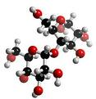
EXP.2 (Quantitative determination of Amylase activity)
Introduction:-
The purpose of this experiment is to study the enzyme amylase which is found in saliva. Amylase breaks down starch into the maltose as the end product.
estimate the amount of maltose by using a standard curve.

Slide 2
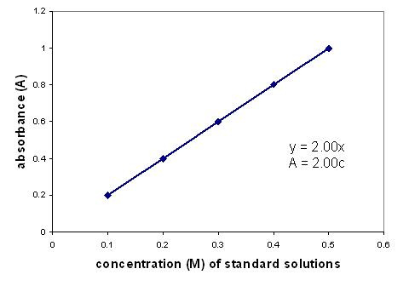
Beer's law states that the absorbance is directly proportional to the concentration of a solution. If you plot absorbance versus concentration, the resulting graph yields a straight line.
C1× V1 = C2 × V2

Slide 3
Principle
Maltose + alkaline dinitrosalicylic acid
Orange-red colour

Slide 4
Procedure
Part (1): construction of maltose std. Curve:
Read the Abs at 520 nm, build std curve.
 | Std.1 | Std.2 | Std.3 | Std.4
Maltose(1mg/ml) | 0.1 | 0.5 | 1.5 | 2
H2O | 1.9 | 1.5 | 0.5 | ---
Reagent DNS (ml) | 2 | 2 | 2 | 2
10 mins., boiling water bath. And cool,
H2O (ml) | 6 | 6 | 6 | 6

Slide 5
Part (2): assay for estimation of amylase activity
 | tube1 | tube2 | tube3
Phosphate buffer | 2.5 ml | 2.5 ml | 2.5 ml
Starch solution | 2.5 ml | 2.5 ml | 2.5 ml
NaCl (1%) | 1 | 1 | 1
Mix, incubate 10 mins at 37⁰c
H2O | 1 | 0.5 | 0.5
Diluted saliva | --- | 0.5 | 0.5
NaOH | ---- | ---- | 0.5
1&2 incubation15 mins, 37⁰c
NaOH | 0.5 | 0.5 | ----
Reagent | 0.5 | 0.5 | 0.5

Slide 6
Mix, heat in boiling water for 5 mins.
cool it at R.T
add 2 ml H2O
Read Abs at 520nm.

Slide 7
Calculations
Part 1: construction of maltose std. curve
After reading the Absorbance calculate the conc. Of std. solns by C1× V1 = C2 × V2
C1= conc. of Stock soln
V1= volume of Stock soln
C2= ?
V2= final volume
Build std. curve

Slide 8
Calculations
Part 2:
Calculate the correct absorbance of maltose
=Final Abs – Initial Abs =Tube 2 – tube 3
Calculate the amount of maltose formed per ml of saliva..( enzyme activity)..

Slide 9
Calculations
enzyme activity= conc. of maltose×20×0.5×2×1000
Mwt of maltose × 15 min
conc. of maltose= find it from std.curve
20= Dilution factor
0.5×2= Volume of diluted saliva
Mwt maltose= ?
Unit= m moles /min/ml

