Slide 1
Dental Anatomy

Slide 2
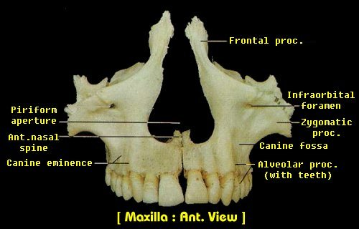
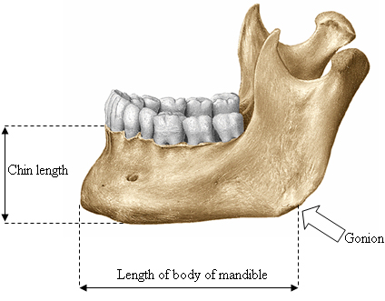
Nomenclature
Maxilla
Mandible

Slide 3
Deciduous Teeth
Primary Teeth
Post-natal development spans 2-1/2 years
Usually 20 in number
  4 incisors
  2 canines
  4 molars per arch

Slide 4
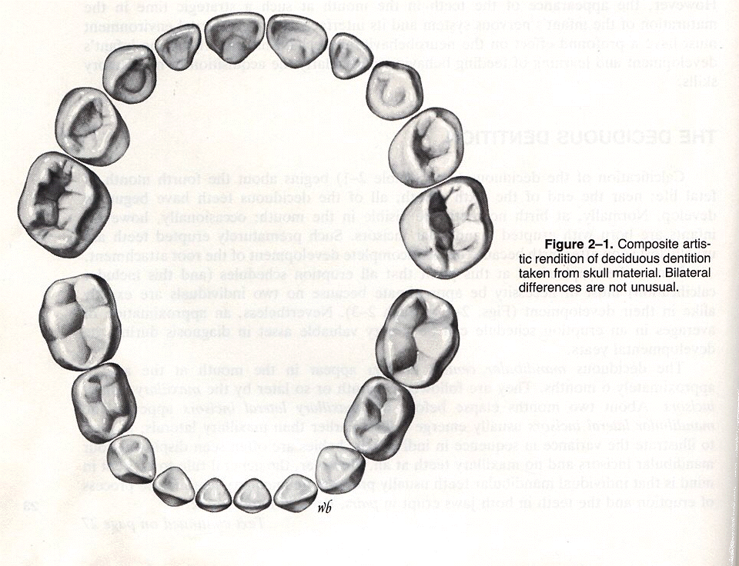
Deciduous Teeth
In clinical practice they are designated by letters: A to T

Slide 5
Permanent Teeth
Development begins with the eruption of the first molars and exfoliation of the deciduous incisors
Process requires 20 years to complete
Usually 32 in number
In clinical practice they are designated by numbers: 1 to 32

Slide 6
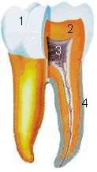
The Crown and Root
Crown- portion above the gingivae covered with enamel
Root- portion below covered with cementum
They are joined at the cemento-enamel junction (CEJ)

Slide 7
Dentin
Comprises the main bulk of tooth structure
Histologically analagous to bone in composition

Slide 8
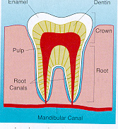
Pulp Chamber and Canal
Contain the pulpal tissue
  Nervous, arteriolar and venous tissue
  fibrous tissue

Slide 9
The Crown
Incisors have an incisal edge
Canines have a single cusp
Premolars and Molars have 2 or more cusps
These are the cutting surfaces of the teeth

Slide 10
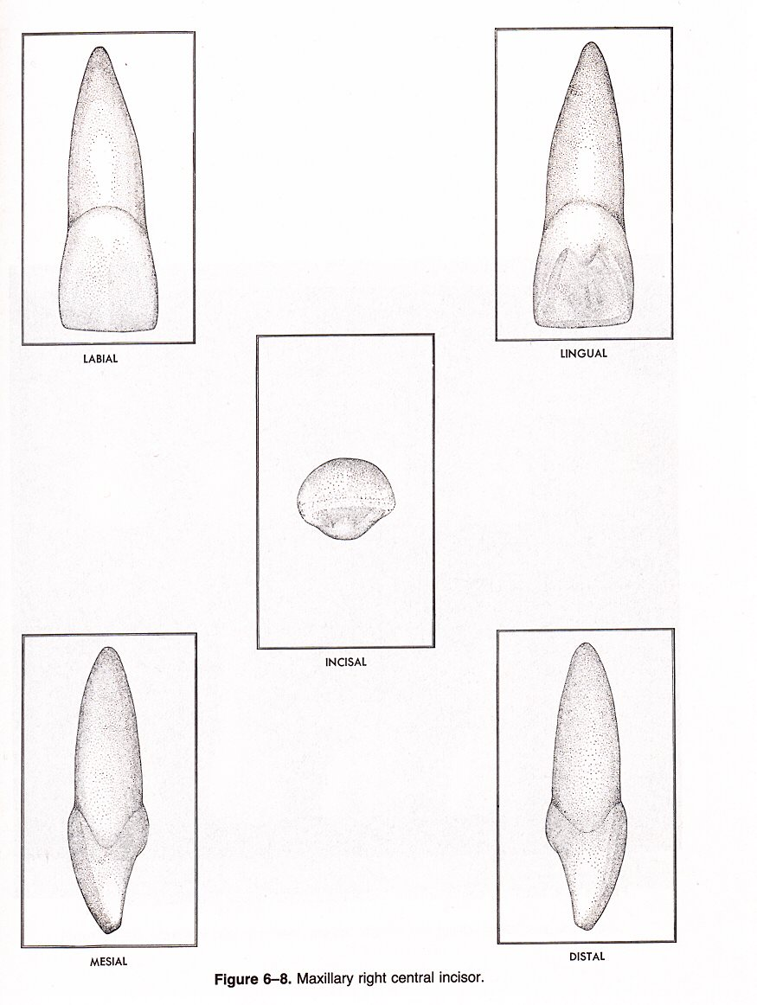
Incisor

Slide 11
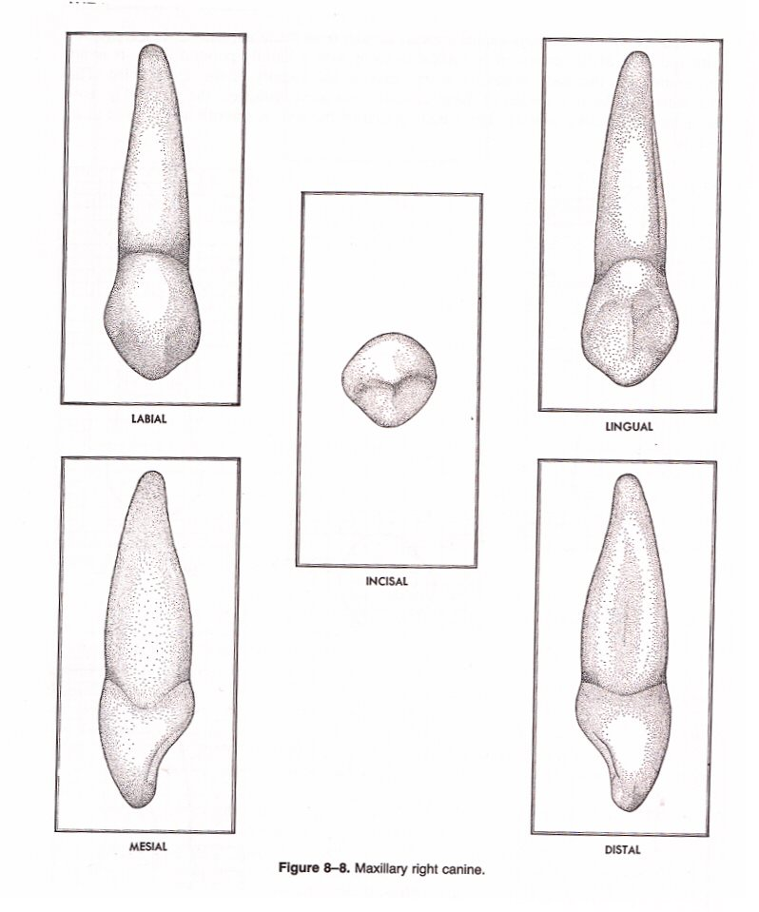
Canine

Slide 12
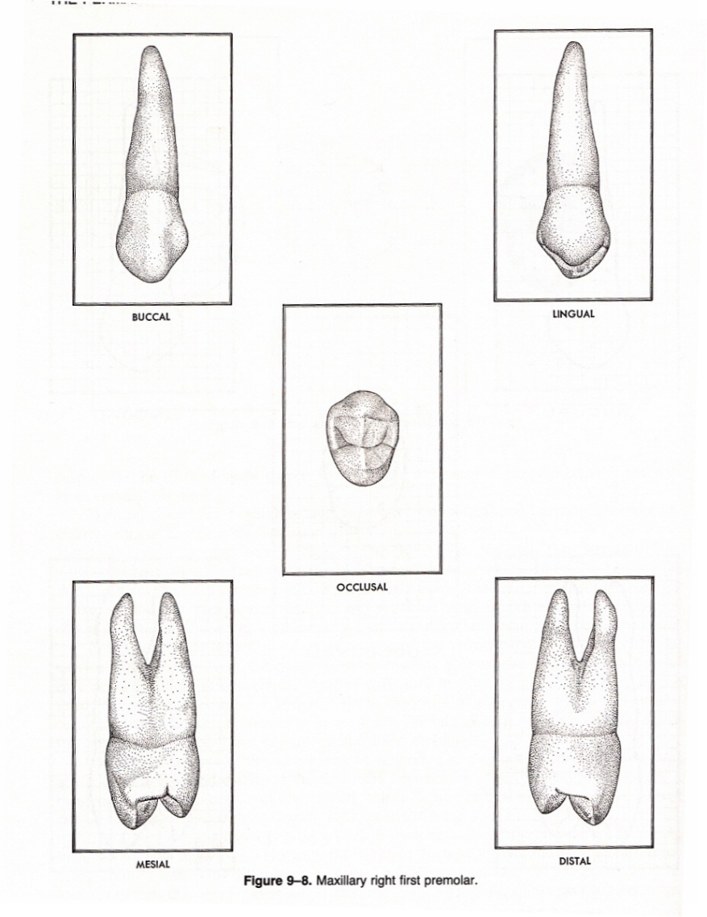
Premolar

Slide 13
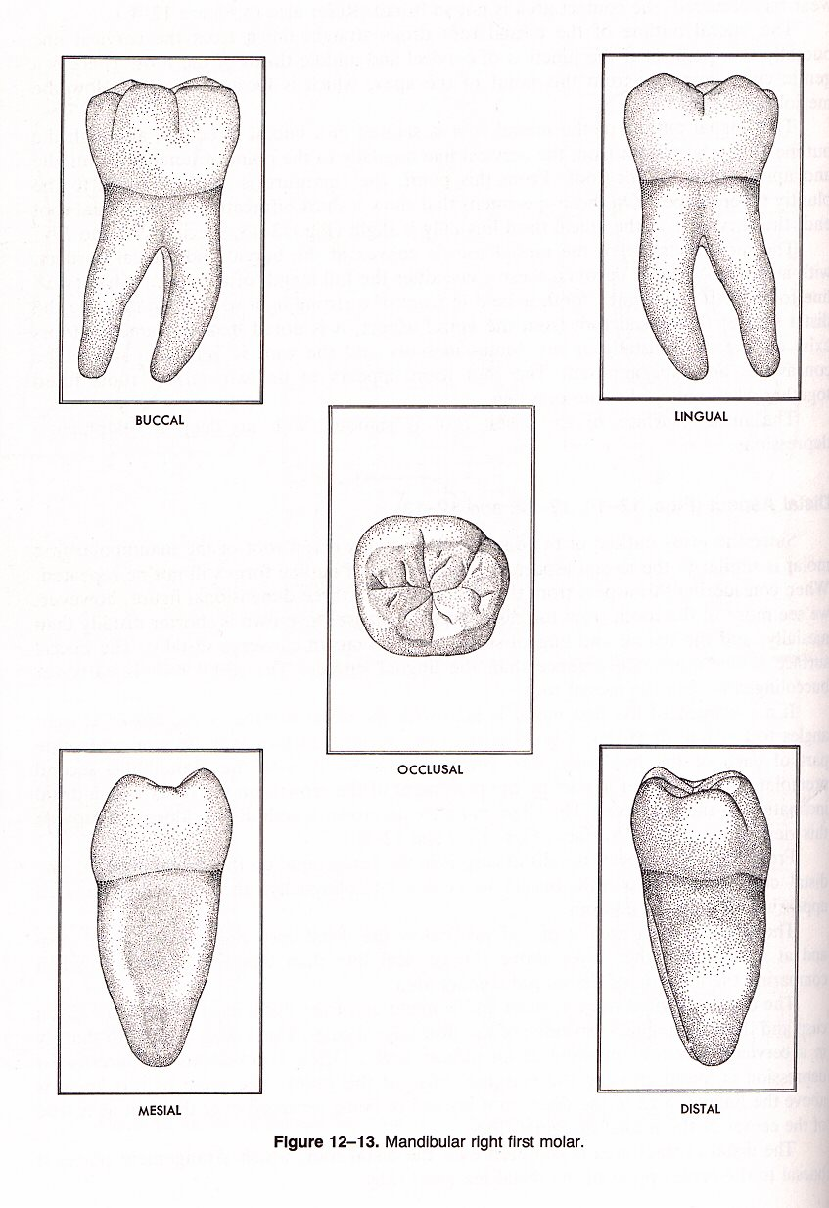
Molar

Slide 14
The Root
May be single or multiple
Firmly positioned in the boney process of the jaw called the alveolus
The alveolus together with the teeth forms the dental arch
The cervical area of the teeth are usually covered with a soft tissue, the gingivae

Slide 15
Surfaces and Ridges
Incisors and Canines- four surfaces and a ridge
Molars and Premolars- five surfaces

Slide 16
Surfaces- named according to positions and uses
Facial- toward the lips or cheeks
Lingual- toward the tongue

Slide 17
Surfaces
Occlusal- come in contact with those of the opposing jaw, molars and premolars only
Incisal- Those surfaces on the incisors and canines coming into contact with the opposing teeth

Slide 18
Proximal Surfaces
Surfaces coming into contact with the adjacent teeth
Mesial- toward the midline
Distal- away from the midline
Which teeth have the mesial surfaces touching each other?

Slide 19
Cusp
an elevation or mound on the crown portion of a tooth making up a divisional part of the occlusal surface

Slide 20
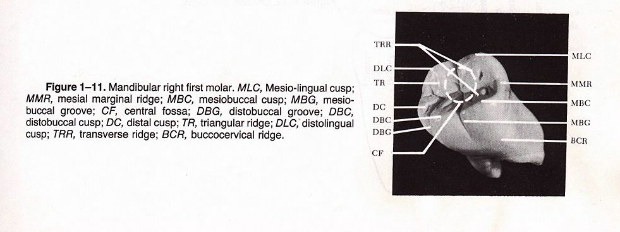

Slide 21
Tubercle
A smaller elevation on the same portion of the crown produced by an extra formation of enamel. Deviation from typical form.

Slide 22
Cingulum
The lingual lobe of an anterior tooth

Slide 23
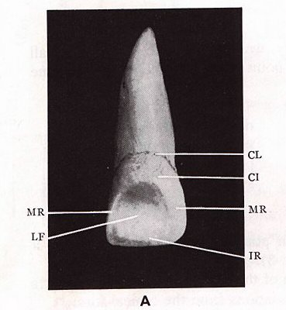

Slide 24
Ridge
Any linear elevation on the surface of a tooth and is named according to its location

Slide 25
Marginal Ridge
Those rounded borders of enamel that form the mesial and distal margins of the occlusal surfaces of premolars or molars, and the lingual surfaces of anterior teeth

Slide 27
Triangular Ridges
descend from the cusp tips of molars and premolars toward the central part of the occlusal surface

Slide 28
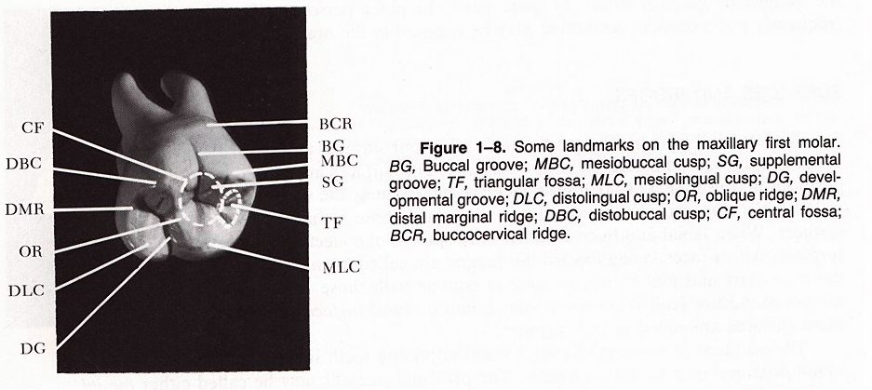

Slide 29
Oblique Ridge
Crosses the occlusal surface of maxillary molars in an oblique fashion

Slide 31
Fossa
An irregular depression or concavity

Slide 33
Sulcus
A long depression or valley in the surface of a tooth between ridges and cusps

Slide 35
Developmental Groove
A shallow groove or line between the primary parts of the crown or root

Slide 37
Pits
Small pinpoint depressions located at the junction of the developmental grooves

