Slide 1
Financial Statements, Taxes, and Cash Flows
Chapter TWO

Slide 2
Key Concepts and Skills
Know the difference between book value and market value
Know the difference between accounting income and cash flow
Know the difference between average and marginal tax rates
Know how to determine a firm’s cash flow from its financial statements

Slide 3
Chapter Outline
The Balance Sheet
The Income Statement
Taxes
Cash Flow

Slide 4
Balance Sheet
The balance sheet is a snapshot of the firm’s assets and liabilities at a given point in time
Assets are listed in order of decreasing liquidity
  Ease of conversion to cash
  Without significant loss of value
Balance Sheet Identity
  Assets = Liabilities + Stockholders’ Equity

Slide 5
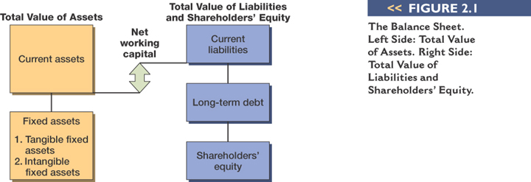
The Balance Sheet - Figure 2.1

Slide 6
Net Working Capital and Liquidity
Net Working Capital
  Current Assets – Current Liabilities
  Positive when the cash that will be received over the next 12 months exceeds the cash that will be paid out
  Usually positive in a healthy firm
Liquidity
  Ability to convert to cash quickly without a significant loss in value
  Liquid firms are less likely to experience financial distress
  But liquid assets earn a lower return
  Trade-off to find balance between liquid and illiquid assets

Slide 7
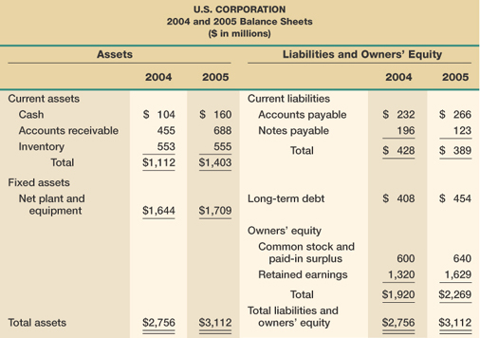
US Corporation Balance Sheet – Table 2.1

Slide 8
Market Vs. Book Value
The balance sheet provides the book value of the assets, liabilities, and equity.
Market value is the price at which the assets, liabilities ,or equity can actually be bought or sold.
Market value and book value are often very different. Why?
Which is more important to the decision-making process?

Slide 9
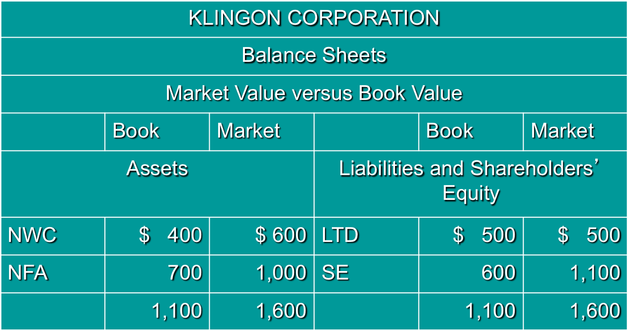
Example 2.2 Klingon Corporation

Slide 10
Income Statement
The income statement is more like a video of the firm’s operations for a specified period of time.
You generally report revenues first and then deduct any expenses for the period
Matching principle – GAAP says to show revenue when it accrues and match the expenses required to generate the revenue

Slide 11
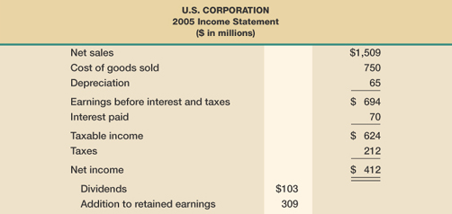
US Corporation Income Statement – Table 2.2

Slide 12
Taxes
The one thing we can rely on with taxes is that they are always changing
Marginal vs. average tax rates
  Marginal tax rate – the percentage paid on the next dollar earned
  Average tax rate – the tax bill / taxable income
Other taxes

Slide 13
Example: Marginal Vs. Average Rates
Suppose your firm earns $4 million in taxable income.
  What is the firm’s tax liability?
  What is the average tax rate?
  What is the marginal tax rate?
If you are considering a project that will increase the firm’s taxable income by $1 million, what tax rate should you use in your analysis?

Slide 14
The Concept of Cash Flow
Cash flow is one of the most important pieces of information that a financial manager can derive from financial statements
The statement of cash flows does not provide us with the same information that we are looking at here
We will look at how cash is generated from utilizing assets and how it is paid to those that finance the purchase of the assets

Slide 15
Cash Flow From Assets
Cash Flow From Assets (CFFA) = Cash Flow to Creditors + Cash Flow to Stockholders
Cash Flow From Assets = Operating Cash Flow – Net Capital Spending – Changes in NWC

Slide 16
Example: US Corporation – Part I
OCF (I/S) = EBIT + depreciation – taxes = $547
NCS ( B/S and I/S) = ending net fixed assets – beginning net fixed assets + depreciation = $130
Changes in NWC (B/S) = ending NWC – beginning NWC = $330
CFFA = 547 – 130 – 330 = $87

Slide 17
Example: US Corporation – Part II
CF to Creditors (B/S and I/S) = interest paid – net new borrowing = $24
CF to Stockholders (B/S and I/S) = dividends paid – net new equity raised = $63
CFFA = 24 + 63 = $87

Slide 18
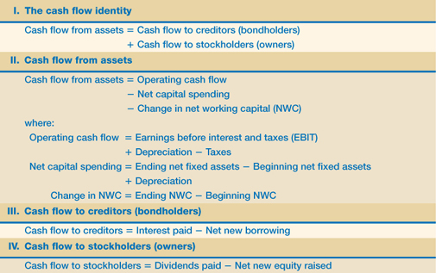
Cash Flow Summary Table 2.5

Slide 19
Example: Balance Sheet and Income Statement Information
Current Accounts
  2007: CA = 3625; CL = 1787
  2006: CA = 3596; CL = 2140
Fixed Assets and Depreciation
  2007: NFA = 2194; 2006: NFA = 2261
  Depreciation Expense = 500
Long-term Debt and Equity
  2007: LTD = 538; Common stock & APIC = 462
  2006: LTD = 581; Common stock & APIC = 372
Income Statement
  EBIT = 1014; Taxes = 368
  Interest Expense = 93; Dividends = 285

Slide 20
Example: Cash Flows
OCF = 1,014 + 500 – 368 = 1,146
NCS = 2,194 – 2,261 + 500 = 433
Changes in NWC = (3,625 – 1,787) – (3,596 – 2,140) = 382
CFFA = 1,146 – 433 – 382 = 331
CF to Creditors = 93 – (538 – 581) = 136
CF to Stockholders = 285 – (462 – 372) = 195
CFFA = 136 + 195 = 331
The CF identity holds.

Slide 21
Review
What is the difference between book value and market value? Which should we use for decision-making purposes?
What is the difference between accounting income and cash flow? Which do we need to use when making decisions?
What is the difference between average and marginal tax rates? Which should we use when making financial decisions?
How do we determine a firm’s cash flows? What are the equations and where do we find the information?

