Slide 1
Cerebrospinal Fluid ( CSF )

Slide 2
Cerebrospinal fluid (CSF) is a clear watery liquid filtrate that is formed and secreted by the choroid plexus, special tissue that has many blood vessels and lines the small cavities or chambers (ventricles) in the brain. CSF flows around the brain and spinal cord, surrounding and protecting them. It is continually produced, circulated, and then absorbed into the blood system.

Slide 3
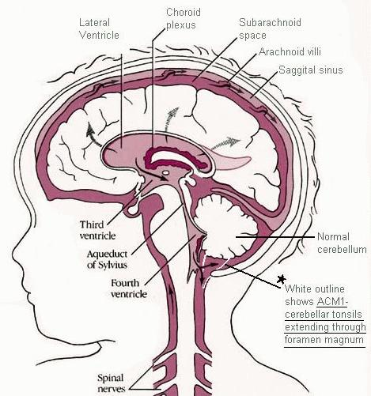
Cerebrospinal Fluid (CSF)
CSF is a clear bodily fluid that occupies the sub arachnoid space and the ventricular system around and inside the brain.
In essence, the brain "floats" in it.

Slide 4
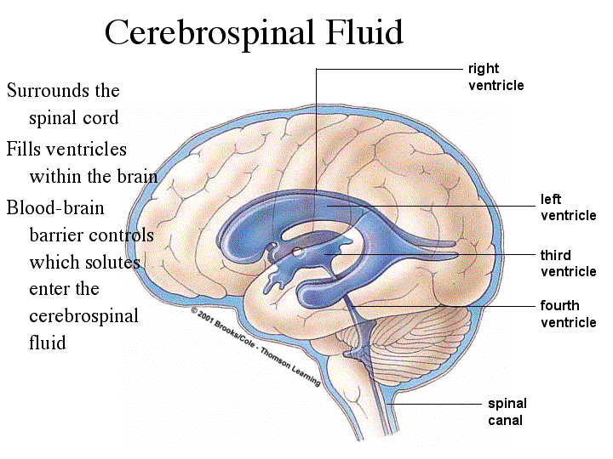
Continuation…
It acts as a "cushion" or buffer for the cortex, providing a basic mechanical and immunological protection to the brain inside the skull .

Slide 5
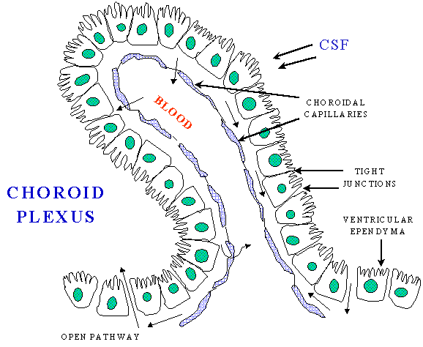
CSF Formation
It is produced in the brain by modified ependymal cells in the choroid plexus (approx. 50-70%), and the remainder is formed around blood vessels and along ventricular walls.
Choroid plexus consists of tufts of capillaries with thin fenestrated endothelial cells.

Slide 6
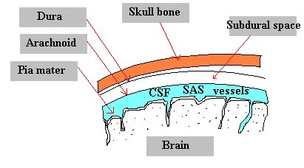
Amount
The CSF is produced at a rate of 500 ml/day.
The brain can only contain 135-150 ml of CSF, so large amounts are drained primarily into the blood through arachnoid granulations in the superior sagittal sinus.
Thus the CSF turns over about 3.7 times a day.

Slide 7
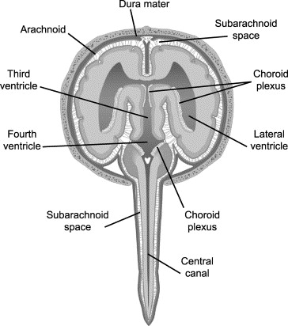
Composition
CSF is a clear , colorless , nearly acellular with low protein concentration.
Normal range for total nuclear cell count (TNCC) in CSF is 0-2 cells/µl
Total protein concentration ranges from 10-15mg/dl. Albumin is the main protein
Glucose concentration: 60% of blood glucose concentration.
Ions
Sodium: 150mmol/L
Potassium:3mmol/L
Calcium:2mmol/L
Enzymes: Creatine Kinase(CK), Aspartate transaminase (AST) & Lactate dehydrogenase (LDH)
Neurotransmitters: Glutamate (GLU) and Gamma amino –butyric acid (GABA).

Slide 8
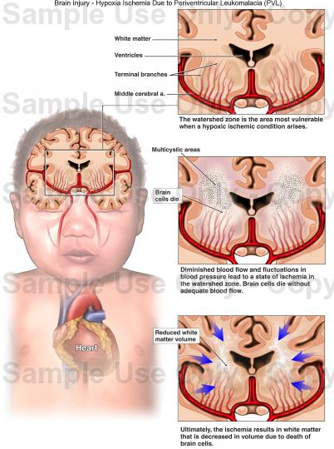
Functions
Mechanical protection of the brain
Distribution of neuroendocrine factors
Prevention of brain ischemia. The prevention of brain ischemia is made by decreasing the amount of CSF in the limited space inside the skull which decreases total intracranial pressure and facilitates blood perfusion.

Slide 9
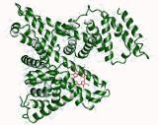
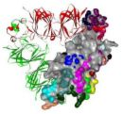
Proteins in CSF
Total protein concentration ranges from 10-15mg/dl. Albumin is the main protein
Albumin
Globulin
Albumin and globulin present in the ratio of 8 to 1

Slide 10
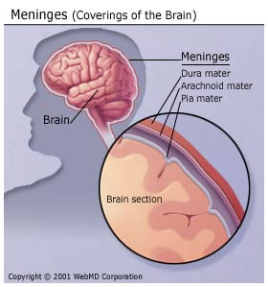
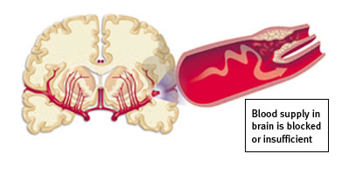
Continuation…
Increased CSF Protein occurs in:
Diabetes Mellitus
Brain Tumor
Meningitis
Syphilis
Cushing's Disease
Uremia
Myxedema
Cerebral hemorrhage

Slide 11
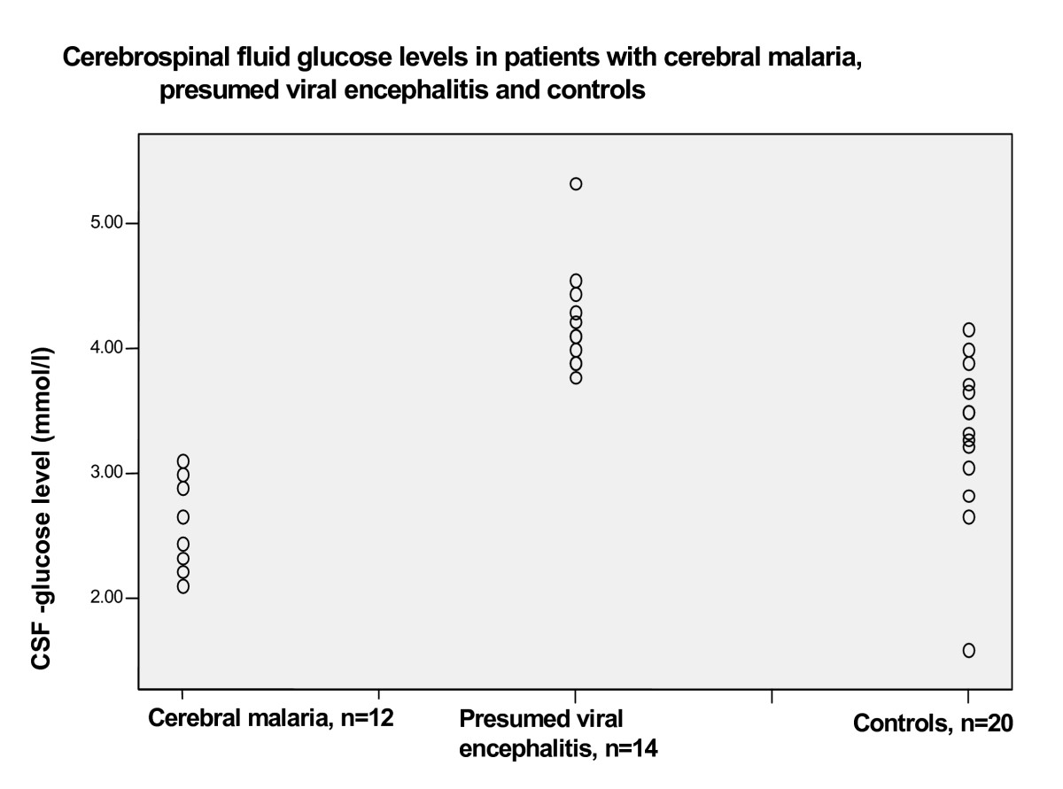
Glucose in CSF
CSF glucose is normally approximately two-thirds of the fasting plasma glucose.
The glucose levels should be between 50 to 80 mg/100 mL
Abnormal results include increased and decreased glucose levels.
Abnormal results may be due to:
Infection (bacterial or fungus)
Inflammation of the central nervous system
Tumor

Slide 12
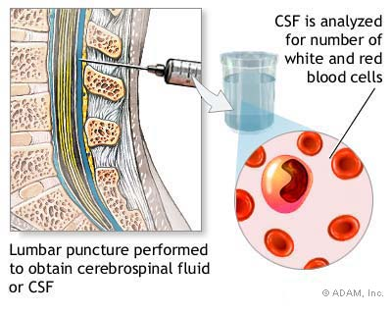
Cell count in CSF
CSF cell count is a test to measure the number of red and white blood cells that are in cerebrospinal fluid (CSF)

Slide 13
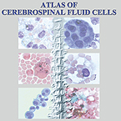
Continuation…
The normal white blood cell count is between 0 and 5 per micro.
The normal red blood cell count is 0.
An increase of white blood cells indicates infection, inflammation, or bleeding into the cerebrospinal fluid. Some causes include:
Abscess
Acute infection
Encephalitis
Hemorrhage
Finding red blood cells in the CSF may be a sign of bleeding.

Slide 14
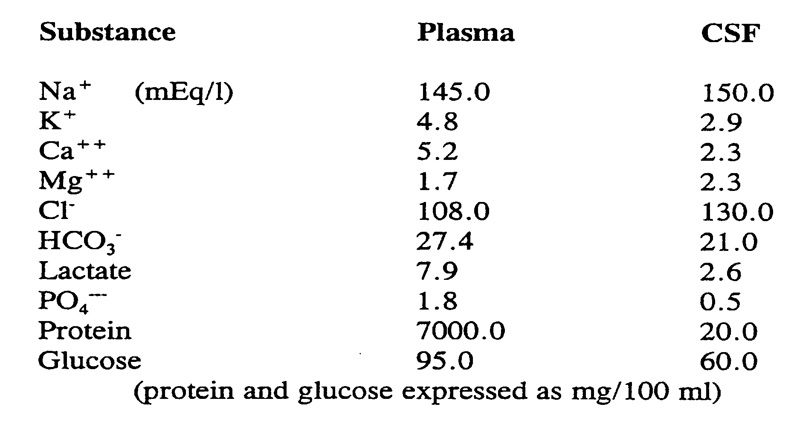
Composition of Cerebrospinal Fluid

Slide 15
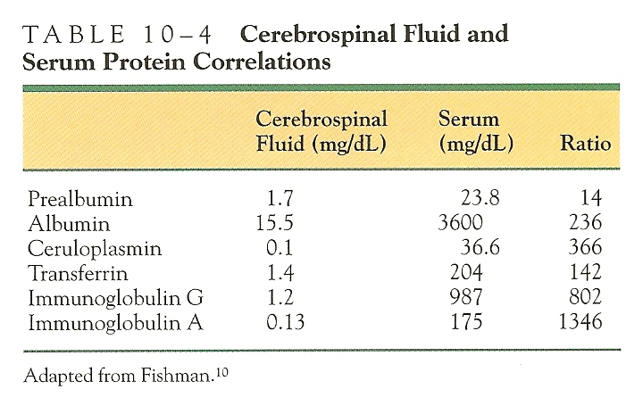
Correlation of Cerebrospinal Fluid and Serum

Slide 16
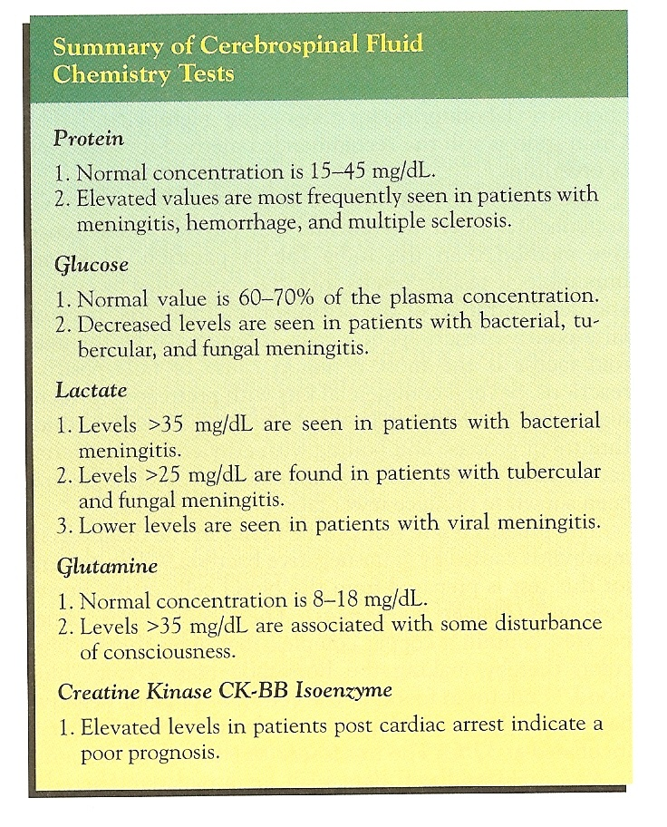
Clinical Significance of Cerebrospinal Fluid Tests

Slide 17
Reference ranges for ions and metals in CSF
Substance | Lower limit | Upper limit | Unit | Corresponds to % of that in plasma
Sodium | 135 | 150 | mmol/L
Potassium | 2.6 | 3.0 | mmol/L
Chloride | 115 | 130 | mmol/L | >100%
Calcium | 1.00 | 1.40 | mmol/L | ~50%
Magnesium | 1.2 | 1.50 | mmol/L | >100%
Iron | 0.2 | 0.4 | µmol/L

Slide 18
Substance | Lower limit | Upper limit | Unit | Corresponds to % of that in plasma
Glucose | 50 | 80 | mg/dL | ~60%
 | 2.2- 2.8 | 3.9- 4.4 | mmol/L
Protein | 15 | 40- 45 | mg/dL | ~1%
Albumin | 7.8 | 40 | mg/dL | 0 - 0.7%
Lactate | 1.1 | 2.4 | mmol/L
Creatinine | 50 | 110 | µmol/L
Phosphorus | 0.4 | 0.6 | µmol/L
Urea | 3.0 | 6.5 | mmol/L
Carbon dioxide | 20 | 25 | mmol/L

Slide 19
Cause | Appearance | Polymorphonuclear Leukocytes | Lymphocytes | Protein | Glucose
Pyogenic bacterial meningitis | Yellowish, turbid | Markedly increased | Slightly increased or Normal | Markedly increased | Decreased
Viral meningitis | Clear fluid | Slightly increased or Normal | Markedly increased | Slightly increased or Normal | Normal
Tuberculous meningitis | Yellowish and viscous | Slightly increased or Normal | Markedly increased | Increased | Decreased
Fungal meningitis | Yellowish and viscous | Slightly increased or Normal | Markedly increased | Slightly increased or Normal | Normal or decreased

Slide 20
About 500 mL is produced each day. This rate of production means that all of the CSF is replaced every few hours.

Slide 21
CSF analysis usually involves an initial basic set of tests performed when CSF analysis is requested:
CSF color, clarity and pressure during collection
CSF protein
CSF glucose
CSF cell count
CSF differential
If infection is suspected, CSF gram stain and culture

Slide 22
Physical characteristics —includes measurement of the pressure during sample collection and the appearance of the CSF.
Chemical tests —this group refers to those tests that detect or measure the chemical substances found in spinal fluid. CSF is basically an ultafiltrate of the blood, so it can also be affected by what is going on in the blood. Normally, certain constituents of CSF such as protein and glucose are a percentage of blood levels, so CSF levels are often evaluated in relation to blood levels.
Microscopic examination (Cell count and differential)—any cells that may be present are counted and identified by cell type under a microscope.
Infectious disease tests —numerous tests can be done to detect and identify microorganisms if an infection is suspected.

Slide 23
What is a lumbar puncture (spinal tap) and how is it performed?
The lumbar puncture is a special but relatively routine procedure. It is usually performed while you are lying on your side in a curled up fetal position, but may sometimes be performed in a sitting position. It is crucial that you remain still during the procedure. Once you are in the correct position, your back is cleaned with an antiseptic and a local anesthetic is injected under the skin. When the area has become numb, a special needle is inserted through the skin, between two vertebrae, and into your spinal canal. It is gently advanced until it enters the subarachnoid space (located between the arachnoid and pia mater layers of the meninges) and cerebrospinal fluid (CSF) begins to flow.

Slide 24
You may be asked to straighten out your legs at this point and relax your muscles. It is important not to move unless you are instructed to do so. An "opening" or initial pressure reading of the CSF is obtained. The doctor then collects a small amount of CSF in multiple sterile vials. A "closing" pressure is obtained, the needle is withdrawn, and a sterile dressing and pressure are applied to the puncture site. You will then be asked to lie quietly in a flat position, without lifting your head, for one or more hours to avoid a potential post-test spinal headache.

Slide 25
CSF can be tested for the diagnosis of a variety of neurological diseases .It is usually obtained by a procedure called lumbar puncture. Removal of CSF during lumbar puncture can cause a severe headache after the fluid is removed, because the brain hangs on the vessels and nerve roots, and traction on them stimulates pain fibers. The pain can be relieved by an injection of sterile isotonic saline.

Slide 26
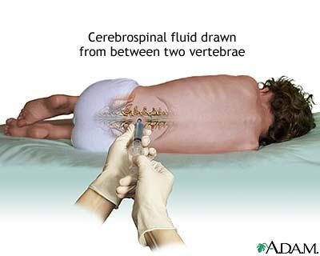
Lumbar Puncture
A lumbar puncture also called a spinal tap is a procedure where a sample of cerebrospinal fluid is taken for examination.

Slide 28
Lumbar puncture is performed in an attempt to count the cells in the fluid and to detect the levels of protein and glucose. These parameters alone may be extremely beneficial in the diagnosis of subarachnoid hemorrhage and central nervous system infections (such as meningitis). Moreover, a CSF culture examination may yield the microorganism that has caused the infection. By using more sophisticated methods, such as the detection of the oligoclonal bands, an ongoing inflammatory condition (for example, multiple sclerosis) can be recognized. A beta-2 transferrin assay is highly specific and sensitive for the detection for, e.g., CSF leakage.

