Slide 1
Chapter 6: Project Time Management
Information Technology Project Management, Seventh Edition

Slide 2
Importance of Project Schedules
Managers often cite delivering projects on time as one of their biggest challenges
Time has the least amount of flexibility; it passes no matter what happens on a project
Schedule issues are the main reason for conflicts on projects, especially during the second half of projects

Slide 3
Individual Work Styles and Cultural Differences Cause Schedule Conflicts
Some people prefer to follow schedules and meet deadlines while others do not
Difference cultures and even entire countries have different attitudes about schedules

Slide 4
Project Time Management Processes
Planning schedule management: determining the policies, procedures, and documentation that will be used for planning, executing, and controlling the project schedule
Defining activities: identifying the specific activities that the project team members and stakeholders must perform to produce the project deliverables
Sequencing activities: identifying and documenting the relationships between project activities
Estimating activity resources: estimating how many resources a project team should use to perform project activities
Estimating activity durations: estimating the number of work periods that are needed to complete individual activities
Developing the schedule: analyzing activity sequences, activity resource estimates, and activity duration estimates to create the project schedule
Controlling the schedule: controlling and managing changes to the project schedule

Slide 5
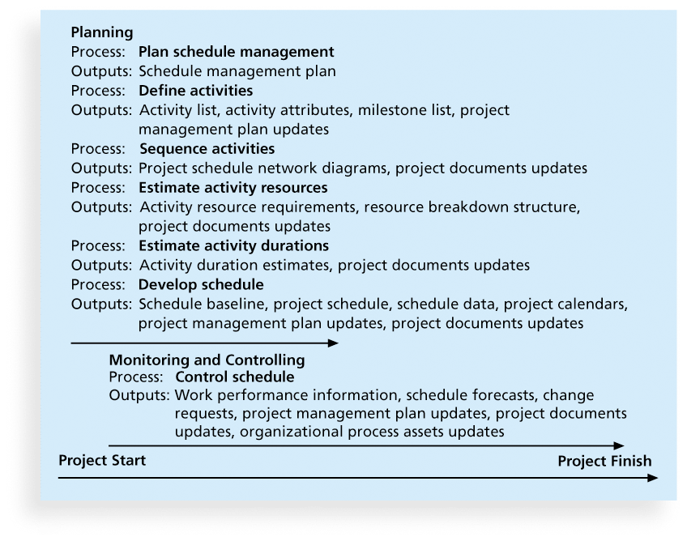
Figure 6-1. Project Time Management Summary

Slide 6
1.Planning Schedule Management
The project team uses expert judgment, analytical techniques, and meetings to develop the schedule management plan
A schedule management plan includes:
Project schedule model development: Many projects include a schedule model, which contains project activities with estimated durations, dependencies, and other planning information that can be used to produce a project schedule.
Level of accuracy and units of measure: This section discusses how accurate schedule estimates should be and determines whether time is measured in hours, days, or another unit.
Rules of performance measurement: For example, if team members are expected to track the percentage of work completed, this section specifies how to determine the percentages.
Reporting formats: This section describes the format and frequency of schedule reports required for the project.
Process descriptions: how all of the schedule management processes will be performed.

Slide 7
2. Defining Activities
An activity or task is an element of work normally found on the work breakdown structure (WBS) that has an expected duration, a cost, and resource requirements
Activity definition involves developing a more detailed WBS and supporting explanations to understand all the work to be done so you can develop realistic cost and duration estimates

Slide 8
2.1Activity Lists and Attributes
An activity list is a tabulation of activities to be included on a project schedule that includes
the activity name
an activity identifier or number
a brief description of the activity
Activity attributes provide more information such as predecessors, successors, logical relationships, leads and lags, resource requirements, constraints, imposed dates, and assumptions related to the activity

Slide 9
2.3 Milestones
A milestone is a significant event that normally has no duration
It often takes several activities and a lot of work to complete a milestone
They’re useful tools for setting schedule goals and monitoring progress
Examples include obtaining customer sign-off on key documents or completion of specific products
The goal of defining activities is to ensure that the project team completely understands all the work it must do as part of the project scope so they can start scheduling the work.
Notes:
For example, a WBS item might be “Study report.” The project team must understand what the item means before team members can make schedule-related decisions. How long should the report be? Does it require a survey or extensive research to produce? What skill level does the report writer need to have? Further defining the task will help the project team determine how long it will take to do and who should do it.

Slide 10
3. Sequencing Activities
Involves reviewing activities and determining dependencies
A dependency or relationship is the sequencing of project activities or tasks
You must determine dependencies in order to use critical path analysis

Slide 11
3.1 Three types of Dependencies
Mandatory dependencies: inherent in the nature of the work being performed on a project, (ex. You cannot test a code until a code is written)
Discretionary dependencies: defined by the project team., sometimes referred to as soft logic and should be used with care since they may limit later scheduling options (ex. Don’t start design until we get a user sign off all the analysis work)
External dependencies: involve relationships between project and non-project activities ( ex installation of new software depend on the delivery of new hardware)

Slide 12
3.2 Network Diagrams
Network diagrams are the preferred technique for showing activity sequencing
A network diagram is a schematic display of the logical relationships among, or sequencing of, project activities

Slide 13
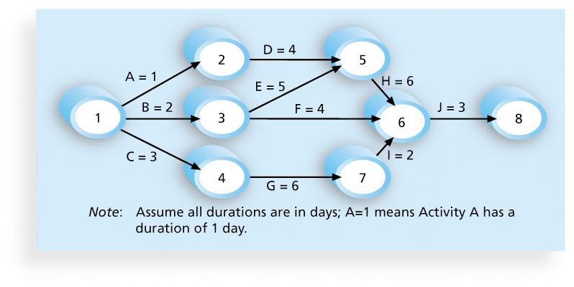
Figure 6-2. Network Diagram for Project X

Slide 14
3.2 Arrow Diagramming Method (ADM)
Also called activity-on-arrow (AOA) network diagrams
Activities are represented by arrows
Nodes or circles are the starting and ending points of activities
Can only show finish-to-start dependencies

Slide 15
4.Estimating Activity Resources
Before estimating activity durations, you must have a good idea of the quantity and type of resources that will be assigned to each activity; resources are people, equipment, and materials
Consider important issues in estimating resources
How difficult will it be to do specific activities on this project?
What is the organization’s history in doing similar activities?
Are the required resources available?
A resource breakdown structure is a hierarchical structure that identifies the project’s resources by category and type

Slide 16
5. Activity Duration Estimating
Duration includes the actual amount of time worked on an activity plus elapsed time
Effort is the number of workdays or work hours required to complete a task
Effort does not normally equal duration
Duration relates to the time estimate on a calendar, not the effort estimate.
People doing the work should help create estimates, and an expert should review them

Slide 17
5.1 Three-Point Estimates
Instead of providing activity estimates as a discrete number, such as four weeks, it’s often helpful to create a three-point estimate
an estimate that includes an optimistic, most likely, and pessimistic estimate, such as three weeks for the optimistic, four weeks for the most likely, and five weeks for the pessimistic estimate

Slide 18
6.Developing the Schedule
Uses results of the other time management processes to determine the start and end date of the project
Ultimate goal is to create a realistic project schedule that provides a basis for monitoring project progress for the time dimension of the project
Important tools and techniques include Gantt charts, critical path analysis, and critical chain scheduling, and PERT analysis

Slide 19
6.1 Gantt Charts
Gantt charts provide a standard format for displaying project schedule information by listing project activities and their corresponding start and finish dates in a calendar format
Symbols include:
A black diamond: a milestones
Thick black bars: summary tasks
Lighter horizontal bars: durations of tasks
Arrows: dependencies between tasks

Slide 20
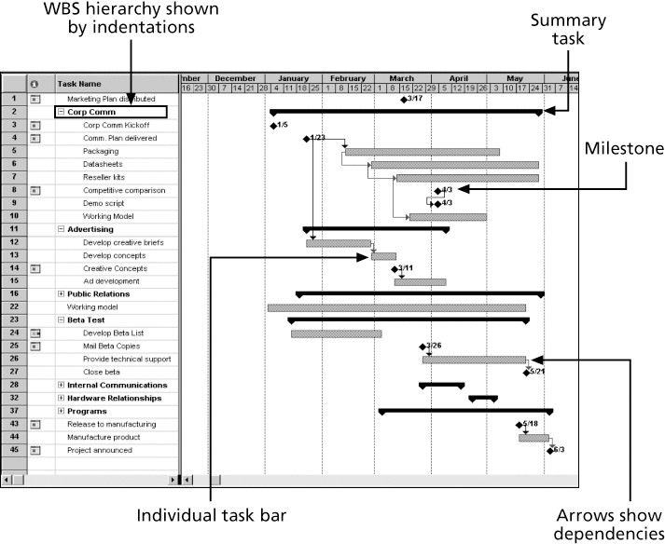
Figure 6-6. Gantt Chart for Software Launch Project

Slide 21
Adding Milestones to Gantt Charts
Many people like to focus on meeting milestones, especially for large projects
Milestones emphasize important events or accomplishments on projects
Normally create milestone by entering tasks with a zero duration, or you can mark any task as a milestone

Slide 22
6.2 tracking Gantt Chart
You can use a special form of a Gantt chart to evaluate progress on a project by showing actual schedule information. Figure 6-7 shows a Tracking Gantt chart—a Gantt chart that compares planned and actual project schedule information.

Slide 23
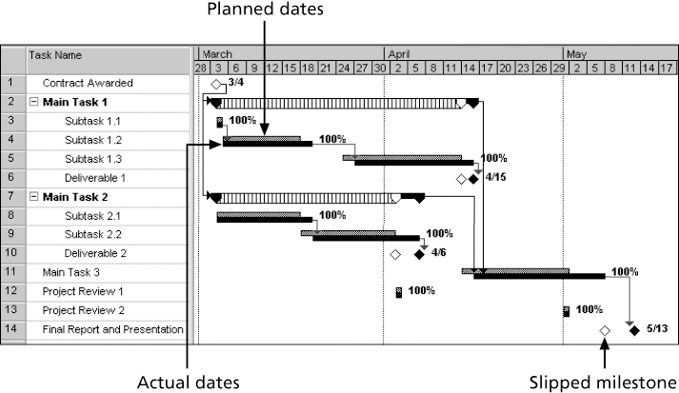
Figure 6-7. Sample Tracking Gantt Chart

Slide 24
6.3 Critical Path Method (CPM)
CPM is a network diagramming technique used to predict total project duration
A critical path for a project is the series of activities that determines the earliest time by which the project can be completed
The critical path is the longest path through the network diagram and has the least amount of slack or float
Slack or float is the amount of time an activity may be delayed without delaying a succeeding activity or the project finish date

Slide 25
6.3Calculating the Critical Path
First develop a good network diagram
Add the duration estimates for all activities on each path through the network diagram
The longest path is the critical path
If one or more of the activities on the critical path takes longer than planned, the whole project schedule will slip unless the project manager takes corrective action

Slide 26
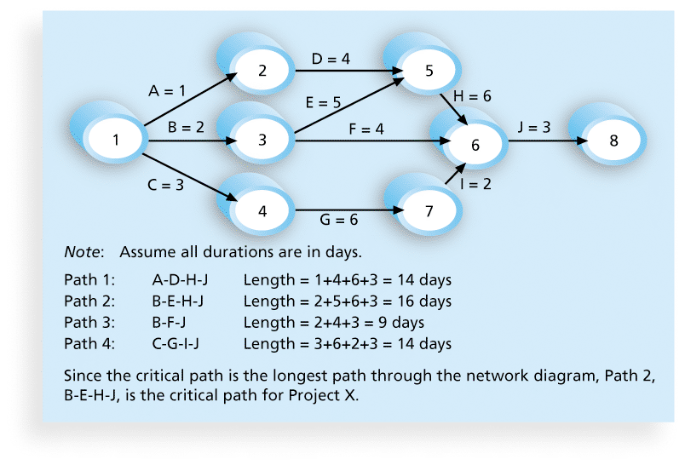
Figure 6-8. Determining the Critical Path for Project X

Slide 27
6.3More on the Critical Path
A project team at Apple computer put a stuffed gorilla on the top of the cubicle of the person currently managing critical task
The critical path is not the one with all the critical activities; it only accounts for time
There can be more than one critical path if the lengths of two or more paths are the same
The critical path can change as the project progresses

Slide 28
6.4 Using the Critical Path to Shorten a Project Schedule
Three main techniques for shortening schedules
Shortening durations of critical activities/tasks by adding more resources or changing their scope
Crashing activities by obtaining the greatest amount of schedule compression for the least incremental cost
Fast tracking activities by doing them in parallel or overlapping them

Slide 29
6.5Importance of Updating Critical Path Data
It is important to update project schedule information to meet time goals for a project
The critical path may change as you enter actual start and finish dates
If you know the project completion date will slip, negotiate with the project sponsor

Slide 30
7. Controlling the Schedule
Goals are to know the status of the schedule, influence factors that cause schedule changes, determine that the schedule has changed, and manage changes when they occur
Tools and techniques include
Progress reports
A schedule change control system
Project management software, including schedule comparison charts like the tracking Gantt chart
Variance analysis, such as analyzing float or slack

Slide 31
Reality Checks on Scheduling
First review the draft schedule or estimated completion date in the project charter
Prepare a more detailed schedule with the project team
Get stakeholders approval
To establish the schedule, it is critical to get involvement and commitment from all project team members, top management, the customer, and other key stakeholders.
Make sure the schedule is realistic and followed
Alert top management well in advance if there are schedule problems

Slide 32
Using Software to Assist in Time Management
Software for facilitating communications helps people exchange schedule-related information
Decision support models help analyze trade-offs that can be made
Project management software can help in various time management areas

Slide 33
Chapter Summary
Project time management is often cited as the main source of conflict on projects, and most IT projects exceed time estimates
Main processes include
Plan schedule management
Define activities
Sequence activities
Estimate activity resources
Estimate activity durations
Develop schedule
Control schedule

