Slide 1
Chapter 5: Project Scope Management
Information Technology Project Management, Seventh Edition
Note: See the text itself for full citations.

Slide 2
What is Project Scope Management?
Scope refers to all the work involved in creating the products of the project and the processes used to create them
A deliverable is a product produced as part of a project, such as hardware or software, planning documents, or meeting minutes
Project scope management includes the processes involved in defining and controlling what is or is not included in a project

Slide 3
Project Scope Management Processes
Planning scope: determining how the project’s scope and requirements will be managed
Collecting requirements: defining and documenting the features and functions of the products produced during the project as well as the processes used for creating them
Defining scope: reviewing the project charter, requirements documents, and organizational process assets to create a scope statement
Creating the WBS: subdividing the major project deliverables into smaller, more manageable components
Validating scope: formalizing acceptance of the project deliverables
Controlling scope: controlling changes to project scope throughout the life of the project

Slide 4
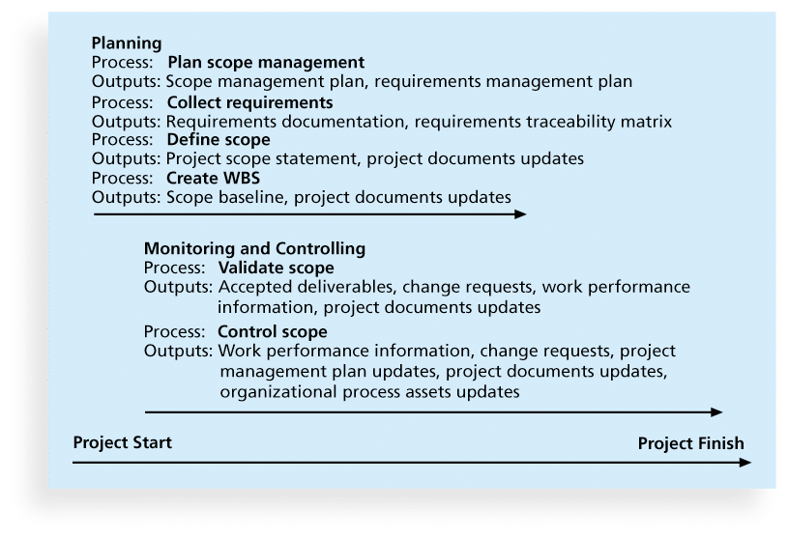
Figure 5-1. Project Scope Management Summary

Slide 5
1.Planning Scope Management
The project team uses expert judgment and meetings to develop two important outputs: the scope management plan and the requirements management plan
The scope management plan is a subsidiary part of the project management plan

Slide 6
1.1Scope Management Plan Contents
How to prepare a detailed project scope statement
How to create a WBS
How to maintain and approve the WBS
How to obtain formal acceptance of the completed project deliverables
How to control requests for changes to the project scope

Slide 7
1.2 Requirements Management Plan
The PMBOK® Guide, Fifth Edition, describes requirements as “conditions or capabilities that must be met by the project or present in the product, service, or result to satisfy an agreement or other formally imposed specification”
The requirements management plan documents how project requirements will be analyzed, documented, and managed (ex. How plan or report requirements activities, how to prioritize requirements, how to use product metrics)

Slide 8
1.2 Requirements Management Plan
For software projects, it is helpful to divide requirements development into the software engineering steps called elicitation, analysis, specification, and validation.
These steps include all the activities involved in gathering, evaluating, and documenting requirements for a software or software-containing product.
It is also important to use an iterative approach to defining requirements because they are often unclear early in a project.

Slide 9
2. Collecting Requirements
The second step in project scope management is often the most difficult: collecting requirements.
A major consequence of not defining requirements well is rework, which can consume up to half of project costs, especially for software development projects.

Slide 10
2.1Methods for Collecting Requirements
Interviewing
Focus groups and facilitated workshops
Using group creativity and decision-making techniques
Questionnaires and surveys
Observation
Prototyping
Benchmarking, or generating ideas by comparing specific project practices or product characteristics to those of other projects or products inside or outside the performing organization, can also be used to collect requirements

Slide 11
2.2Requirements Traceability Matrix
A requirements traceability matrix (RTM) is a table that lists requirements, various attributes of each requirement, and the status of the requirements to ensure that all requirements are addressed
Table 5-1. Sample entry in an RTM

Slide 12
3. Defining Scope
Project scope statements should include at least a product scope description, product user acceptance criteria, and detailed information on all project deliverables. It is also helpful to document other scope-related information, such as the project boundaries, constraints, and assumptions. The project scope statement should also reference supporting documents, such as product specifications
As time progresses, the scope of a project should become more clear and specific

Slide 13
3.1 Defining Scope
Many IT projects require detailed functional and design specifications for developing software, which also should be referenced in the detailed scope statement.
An up-to-date project scope statement is an important document for developing and confirming a common understanding of the project scope.

Slide 14
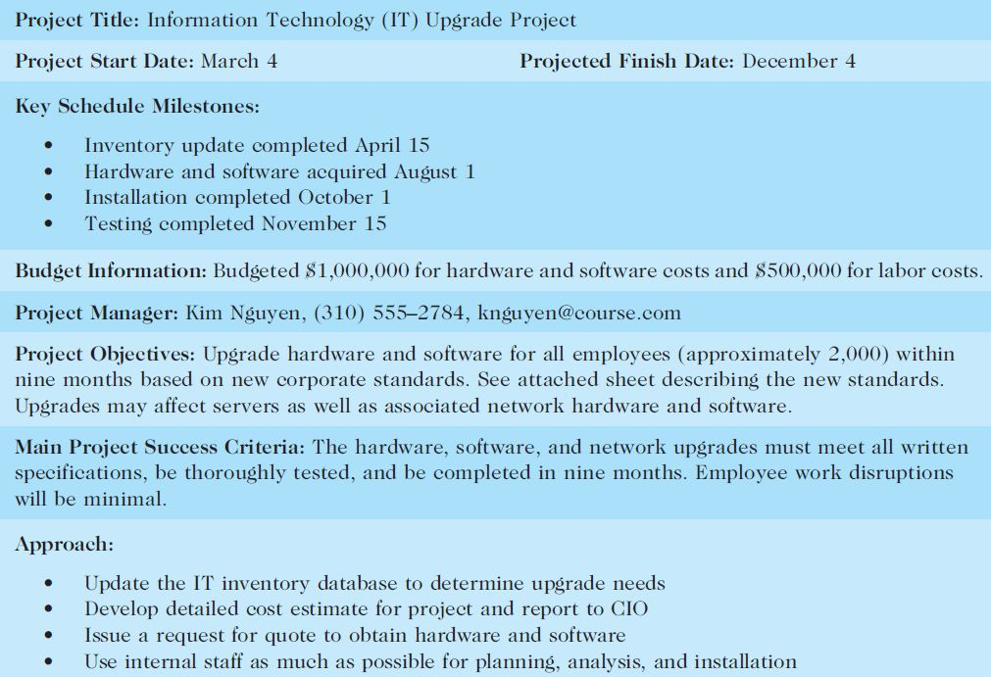
Table 5-2. Sample Project Charter (partial)

Slide 15
Table 5-3: Further Defining Project Scope

Slide 16
4. Creating the Work Breakdown Structure (WBS)
A WBS is a deliverable-oriented grouping of the work involved in a project that defines the total scope of the project
WBS is a foundation document that provides the basis for planning and managing project schedules, costs, resources, and changes
Decomposition is subdividing project deliverables into smaller pieces
A work package is a task at the lowest level of the WBS
The scope baseline includes the approved project scope statement and its associated WBS and WBS dictionary

Slide 17
4.1 Creating the Work Breakdown Structure (WBS)
Types of Organizing WBS: By Product By Phase(Level) By Project Management Process Groups

Slide 18
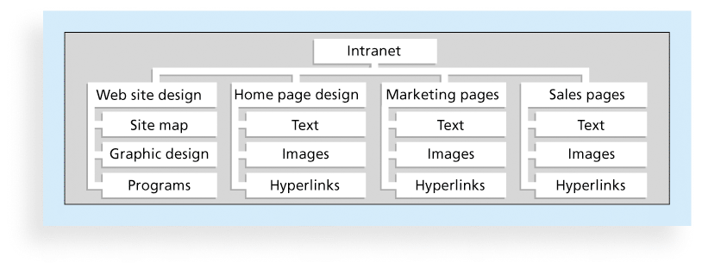
Figure 5-3. Sample Intranet WBS Organized by Product

Slide 19
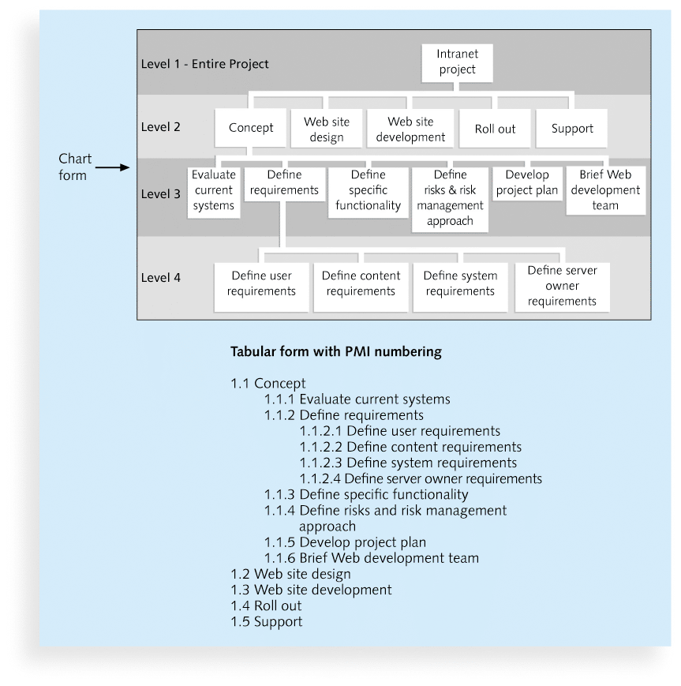
Figure 5-4. Sample Intranet WBS Organized by Phase

Slide 20
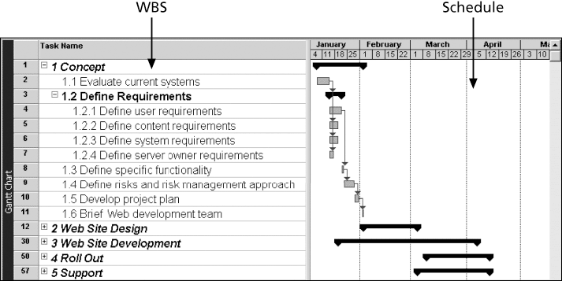
Figure 5-5. Intranet WBS and Gantt Chart in Microsoft Project

Slide 21
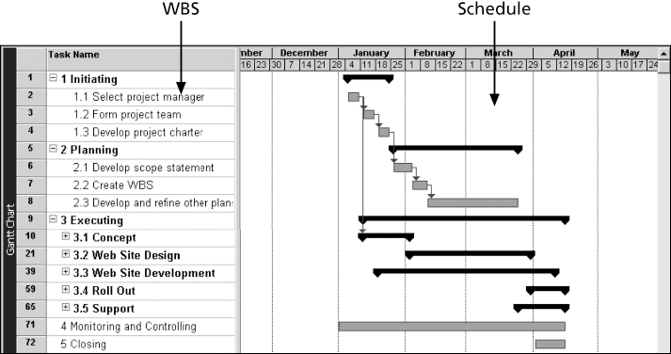
Figure 5-6. Intranet Gantt Chart Organized by Project Management Process Groups

Slide 22
4.1 Creating the Work Breakdown Structure (WBS)
The example WBSs shown here are simplified so that they are somewhat easy to understand and construct. Nevertheless, it is very difficult to create a good WBS.
To create a good WBS, you must understand the project and its scope and incorporate the needs and knowledge of the stakeholders.
The project manager and the project team must decide as a group how to organize the work and how to include many levels in the WBS.

Slide 23
4.1 Creating the Work Breakdown Structure (WBS)
Many people confuse tasks on a WBS with specifications. Tasks on a WBS represent work that needs to be done to complete the project. For example, if you are creating a WBS to redesign a kitchen, you might have Level 2 categories called design, purchasing, flooring, walls, cabinets, and appliances. Under flooring, you might have tasks to remove the old flooring, install the new flooring, and install the trim. You would not have tasks like “12 ft. by 14 ft. of light oak” or “flooring must be durable”; these are specifications.

Slide 24
4.1 Creating the Work Breakdown Structure (WBS)
Another concern when creating a WBS is how to organize it to provide the basis for the project schedule. You should focus on what work needs to be done and how it will be done, not when it will be done. In other words, the tasks do not have to be developed as a sequential list of steps.
It is also very important to involve the entire project team and the customer in creating and reviewing the WBS. People who will do the work should help to plan the work by creating the WBS.

Slide 25
4.2 Approaches to Developing WBSs
Using guidelines: Some organizations, like the Department Of Defense, provide guidelines for preparing WBSs
The analogy approach: Review WBSs of similar projects and tailor to your project
The top-down approach: Start with the largest items of the project and break them down
The bottom-up approach: Start with the specific tasks and roll them up
Mind-mapping approach: Mind mapping is a technique that uses branches radiating out from a core idea to structure thoughts and ideas

Slide 26
Figure 5-7. Sample Mind-Mapping Approach for Creating a WBS

Slide 27
4.3 The WBS Dictionary and Scope Baseline
Many WBS tasks are vague and must be explained more so people know what to do and can estimate how long it will take and what it will cost to do the work
A WBS dictionary is a document that describes detailed information about each WBS item

Slide 28
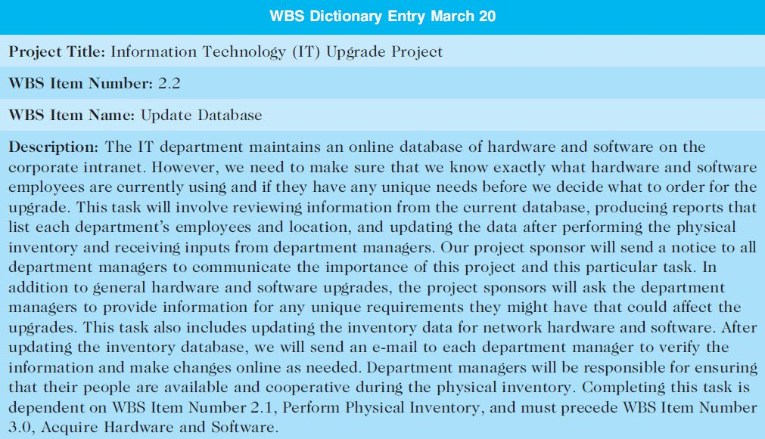
Table 5-5. Sample WBS Dictionary Entry

Slide 29
4.5 Advice for Creating a WBS and WBS Dictionary
A unit of work should appear at only one place in the WBS.
The work content of a WBS item is the sum of the WBS items below it
A WBS item is the responsibility of only one individual, even though many people may be working on it
The WBS must be consistent with the way in which work is actually going to be performed; it should serve the project team first, and other purposes only if practical

Slide 30
4.5 Advice for Creating a WBS and WBS Dictionary (cont’d)
Project team members should be involved in developing the WBS to ensure consistency and buy-in
Each WBS item must be documented in a WBS dictionary to ensure accurate understanding of the scope of work included and not included in that item
The WBS must be a flexible tool to accommodate inevitable changes while properly maintaining control of the work content in the project according to the scope statement

Slide 31
5. Validating Scope
It is very difficult to create a good scope statement and WBS for a project
It is even more difficult to verify project scope and minimize scope changes
Scope validation involves formal acceptance of the completed project deliverables
Acceptance is often achieved by a customer inspection and then sign-off on key deliverables
Even when the project scope is fairly well defined, many IT projects suffer from scope creep—(the tendency for project scope to keep getting bigger and bigger.). For this reason it is very important to verify scope with users throughout project life

Slide 32
6. Controlling Scope
Scope control involves controlling changes to the project scope while keeping project goals and business strategy in mind
Goals of scope control are to
influence the factors that cause scope changes
assure changes are processed according to procedures developed as part of integrated change control, and
manage changes when they occur

Slide 33
6.1 Variance
An important tool for performing scope control is data analysis, including variance analysis
Variance is the difference between planned and actual performance For example, if a supplier was supposed to deliver five special keyboards and you received only four, the variance would be one keyboard. The outputs of scope control include work performance information, change requests, project management plan updates, and project documents updates.

Slide 34
6.2 Suggestions for Improving User Input
To avoid project failures, it is crucial for IT project managers and their teams to improve user input and executive support and reduce incomplete and changing requirements.
Develop a good project selection process and insist that sponsors are from the user organization
Have users on the project team in important roles
Have regular meetings with defined agendas, and have users sign off on key deliverables presented at meetings
Deliver something to users and sponsors on a regular basis
Don’t promise to deliver when you know you can’t
Co-locate users with developers

Slide 35
6.3 Suggestions for Reducing Incomplete and Changing Requirements
Develop and follow a requirements management process
Use techniques such as prototyping, use case modeling,
Put requirements in writing and keep them current
Create a requirements management database for documenting and controlling requirements

Slide 36
6.3 Suggestions for Reducing Incomplete and Changing Requirements (cont’d)
Provide adequate testing and conduct testing throughout the project life cycle
Review changes from a systems perspective
Emphasize completion dates to help focus on what’s most important
Allocate resources specifically for handling change requests/enhancements

Slide 37
Using Software to Assist in Project Scope Management
Word-processing software helps create several scope-related documents
Spreadsheets help to perform financial calculations, weighed scoring models, and develop charts and graphs
Communication software like e-mail and the Web help clarify and communicate scope information
Project management software helps in creating a WBS, the basis for tasks on a Gantt chart
Specialized software is available to assist in project scope management

Slide 38
Chapter Summary
Project scope management includes the processes required to ensure that the project addresses all the work required, and only the work required, to complete the project successfully
Main processes include
Define scope management
Collect requirements
Define scope
Create WBS
Validate scope
Control scope

