Slide 1
Chapter 4: Project Integration Management
Information Technology Project Management, Seventh Edition
Note: See the text itself for full citations.

Slide 2
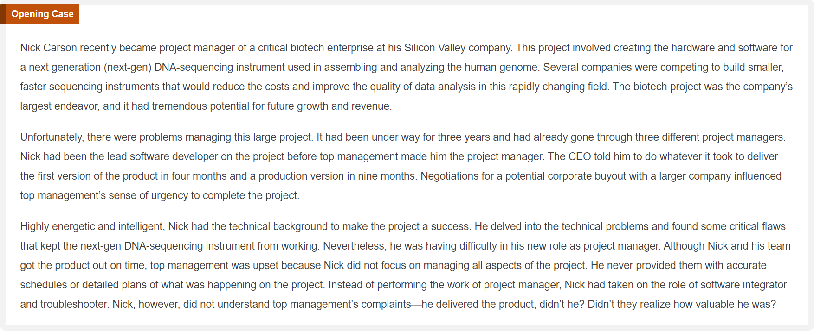

Slide 3
What is project integration management
project integration management involves coordinating all of the other project management knowledge areas throughout a project’s life cycle.
Many new project managers have trouble looking at the “big picture” and want to focus on too many details (See opening case for a real example)
Project integration management is not the same thing as software integration

Slide 4
Project Integration Management Processes
1. Developing the project charter involves working with stakeholders to create the document that formally authorizes a project—the charter.
2. Developing the project management plan involves coordinating all planning efforts to create a consistent, coherent document—the project management plan.
3. Directing and managing project work involves carrying out the project management plan by performing the activities included in it.

Slide 5
Project Integration Management Processes (cont’d)
4. Managing project knowledge involves using existing knowledge and creating new knowledge to achieve project objectives while also contributing to organizational learning.
5. Monitoring and controlling project work involves overseeing activities to meet the performance objectives of the project
6. Performing integrated change control involves identifying, evaluating, and managing changes throughout the project life cycle.
7. Closing the project or phase involves finalizing all activities to formally close the project or phase.

Slide 6
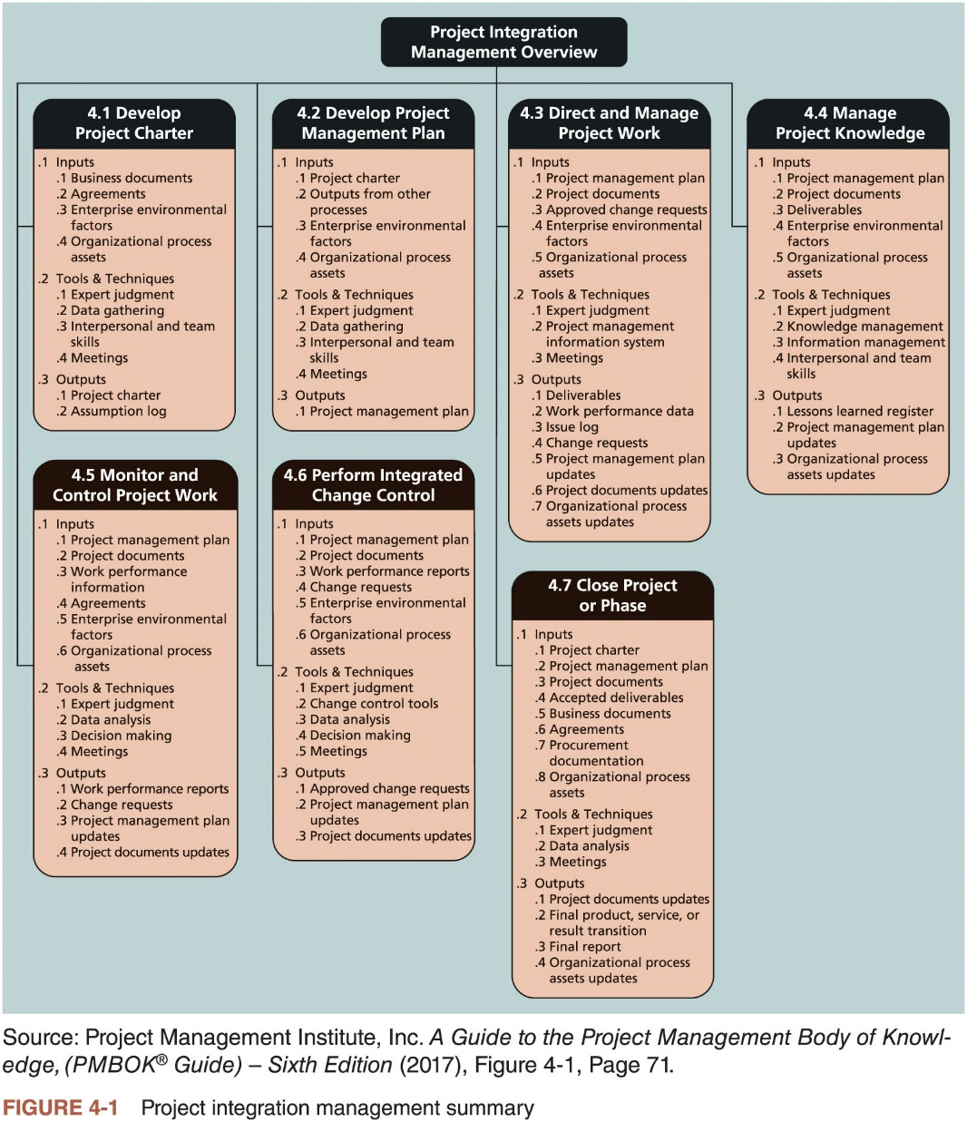

Slide 7
Strategic Planning and Project Selection
Strategic planning involves determining long-term objectives, predicting future trends, and projecting the need for new products and services
Organizations often perform a SWOT analysis
analyzing Strengths, Weaknesses, Opportunities, and Threats
As part of strategic planning, organizations
identify potential projects
use realistic methods to select which projects to work on (ex. Weight scoring model, Net present value NPV analysis)
formalize project initiation by issuing a project charter

Slide 8
1.Developing a Project Charter
After deciding what project to work on, it is important to let the rest of the organization know
A project charter is a document that formally recognizes the existence of a project and provides direction on the project’s objectives and management
Key project stakeholders should sign a project charter to acknowledge agreement on the need and intent of the project; a signed charter is a key output of project integration management

Slide 9
1.1Inputs for Developing a Project Charter
A project statement of work: a document that describes the products or services to be created by the project
A business case: many projects require a business case to justify their investment. Information in the business case, such as the project objective, high-level requirements, and time and cost goals, is included in the project charter.
Agreements
Enterprise environmental factors including governments or industry standards
Organizational process assets, which include formal and informal plans, policies, procedures, guidelines, information systems, financial systems, management systems, lessons learned, and historical information

Slide 10
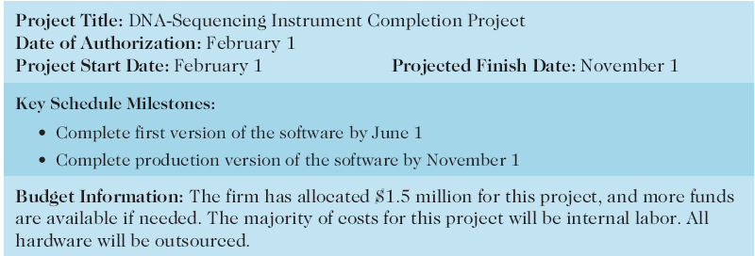
Table 4-1. Project Charter for the DNA-Sequencing Instrument Completion Project

Slide 11
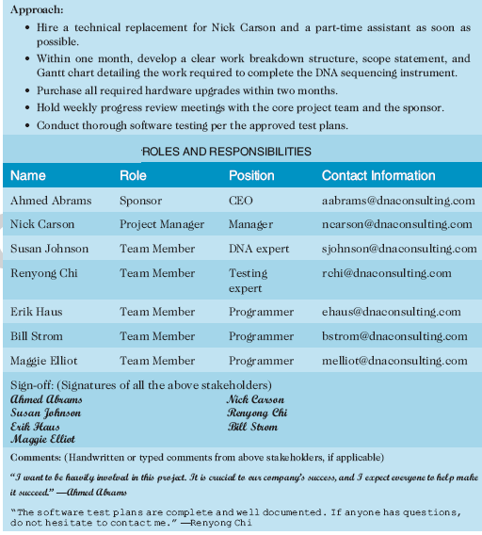
Table 4-1. Project Charter (cont.)

Slide 12
2.Developing a Project Management Plan
A project management plan is a document used to coordinate all project planning documents and help guide a project’s execution and control
Plans created in the other knowledge areas are subsidiary parts of the overall project management plan

Slide 13
2.1Common Elements of a Project Management Plan
Introduction or overview of the project
Description of how the project is organized
Management and technical processes used on the project
Work to be done, schedule, and budget information

Slide 14
3.Directing and Managing Project Work
Involves managing and performing the work described in the project management plan
The majority of time and money is usually spent on execution

Slide 15
3.1Coordinating Planning and Execution
Project planning and execution are intertwined and inseparable activities
Those who will do the work should help to plan the work
Project managers must solicit input from the team to develop realistic plans

Slide 16
3.2Providing Leadership and a Supportive Culture
Project managers must lead by example to demonstrate the importance of creating and then following good project plans
Organizational culture can help project execution by
providing guidelines and templates
tracking performance based on plans
Project managers may still need to break the rules to meet project goals, and senior managers must support those actions

Slide 17
3.3Capitalizing on Product, Business, and Application Area Knowledge
It is often helpful for IT project managers to have prior technical experience
On small projects, the project manager may be required to perform some of the technical work or mentor team members to complete the projects
On large projects, the project manager must understand the business and application area of the project

Slide 18
3.4Project Execution Tools and Techniques
Expert judgment: Experts can help project managers and their teams make many decisions related to project execution
Meetings: Meetings allow people to develop relationships, pick up on important body language or tone of voice, and have a dialogue to help resolve problems.
Project management information systems: There are hundreds of project management software products available on the market today, and many organizations are moving toward powerful enterprise project management systems that are accessible via the Internet

Slide 19
4.Managing Project Knowledge
Basic types of knowledge
Explicit knowledge: easily explained using words, pictures, or numbers and is easy to communicate, store, and distribute
Tacit knowledge: difficult to express and highly personal
Knowledge management should be done before, during, and after projects are completed
Often very difficult to accomplish

Slide 20
5.Monitoring and Controlling Project Work
Changes are inevitable on most projects, so it’s important to develop and follow a process to monitor and control changes
Monitoring project work includes collecting, measuring, and disseminating performance information
A baseline is the approved project management plan plus approved changes

Slide 21
6.Performing Integrated Change Control
Integrated change control involves identifying, evaluating, and managing changes throughout the project life cycle.
Three main objectives are:
Influencing the factors that create changes to ensure that changes are beneficial
Determining that a change has occurred
Managing actual changes as they occur

Slide 22
6.1Change Control on Information Technology Projects
Former view: The project team should strive to do exactly what was planned on time and within budget
Problem: Stakeholders rarely agreed up-front on the project scope, and time and cost estimates were inaccurate
Modern view: Project management is a process of constant communication and negotiation
Solution: Changes are often beneficial, and the project team should plan for them

Slide 23
6.2Change Control System
A change control system is a formal, documented process that describes when and how official project documents and work may be changed
Describes who is authorized to make changes and how to make them

Slide 24
6.3Change Control Board (CCB)
A change control board is a formal group of people responsible for approving or rejecting changes on a project
CCBs provide guidelines for preparing change requests, evaluate change requests, and manage the implementation of approved changes
Includes stakeholders from the entire organization

Slide 25
6.4Making Timely Changes
Some CCBs only meet occasionally, so it may take too long for changes to occur
Some organizations have policies in place for time-sensitive changes
“48-hour policy” allows project team members to make decisions, then they have 48 hours to reverse the decision pending senior management approval
Delegate changes to the lowest level possible, but keep everyone informed of changes

Slide 26
6.5Configuration Management
Configuration management ensures that the descriptions of the project’s products are correct and complete
Involves identifying and controlling the functional and physical design characteristics of products and their support documentation

Slide 27
7.Closing Projects or Phases
To close a project or phase, you must finalize all activities and transfer the completed or cancelled work to the appropriate people
Main outputs include
Final product, service, or result transition
Organizational process asset updates

Slide 28
Using Software to Assist in Project Integration Management
Several types of software can be used to assist in project integration management
Documents can be created with word processing software
Presentations are created with presentation software
Tracking can be done with spreadsheets or databases
Communication software like e-mail and Web authoring tools facilitate communications
Project management software can pull everything together and show detailed and summarized information
Business Service Management (BSM) tools track the execution of business process flows

Slide 29
Chapter Summary
Project integration management involves coordinating all of the other knowledge areas throughout a project’s life cycle
Main processes include
Develop the project charter
Develop the project management plan
Direct and manage project execution
Manage project Knowledge
Monitor and control project work
Perform integrated change control
Close the project or phase

