Slide 1
Chapter 1: Introduction to Project Management
Information Technology Project Management, Seventh Edition
Note: See the text itself for full citations.

Slide 2
Introduction
Many organizations today have a new or renewed interest in project management
Computer hardware, software, networks, and the use of interdisciplinary and global work teams have radically changed the work environment
The Project Management Institute reported that the number of jobs reached almost 66 million in 2017. By 2027, employers will need 87.7 million individuals working in project management–oriented roles

Slide 3
Project Management Statistics
In 2017, the average annual salary (without bonuses) for someone in the project management profession was $112,000 in the U.S. and $130,866 in Switzerland
The top skills employers look for in new college graduates are all related to project management: team-work, problem-solving, and verbal communications
Organizations waste $97 million for every $1 billion spent on projects, according to PMI’s Pulse of the Profession® report

Slide 4
Introduction
The complexity and importance of IT projects, (which involve using hardware, software, and networks to create a product, service, or result, )have evolved dramatically.
Today’s companies, governments, and nonprofit organizations are recognizing that to be successful, they need to use modern project management techniques, especially for IT projects.
Individuals are realizing that to remain competitive in the workplace, they must develop skills to become good project team members and project managers.
They also realize that many of the concepts of project management will help them in their everyday lives as they work with people and technology on a day-to-day basis

Slide 5
Advantages of Using Formal Project Management
Better control of financial, physical, and human resources
Improved customer relations
Shorter development times
Lower costs and improved productivity
Higher quality and increased reliability
Higher profit margins
Positive impact on meeting strategic goals
Better internal coordination
Higher worker morale

Slide 6
What Is a Project?
A project is “a temporary endeavor undertaken to create a unique product, service, or result” (PMBOK® Guide, Fifth Edition, 2012)
Operations is work done to sustain the business
Projects end when their objectives have been reached or the project has been terminated
Projects can be large or small and take a short or long time to complete

Slide 7
Examples of IT Projects
A team of students creates a smartphone application and sells it online
A company develops a driverless car
A small software development team adds a new feature to an internal software application for the finance department
A college upgrades its technology infrastructure to provide wireless Internet access across the whole campus

Slide 8
Project Example 1
manufacturing cell phone cases:
A cell phone company is interested in manufacturing a special cell phone case for their newest model. This cell phone case is part of a promotion to sell the phone. They begin four months from today. Only 1200 of these special cases will be manufactured for distribution during the promotion. After the promotion, no further cases will be manufactured or distributed.
is it temporary? ✓
is it unique? ✓
will the end of the project reach the project objectives? ✓

Slide 9
Project Example 2
manufacturing cell phone cases:
The cell phone company has so much success with their promotional cell phone cases that customer demand has convinced them to integrate this case as part of their regular product offering. It will now be manufactured along with the other five cases that are currently offered. The cases will be manufactured until the customer demands for the phone drops.
is it temporary? ✗
is it unique? ✗
will the end of the project reach the project objectives? ✗
It is not a project , it is an operation work.

Slide 10
Project Attributes
A project
has a unique purpose
is temporary: has a definitive beginning and end.
is developed using progressive elaboration: projects are often defined broadly when they begin, and as time passes, the specific details of the project become clearer. Therefore, projects should be developed in increments. A project team should develop initial plans and then update them with more detail based on new information

Slide 11
Project Attributes
A project
requires resources, often from various areas: Resources include people, hardware, software, and other assets. Many projects cross departmental or other boundaries to achieve their unique purposes. For the IT collaboration project, people from IT, marketing, sales, distribution, and other areas of the company would need to work together to develop ideas
should have a primary customer or sponsor
The project sponsor usually provides the direction and funding for the project

Slide 12
Project Attributes
involves uncertainty: Because every project is unique, it is sometimes difficult to define its objectives clearly, estimate how long it will take to complete, or determine how much it will cost. External factors also cause uncertainty, such as a supplier going out of business or a project team member needing unplanned time off. This uncertainty is one of the main reasons project management is so challenging, especially on projects involving new technologies.
A project drives change and enables value creation. A project is initiated to bring about a change in order to meet a need or desire. Its purpose is to achieve a specific objective which changes the context (a living situation, in a house project example) from a current state to a more desired or valued future state

Slide 13
Project and Program Managers
Project managers are crucial to project success , managers work with project sponsors, project team, and other people involved in a project to meet project goals

Slide 14
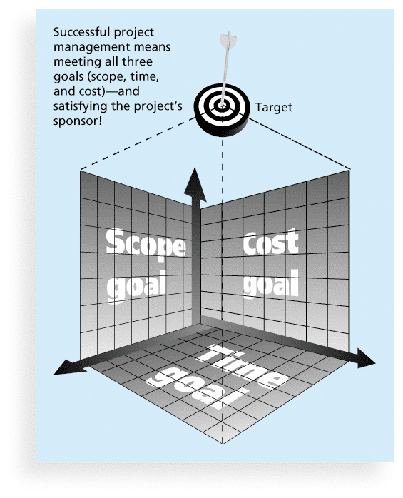
Figure 1-1 The Triple Constraint of Project Management
Notes:
illustrates the three dimensions of the triple constraint. Each area—scope, time, and cost—has a target at the beginning of the project. For example, the IT collaboration project might have an initial scope of producing a 40- to 50-page report and a one-hour presentation on about 30 potential IT projects. The project manager might further define project scope to include providing a description of each potential project, an investigation of what other companies have implemented for similar projects, a rough time and cost estimate, and assessments of the risk and potential payoff as high, medium, or low. The initial time estimate for this project might be one month, and the cost estimate might be $45,000–$50,000. These expectations provide targets for the scope, time, and cost dimensions of the project.

Slide 15
The Triple Constraint of Project Management
Scope: What work will be done as part of the project? What unique product, service, or result does the customer or sponsor expect from the project? How will the scope be verified?
Time: How long should it take to complete the project? What is the project’s schedule? How will the team track actual schedule performance? Who can approve changes to the schedule?
Cost: What should it cost to complete the project? What is the project’s budget? How will costs be tracked? Who can authorize changes to the budget?

Slide 16
The Triple Constraint of Project Management
Managing the triple constraint involves making trade-offs between scope, time, and cost goals for a project. For example, you might need to increase the budget for a project to meet scope and time goals.
Experienced project managers know that you must decide which aspect of the triple constraint is most important. If time is most important, you must often change the initial scope and cost goals to meet the schedule. If scope goals are most important, you may need to adjust time and cost goals
Although the triple constraint describes how the basic elements of a project interrelate, other elements can also play significant roles. Quality and risk and resources

Slide 17
What is Project Management?
Project management is “the application of knowledge, skills, tools and techniques to project activities to meet project requirements” (PMBOK® Guide, Fourth Edition, 2012)
Project managers strive to meet the triple constraint (project scope, time, and cost goals) and also facilitate the entire process to meet the needs and expectations of project stakeholders

Slide 18
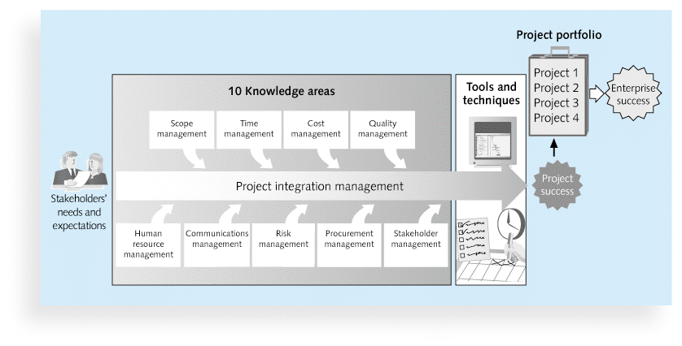
Figure 1-2 Project Management Framework

Slide 19
Key elements of the Frame work
Project stakeholders.
Project management knowledge areas.
Project management tools and techniques.

Slide 20
10 Project Management Knowledge Areas
Knowledge areas describe the key competencies that project managers must develop
Project managers must have knowledge and skills in all 10 knowledge areas (project integration, scope, time, cost, quality, human resource, communications, risk, procurement, and stakeholder management)
This text includes an entire chapter on each knowledge area

Slide 21
Project Stakeholders
Stakeholders are the people involved in or affected by project activities
Stakeholders include
the project sponsor
the project manager
the project team
support staff
customers
users
suppliers
opponents to the project

Slide 22
Project Management Tools and Techniques
Project management tools and techniques assist project managers and their teams in various aspects of project management
Some specific ones include
Project charter, scope statement, and WBS (scope)
Gantt charts, network diagrams, critical path analysis, critical chain scheduling (time)
Cost estimates and earned value management (cost)
See Table 1-1 for many more

Slide 23
Project Success
There are several ways to define project success:
The project met scope, time, and cost goals
The project satisfied the customer/sponsor
The results of the project met its main objective, such as making or saving a certain amount of money, providing a good return on investment, or simply making the sponsors happy

Slide 24
Program and Project Portfolio Management
A program is “a group of related projects managed in a coordinated way to obtain benefits and control not available from managing them individually” (PMBOK® Guide, Fifth Edition, 2012)
A program manager provides leadership and direction for the project managers heading the projects within the program
Examples of common programs in the IT field include infrastructure, applications development, and user support

Slide 25
Project Portfolio Management
Portfolio: A group of investments.
As part of project portfolio management, organizations group and manage projects and programs as a portfolio of investments that contribute to the entire enterprise’s success
Portfolio managers help their organizations make wise investment decisions by helping to select and analyze projects from a strategic perspective

Slide 26
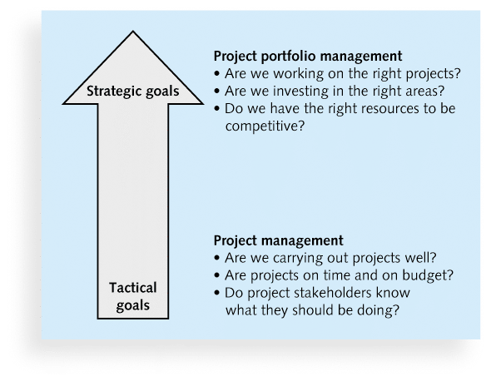
Figure 1-3. Project Management Compared to Project Portfolio Management

Slide 27
The Role of the Project Manager
Job descriptions vary, but most include responsibilities like planning, scheduling, coordinating, and working with people to achieve project goals
Project management is a skill needed in every major IT field, from database administrator to network specialist to technical writer

Slide 28
Table 1-3 Ten Most Important Skills and Competencies for Project Managers
1. People skills
2. Leadership
3. Listening
4. Integrity, ethical behavior, consistent
5. Strong at building trust
6. Verbal communication
7. Strong at building teams
8. Conflict resolution, conflict management
9. Critical thinking, problem solving
10. Understands, balances priorities

Slide 29
Careers for IT Project Managers (1 of 2)
In a 2017 survey, IT executives listed the “ten hot tech skills” they planned to hire for in 2017
Project management was second only to full-stack software development
Even if you choose to stay in a technical role, you still need project management knowledge and skills to help your team and organization

Slide 30
Careers for IT Project Managers (2 of 2)
1. | Full-stack software development
2. | Project management
3. | Cyber-security
4. | Networking
5. | User experience/user interface (UX/UI) design
6. | Quality assurance (QA)/testing
7. | Cloud engineering
8. | Big data
9. | Machine learning/artificial intelligence
10. | DevOps
Source: Sharon Florentine, “10 IT skills that employers need in 2017,” CIO from IDG (February 1, 2017).
Table 1-4 Ten hot tech skills for 2017

Slide 31
The Project Management Institute
The Project Management Institute (PMI) is an international professional society for project managers founded in 1969

Slide 32
Project Management Certification
PMI provides certification as a Project Management Professional (PMP)
A PMP has documented sufficient project experience, agreed to follow a code of ethics, and passed the PMP exam
The number of people earning PMP certification is increasing quickly
Top Ten Professional Certificates http://www.globalknowledge.com/training/generic.asp?pageid=3510&country=United+States&utm_source=email

Slide 33
Chapter Summary
A project is a temporary endeavor undertaken to create a unique product, service, or result
Project management is the application of knowledge, skills, tools, and techniques to project activities to meet project requirements
A program is a group of related projects managed in a coordinated way
Project portfolio management involves organizing and managing projects and programs as a portfolio of investments
Project managers play a key role in helping projects and organizations succeed
The project management profession continues to grow and mature

