Slide 1
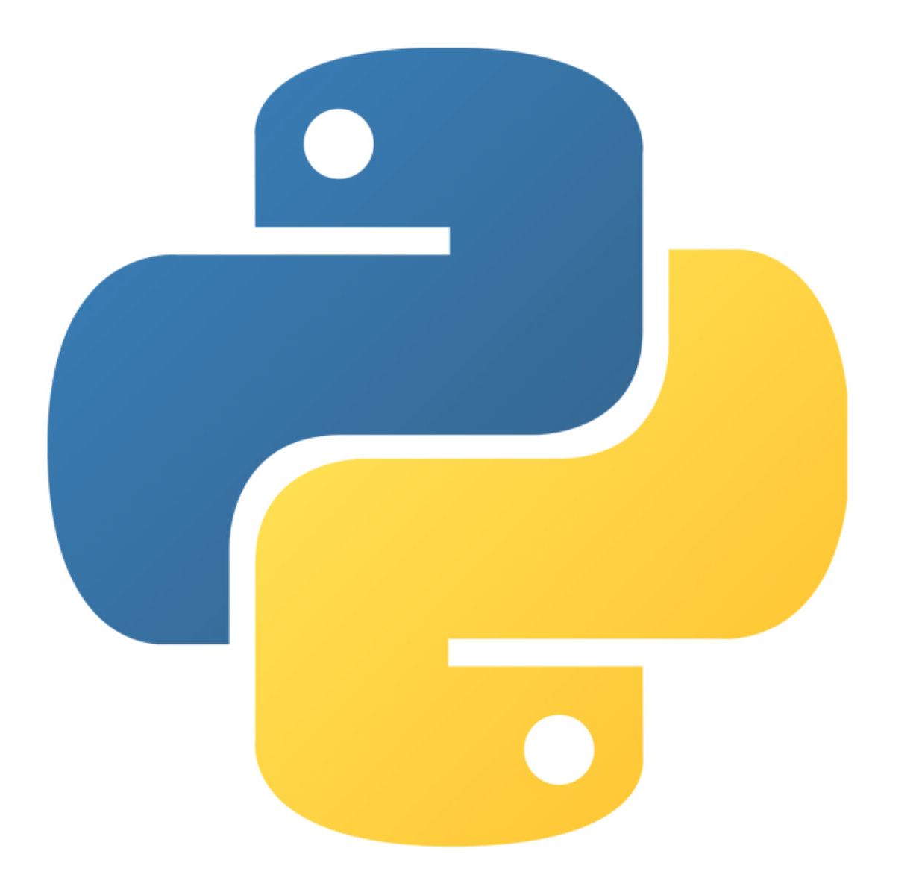
More About object oriented programming
Created by : Nouf almunyif

Slide 2
built-in functions

Slide 3
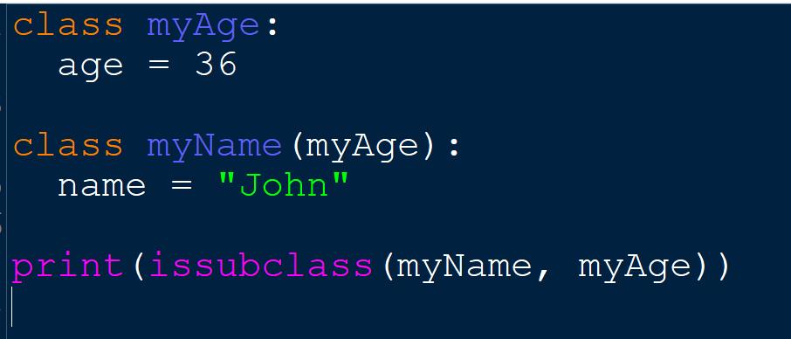
issubclass()
The issubclass() function returns True if the specified object is a subclass of the specified object, otherwise False.
Format : issubclass(object, subclass)

Slide 4
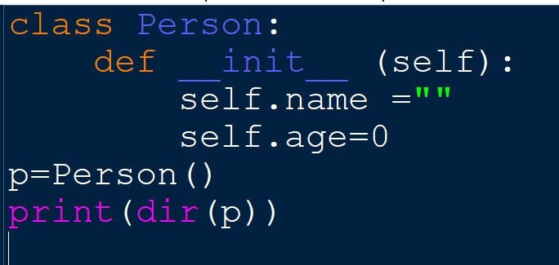
dir()
the dir() function returns all properties and methods of the specified object,
without the values.
even built-in properties which are default for all object.
['__class__', '__delattr__', '__dict__', '__dir__', '__doc__', '__eq__', '__format__', '__ge__', '__getattribute__', '__gt__', '__hash__', '__init__', '__init_subclass__', '__le__', '__lt__', '__module__', '__ne__', '__new__', '__reduce__', '__reduce_ex__', '__repr__', '__setattr__', '__sizeof__', '__str__', '__subclasshook__', '__weakref__', 'age', 'name']

Slide 5
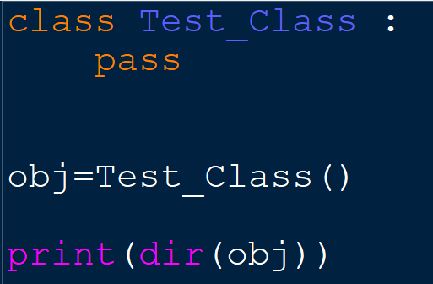
An Overview of Inheritance in Python
When you write Python code using classes, you are using inheritance even if you don’t know you’re using it .. Lets see the following class example:
its an empty class with no attributes
Output:
['__class__', '__delattr__', '__dict__', '__dir__', '__doc__', '__eq__', '__format__', '__ge__', '__getattribute__', '__gt__', '__hash__', '__init__', '__init_subclass__', '__le__', '__lt__', '__module__', '__ne__', '__new__', '__reduce__', '__reduce_ex__', '__repr__', '__setattr__', '__sizeof__', '__str__', '__subclasshook__', '__weakref__']
every class you create in Python implicitly derives from object.
You could be more explicit and write:
class Test_Class(object):
but it’s redundant and unnecessary.

Slide 6
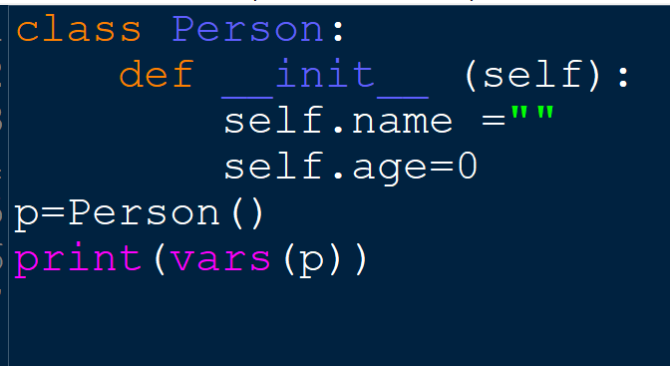
vars()
the vars() function returns the __dic__ attribute of an object.
The __dict__ attribute is a dictionary containing the object's changeable attributes.

Slide 7
Polymorphism

Slide 8
Polymorphism
Polymorphism defines the ability to take different forms.
Polymorphism is taken from the Greek words Poly (many) and morphism (forms).
It means that the same function name can be used for different types. This makes programming more intuitive and easier.
In Python, we have different ways to define polymorphism

Slide 9
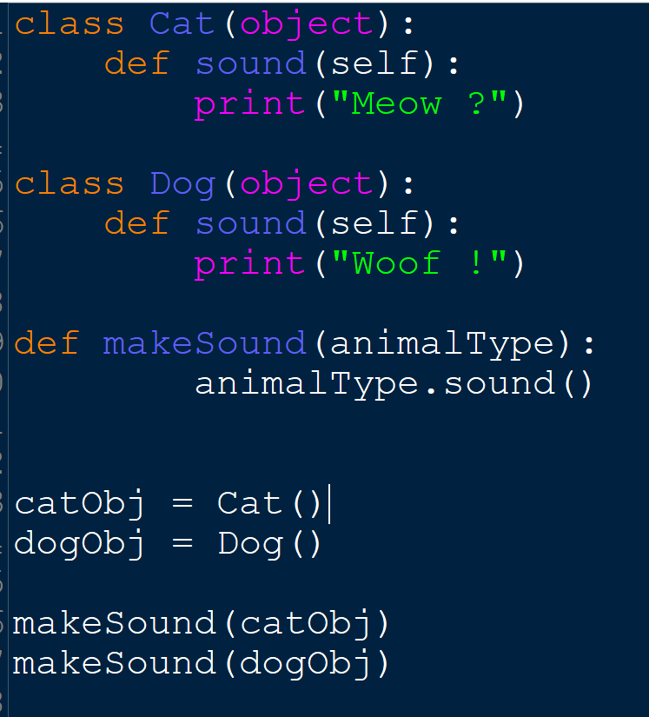
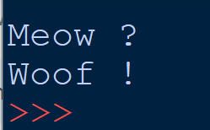
Polymorphism with a function:

Slide 10
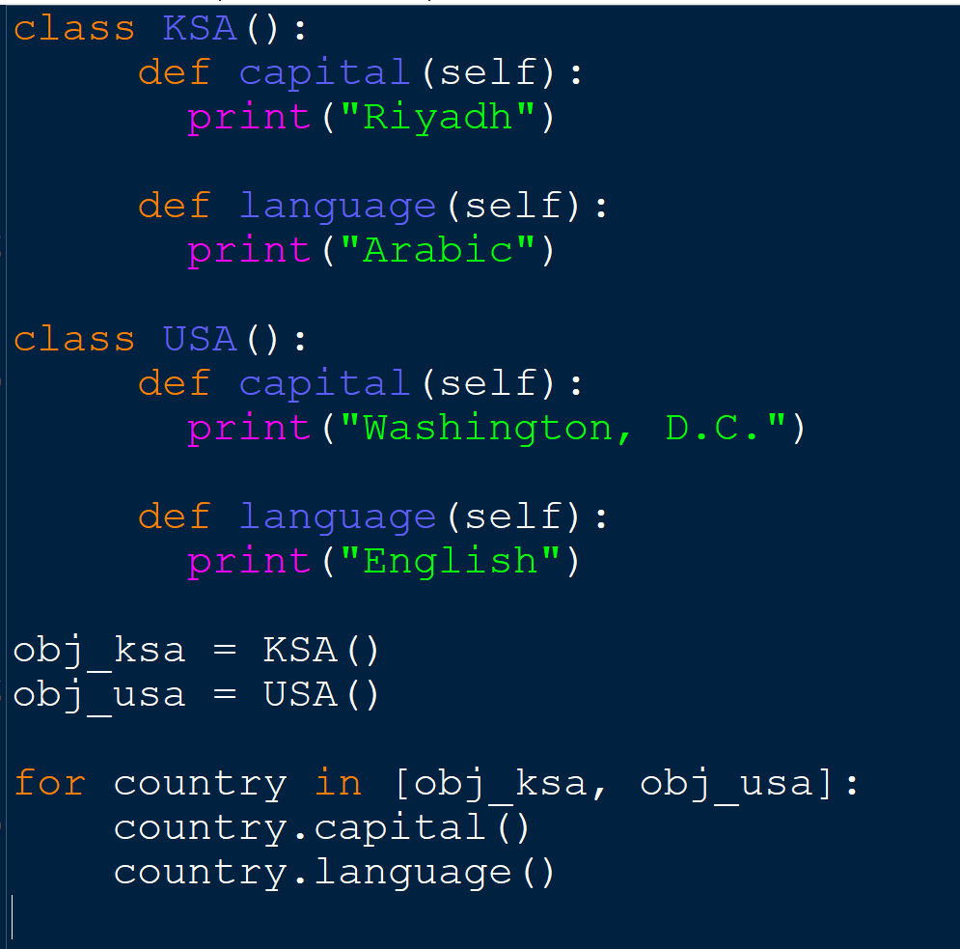
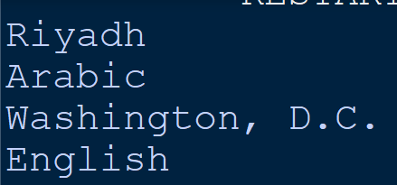
Polymorphism with a function:

Slide 11
Method Overloading

Slide 12
What is Overloading?
the ability of a function or an operator to behave in different ways depending on the parameters that are passed to the function, or the operands that the operator acts on
Overloading a method fosters reusability. For instance, instead of writing multiple methods that differ only slightly, we can write one method and overload it. Overloading also improves code clarity and eliminates complexity.
Method overloading is one concept of Polymorphism.

Slide 13
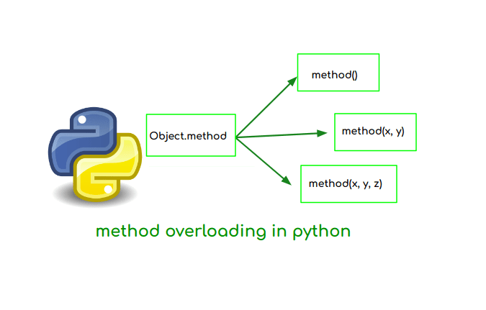
Call len using STR
Call len using LIST

Slide 14
method overloading
method overloading in python can be defined as writing the method in such a way that method will provide different functionality for different datatype arguments with the same method name. Programming languages like Java and C++ implements the method overloading by defining the two methods with the same name but different parameters. In python we do not implement *method overloading *in that way

Slide 15
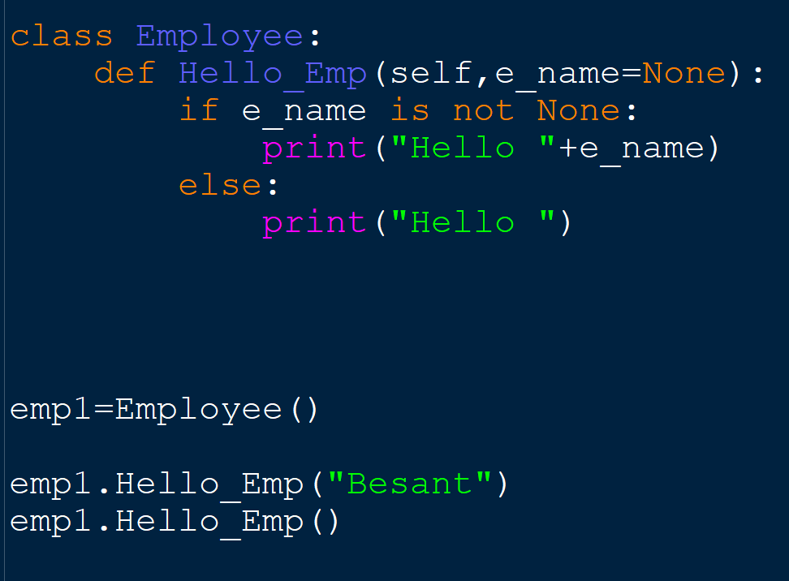
method overloading

Slide 16
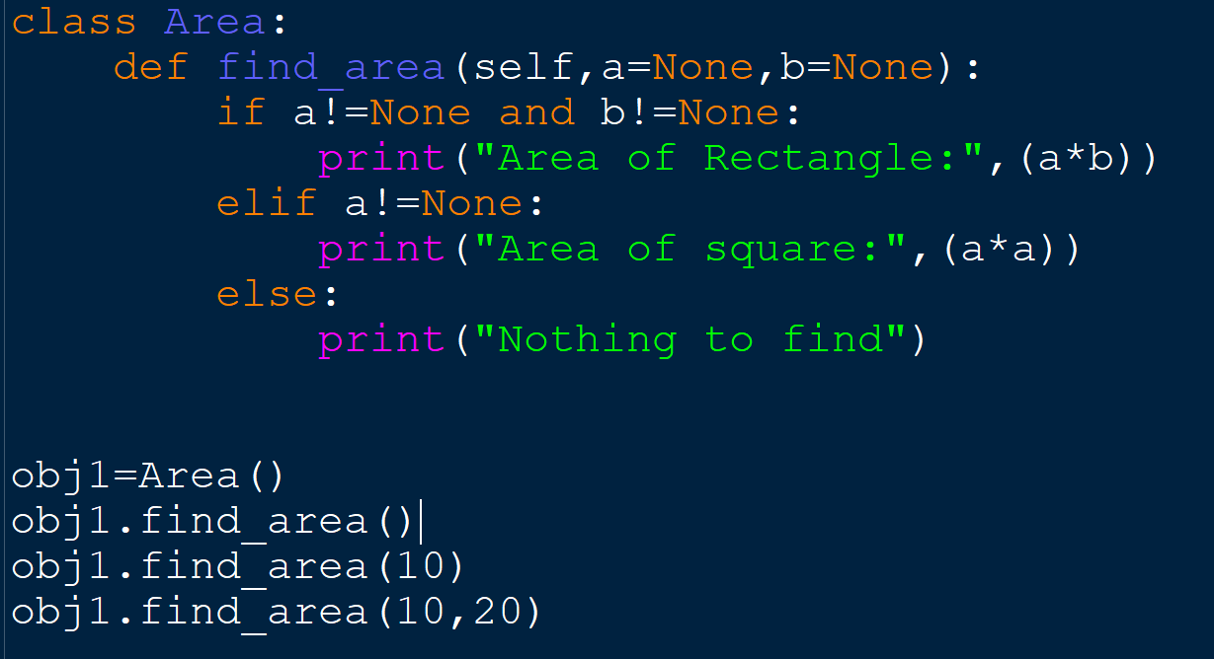
method overloading

Slide 17
Method Overriding

Slide 18
Polymorphism with Inheritance
In inheritance, the child class inherits the methods from the parent class.
And there is many cases the method inherited from the parent class doesn’t fit the child class.
The ability of any object-oriented programming language that allows a subclass or child class to provide a specific implementation of a method that is already provided by one of its super-classes or parent classes is known as Method Overriding.

Slide 19
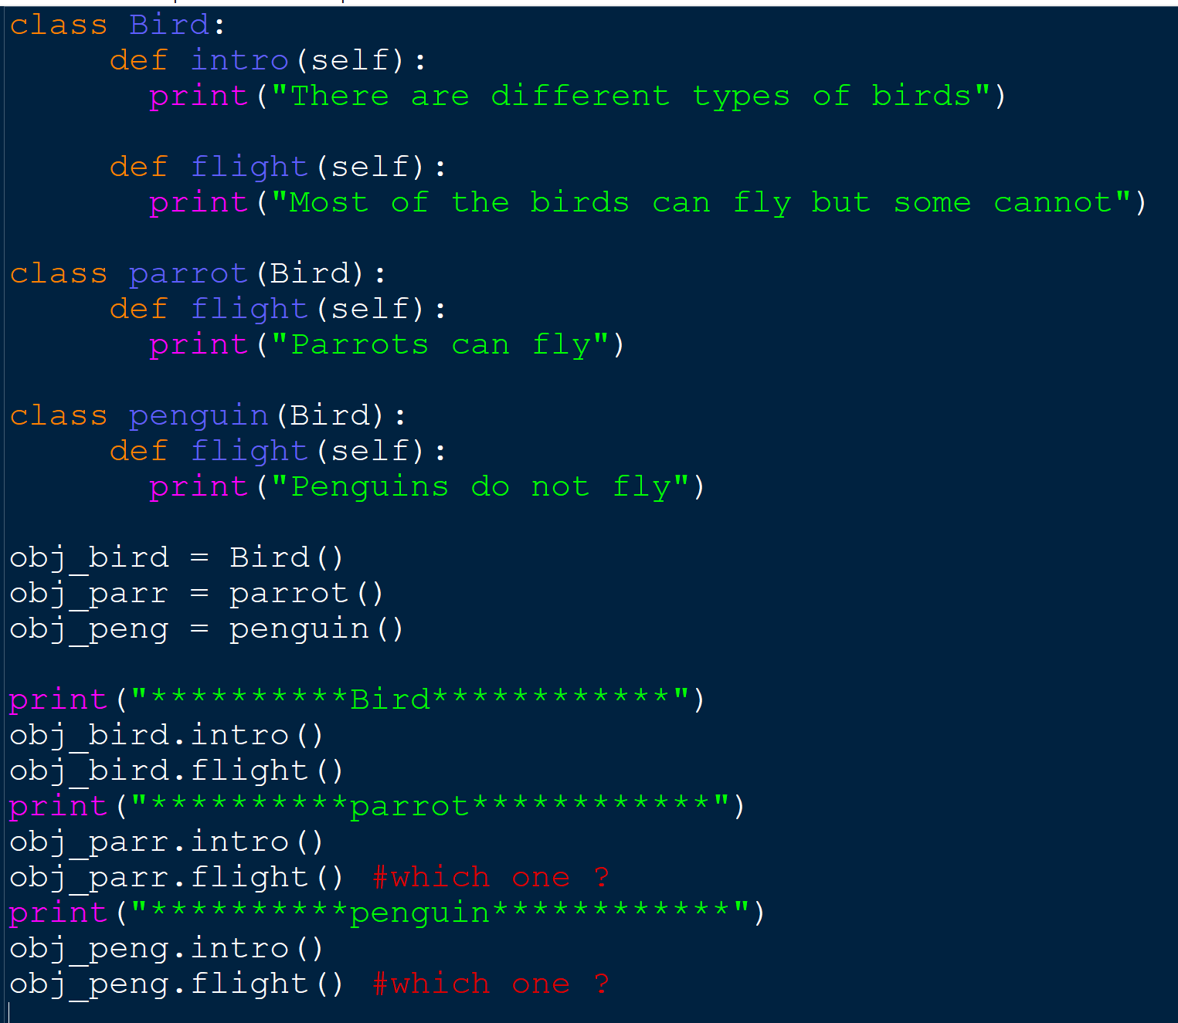
Method Overriding

Slide 20
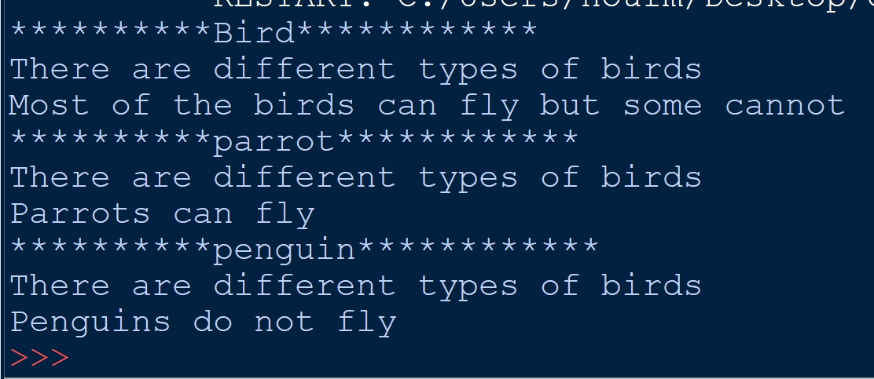
Method Overriding

Slide 21
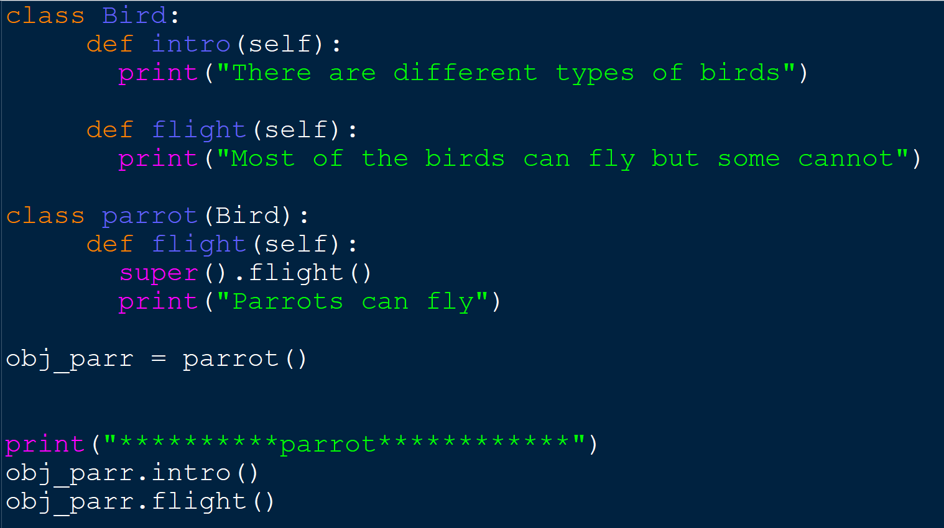
Method Overriding
What if we wan to call the parent function ?
OR

Slide 22
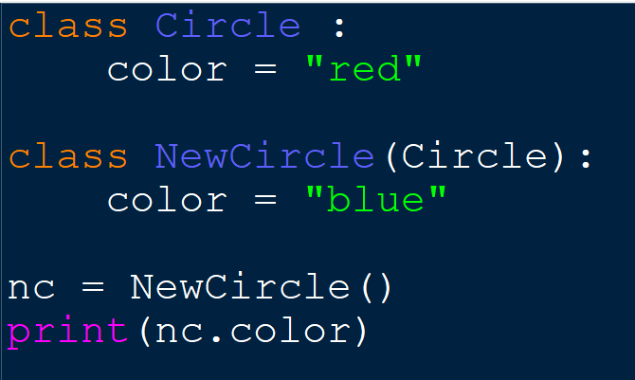
Overriding attributes
One of the core purposes of a subclass is to change the behavior of the parent class in some useful way. We call this overriding the inherited behavior. Overriding attributes of a parent class in Python is as simple as creating a new attribute with the same name:
Any instances of the new class will have the blue color. Instances of the original class will have the red color.

Slide 23
Operator Overriding

Slide 24
Operator Overloading
Python operators work for built-in classes. But the same operator behaves differently with different types. For example, the + operator will perform arithmetic addition on two numbers, merge two lists, or concatenate two strings
Operator Overloading is a feature in Python that allows the same operator to have different meaning according to the context

Slide 25
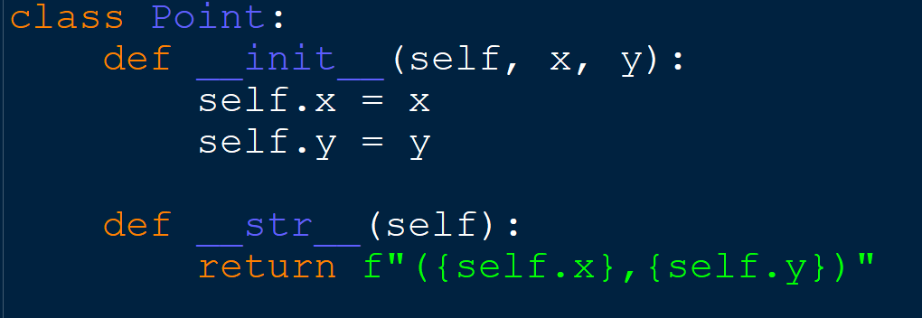
Example: use the + operator with objects of a user-defined class
we can see that a TypeError was raised,
since Python didn't know how to add two Point objects together.

Slide 26
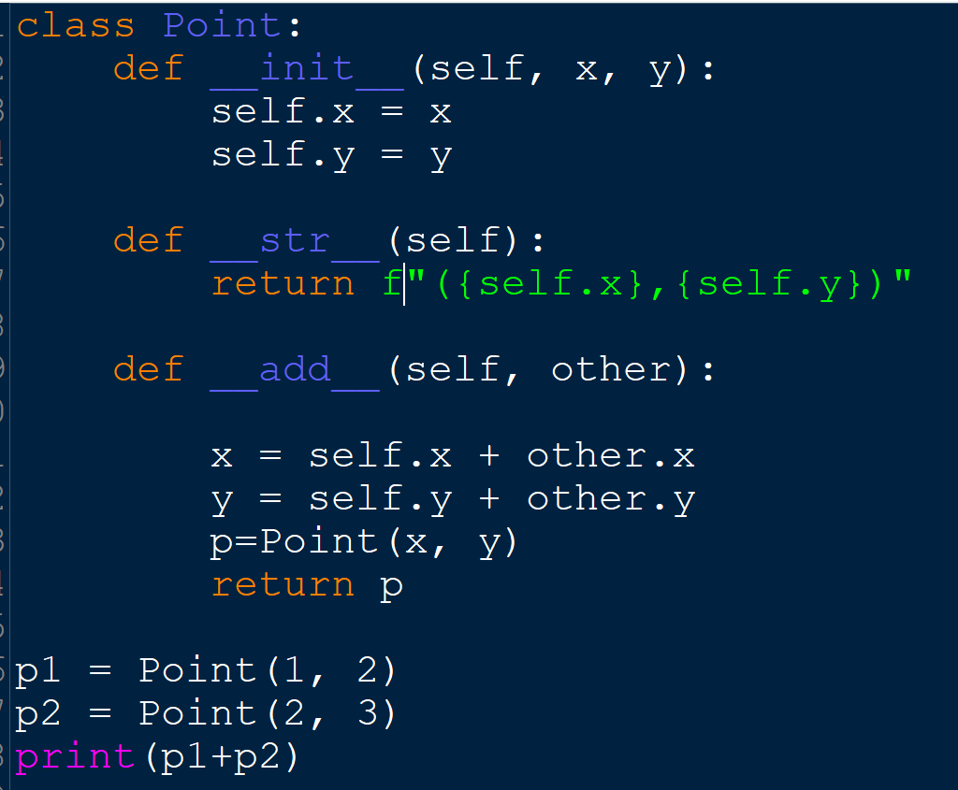
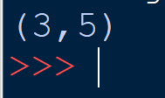
Example: use the + operator with objects of a user-defined class
To overload the + operator, we will need to implement __add__() function in the class.
What actually happens is that,
when you use p1 + p2, Python calls p1.__add__(p2)

Slide 27
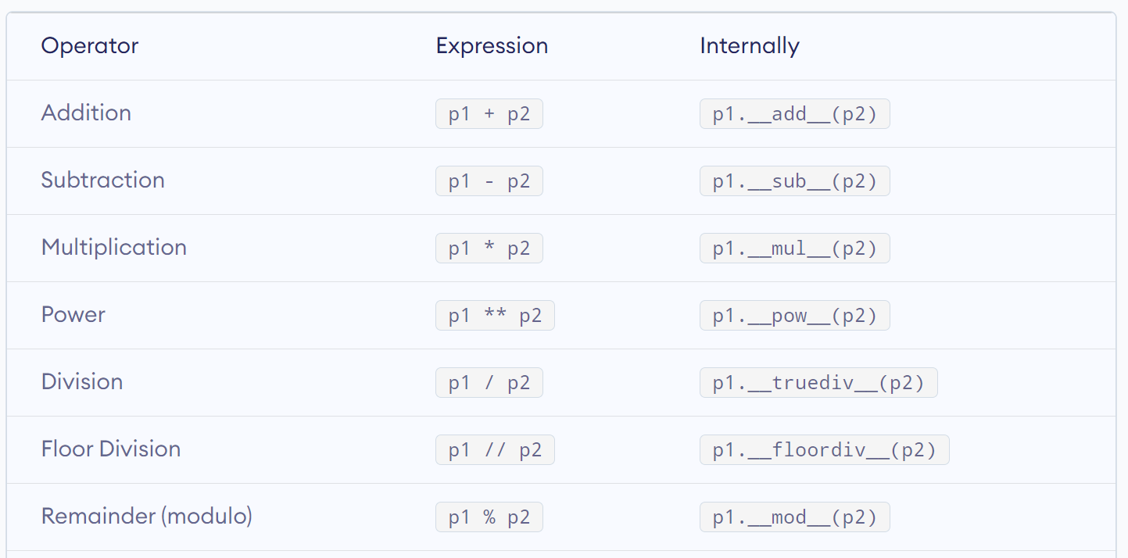
Mathematical Operator
Similarly, we can overload other operators as well

Slide 28
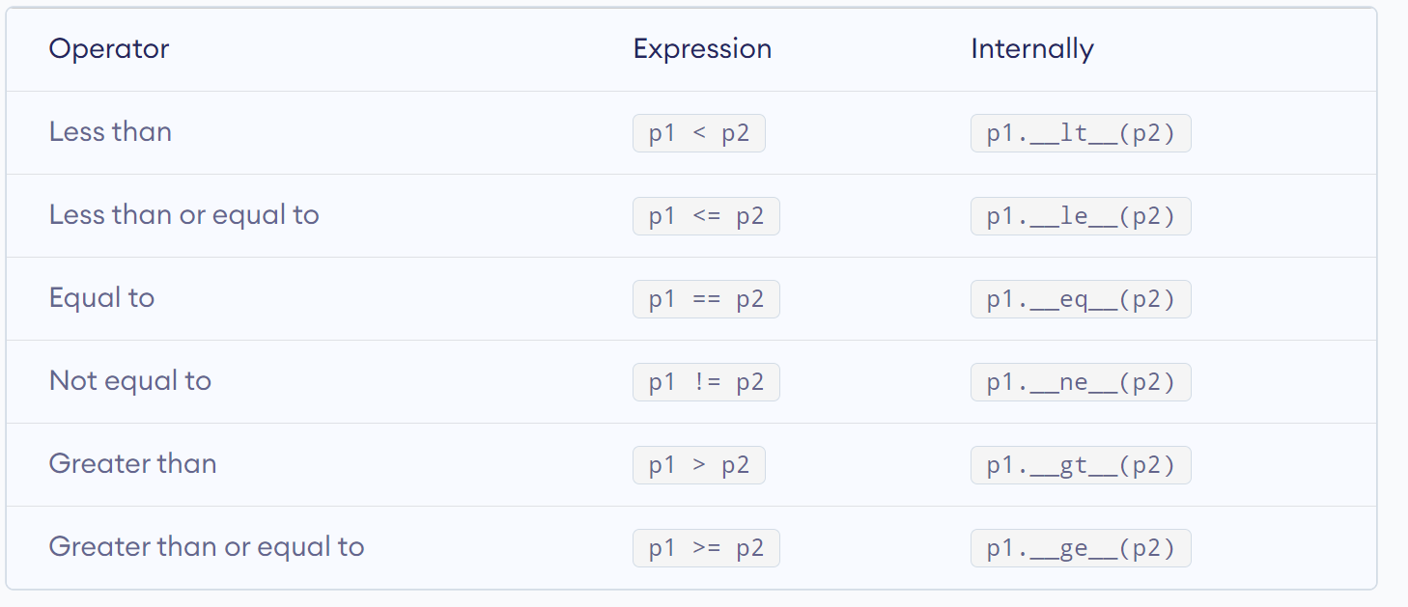
Relational Operator
Python does not limit operator overloading to arithmetic operators only. We can overload comparison operators as well.

Slide 29
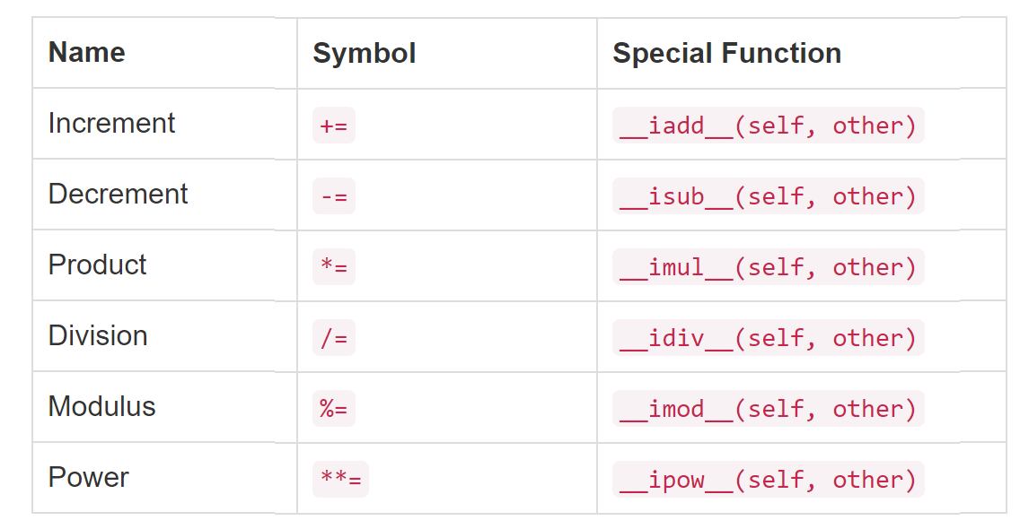
Assignment Operator

Slide 30
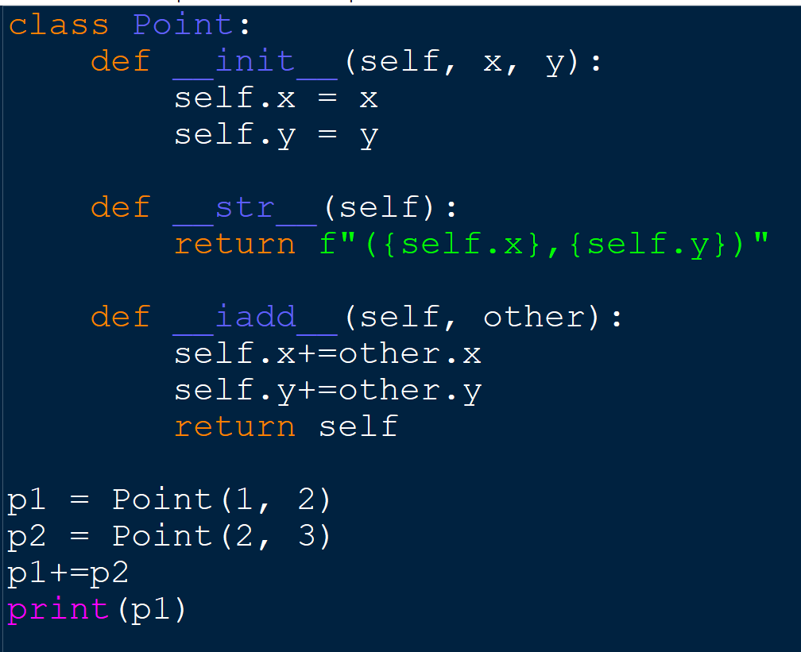
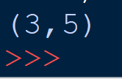
Example: use the += operator with objects of a user-defined class

Slide 31
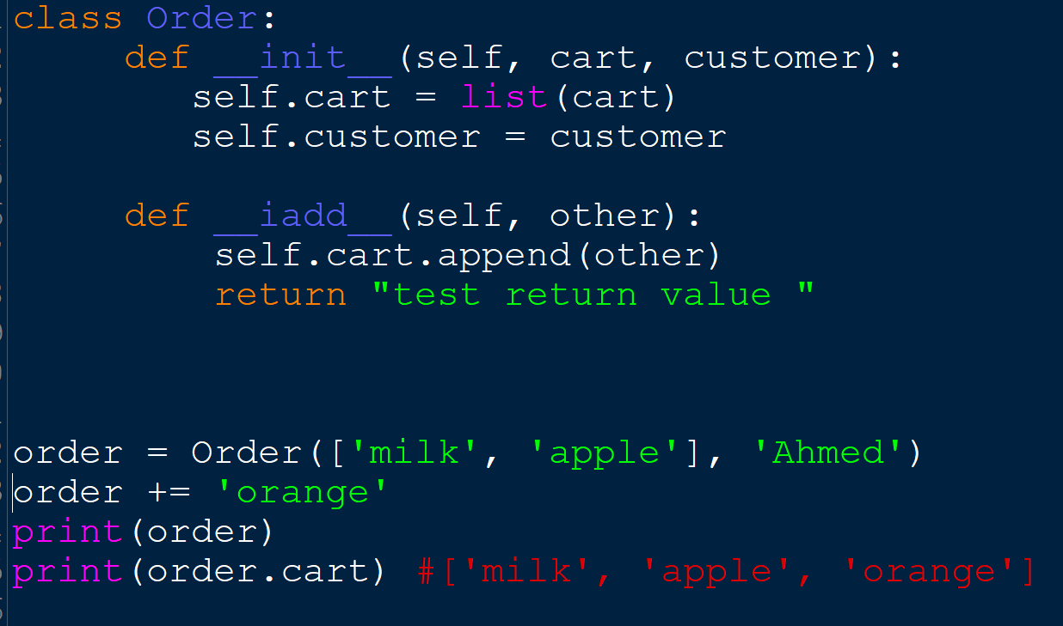
In the previous Examples any change is made directly to self and it is then returned.
What happens when you return some random value, like a string or an integer?

Slide 32
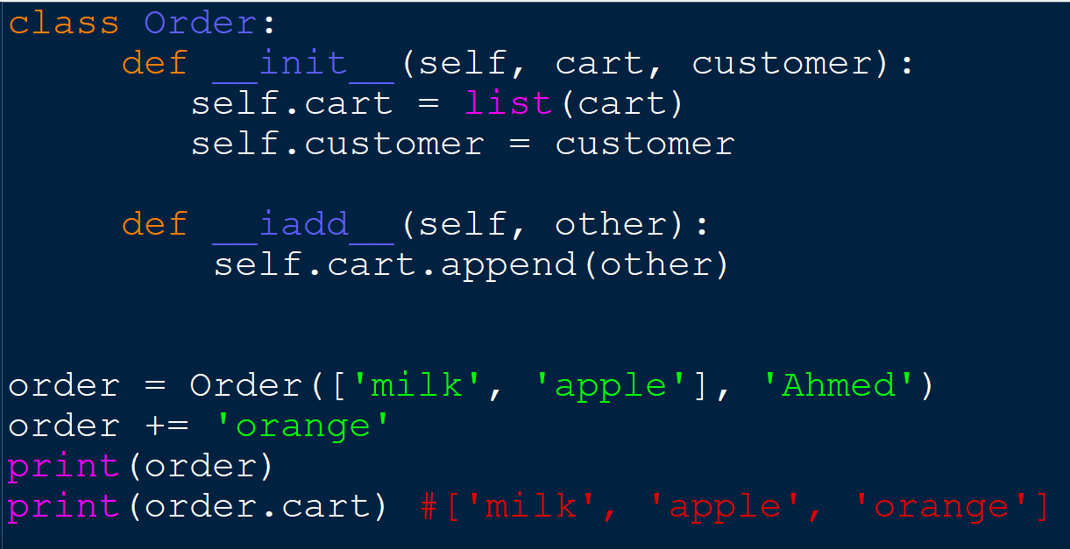
What if you forget to return some thing ?

Slide 33
CASE Study

Slide 34
Creating Class Hierarchies
We will start modeling an HR system:
The HR system needs to process payroll for the company’s employees, but there are different types of employees depending on how their payroll is calculated.
The HR system requires that every Employee processed must provide a .calculate_payroll() interface that returns the weekly salary for the employee. The implementation of that interface differs depending on the type of Employee.

Slide 35
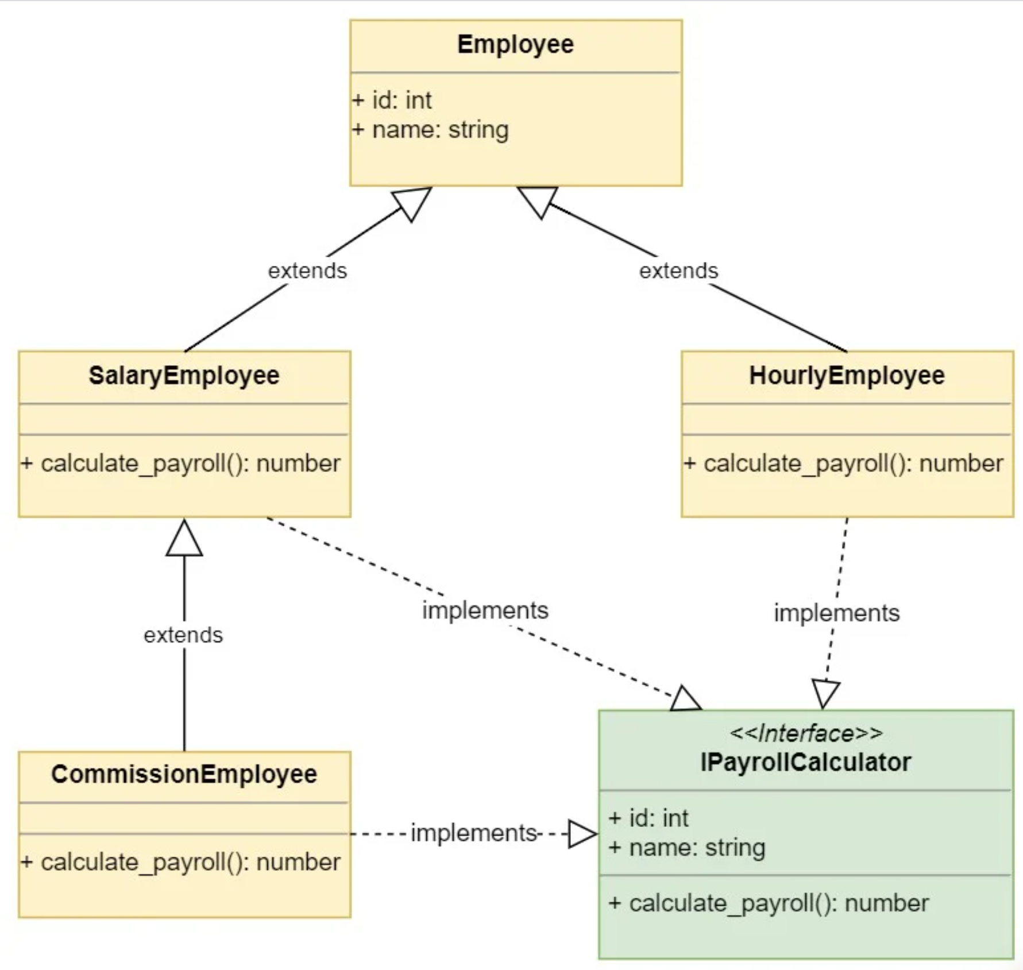
the inheritance
hierarchy of the classes.

Slide 36
Employee(BASE) common interface for every employee type
It is constructed with an id and a name.
every Employee must have an id assigned as well as a name.

Slide 37
Salary Employee(derived)
administrative workers have a fixed salary, so every week they get paid the same amount

Slide 38
HourlyEmployee(derived)
The company also employs manufacturing workers that are paid by the hour:

Slide 39
Commission Employee(derived)
the company employs sales associates that are paid through a fixed salary plus a commission based on their sales

Slide 40
PayrollSystem class
The PayrollSystem implements a .calculate_payroll() method that takes a collection of employees and prints their id, name, and check amount using the .calculate_payroll() method exposed on each employee object.

Slide 41
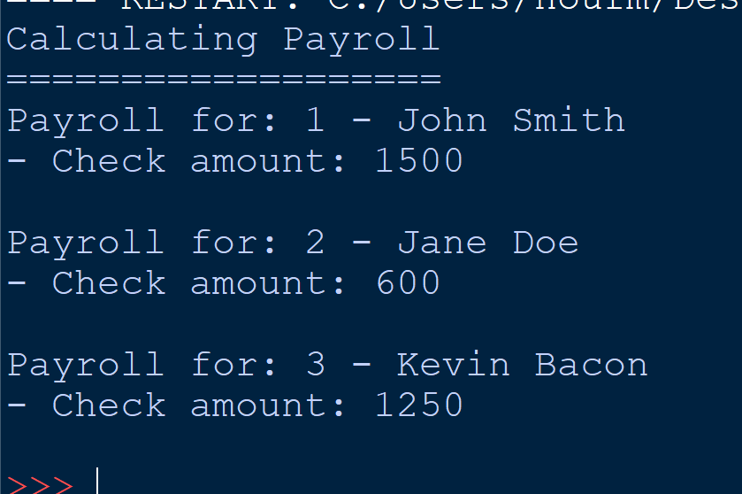
Output :

Slide 42
Abstract Base Classes in Python
The Employee class in the previous example is what we called
an abstract base class.
Abstract base classes exist to be inherited, but never instantiated
You can use leading underscores in your class name to communicate that objects of that class should not be created

Slide 43
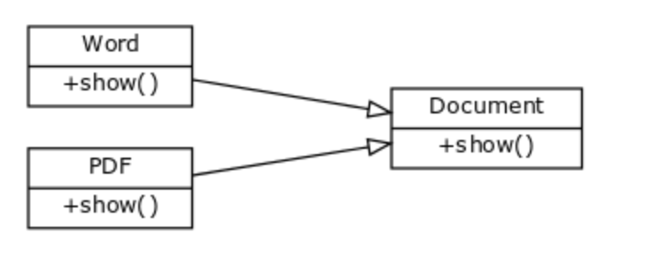
Polymorphism with abstract class
Abstract structure is defined in Document class . If you create an editor you may not know in advance what type of documents a user will open (pdf format or word format?).
it would be great to access them like this

Slide 44
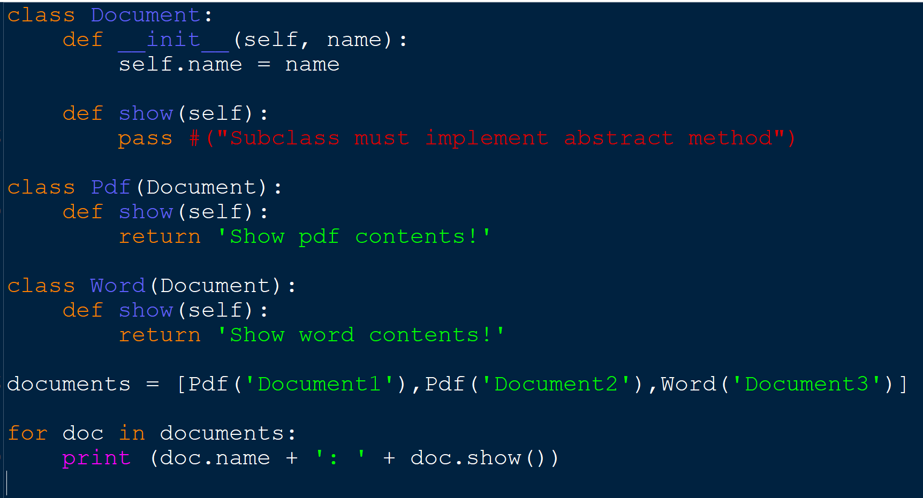

Slide 45
References:
stackabuse.com
https://realpython.com/
https://dbader.org/blog/meaning-of-underscores-in-python
Besanttechnologies
Pythonspot
https://www.programiz.com/python-programming/operator-overloading
https://www.studytonight.com/python/python-operator-overloading
https://realpython.com/operator-function-overloading/#overloading-built-in-operators
https://codefellows.github.io/sea-python-401d4/lectures/inheritance_v_composition.html#overriding-attributes

