Slide 1
Python Files

Slide 2
Introduction to File Input and Output

Slide 3
Introduction to File Input and Output
Concept:
When a program needs to save data for later use, it writes the data in a file. The data can be read from the file at a later time. Data is saved to a file, typically on computer disk

Slide 4
Introduction to File Input and Output
Output file = file that data is written to
“writing data to” the file= Saving data in a file (it is copied from a variable in RAM to the file.)
Input file = file that data is read from
“reading data from” the file = Retrieving data from a file (it is copied from the file into RAM and referenced by a variable.)

Slide 5
Introduction to File Input and Output
There are always three steps that must be taken when a file is used by a program.
Open the file
Process the file
Close the file

Slide 6
Types of Files and File Access Methods

Slide 7
Types of Files and File Access Methods
In general, two types of files
Text file: contains data that has been encoded as text
Binary file: contains data that has not been converted to text
Two ways to access data stored in file
Sequential access: file read sequentially from beginning to end, can’t skip ahead
Direct access: can jump directly to any piece of data in the file

Slide 8
Filenames and File Objects
Filename extensions: short sequences of characters that appear at the end of a filename preceded by a period
Extension indicates type of data stored in the file
File object: object associated with a specific file
Provides a way for a program to work with the file: file object referenced by a variable

Slide 9
Filenames and File Objects (cont’d.)

Slide 10
Opening a File

Slide 11
Opening a File
open function: used to open a file
Creates a file object and associates it with a file on the disk
General format:
file_object = open(filename, mode)
file_object is the name of the variable that will reference the file object
filename is a string specifying the name of the file
mode is a string specifying the mode (reading, writing, etc.)

Slide 12
Opening a File
customer_file = open(‘customers.txt’, ‘r’)
sales_file = open(‘sales.txt’, ‘w’)

Slide 13
Specifying the Location of a File
If open function receives a filename that does not contain a path, assumes that file is in same directory as program
If program is running and file is created, it is created in the same directory as the program
Can specify alternative path and file name in the open function argument
Prefix the path string literal with the letter r

Slide 14
Specifying the Location of a File
If the program is running and it executes the following statement, the file test.txt is created in the same folder:
test_file = open('test.txt', 'w’)
If you want to open a file in a different location, you can specify a path as well as a filename in the argument that you pass to the open function. If you specify a path in a string literal (particularly on a Windows computer), be sure to prefix the string with the letter r.
test_file = open(r'C:\Users\Blake\temp\test.txt', 'w')

Slide 15
Reading From a File

Slide 16
Reading Data From a File
Method: a function that belongs to an object
Performs operations using that object
read method: file object method that reads entire file contents into memory
Only works if file has been opened for reading
Contents returned as a string
readline method: file object method that reads a line from the file
Line returned as a string, including '\n'
Read position: marks the location of the next item to be read from a file

Slide 17
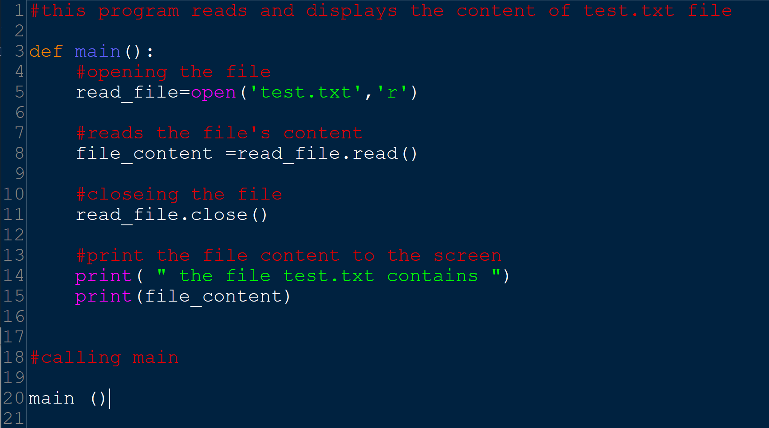
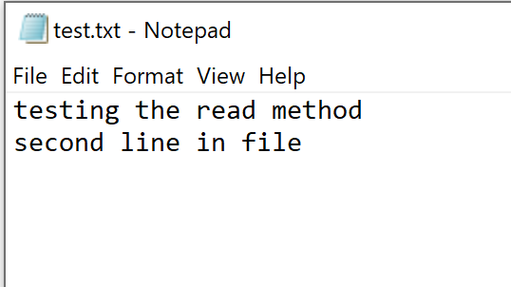
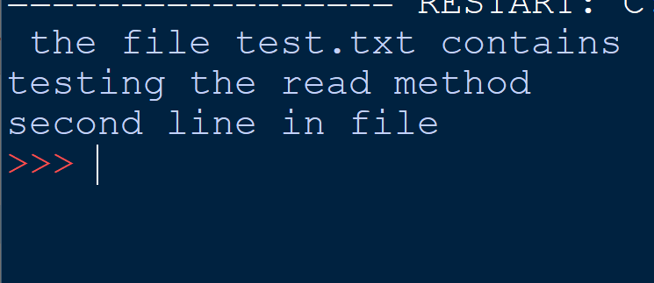
Reading Data from a File
read method
output

Slide 18
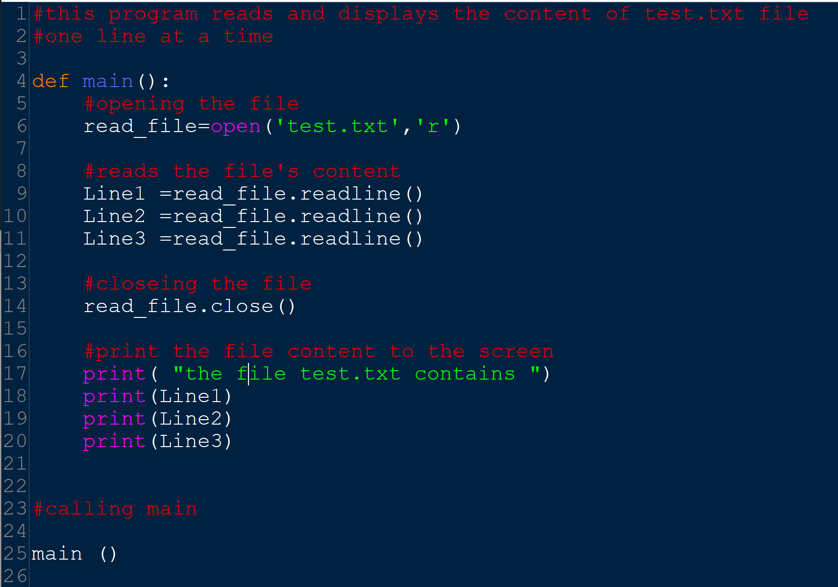
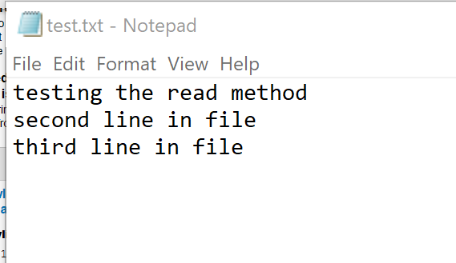
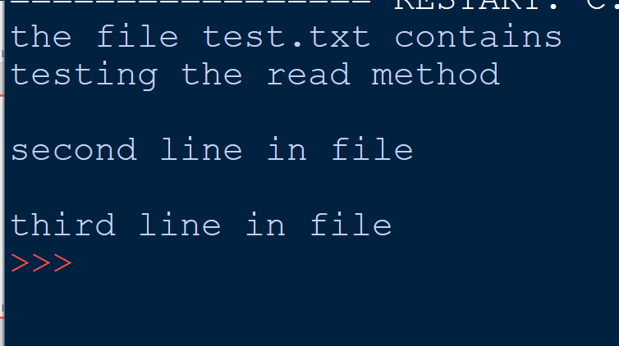
Reading Data from a File
readline method
output

Slide 19
Reading Data from a File

Slide 20
Writing to a File

Slide 21
Writing Data to a File
File object’s write method used to write data to the file
Format: file_variable.write(string)
File should be closed using file object close method
Format: file_variable.close()

Slide 22
Writing Data to a File
assume that customer_file references a file object, and the file was opened for writing with the 'w' mode. Here is an example of how we would write the string ‘Charles Pace’ to the file:
customer_file.write('Charles Pace')
Another example:
name = 'Charles Pace'
customer_file.write(name)

Slide 23
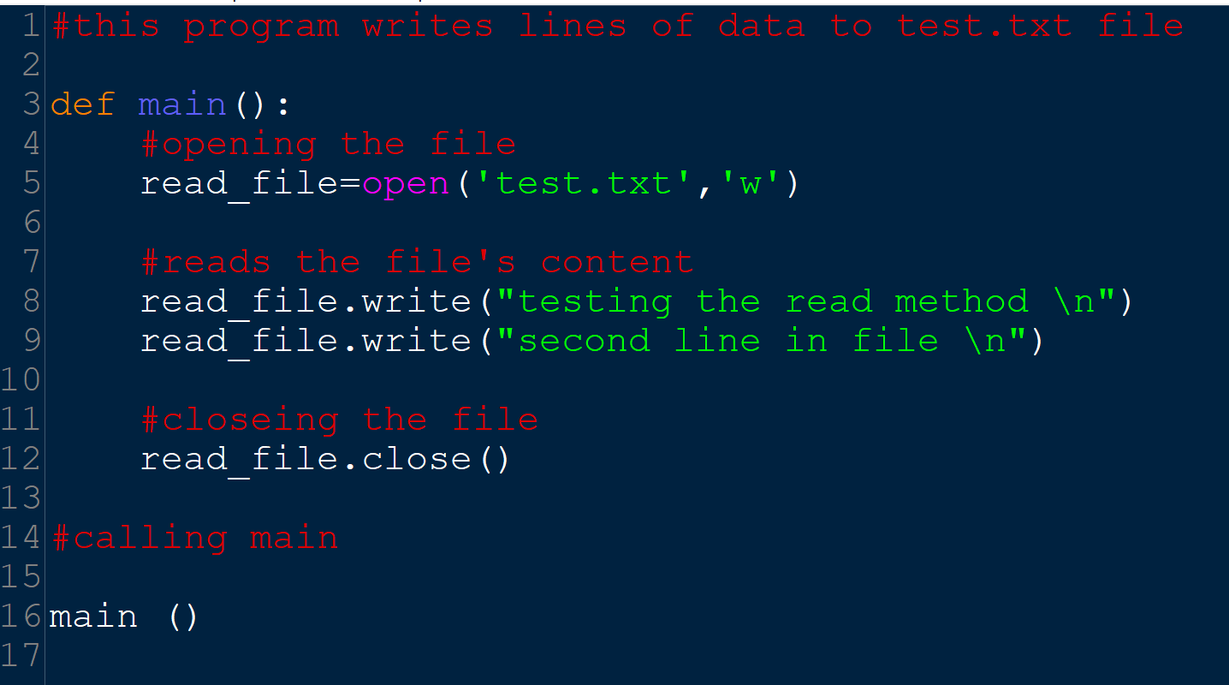
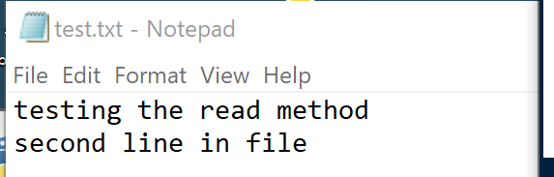
Writing Data to a File
write method

Slide 24
Concatenating a Newline to and Stripping it From a String
In most cases, data items written to a file are values referenced by variables
Usually necessary to concatenate a '\n' to data before writing it
Carried out using the + operator in the argument of the write method
In many cases need to remove '\n' from string after it is read from a file
rstrip method: string method that strips specific characters from end of the string

Slide 25
Concatenating a Newline to and Stripping it From a String
Concatenating a Newline to a String
myfile.write(name1 + ‘\n’)
Reading a String and Stripping the Newline From It
line1 = infile.readline()
# Strip the \n from the string
line1 = line1.rstrip(‘\n’)

Slide 26
Appending Data to an Existing File
When open file with 'w' mode, if the file already exists it is overwritten
To append data to a file use the 'a' mode
If file exists, it is not erased, and if it does not exist it is created
Data is written to the file at the end of the current contents

Slide 27
Handling Numeric Data

Slide 28
Writing and Reading Numeric Data
Numbers must be converted to strings before they are written to a file
write() argument must be str
str function: converts value to string
Number are read from a text file as strings
Must be converted to numeric type in order to perform mathematical operations
Use int and float functions to convert string to numeric value

Slide 29
Files processing

Slide 30
Using Loops to Process Files
Files typically used to hold large amounts of data
Loop typically involved in reading from and writing to a file
Often the number of items stored in file is unknown
The readline method uses an empty string as a sentinel when end of file is reached
Can write a while loop with the condition
while line != ''

Slide 31
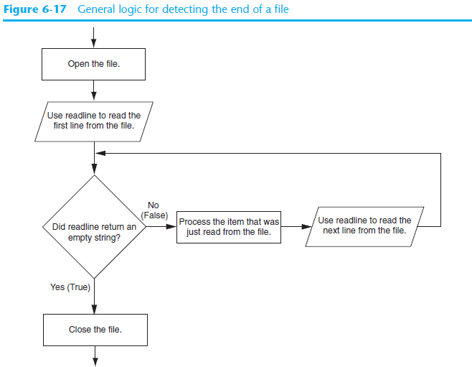

Slide 32
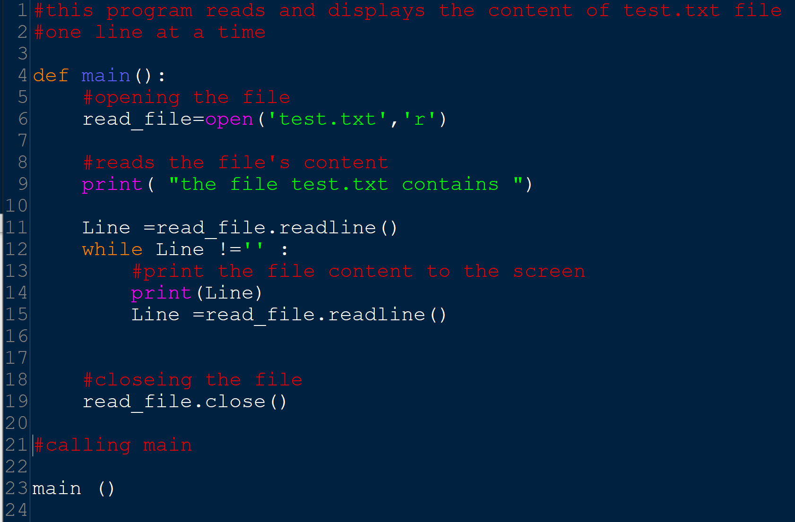
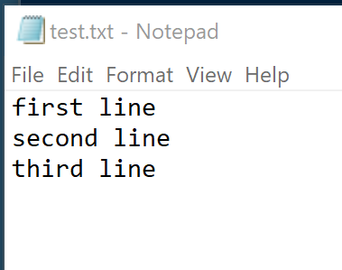
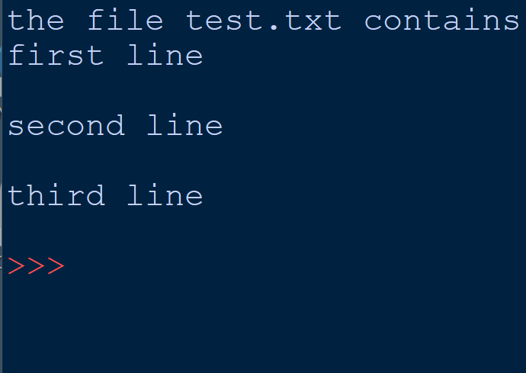
Using Loops to Process Files
output

Slide 33
Using Python’s for Loop to Read Lines
Python allows the programmer to write a for loop that automatically reads lines in a file and stops when end of file is reached
Format: for line in file_object:
statements
The loop iterates once over each line in the file

Slide 34
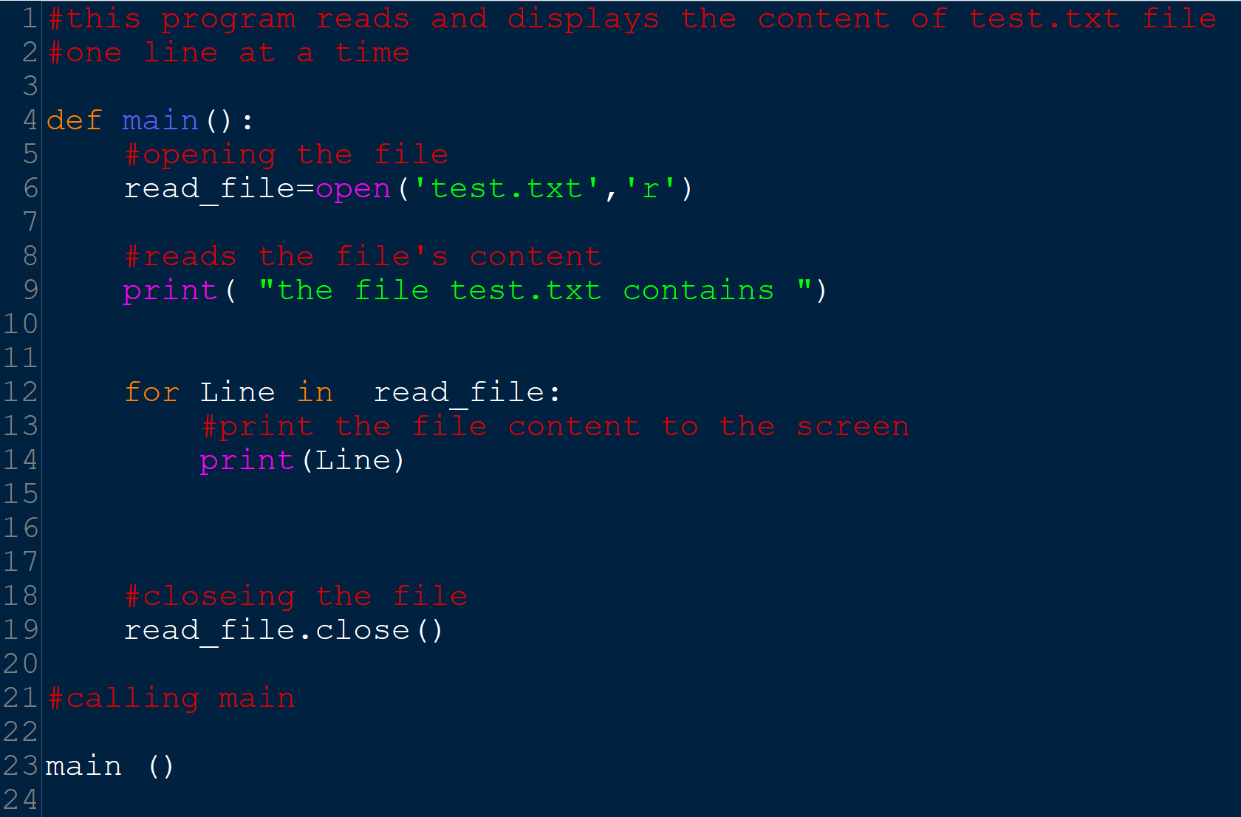

Slide 35
Processing Records

Slide 36
Processing Records
Record: set of data that describes one item
Field: single piece of data within a record
Write record to sequential access file by writing the fields one after the other
Read record from sequential access file by reading each field until record complete

Slide 37
Processing Records (cont’d.)
When working with records, it is also important to be able to:
Add records
Display records
Search for a specific record
Modify records
Delete records

Slide 38
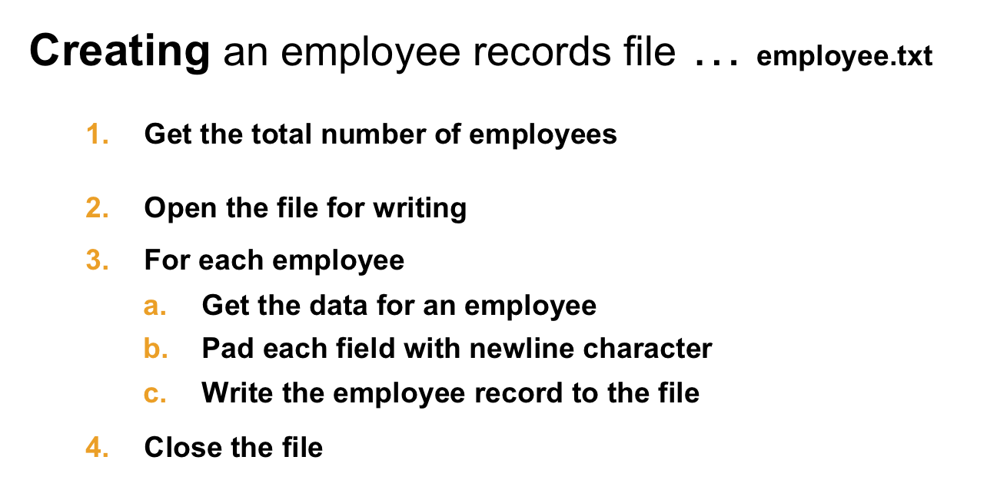
Processing Records

Slide 39
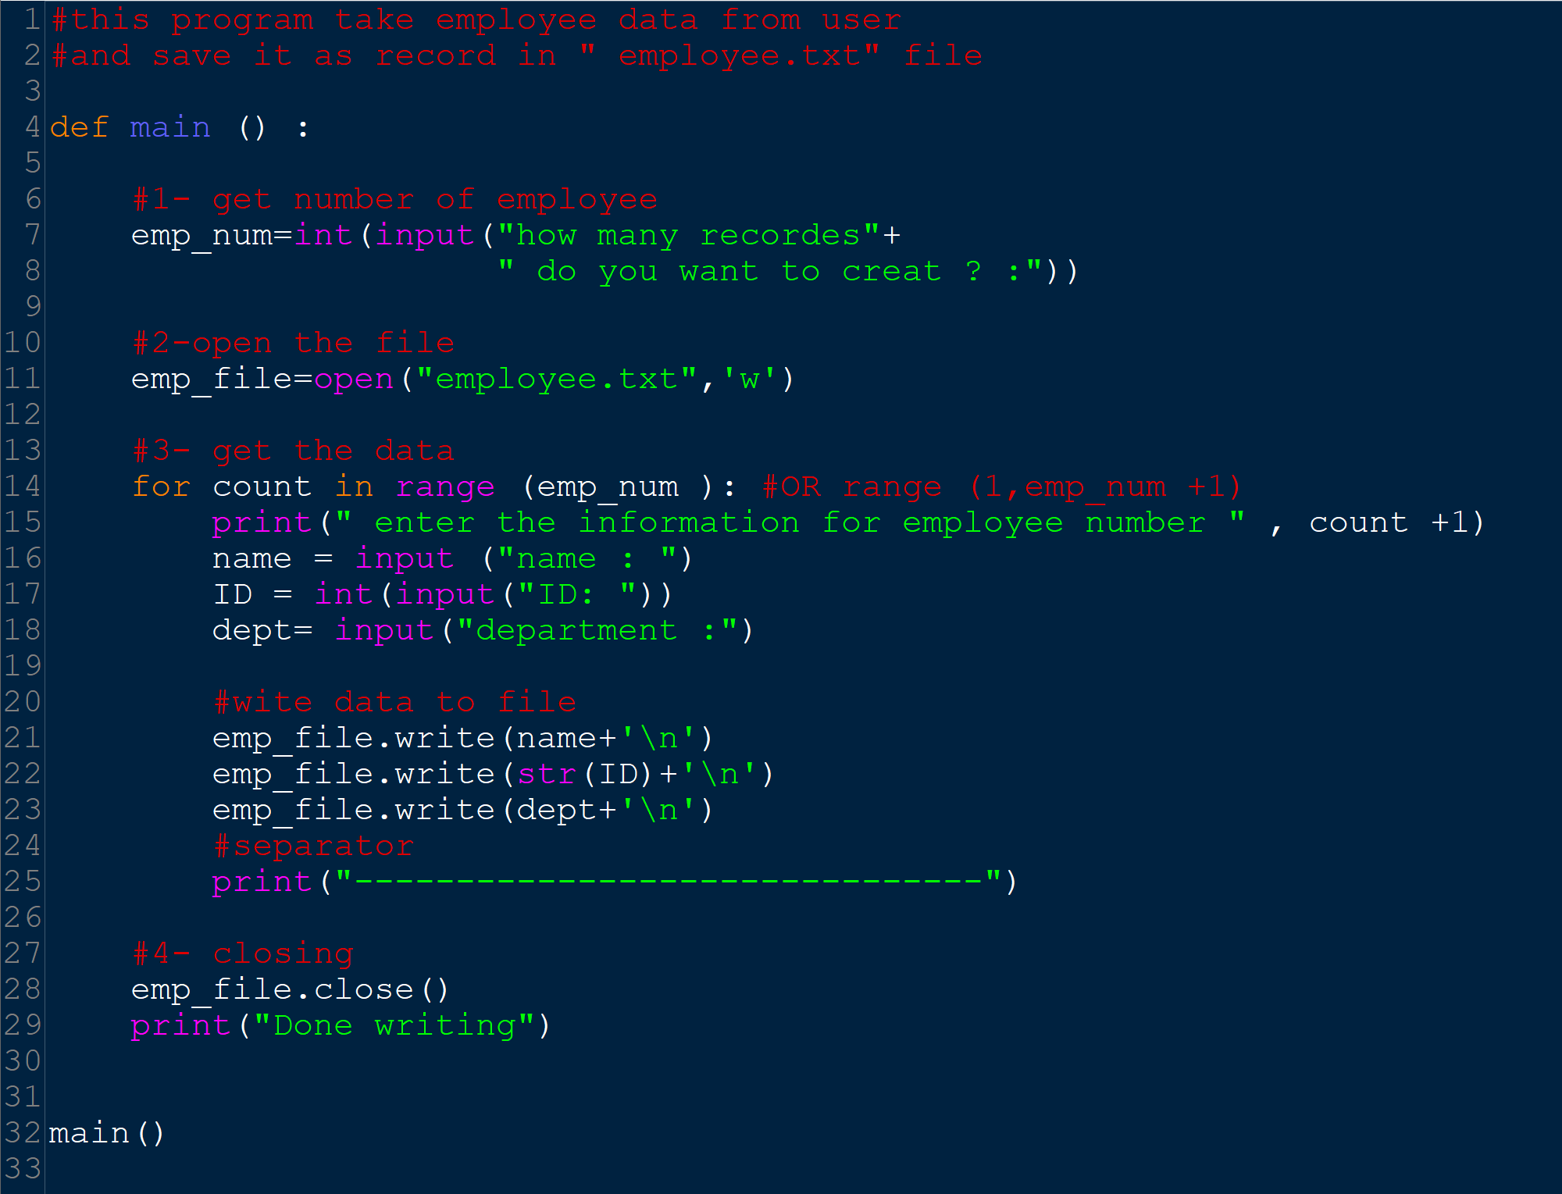

Slide 40
Processing Records

Slide 41
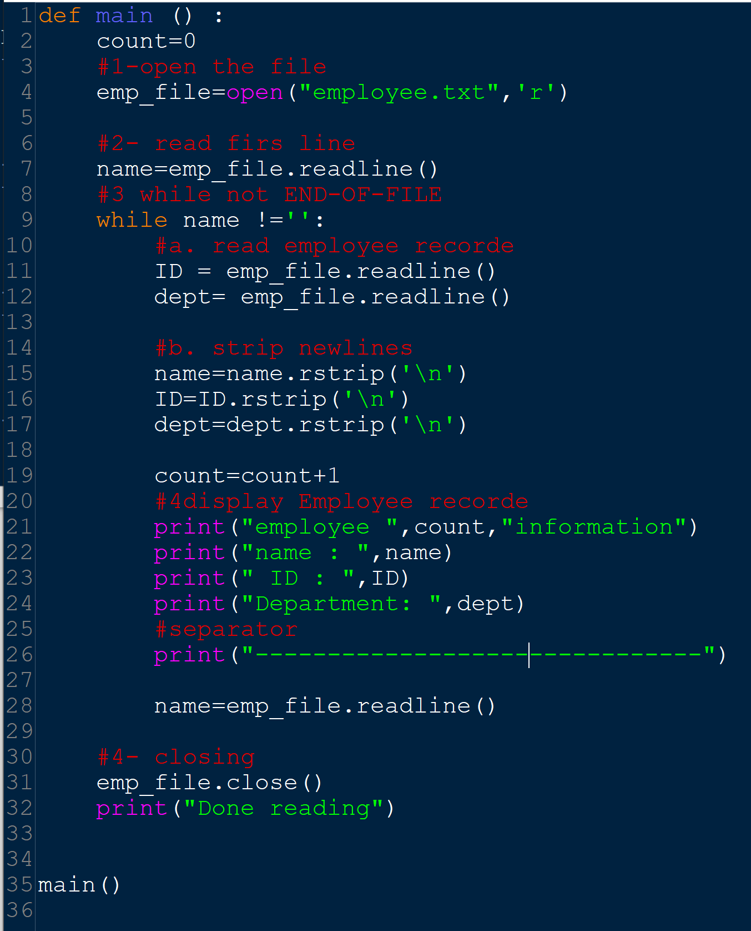

Slide 42
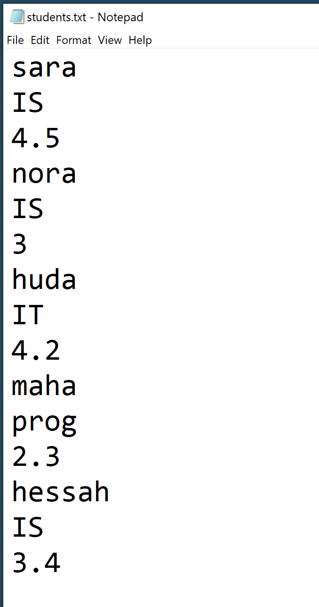
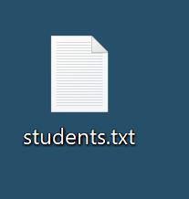
Exercise : Processing Records
Read students record
Search for student Majors

Slide 43
Processing Records

Slide 44
Processing Records
Read students record

Slide 45
Processing Records
Read students record

Slide 46
HW exercise
How to Check if File exist before open it for reading to avoid getting an error if it doesn’t exist?
How to Read position: marks the location of the next item to be read from a file
Notes:
import os.path
file_exists = os.path.exists('readme.txt’)
print(file_exists)
seek() method
# Python program to demonstrate
# seek() method
# Opening "GfG.txt" text file
f = open("GfG.txt", "r")
# Second parameter is by default 0
# sets Reference point to twentieth
# index position from the beginning
f.seek(20)
# prints current position
print(f.tell())
print(f.readline())
f.close()

Slide 47
References:
Tony Gaddis - Starting Out with Python, Global Edition (2018, Pearson Education)
https://www.w3schools.com/python/python_file_open.asp

