Slide 1
108 Chem
Chapter 8
Amines

Slide 2
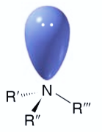
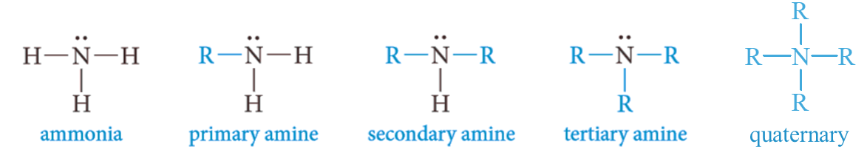
Structure and Classification of Amines
Amines are organic derivatives of ammonia in which one or more hydrogens are replaced with alkyl or aryl groups.
It has high degree of biological activity, many amines are used as drugs and medicines.
Amines are classified as primary, secondary, or tertiary, depending on the number of carbon atoms bonded directly to nitrogen.
+

Slide 3
Nomenclature of Amines
Common names are formed from the names of the alkyl groups bonded to nitrogen, followed by the suffix -amine.
The prefixes di-, tri-, and tetra- are used to describe two, three, or four identical substituents.
The IUPAC system, the amino group, -NH₂, is named as a substituent.
In this system, secondary or tertiary amines are named by using a prefix that includes all but the longest carbon chain.
Recently, Chemical Abstracts (CA) introduced a system for naming amines that is rational and easy to use. In this system, amines are named as alkanamines, the -e ending in the alkane name is changed to -amine, and a number shows the position of the amino group along the chain.
Other substituents on the carbon chain are given numbers, and the prefix N- is used for each substituent on nitrogen.

Slide 4
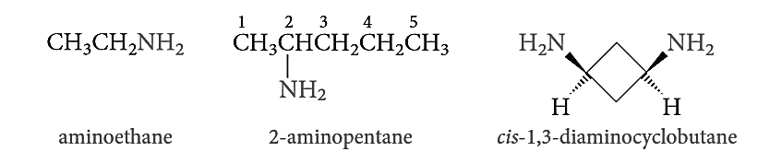
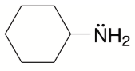
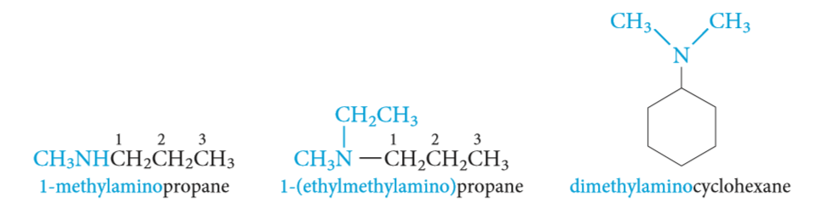
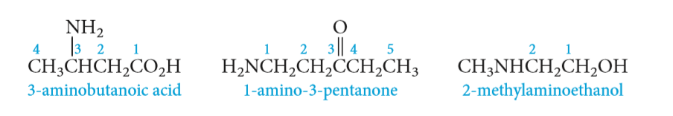

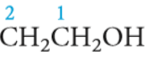
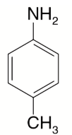
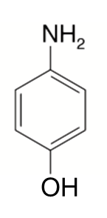
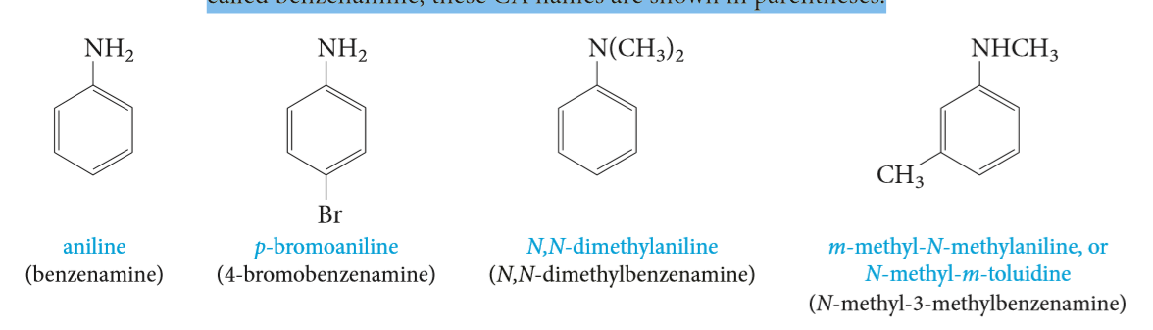
IUPAC name:
Common name:
aminoethane
ethanamine
ethylamine
2-aminopentane
2-pentanamine
sec-butylamine
aminocyclohexane
cyclohexanamine
cyclohexylamine
1-(methylamino)propane
N-methyl-1-propanamine
methylpropylamine
N,N-dimethylcyclohexanamine
cyclohexyldimethylamine
2-aminoethanol
1-amino-3-pentanone
3-aminobutanoic acid
Aromatic amines are named as derivatives of aniline. In the CA system, aniline is called benzenamine.
Aniline
benzenamine
4-bromoaniline
p-bromoaniline
4-methylaniline
p-Toluidine
N,N-dimethylaniline
N-methyl-3-methylaniline
N-methyl-m-toluidine
4-aminophenol

Slide 5
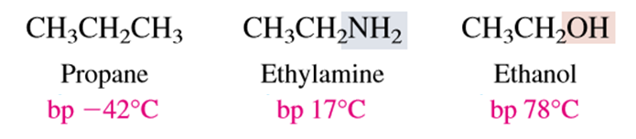
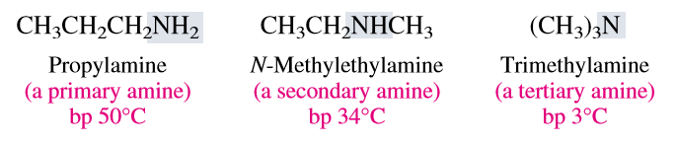
Physical Properties of Amines
Solubility
All three classes of amines can form hydrogen bonds with the -OH group of water (that is, O-H· · ·N).
Primary and secondary amines can also form hydrogen bonds with the oxygen atom in water: N-H· · ·O. Thus, most simple amines with up to five or six carbon atoms are either completely or appreciably soluble in water.
Boiling point
Amines are moderately polar substances; they boil well above alkanes with comparable molecular weights, but below comparable alcohols.
Intermolecular N-H· · ·N hydrogen bonds are important and raise the boiling points of primary and secondary amines but are not as strong as the O-H· · ·O bonds of alcohols. The reason for this is that nitrogen is not as electronegative as oxygen.
Molecules of tertiary amines cannot form hydrogen bonds to each other, as a result, tertiary amines generally boil at lower temperatures than primary and secondary amines of comparable molecular weight.

Slide 6
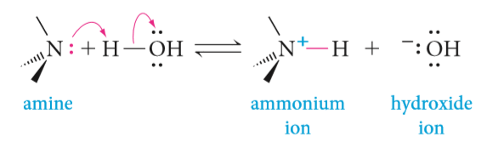

Physical Properties of Amines
Basicity of Amines: Amine Salts
The unshared pair of electrons on the nitrogen atom dominates the chemistry of amines. Because of this electron pair, amines are both basic and nucleophilic. Aqueous solutions of amines are basic because of the following equilibrium:
Amines are relatively weak bases. Most are stronger bases than water but are far weaker bases than hydroxide ions.
Alkylamines are approximately 10 times as basic as ammonia. Recall that alkyl groups are electron-donating relative to hydrogen.
Aromatic amines less basic than aliphatic amines.
Electron-donating groups increase the basicity of amines, and electron-withdrawing groups decrease their basicity.

Slide 7
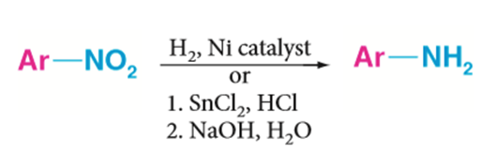
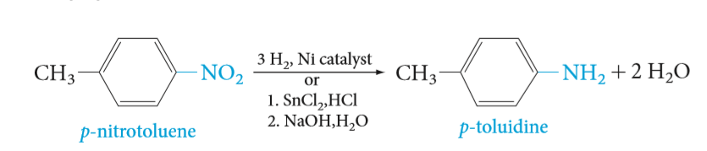
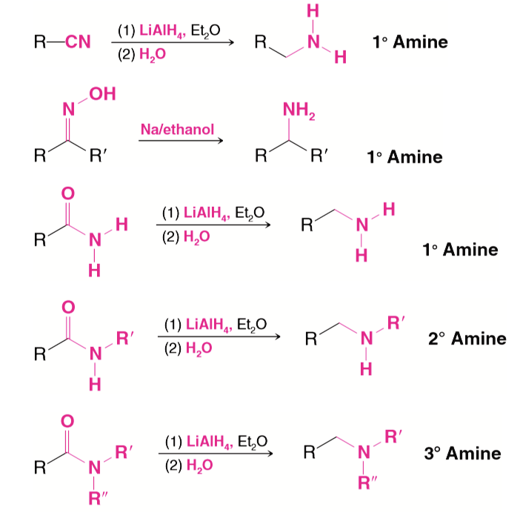
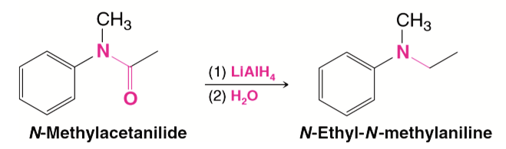
Preparation of Amines
1- Reduction of nitro compounds
2- Reduction of Amides

Slide 8
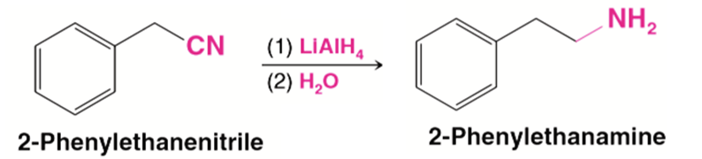
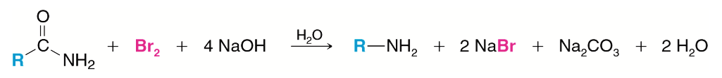
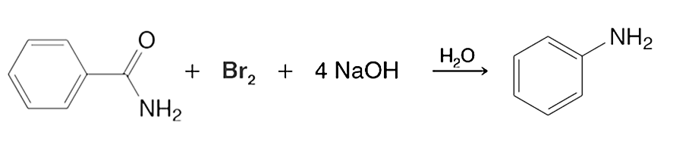
Preparation of Amines
3- Reduction of Nitriles
4- Preparation of Primary Amines through the Hofmann degradation
Aniline

Slide 9
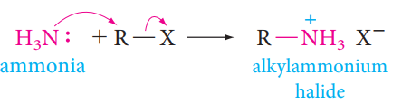

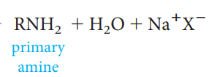
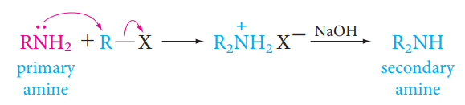
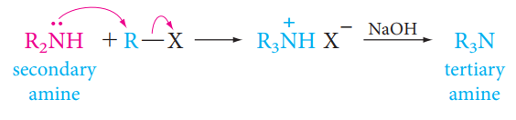
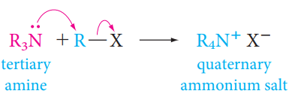
Preparation of Amines
5- Alkylation of Ammonia and amines

Slide 10

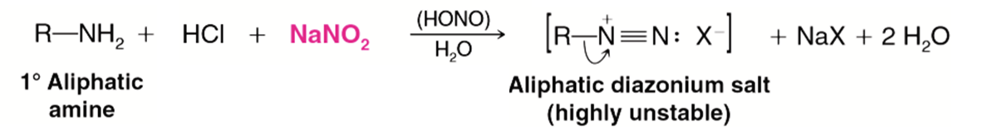
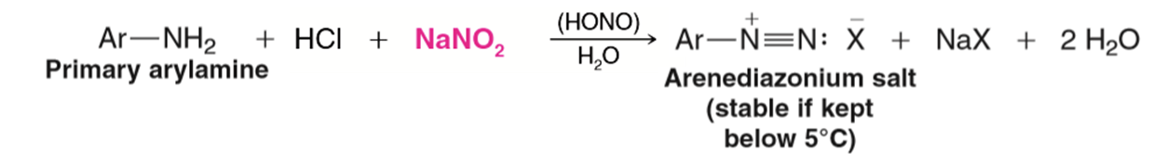
Reactions of Amines
1- Reactions with Nitrous Acid
Primary aliphatic amines react with nitrous acid through a reaction called diazotization to yield highly unstable aliphatic diazonium salt.

Slide 11
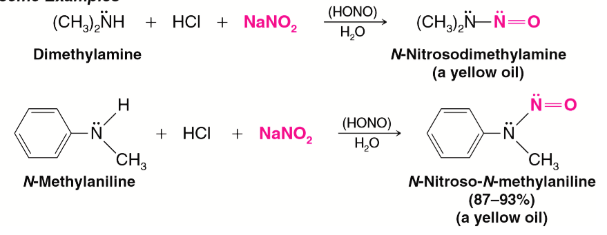
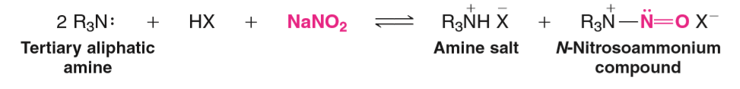
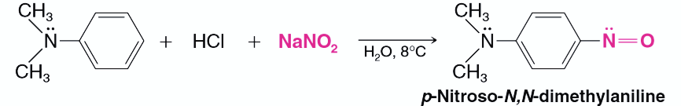
Secondary amines react with nitrous acid to yield N-nitrosoamines.
Tertiary aliphatic amine react with nitrous acid to form the tertiary amine salt and N-nitrosoammonium compound.
Tertiary arylamines react with nitrous acid to form C-nitroso aromatic compounds.

Slide 12
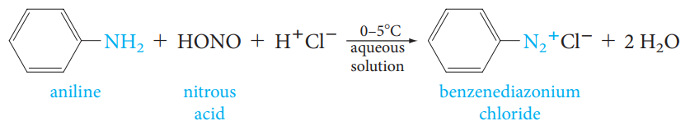
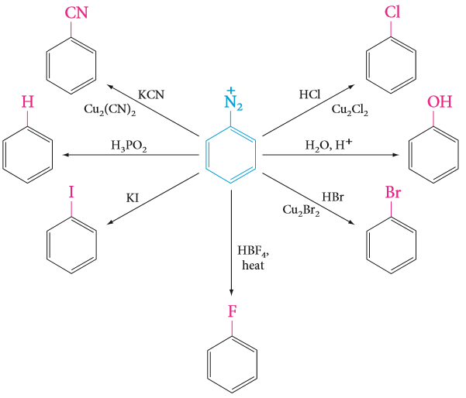
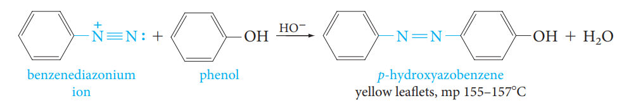
Reactions of Amines
2- Syntheses Using Diazonium Salts
Diazo Coupling; Azo Dyes

