Slide 1
Chapter 5
Aromatic Compounds

Slide 2
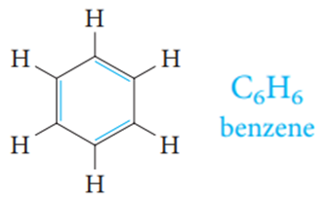
The expressing aromatic compounds came to mean benzene and derivatives.
Structure of Benzene: Resonance Description
It contains a six-membered ring and three additional degrees of unsaturation.
It is planar.
All C—C bond lengths are equal.

Slide 3
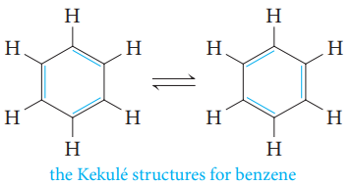
The Kekule Structure for Benzene:
In 1865, Kekulé proposed a reasonable structure for benzene. He suggested that six carbon atoms are located at the corners of a regular hexagon, with one hydrogen atom attached to each carbon atom.
To give each carbon atom a valence of 4, he suggested that single and double bonds alternate around the ring (what we now call a conjugated system of double bonds).
Kekulé suggested that the single and double bonds exchange positions around the ring so rapidly that the typical reactions of alkenes cannot take place.

Slide 4
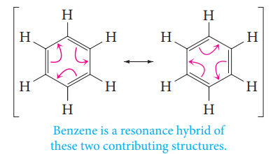
Kekulé’s formulas represent two identical contributing structures to a single resonance hybrid structure of benzene.
Modern physical measurements support this model for the benzene structure. Benzene is planar, and each carbon atom is at the corner of a regular hexagon. All of the carbon–carbon bond lengths are identical: 1.39 Å, intermediate between typical single (1.54 Å) and double (1.34 Å) carbon–carbon bond lengths.

Slide 5
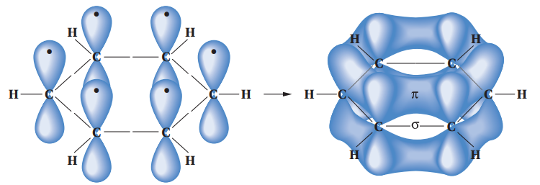
Orbital Model for Benzene:
Each carbon atom in benzene is connected to only three other atoms (two carbons and a hydrogen).
Each carbon is therefore sp² -hybridized, as in ethylene.
It also explains its hexagonal shape, with H-C-C and C-C-C angles of 120°.
An orbital representation of the bonding in benzene. Sigma (s) bonds are formed by the end-on overlap of sp2 orbitals. In addition, each carbon contributes one electron to the pi (p) system by lateral overlap of its p orbital with the p orbitals of its two neighbors.

Slide 6
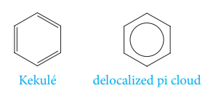
Symbols for Benzene:
Two symbols are used to represent benzene. One is the Kekulé structure, and the other is a hexagon with an inscribed circle, to represent the idea of a delocalized pi electron cloud.
Aromatic Character: The (4n + 2 ) π Rule
A molecule must be cyclic.
A molecule must be planar.
A molecule must be completely conjugated.
A molecule must satisfy Hückel’s rule, and contain a particular number of π electrons.
4n+2 π electrons ( n= 0, 1, 2, 3, ….= 2, 6, 10, 14, ….)

Slide 7
Examples:
Aromatic
Not aromatic
Not aromatic
Aromatic
Aromatic
Aromatic
Aromatic

Slide 8
Examples:
Not aromatic
Not aromatic
Aromatic
Not aromatic
Not aromatic
Aromatic
Not aromatic
Aromatic
Not aromatic
Furan
Aromatic
Thiophene
Aromatic
Pyrrole
Aromatic
Pyridine
Aromatic

Slide 9
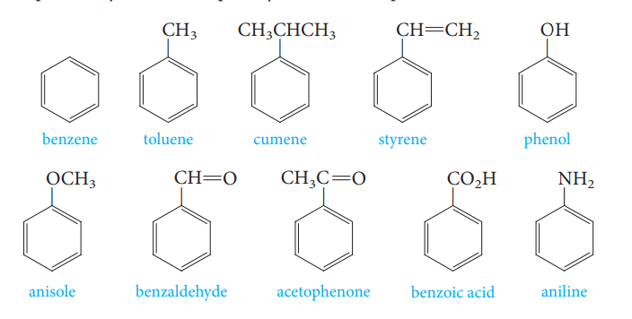
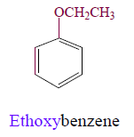
Nomenclature of Aromatic compounds
Common names have acquired historic respectability and are accepted by IUPAC. Examples include:
Monosubstituted benzenes that do not have common names accepted by IUPAC are named as derivatives of benzene.
EthoxyBenzene

Slide 10
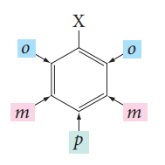
When two substituents are present, three isomeric structures are possible. They are designated by the prefixes ortho-, meta-, and para- (abbreviated as o-, m-, and p-) or by the use of numbers.
Examples:

Slide 11
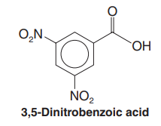
When more than two groups are present on the benzene ring, their positions must be indicated by the use of numbers.
Examples:

Slide 12
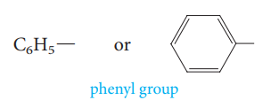
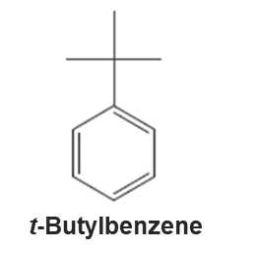
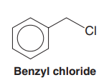
When the C₆H₅- group is named as a substituent, it is called a phenyl group. The phenyl group is often abbreviated as C₆H₅- , Ph- or ϕ−.
Benzyl group, C₆H₅CH₂- is an alternative name for the phenylmethyl group. It is sometimes abbreviated Bn.
Examples:

Slide 13
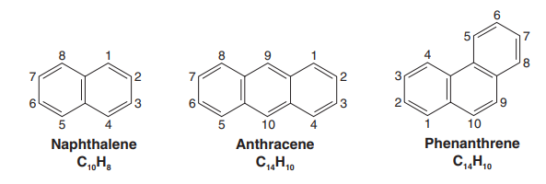
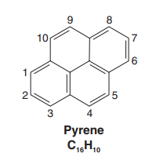
Polycyclic Aromatic Hydrocarbons:
1-Nitronaohthalene
α-Nitronaohthalene
2-Nitronaohthalene
β-Nitronaohthalene

Slide 14
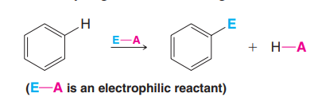
Reaction of Benzene
A- Electrophilic Aromatic Substitution
Some of the most important reactions of aromatic compounds are those in which an electrophile replaces one of the hydrogen atoms of the ring.
These reactions, called electrophilic aromatic substitutions (EAS).
The Mechanism of Electrophilic Aromatic Substitution

Slide 15
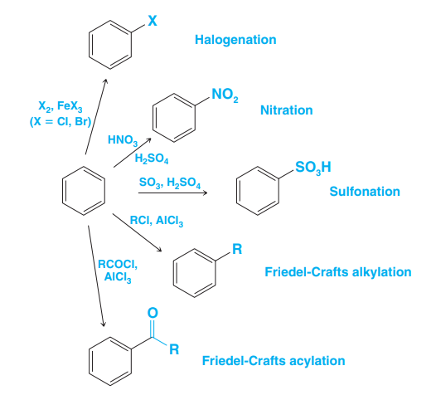
Electrophilic Aromatic Substitution

Slide 16
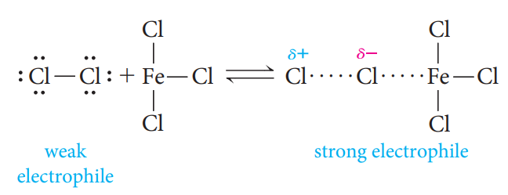
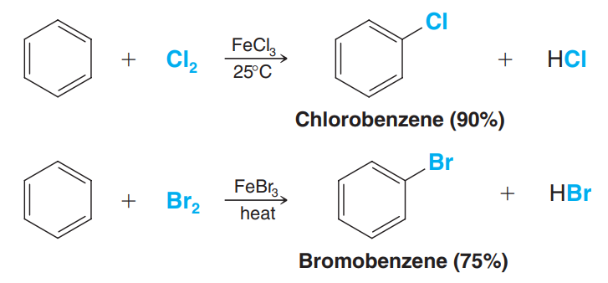
Halogenation of Benzene
Benzene reacts with bromine and chlorine in the presence of Lewis acids ( iron chloride (FeCl₃) for chlorination, and iron bromide (FeBr₃) for bromination).

Slide 17
Nitration of Benzene
Benzene undergoes nitration on reaction with a mixture of concentrated nitric acid and concentrated sulfuric acid.

Slide 18
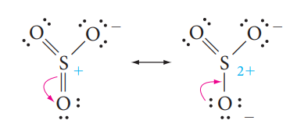
Sulfonation of Benzene
Benzene reacts with concentrated or fuming sulfuric acid, and the electrophile may be sulfur trioxide (SO₃), or protonated sulfur trioxide (⁺SO₃H).

Slide 19
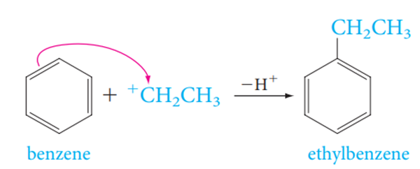
Friedel-Crafts Alkylation
The Electrophile is a carbocation, which can be formed either by removing
a halide ion from an alkyl halide with a Lewis acid catalyst (for example, AlCl₃).

Slide 20
Friedel-Crafts Acylation
The Electrophile is an acyl cation generated from an acyl halide, the reaction requires the addition of at least one equivalent of a Lewis acid (such as AlCl₃). The product of the reaction is an aryl ketone.

Slide 21
Reaction of Benzene
B- Reactions of the Side Chain of Alkylbenzene
1- Oxidation of the Side Chain
Alkylbenzenes with alkyl groups longer than methyl are ultimately degraded to benzoic acids.

Slide 22
2- Halogenation of the Side Chain
Chlorine and bromine can be made to replace hydrogen atoms that are on a benzylic carbon, such as the methyl group of toluene.
Benzylic halogenation is carried out in the absence of Lewis acids and under conditions that favor the formation of radicals.

Slide 23
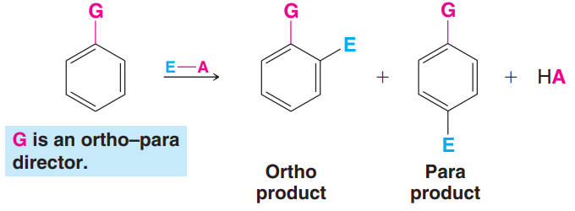
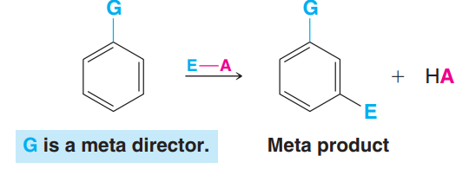
Substituents Can Affect Both the Reactivity of the Ring and the Orientation of the Incoming Group
A substituent group already present on a benzene ring can affect both the reactivity of the ring toward electrophilic substitution and the orientation that the incoming group takes on the ring.

Slide 24
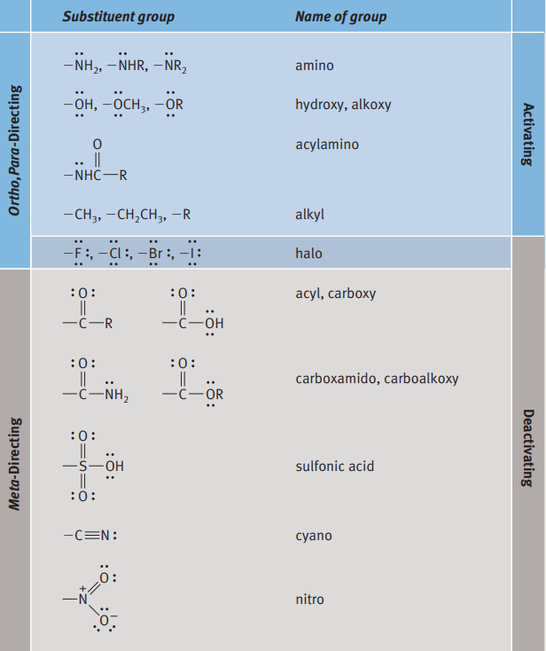
Directing and Activating Effects of Common Functional Groups
(Groups are Listed in Decreasing Order of Activation)

Slide 25
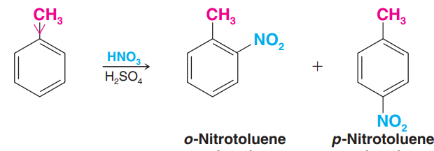
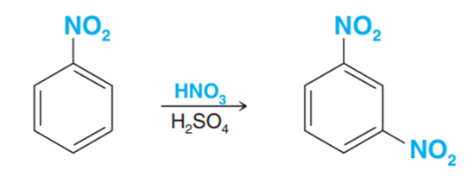
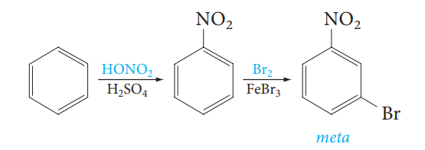
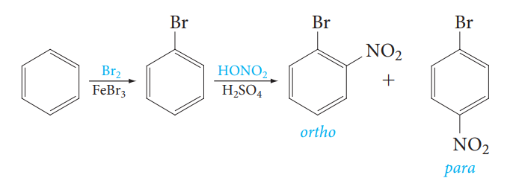
Examples:
The Importance of Directing Effects in Synthesis:

