Slide 1
108 Chem
Chapter 4-1
Alcohols and Phenols
1

Slide 2
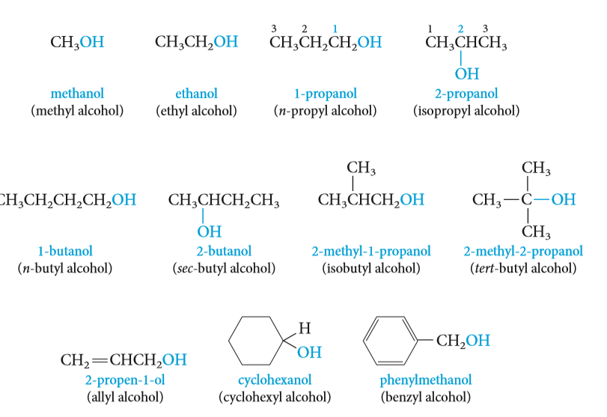

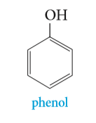
Structure of Alcohols and Phenols
Alcohols, a class of compounds containing the hydroxyl group ( OH )
Alcohols have a hydroxyl ( OH ) group bonded to a saturated carbon atom.
  The alcohol carbon atom may be part of a simple alkyl group, an alkenyl or the carbon atom may be a saturated carbon atom that is attached to a benzene ring:
Phenols are compounds of the general formula ArOH, where Ar is an groups.
Phenols differ from alcohols in having the OH group attached directly to an benzene ring.
Phenols is the specific name for hydroxybenzene, and it is the general name for the family of compounds derived from hydroxybenzene.

Slide 3
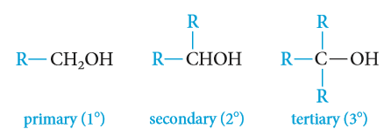
Classification of Alcohols
Alcohols are classified as primary ( 1º ), secondary ( 2º ), or tertiary ( 3º ), depending on whether one, two,
or three organic groups are connected to the hydroxyl-bearing carbon atom.
The carbon atom which connected to the hydroxyl group called carbinol carbon.
Methyl alcohol, which is not strictly covered by this classification, is usually grouped with the primary alcohols.
Example:
2º
3º
3º
1º
1º
2º

Slide 4
Type of Alcohols
Monohydroxyls: containing one hydroxyl group.
Dihydroxyls (glycols) : containing two hydroxyl groups.
Polyhydroxyls : containing more than two hydroxyl groups.

Slide 5
Nomenclature of Alcohols
Common names derived by naming the alkyl group followed by the word alcohol.
The IUPAC system: select the longest carbon chain that contains the -OH group as the parent alkane and numbered from the end closer to OH. change the suffix -e of the parent alkane to -ol
use a number to show the location of the OH group.
If there is a functional group suffix and a substituent, the functional group suffix gets the lowest possible number..
Cyclic alcohols are named using the prefix cyclo-, the carbon bearing the hydroxyl group is assumed to take number 1.
So the compound containing two hydroxyl groups is named as a diol , one containing three hydroxyl groups as a triol , and so on.
Compounds containing OH and C=C groups are often referred to as unsaturated alcohols. choose the chain that include them both even if this is not the longest chain.
The IUPAC system: the double bond is shown by changing the infix of the parent alkane from -an- to -en- and the hydroxyl group is shown by changing the suffix of the parent alkene from -e to -ol.
Numbers must be used to show the location of both the carbon-carbon double bond and the hydroxyl group.

Slide 6
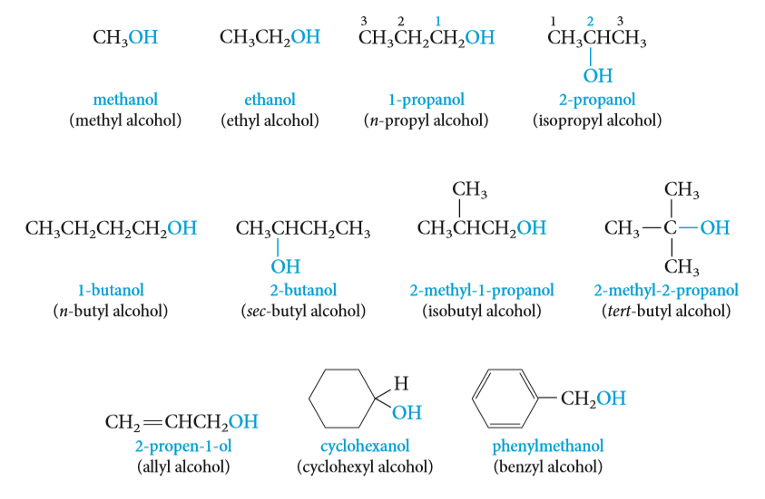
Nomenclature of Alcohols
4-Pentyn-1-ol
(Ethylene glycol)
(Trimethylene glycol)
(Glycerol)

Slide 7
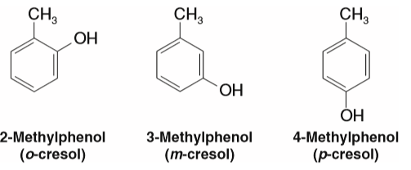
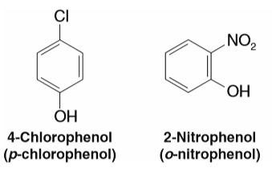
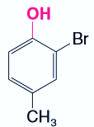
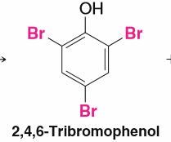
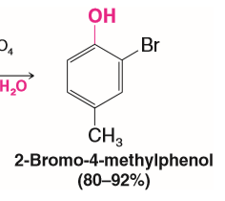
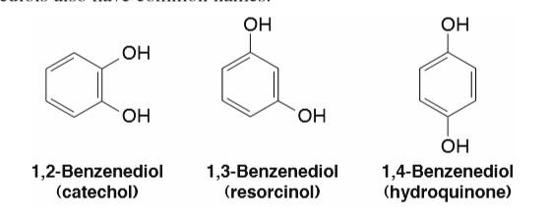
Nomenclature of phenols
The simplest member of this class of compounds is named phenol.
Phenols are usually named as derivatives of the parent compounds.
Numbering of the ring begins at the hydroxyl-substituted carbon and proceeds in the direction that gives the lower number to the next substituted carbon. Substituents are cited in alphabetical order.
Dihydroxypenols
Polyhydroxypenols
1,2,3-Benzenetriol
Pyrogallol
1,3,5-Benzenetriol
(Phloroglucinol)

Slide 8
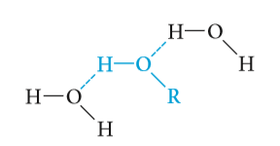

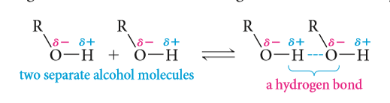
Physical Properties of Alcohols
Solubility
Water and alcohols have similar properties because they all contain hydroxyl groups that can form hydrogen bonds.
Several of the lower-molecular-weight alcohols as CH₃OH,,,,C₃H₇OH are miscible (soluble in any proportions) with water.
The solubility decreases as the alkyl group becomes larger.
The number of hydroxyl groups increases so the solubility increases.
Boiling Points
The boiling points of alcohols are much higher than those of hydrocarbons with similar molecular weights.
Alcohol molecules can associate with each other through hydrogen bonding, whereas those of hydrocarbons cannot.
The boiling point decreases with increase in branching in the alkyl group: 1º alcohol > 2º alcohol > 3º alcohol.
The boiling points increase with the increase of the number of OH groups .

Slide 9
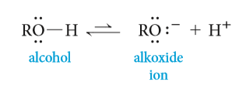
Physical Properties of Alcohols
Acidity of Alcohols
Alcohols can function as both weak acids (proton donors) and weak bases (proton acceptors).
A strong base can remove the hydroxyl proton to give an alkoxide ion (for example, methoxide ion from methanol, ethoxide ion from ethanol, and so on).
The order of acidity of various liquid alcohols generally : water > 1º>2º>3º

Slide 10
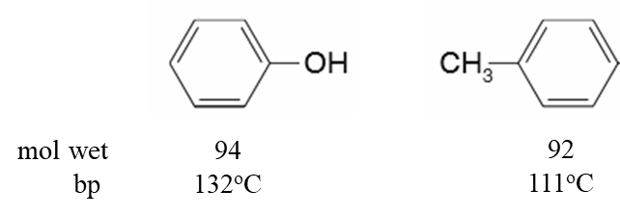

Physical properties of phenols
Phenol is a colourless, crystalline
The presence of hydroxyl groups in phenols means that phenols are like alcohols. For example, they are able to form strong intermolecular hydrogen bonds, and therefore have higher boiling points than hydrocarbons of the same molecular weight.
Phenols are also modestly soluble in water because of their ability to form strong hydrogen bonds with water molecules.
Acidity of phenols
Like water, alcohols and phenols are weak acids. The hydroxyl group can act as a proton donor, and dissociation occurs in a manner similar to that for water
Phenol
Phenoxide ion

Slide 11
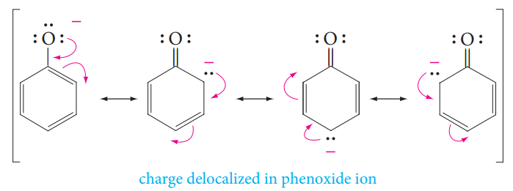
Physical properties of phenols
Phenols are more acidic than alcohols, and weaker acids than carboxylic acids.
Phenols are stronger acids than alcohols mainly because the corresponding phenoxide ions are stabilized by resonance.
Electron-withdrawing groups increase acidity by stabilizing the conjugate base.
Electron-donating groups decrease acidity because they destabilize the conjugate base.

Slide 12
Preparation Of Alcohols
Preparation of alcohols via alkenes
    Addition reaction
    Oxidation reaction
Preparation of alcohols via alkyl halides (Nucleophilic Substitution)
Preparation of alcohols via Reduction reaction of:
Aldehydes, Ketones, Acids and Esters
Preparation of alcohols via Grignard reagents with:
    Aldehydes and Ketones

Slide 13
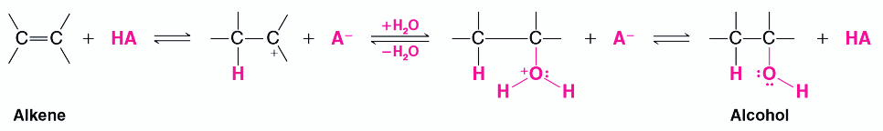
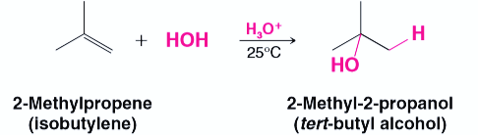


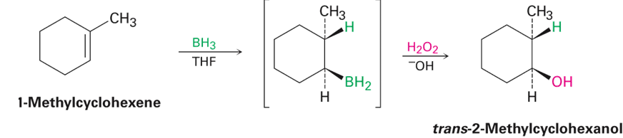
Preparation Of Alcohols
1- Preparation of alcohols via alkenes
a) Acid-Catalyzed Hydration of Alkenes: Addition of water to alkenes
Markovnikov Hydration
Electrophilic Addition
Anti-Markovnikov Hydration
Hydroboration–Oxidation

Slide 14
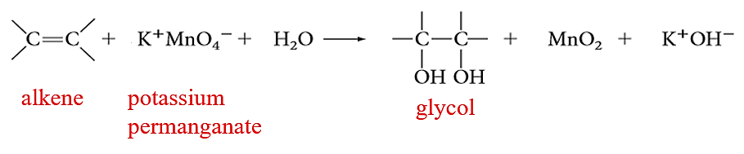
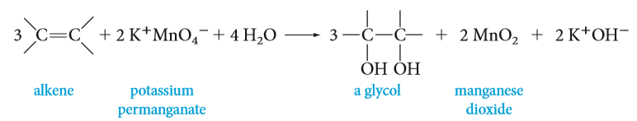
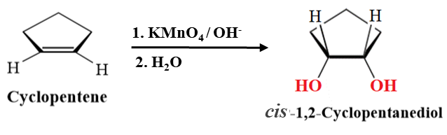
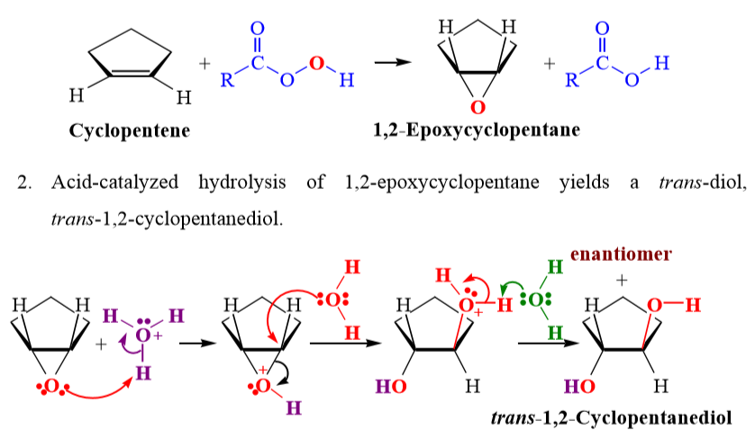
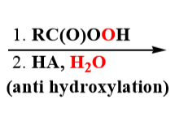
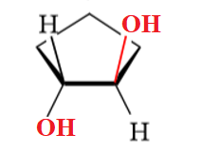
Preparation Of Alcohols
b) Oxidation of alkenes: Synthesis of 1,2-diols
1,2-dihydroxylation
Anti-1,2-dihydroxylation
OH⁻
RCOOOH
RCOOH
alkene
peroxy acid
epoxide
glycol

Slide 15

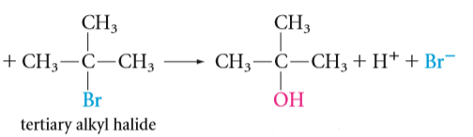
Preparation Of Alcohols
2- Preparation of alcohols via alkyl halides: Hydrolysis of alkyl halides
Nucleophilic Substitution Reactions

Slide 16
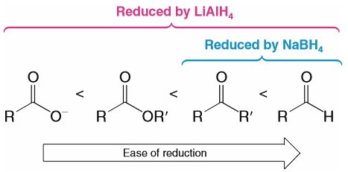
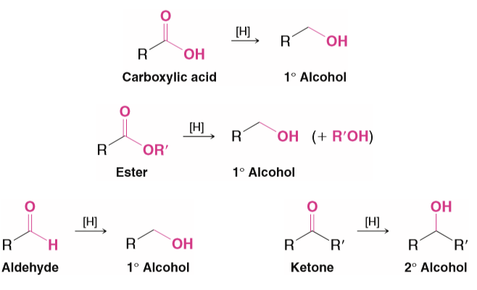
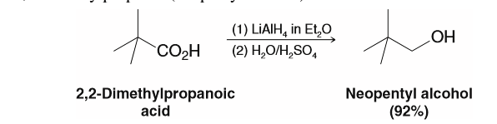
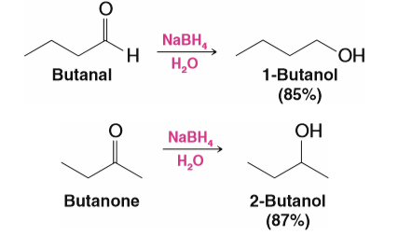
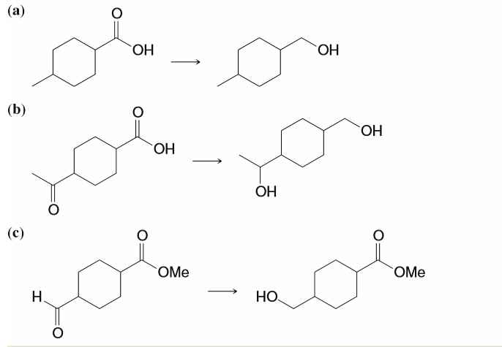
Preparation Of Alcohols
3- Preparation of alcohols via Reduction reaction
By hydrogenation of the carbon–oxygen double bond.
sodium borohydride (NaBH₄) reduce carbonyl groups (aldehydes, ketones).
lithium aluminum hydride (LiAlH₄) reduce all kind of carbonyl groups.

Slide 17
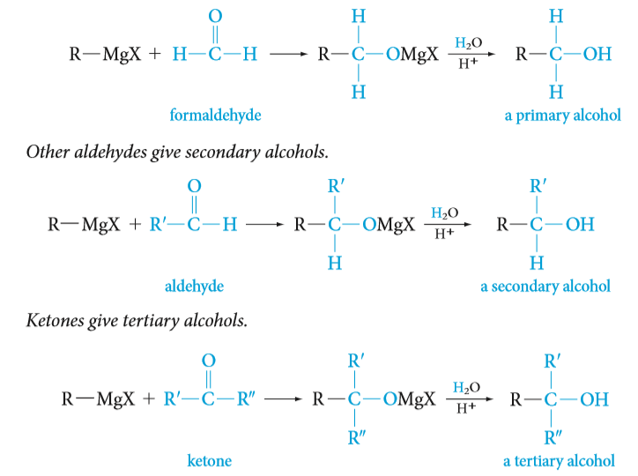
Preparation Of Alcohols
4- Preparation of alcohols via Grignard reagents with Aldehydes and ketones.

Slide 18
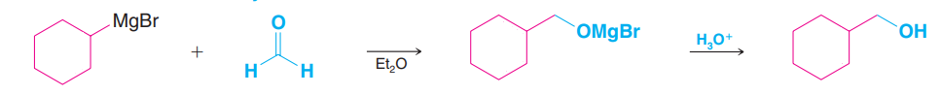
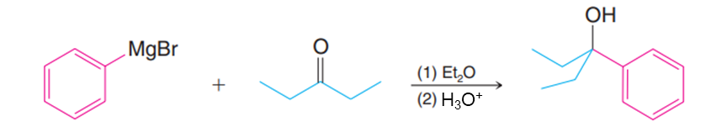
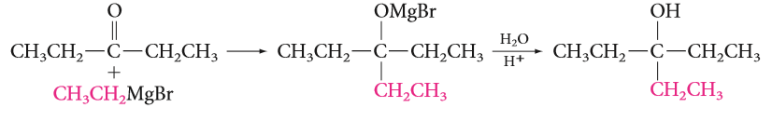
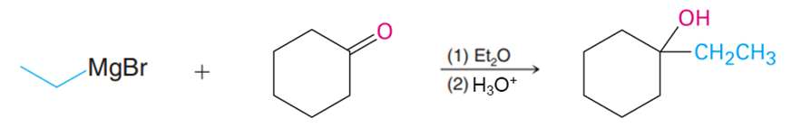
Examples:

Slide 19
Preparation of Phenols
From Cumene Hydroperoxide ( Industrial Syntheses )
Hydrolysis of Diazonium salts
Alkali fusion of Benzenesulfonic acid
Hydrolysis of Chlorobenzene (The Dow process)

Slide 20
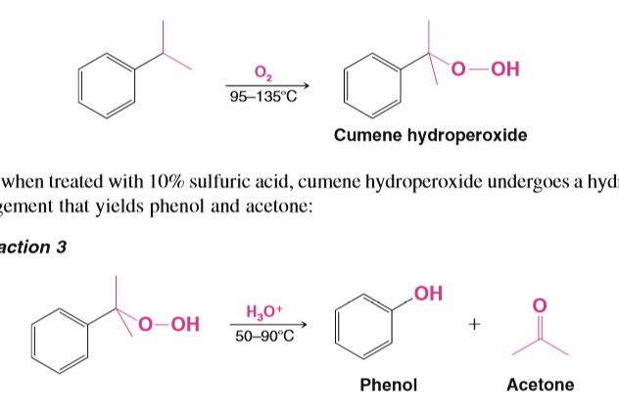
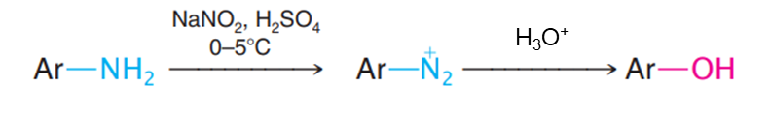
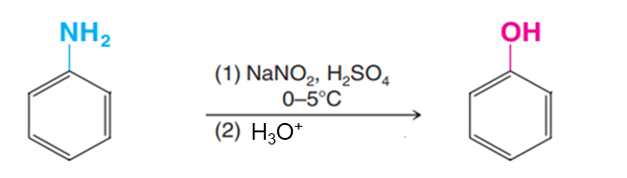
Preparation of Phenols
1. From Cumene Hydroperoxide ( Industrial Syntheses )
Cumene
(isopropylbenzene(
2. Hydrolysis of Diazonium salts
Diazonium salts react with water in the presence of mineral acids to yield phenols.

Slide 21
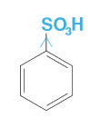
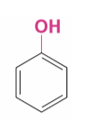

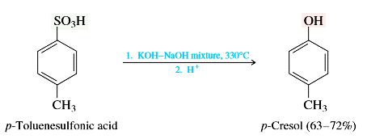
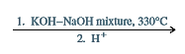
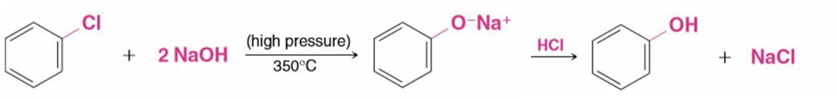
Preparation of Phenols
3. Alkali fusion of Benzenesulfonic acid
Addition-elimination of nucleophilic aromatic substation
4. Hydrolysis of Chlorobenzene (The Dow process)

Slide 22
Reactions Of Alcohols
The reactions of alcohols have mainly to do with the following:
  The hydrogen atom of the hydroxyl group is weakly acidic.
                Preparation of alkoxides
                Preparation of Esters (Fisher esterification)
  The oxygen atom of the hydroxyl group is nucleophilic and weakly basic.
                Oxidation Reactions
  The hydroxyl group can be converted to a leaving group so as to allow substitution or elimination reactions.
                Conversion of Alcohols into Alkyl Halides
                Preparation of Ethers
                Preparation of alkenes

Slide 23
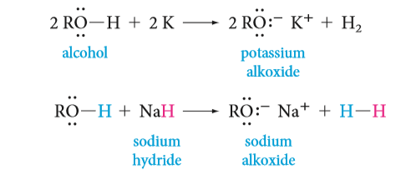

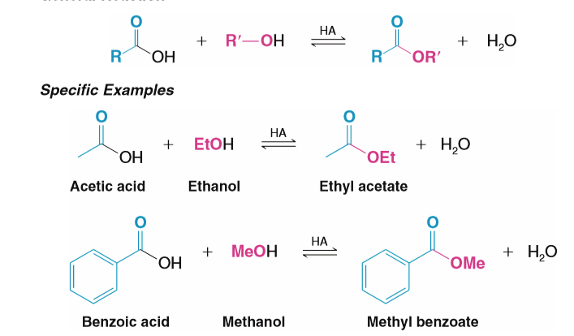
Reactions Of Alcohols
Preparation of alkoxides
They can be prepared by the reaction of an alcohol with sodium or potassium metal or with a metal hydride.
Hint:
2- Preparation of Esters: Acid-catalyzed esterification (Fisher esterification)

Slide 24

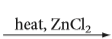

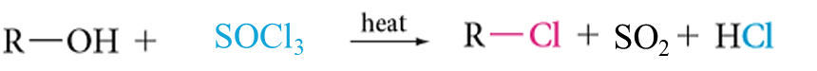
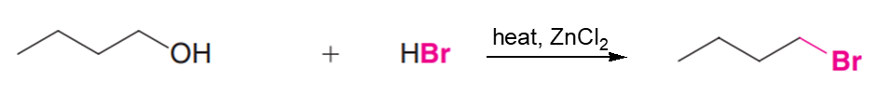
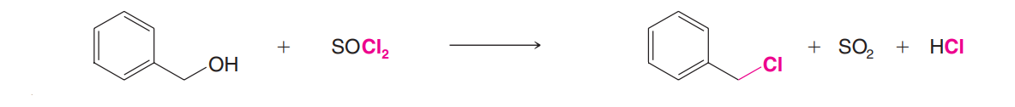
Reactions Of Alcohols
    3- Conversion of Alcohols into Alkyl Halides:
The most commonly used reagents for conversion of alcohols to alkyl halides are the following:
  Hydrogen halides (HCl, HBr, Hl)
  Phosphorus tribromide (PBr₃)
  Thionyl chloride (SOCl₂)
Examples:

Slide 25


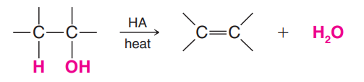


Reactions Of Alcohols
4- Preparation of Ethers
5- Elimination Reaction: Preparation of alkenes

Slide 26





Reactions Of Alcohols
6. Oxidation of Alcohols
Strong oxidizing agent
Weak oxidizing agent
Potassium permanganate KMnO₄ ,OH⁻/ H₃O⁺
Chromic oxide CrO₃ / H₂SO₄ (H₂CrO₄ Jones’ reagent )
Chromic oxide CrO₃ / pyridine
Examples:
No reaction
Tertiary alcohol

Slide 27
Reactions of phenols
Salt formation via strong base or active metal
Oxidation of Phenols
Reaction of aromatic nucleus of phenol:
  Nitration
  Sulphonation
  Halogenation

Slide 28


Salt formation via strong base or active metal
Reactions of phenols
With active metals
With bases
Oxidation of Phenols: Quinones
Oxidation of derivatives of 1,4-benzenediol (hydroquinone) by oxidizing agents (Silver oxide or Chromic acid )

Slide 29




Reactions of phenols
Reaction of aromatic nucleus of phenol
The hydroxyl group is a powerful activating group and an ortho - para director in Electrophilic Aromatic Substitutions
b. Sulfonation
a. Nitration
2-Hydroxysulfonic acid
4-Hydroxysulfonic acid
c. Halogenation

