Slide 1
Chapter 4
Unsaturated Hydrocarbons II
Alkynes

Slide 2
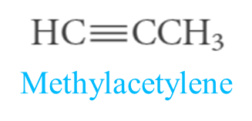
Alkynes
C_{n}H_{2n-2} Crabon-Carbon Trible bond
Nomenclature of Alkynes
Common Names:
Named as substituted
Isobutylisopropylacetylene
IUPAC Names:
ane
yne

Slide 3
Examples:
1,3-Hexadiyne
2,5-dimethyl-3-heptyne
4-Methyl-1-hexen-5-yne
5-Methyl-4-hexen-1-yne
The two-carbon alkyl group derived from acetylene is called an ethynyl group.
Ethynylcyclohexane

Slide 4
Physical Properties
C₁-C₄ gases
C₅-C₁₈ liquid
More than C₁₈ soilds
Alkynes are nonpolar compounds. Thus alkynes are soluble in the nonpolar solvents
such as carbon tetrachloride (CCl₄) and benzene (C₆H₆), but they are insoluble in polar solvents such as water.
Acidity of Terminal Alkynes
A hydrogen atom on a triply bonded carbon is weakly acidic and can be removed by a very strong base. Sodium amide, for example, converts acetylenes to acetylides.

Slide 5
Preparation of Alkynes
1) Industrial
From Calcium carbide

Slide 6
2- Dehydrohalogenation of Alkyl Dihalide
Examples:

Slide 7
3- Alkylation of Acetylene and Terminal Acetylene
By attaching alkyl groups to acetylene, more complex alkynes can be prepared.
By treating the sodium alkynide with a primary alkyl halide.
Examples:

Slide 8
Reactions of Alkynes
1- Addition of Hydrogen: Hydrogenation

Slide 9
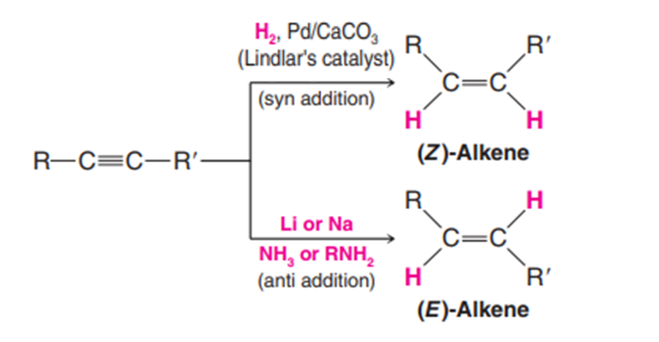
Hydrogenation of an alkyne to an alkene can be accomplished through the use of special catalysts or reagents. Moreover, these special methods allow the preparation of either (E)- or (Z)-alkenes from disubstituted alkynes.
Examples:

Slide 10
2- Addition of Halogen: Halogenation
3- Addition of Hydrogen Halide: Hydrohalogenation
Markovnikov addition

Slide 11
4- Addition of Water : Hydration
Addition of water to alkynes requires not only an acid catalyst but mercuric ion as well.
Markovnikov addition

Slide 12
5- Ozonolysis of alkynes
Example:

