Slide 1
240 Chem
Chapter 2
Saturated Hydrocarbons
Alkanes and Cycloalkanes

Slide 2
Hydrocarbons
Hydrocarbons
Aromatic
Aliphatic
Cyclic related to benzene
Cyclic
Straight Chain
Unsaturated
Saturated
Alkyne
Cycloalkyne
Alkene
Cycloalkene
Alkane
Cycloalkane

Slide 3
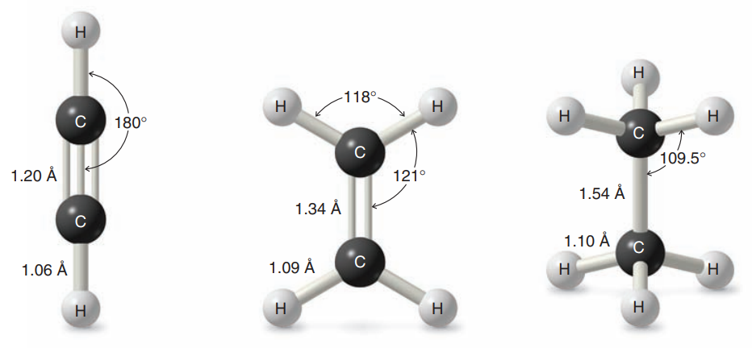
General Molecular Formula of Hydrocarbons
(Homologous Series)
Alkane | C_{n}H_{2n+2} Saturated
Cycloalkane | C_{n}H_{2n} Containing a single ring
Alkene | C_{n}H_{2n} Containing one carbon–carbon double bond
Cycloalkene | C_{n}H_{2n-2} Containing a single ring with one double bond
Alkyne | C_{n}H_{2n-2} Containing one carbon–carbon triple bond
Cycloalkyne | C_{n}H_{2n-4} Containing a single ring with one triple bond

Slide 4
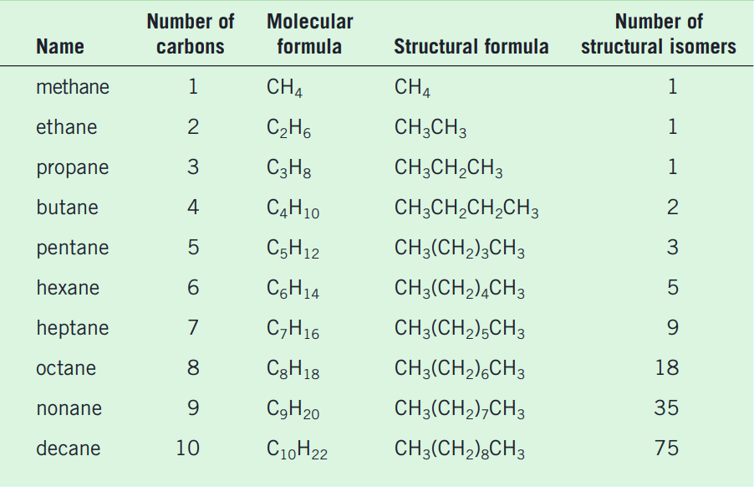
Alkanes
C_{n}H_{2n+2} Saturated
- ane
Names and Formulas of the first Ten unbranched Alkanes

Slide 5
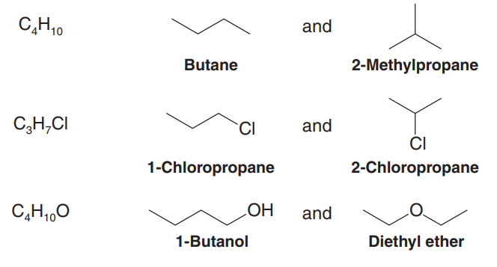
Isomerism
Isomers are molecules with the same number and kinds of atoms but different arrangements of the atoms.
structural ( or constitutional ) isomers have the same molecular formula but different structural formulas.
molecular formula
Structural Isomers

Slide 6
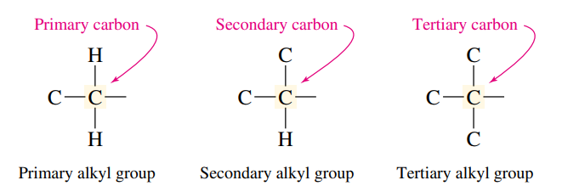
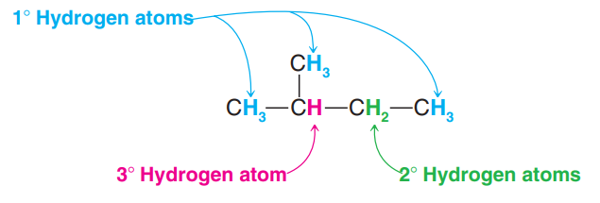
Classification of Carbon and Hydrogen Atoms
The carbon atoms are classified according to their degree of substitution by other carbons.
1º
2º
3º
The hydrogen atoms of an alkane are classified on the basis of the carbon atom to which they are attached. A hydrogen atom attached to a primary carbon atom is a primary (1°) hydrogen atom, and so forth.

Slide 7
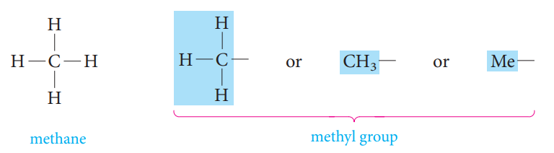
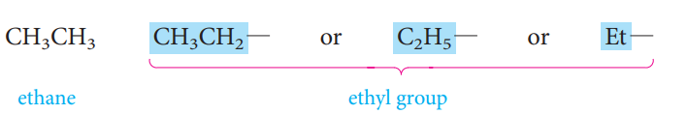
Alkyl Substituents
An alkyl group lacks one of the hydrogen substituents of an alkane.
An alkyl group is named by taking the name of the alkane with the same number of carbon atoms and changing the -ane ending to -yl.
The symbol R is used as a general symbol to represent any alkyl group.

Slide 8
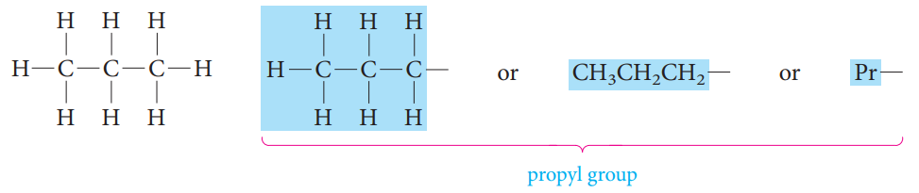
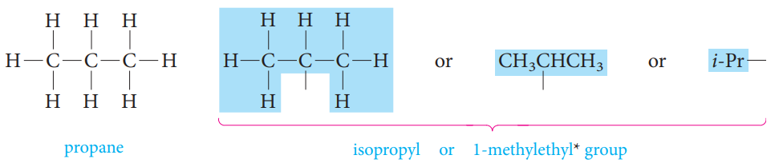
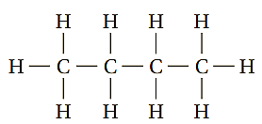
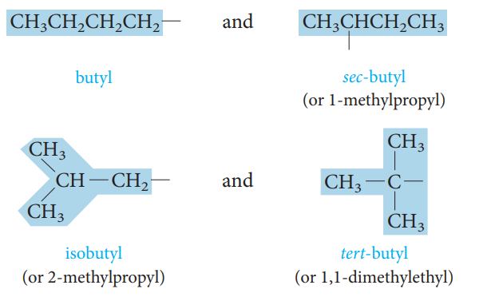
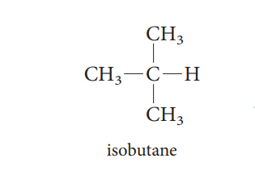

Slide 9


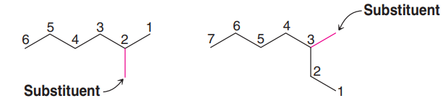
Nomenclature of Organic Compounds
Common or trivial names: The older unsystematic names.
Systematic names: Chemists use a systematic nomenclature developed and updated by the International Union of Pure and Applied Chemistry (IUPAC). Underlying the IUPAC system is a fundamental principle.
IUPAC Rules for Naming Alkanes
1) Locate the longest continuous carbon chain. This gives the name of the parent alkane.
2) Number the longest chain beginning with the end of the chain nearer the substituent.

Slide 10
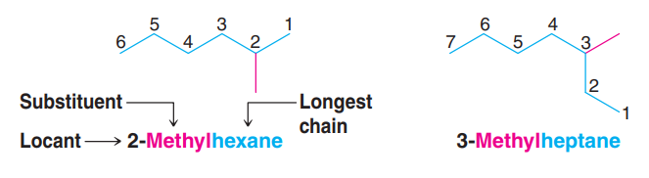
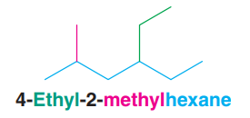
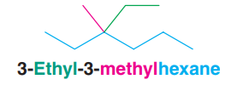
3) Use the numbers obtained by application of rule 2 to designate the location of the substituent group.
4) When two or more substituents are present, give each substituent a number corresponding to its location on the longest chain. The substituent groups should be listed alphabetically (i.e., ethyl before methyl).
5) When two substituents are present on the same carbon atom, use that number twice.

Slide 11
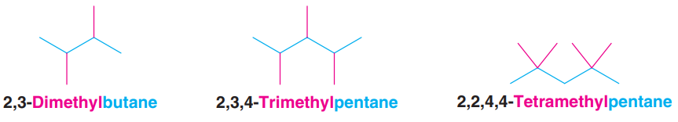
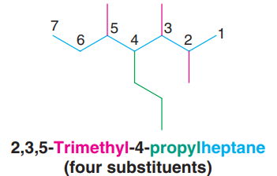
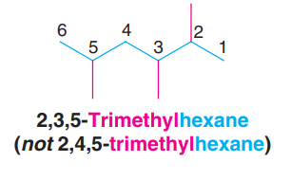
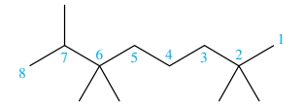
6) When two or more substituents are identical, indicate this by the use the prefixes
di-, tri-, tetra-, and so on.
7) When two chains of equal length compete for selection as the parent chain, choose the chain with the greater number of substituents.
8) When branching first occurs at an equal distance from either end of the longest chain, choose the name that gives the lower number at the first point of difference.
2,2,6,6,7-Pentamethyloctane
(not 2,3,3,7,7-Pentamethyloctane)

Slide 12

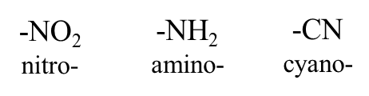

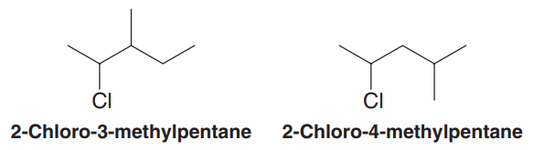
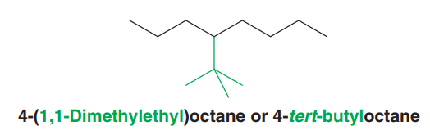
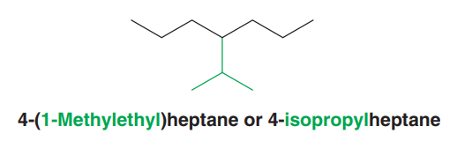
9) Halogen substituents are named by changing the -ine ending of the element to -o.

Slide 13
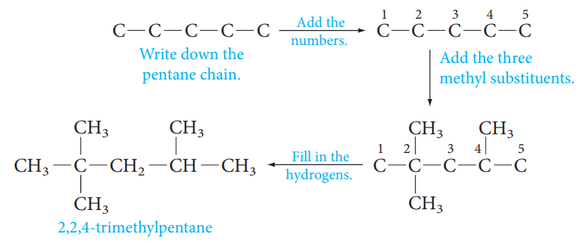
Use of the IUPAC Rules
It is important not only to be able to write a correct IUPAC name for a given structure, but also to do the converse: Write the structure given the IUPAC name.
For example, to write the formula for 2,2,4-trimethylpentane :

Slide 14
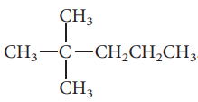
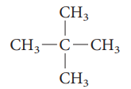








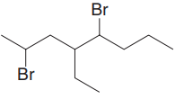

Examples

Slide 15
Physical properties of alkanes
A) Physical States and Solubilities
C₁-C₄
colorless gases
C₅-C₁₇
liquids with characteristic odor
C₂₀ and more
odorless waxy materials
Alkanes are nonpolar compounds. Thus alkanes are soluble in the nonpolar solvents such as carbon tetrachloride (CCl₄) and benzene (C₆H₆), but they are insoluble in polar solvents such as water.

Slide 16
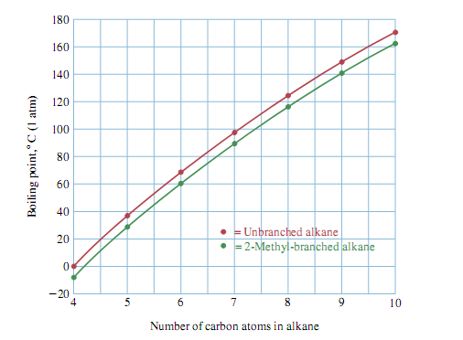
B) Boiling Points
The boiling points of the normal alkanes increase with increasing molecular weight.
Branching of the alkane chain lowers the boiling point.
Example:
C) Melting Points
Generally, melting point increases as molecular weight increases, but with no particular pattern.

Slide 17
Sources of Alkanes and Cycloalkanes
The two most important natural sources of alkanes are petroleum and natural gas.
Petroleum is a complex liquid mixture of organic compounds, many of which are alkanes or cycloalkanes.
Natural gas, often found associated with petroleum deposits, consists mainly of methane (about 80%) and ethane (5% to 10%), with lesser amounts of some higher alkanes. Propane is the major constituent of liquefied petroleum gas (LPG), a domestic fuel used mainly in rural areas and mobile homes. Butane is the gas of choice in some areas. Natural gas is becoming an energy source that can compete with and possibly surpass oil.

Slide 18
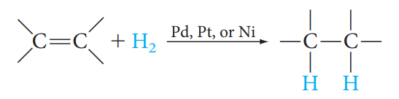
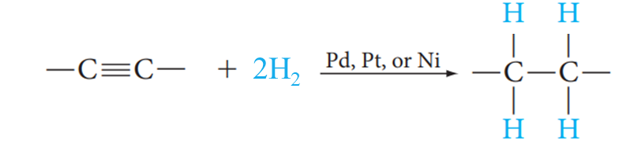
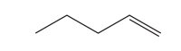

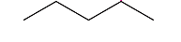

Preparation of alkanes
1) From Alkenes & Alkynes
Catalytic Hydrogenation
Examples
H₂
Pt
1-Pentene
Pentane
2H₂
Pt
1-Pentyne
Pentane

Slide 19
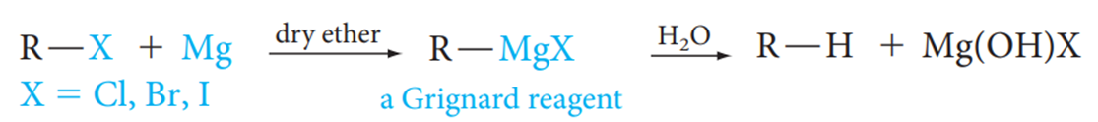
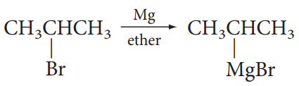


2) Hydrolysis of Grignard Reagent
2-Bromopropane
Propane

Slide 20
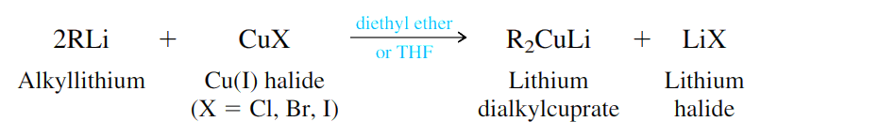
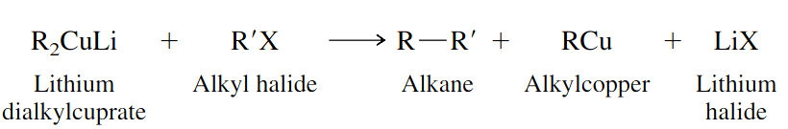
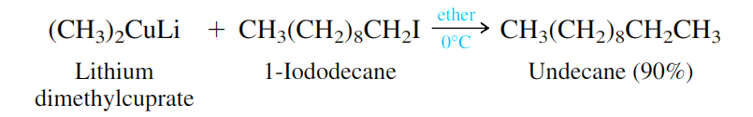
3) The Corey–Posner, Whitesides–House Reaction
Use of Lithium Dialkyl Cuprate (Gilman Reagent) in Coupling Reaction

Slide 21

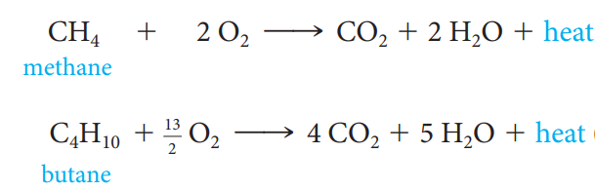
Reactions of alkanes
1) Oxidation and Combustion; Alkanes as Fuels

Slide 22




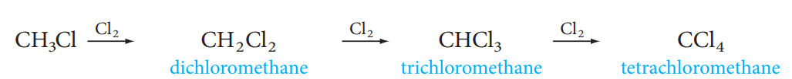
2) Halogenation
Chlorination or Bromination of hydrocarbons is a substitution reaction in which a chlorine or bromine atom is substituted for a hydrogen atom.
If excess halogen is present:

Slide 23

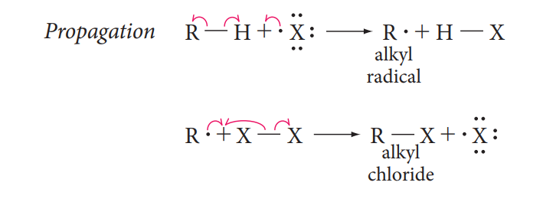
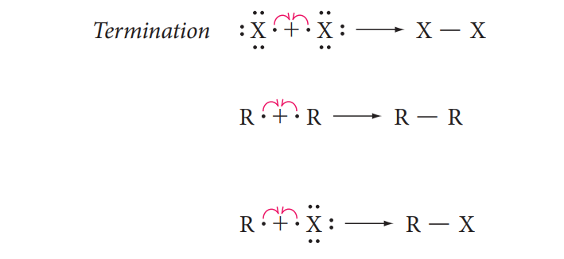
The Free-Radical Chain Mechanism of Halogenation
A reaction mechanism is a step-by-step description of the bond-breaking and bond-making processes that occur when reagents react to form products.
A free-radical chain reaction includes a chain-initiating step, chain-propagating steps, and chain-terminating steps.
(Homolysis of a halogen molecule)

Slide 24
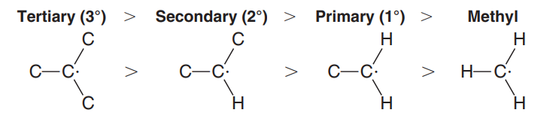
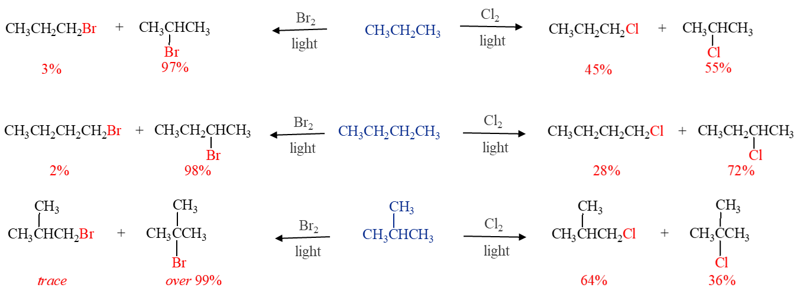
Selectivity in Halogenation Reactions
The relative stabilities of radicals are 3° > 2° > 1° > methyl

Slide 25
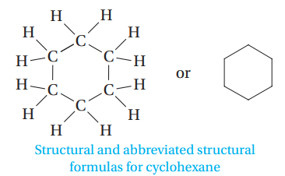
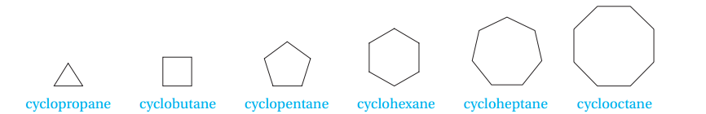
Cycloalkanes
C_{n}H_{2n}
Cycloalkanes are saturated hydrocarbons that have at least one ring of carbon atoms.
Nomenclature of Cycloalkane
Cycloalkanes are named by placing the prefix cyclo- before the alkane name that corresponds to the number of carbon atoms in the ring.

Slide 26
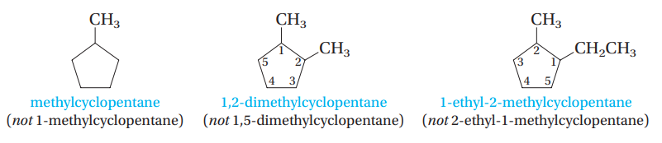
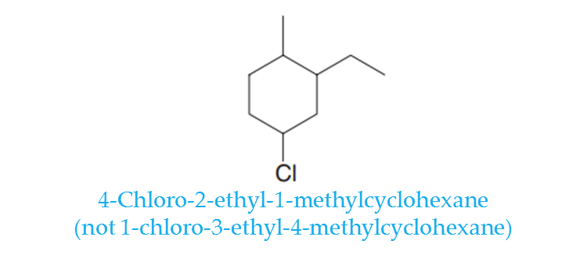
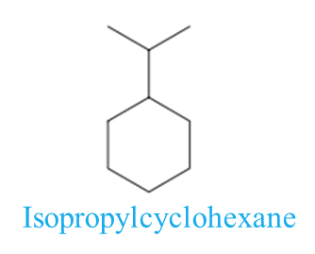
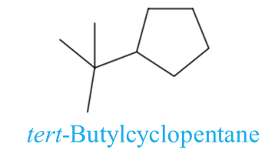






Slide 27





Nomenclature of Bicycloalkane
Bicycloalkanes: compounds containing two fused or bridged rings.

Slide 28




Slide 29
Reaction of cycloalkanes
Ring less stable 3 and 4
Ring more stable 5 and 6

Slide 30
Conformations of Alkanes
Different conformations (shapes) of the same molecule that are interconvertible by rotation around a single bond are called conformers or rotamers.
Conformers are stereoisomers, isomers with the same atom connectivity but different spatial arrangements of atoms.
The certain types of structural formulas are:
    Newman projection formula
    Sawhorse formula

Slide 31




Slide 32





Conformation of Cyclohexane
Chair conformation (most stable)
Boat conformation
In the chair conformation, the hydrogens in cyclohexane fall into two sets, called axial and equatorial.

Slide 33

Disubstituted Cycloalkanes: Cis–Trans Isomerism
Ring structures like C=C restrict rotation and therefore can result in cis and trans isomers.
The trans-isomer is the molecule with branches on OPPOSITE sides of the ring.
The cis-isomer is the molecule with branches on the SAME side of the ring.
These cis-trans isomers are also stereoisomers.
The physical properties of cis-trans isomers are different; they have different melting points, boiling points, and so on.
cis-1,2-Dimethylcyclopropane
trans-1,2-Dimethylcyclopropane

Slide 34







Slide 35

Cis-trans isomerism and Conformational Structure of
Disubstituted Cyclohexane

Slide 36





1,4-Disubstituted Cyclohexanes
1,2-Disubstituted Cyclohexanes

