Slide 1
Barium Swallow
أ. منال العسيمي

Slide 2
Introduction
A barium swallow is a test used to determine the cause of painful swallowing, difficulty with swallowing, abdominal pain, or unexplained weight loss.

Slide 3
These problems can be detected with a barium swallow:
Narrowing of the esophagus (the muscular tube between the back of the throat and the stomach)
Disorders of swallowing
Abnormally enlarged veins in the esophagus that cause bleeding
Ulcers
Tumors
Polyps (growths that are usually not cancerous, but could be precancerous)

Slide 4
To Prepare:
Do not eat or drink anything, including water, after midnight before the test.
If you are pregnant, or think you might be, tell the staff before the x-ray is taken.

Slide 5
Contrast media
(-ve c/m) Radiolucent
Radiopaque (+ve c/m)
Swallowed air
CO2
Gas crystals
Normal gas present in the stomach
Thin
Thick
Ba sulfate
(powdered, chalklike substance, mixed with water before ingestion by the pt.

Slide 6
Consistency of cooked cereal
Used to study the esophagus ??
3 or 4 parts of Ba + 1 part of water
Thick
Ba sulfate
Consistency of a thin milkshake
Used to study the GI tract
1 part of BaSO4 +1 part of water
Thin
Radiopaque (+ve c/m)
(-ve c/m) Radiolucent
Contrast media
Descends slowly and tend to coat the mucosal lining

Slide 7
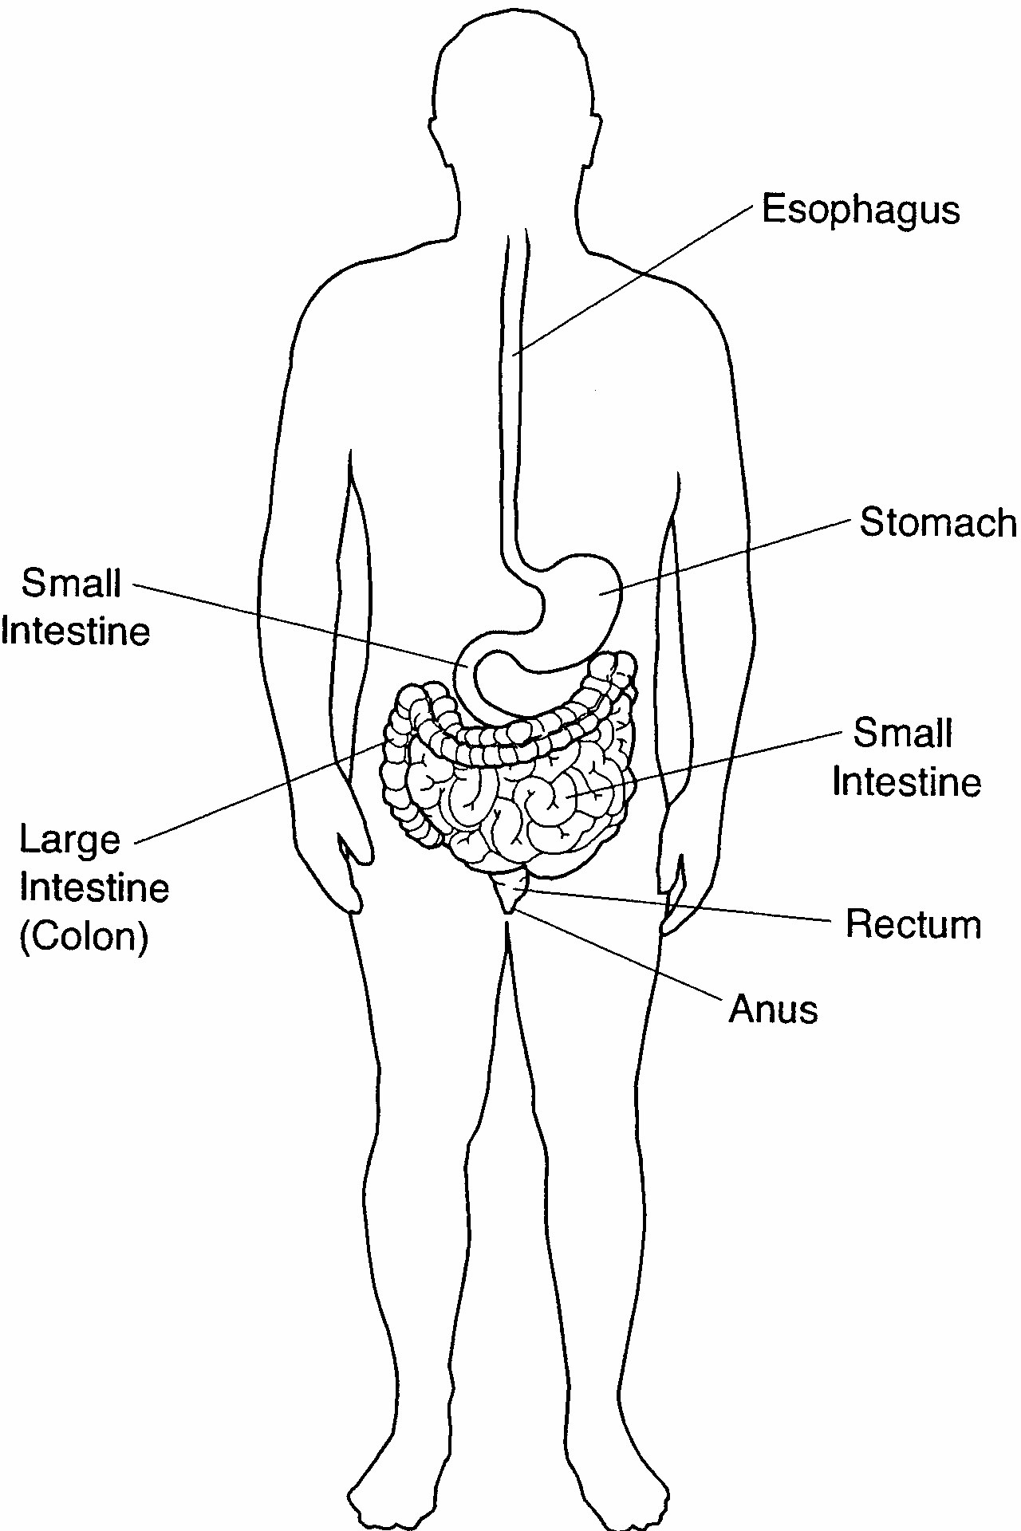
Anatomy:

Slide 8
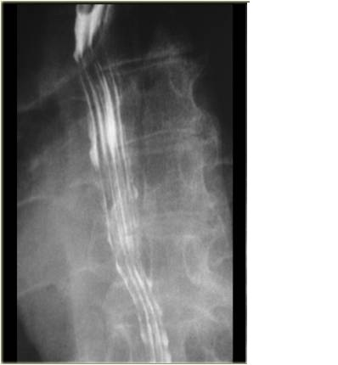
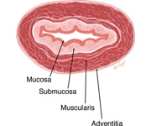

Slide 9
When the esophagus is empty , the mucosa coat is thrown into three or four straight longitudinal folds appeared as straight parallel lines throughout the esophagus

Slide 10
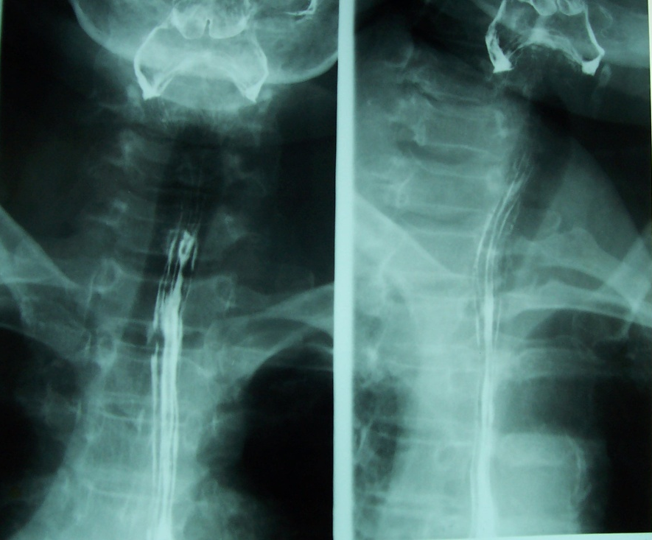
Oesophagus

Slide 11
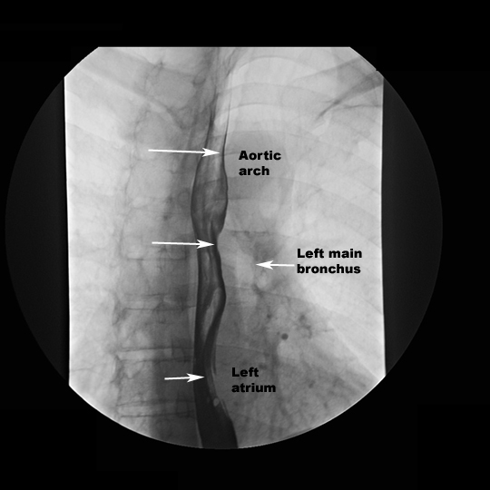
Oesophagus

Slide 12
Normal indentations
There are Two normal indentations of the esophagus
1- At the aortic arch
2- At the left bronchus

Slide 13
Basic Positions
RAO (35° to 40°)
Lateral
AP
LAO

Slide 14
AP - LAT
AP

Slide 15
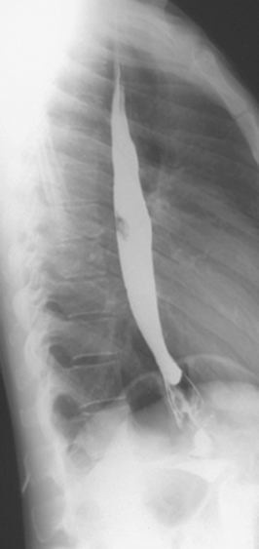
LAT - RAO
LAT

Slide 16
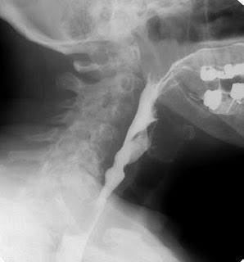
LAT - RAO
LAT

Slide 17
Lateral
Because the esophagus is thrown away from the spine, allowing better visualization

Slide 18
LAT - RAO
RAO

Slide 19
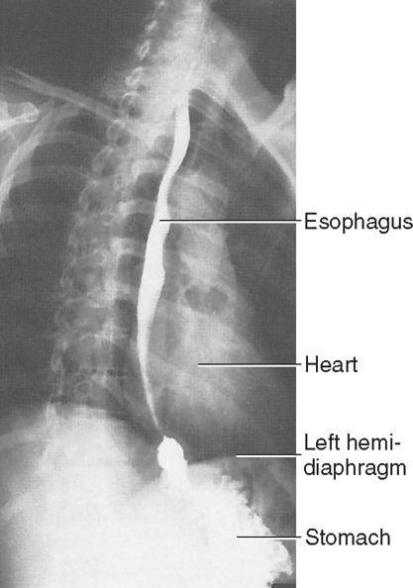
LAT - RAO
RAO

Slide 20
RAO
The esophagus is seen between the heart and the spine
The patient is rotate 35- 40 degrees with the RT side against the table

Slide 21
Abnormalities

Slide 22
1.Oesophageal Varices
They appear inside the oesophagus and occasionally they occur in the stomach. Varices develop when most of the normal liver tissue has been replaced by scar tissue. Because the scar tissue pushes upon the veins in the liver, blood cannot flow normally through the veins.

Slide 23
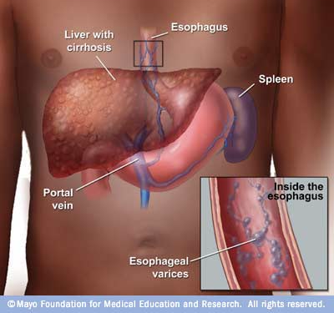
1.Oesophageal Varices

Slide 24
1.Oesophageal Varices

Slide 25
What is the radiographic appearance ?
There are multiple submucosal filling defects in a barium filled esophagus in AP view.

Slide 26
2. Achalasia
Achalasia is a disease of esophagus . The term achalasia means "failure to relax" and refers to the inability of the lower esophageal sphincter (a ring of muscle situated between the lower esophagus and the stomach) to open and let food pass into the stomach. As a result, patients with achalasia have difficulty in swallowing food.

Slide 27
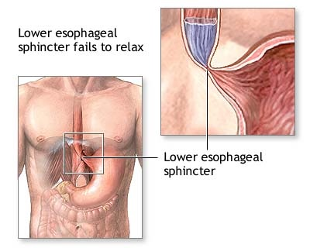
2. Achalasia

Slide 28
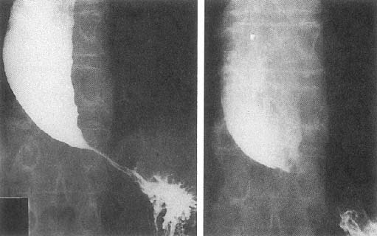
2. Achalasia

Slide 29
Lower Esophagus
Proximal
Dilatations
Distal Narrowing

Slide 30
What is the radiographic appearance ?
Dilated smooth outlined barium filled esophagus with narrow tapering lower end of the esophagus with smooth outline and absence of fundal gas in stomach. .
( Rat Tail or Bird Beak Deformity)

Slide 31
3. Zenker's diverticulum (ZD)
Is a blind sac (pouch) that branches off the cervical esophagus. It is the most common type of esophageal diverticulum.

Slide 32
3. Zenker's diverticulum (ZD)

Slide 33
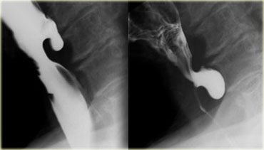
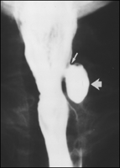
3. Zenker's diverticulum (ZD)

Slide 34
3. Zenker's diverticulum (ZD)
diverticula appeared as smoothly marginated round-to-ovoid sacs. The size of the openings of the diverticula depended on the location of the barium bolus .

Slide 35
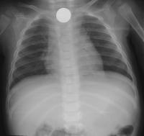
4.Foreign body
Anteroposterior chest radiograph depicts a penny at the thoracic inlet of a 13-month-old infant who refused to eat.

Slide 36
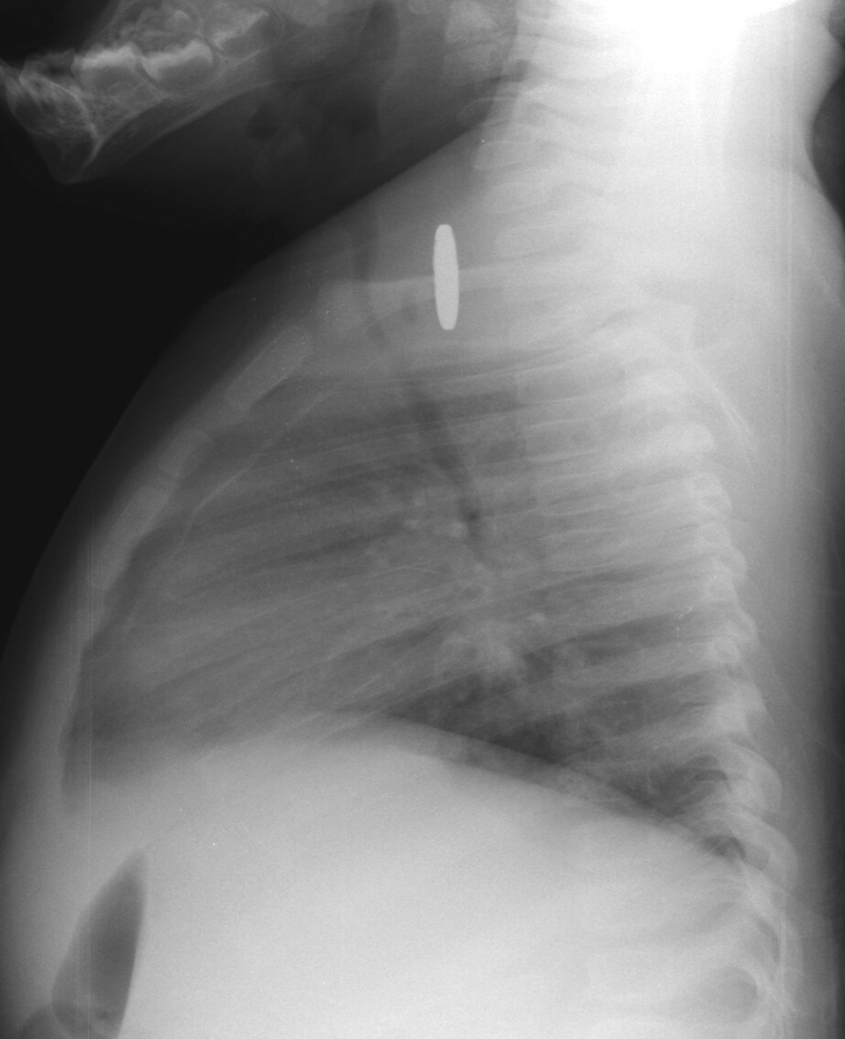
4.Foreign body
Lateral chest radiograph depicts soft-tissue thickening at the tracheoesophageal interface. A penny was removed at esophagoscopy.

