Slide 1
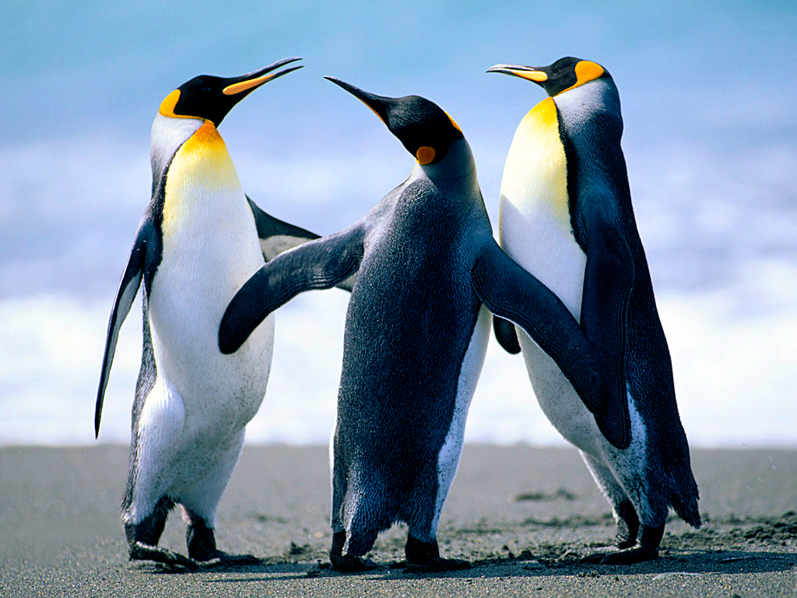
374 zoo Laboratory Aquatic Ecology
Amal Al muhanna
Lab (1)
2012

Slide 2
Topics to be covered: Study of the following: a-Phytoplankton b-Zooplaknton c-Benthos d-Macrophytes Chemical Properties of Water: 1) Free carbondioxide 2) Alkalinity 3) Dissolved oxygen(Modified Winklers method)

Slide 3
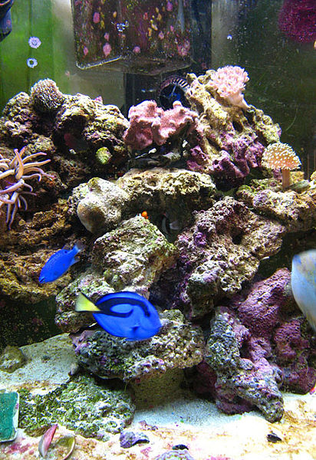
Introduction
What is Aquatic Ecology? Aquatic ecology is a branch of the science of ecology which is concerned with the study of aquatic ecosystem. This field can be broken into two divisions: A) Freshwater ecology . B) Marine ecology.

Slide 4
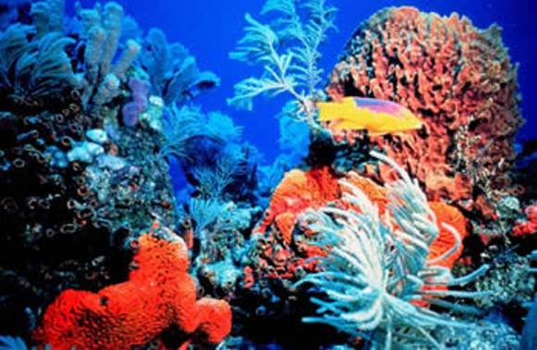
Aquatic environment can be divided into: A) Marine ecosystem : - It is the largest of Earth's aquatic ecosystem. - It covers two-thirds of the surface of the Earth . E.g .Shorelines, Coral Reefs, Open Ocean.

Slide 5
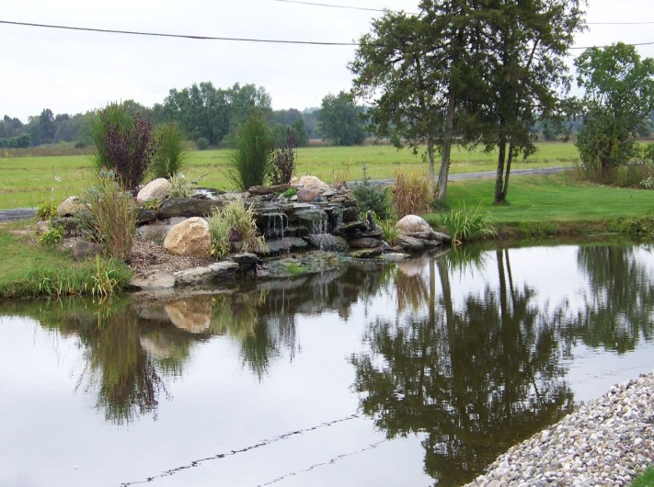
Aquatic environment can be divided into: B) Freshwater ecosystem: - Characterized by having low concentration of dissolved oxygen. E.g. Ponds, Lakes, Rivers ,Streams.

Slide 6
What are the Organisms found in Aquatic environment?
Organisms found in aquatic ecosystem
1-Plankton
2-Macrophytes
3- Benthos
a) Phytoplankton
b) Zooplankton

Slide 7
1- Plankton:
Plankton are any drifting organisms (animals, plants, archaea, or bacteria).
Inhabit in oceans, seas, or bodies of fresh water and detritus in water.

Slide 8
Plankton
a) Phytoplankton
b) Zooplankton
are tiny chlorophyll bearing microscopic organisms consisting of algae that live near the water surface where there is sufficient light to support photosynthesis.
e.g. diatoms
are microscopic free swimming animal components of aquatic system.
e.g. jellyfish ,crustaceans, mollusca

Slide 9
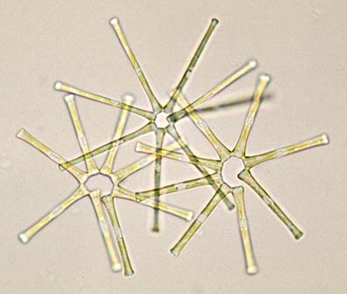
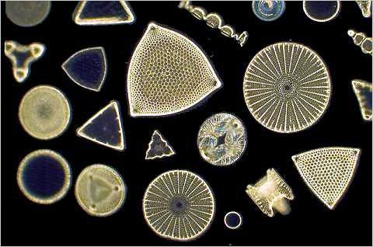
a) Phytoplankton
Diatoms

Slide 10
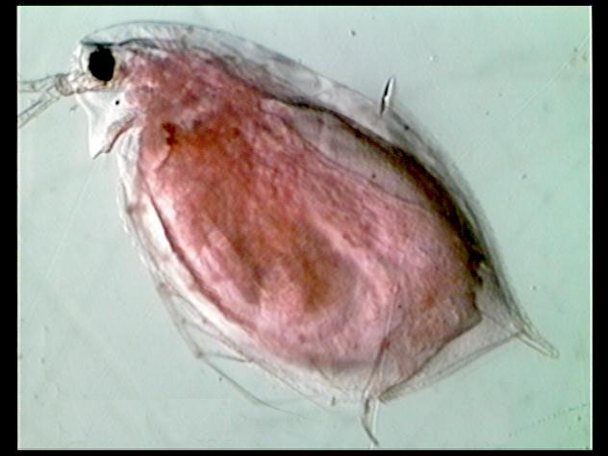
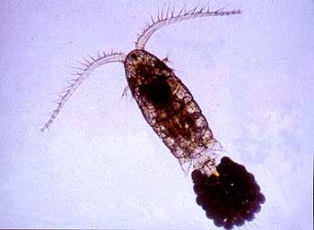
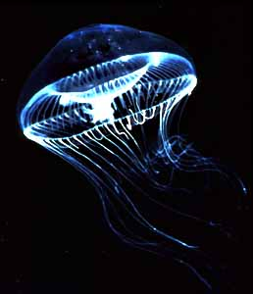
b) Zooplankton
Copepod
Copepod
Daphnia pulex
Jelly fish

Slide 11
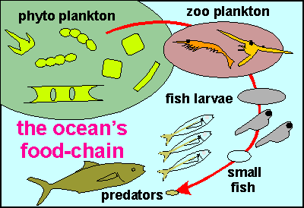
The ocean’s food chain

Slide 12
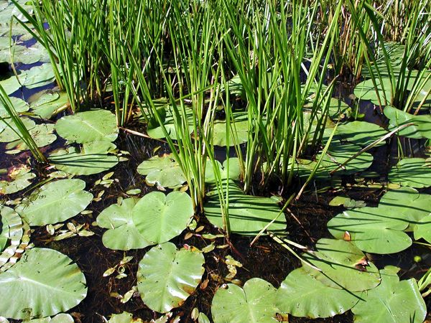
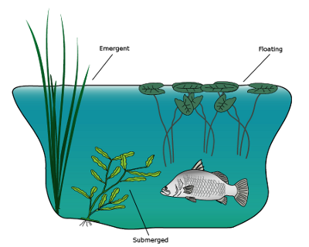
2- Macrophytes
Are the aquatic macroscopic plants that grows in or near water.
Produce oxygen, and act as food for some fish and wildlife.

Slide 13
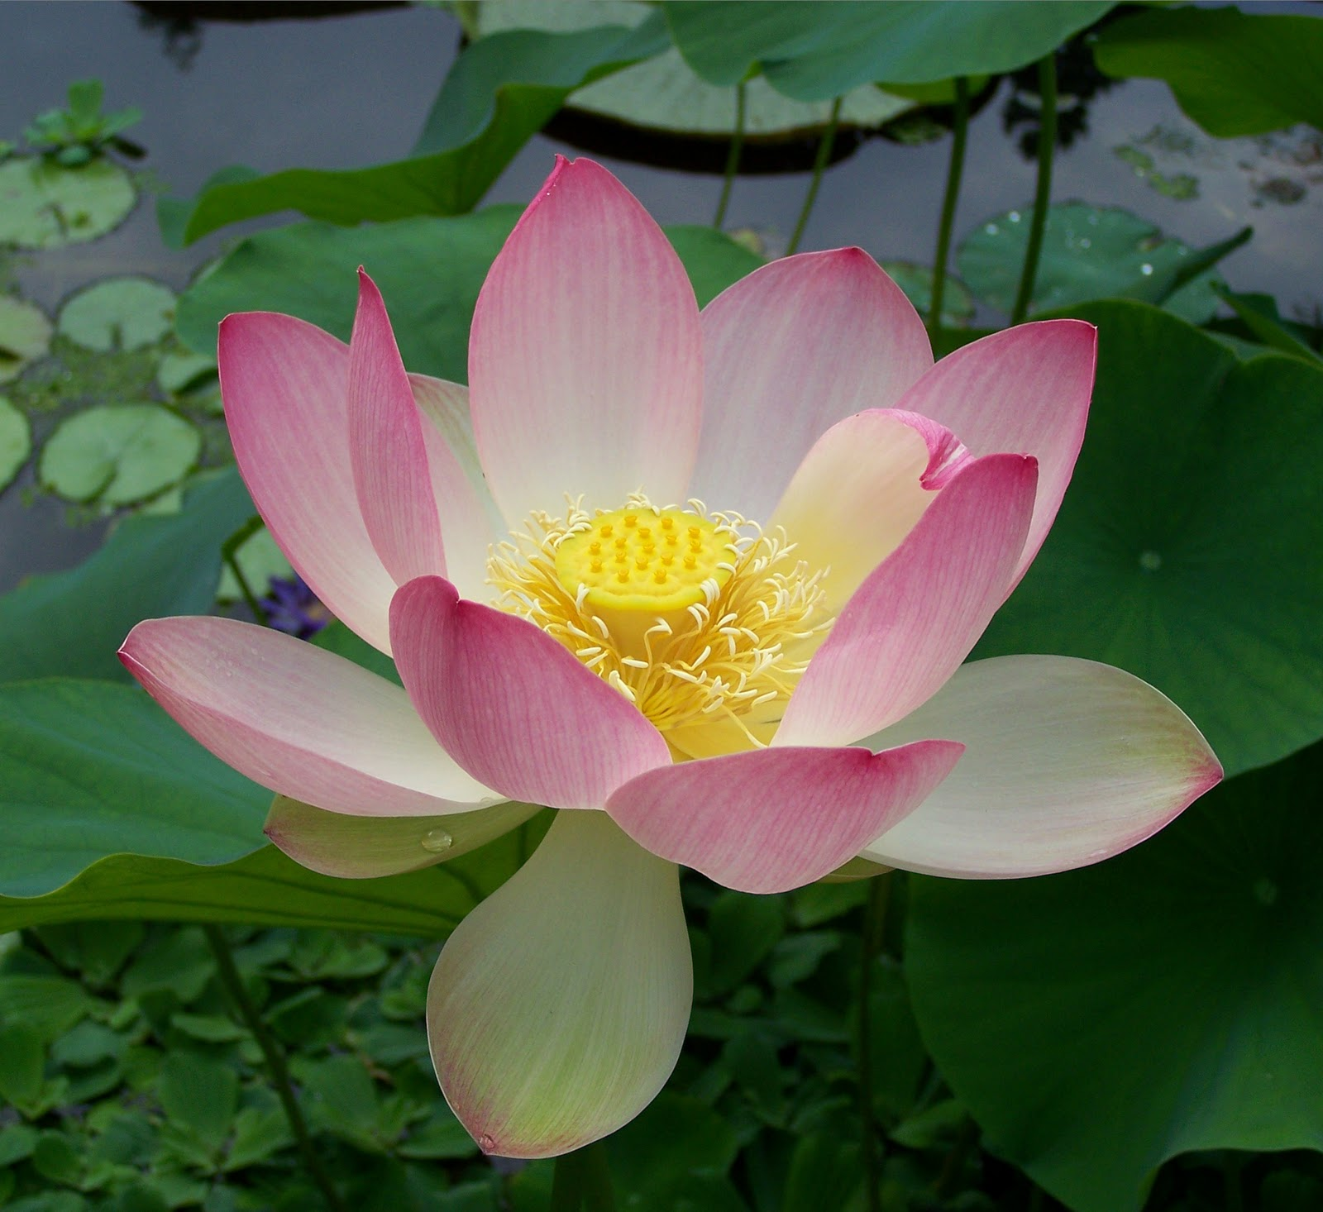
Macrophytes

Slide 14
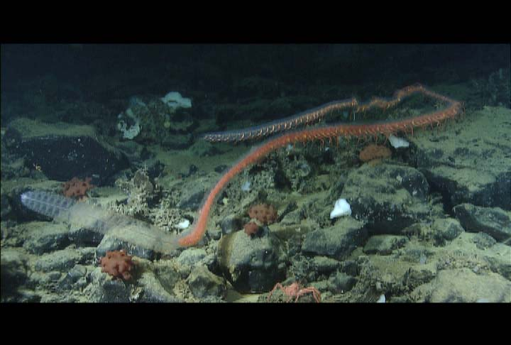
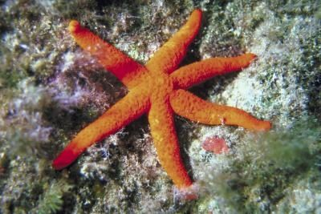
3- Benthos
The term benthos denotes the whole organisms dwelling at the bottom of the ocean or sea bed. Ex:- bivalves , echinoderms, sea anemone, corals, sponges, and larger crustacean such as crabs, lobster , ……etc..

Slide 15
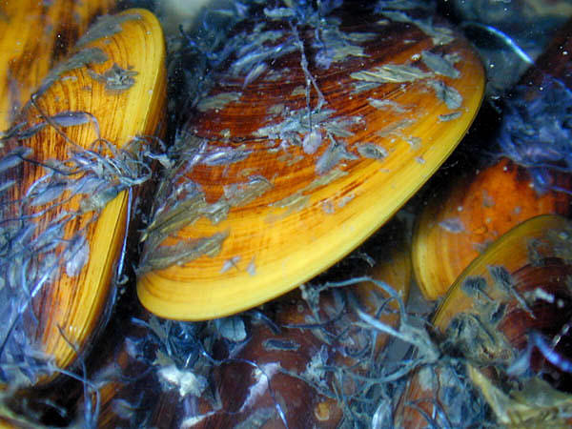
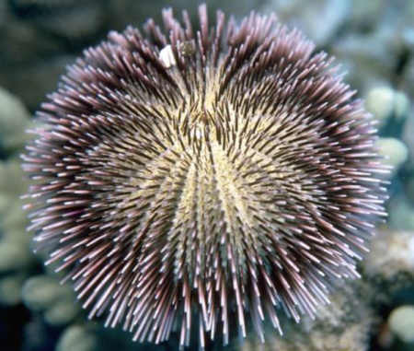
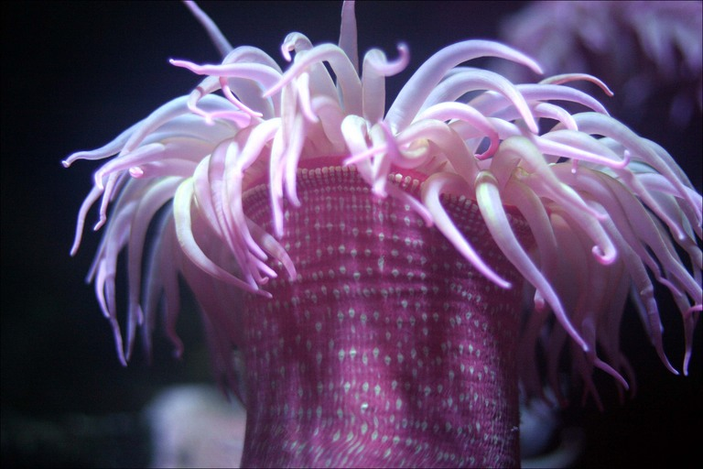
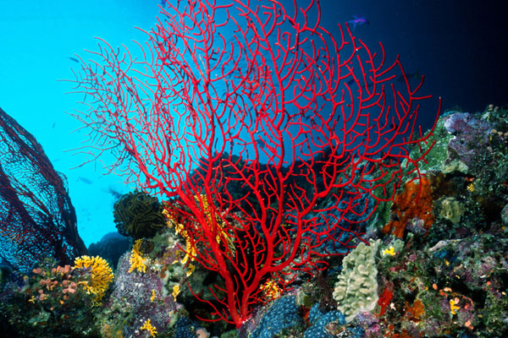
Examples
Echinoderm
Bivalves
Sea anemone
Corals

Slide 16
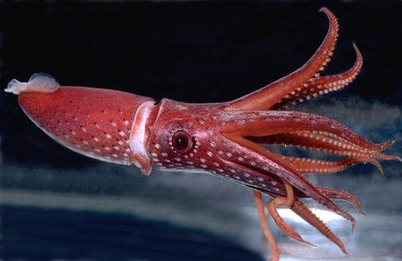
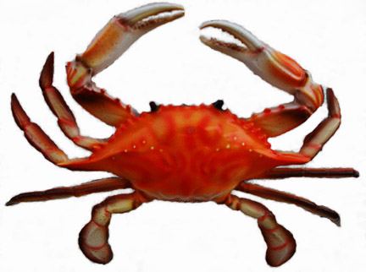
Nektons
Nekton refers to the aggregate of actively swimming aquatic organisms (usually in oceans or lakes).
They able to move independently of water currents.
Oceanic nekton comprises animals largely from three classes:-
Vertebrates, these animals are supported by either bones or cartilage.
Mollusks are animals such as squid and scallops.
Crustaceans are animals such as lobester and crabs.
squid
crab

