Slide 1
Aquatic Ecology And The Food Web

Slide 2
some Understanding of the aquatic ecosystem
is necessary before fisheries managers or pond
owners can begin to understand changes in fish
populations. The aquatic ecosystem is a complex of interrelated species and their reaction to each other and their habitat.
Changes in one part of the system often cause
changes, large and small, throughout the system.

Slide 3
Eradication of aquatic plants in a pond with a healthy
large mouth bass population is a good example of
this concept.
When all plants are eliminated from
the pond in an effort to improve angling access;
forage fish such as bluegill lose their protective
cover and are exposed to excessive predation by
largemouth bass. Bass initially respond by growing
and reproducing rapidly, however, as the forage
fish population declines, the once healthy bass
population, limited by declining food supplies,
becomes numerous, small and stunted.

Slide 4
The basic ecological concepts discussed in this
section will provide the pond owner with the
knowledge necessary to understand the reasoning behind fish and plant management techniques.

Slide 5
Succession
The aquatic ecosystem is a dynamic, changing
environment. Daily and annual bio-geo-chemical
cycles drive changes in water chemistry and the
species composition of aquatic communities.
Ponds and lakes go through a cycle of changes over time, from newly created aquatic environment back to terrestrial habitat.

Slide 6
Energy movement in the aquatic ecosystem
An ecosystem can be thought of as a conduit of energy derived from sunlight. Energy from the sun plus inorganic materials are the basis of all life. Energy can not be recycled. It moves through the ecosystem and ultimately dissipates as heat. Energy transfer efficiencies are low, usually about 10 % between each trophic level of the ecosystem. Trophic levels contain groups of organisms with similar methods of food (energy)consumption. Energy moves from one trophic level to the next through the food web .
An example of a common, linear aquatic food chain is:
Phytoplankton (microscopic
plants) - Zooplankton (microscopic
animals) -Insects - Blue gill -
Largemouth Bass -Turtle –Bacteria
In reality, most food chains are usually complex and interconnected. They are more accurately described as food webs.

Slide 7
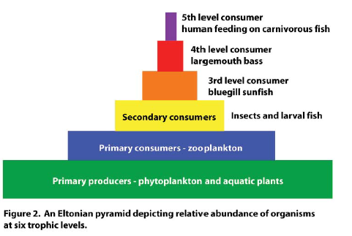

Slide 8
Producers
Producers are the first trophic level in the ecosystem and form the base
of the food chain. Producers obtain nutrition from inorganic materials
and sunlight energy.
In aquatic ecosystems phytoplankton are the primary producers; other aquatic plants also contribute but to a lesser extent. The total amount of energy per unit of time fixed as plant tissue is called primary production.
Plants are able to convert only about 1-2 percent of the available sunlight energy into chemical energy usable for plant production.
Each time energy passes from one trophic level to the next, for example, a grass carp eating an aquatic plant or a largemouth bass consuming a bluegill, about 90 percent of the energy will be lost.
Consequently, ecosystems require a large base of primary production to support a relatively modest level of production at higher trophic levels. The Eltonian trophic pyramid shown in fig, 2 illustrates this concept graphically.

Slide 9
Light is needed for all plant growth. Because clear
ponds allow light penetration to greater depths than
muddy ponds, more phytoplankton and other plants
can grow, resulting in greater primary production in
the base of the food chain.
More production in the food web base allows more
production through out the aquatic ecosystem; and
consequently, greater natural fish production in clear
ponds than in muddy ponds.
Fish production in muddy ponds can be increased by clearing the pond or by addition of supplemental fish food to compensate for lack of primary production.

Slide 10
Consumers
Consumers make up the next trophic level; and must
eat other organisms to obtain their energy.
Consumers, in turn, occupy different trophic levels. Trophic levels of common aquatic organisms .
Primary consumers are herbivores, they eat plants. In our aquatic ecosystem example, zooplankton feeding on phytoplankton occupy the primary consumer trophic level. Cattle are primary consumers in terrestrial
ecosystems.
Secondary consumers, represented by certain aquatic insects are carnivores and feed upon primary consumers, the zooplankton. Our example also includes a tertiary consumer, the large mouth bass that feeds upon other carnivores.

Slide 11
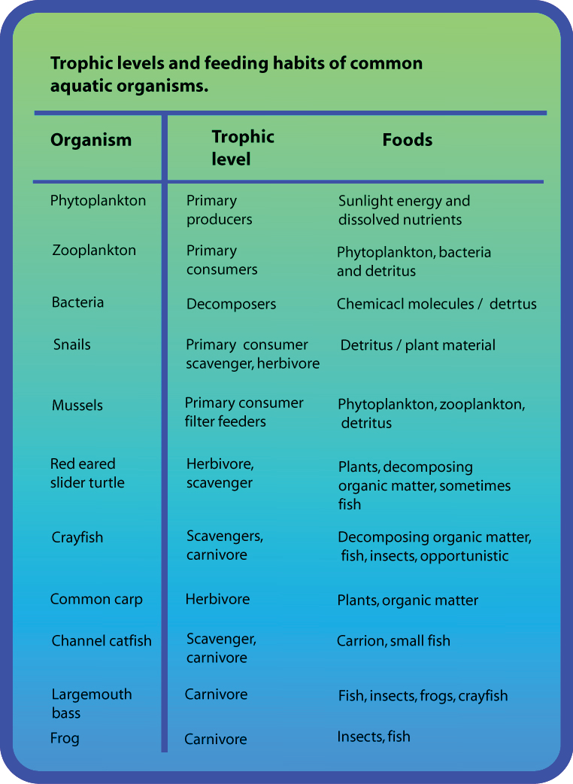

Slide 12
The first trophic level which includes algae, phytoplankton and aquatic vascular plants, usually makes up the bulk by weight of organisms (about 85%) in natural aquatic ecosystems and forms the base of the food chain.( In some systems bacteria may actually be more abundant than plants.) Because there is up to a 90 percent loss of energy in each step of the food chain, each higher level of consumer will constitute a correspondingly lower amount of the total weight of living organisms in the pond.

Slide 13
The aquatic habitat
Changes in light penetration and plant growth dictate
much of the habitat variety found in the aquatic
ecosystem.
The benthic or bottom dwelling aquatic communities
begin at the shore line and extend to the deepest
parts of the pond. Many bacteria, phytoplankton and
protozoa live between the damp particles of sand and
soil. Sedge species, bullrush and cattail also colonize
the area and often extend out into the pond to depths
of 4 feet or more

Slide 14
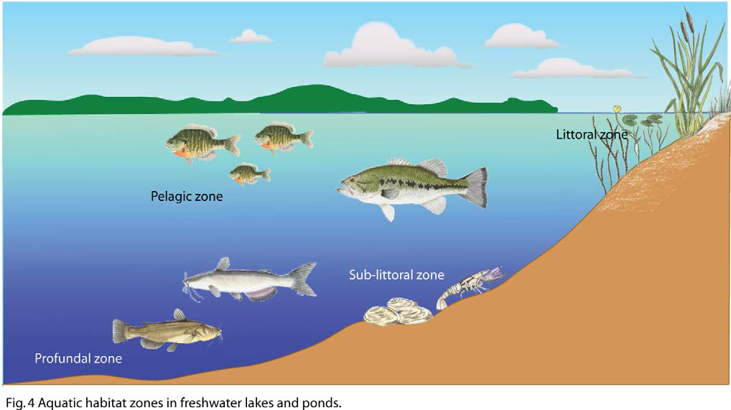

Slide 15
The littoral zone extends into the body of water from the shore to the deepest area of rooted plant growth. The extent of the littoral zone depends on water clarity, light penetration and wave action. The littoral zone must have adequate light for photosynthesis.
The depth of this zone in your pond can be roughly calculated by lowering a white coffee cup on a string into the water and measuring the depth at which it just disappears. Multiply this depth by 2.75 to estimate the depth of the deepest rooted plants in the pond.
The littoral zone contains a large and diverse community of aquatic organisms. Vascular aquatic plants in this region support a variety of insects, snails, crawfish, mussels, frogs, turtles, larval fish and their predators. Many of the mobile organisms such as turtles and fish occupy more than one habitat zone.
Below the littoral zone is the sub-littoral region.
This habitat is characterized by accumulations of crustacean, mussel shells, and some dead plant material. This region is well oxygenated but poorly lighted. Fewer species are found here than in the littoral zone.

Slide 16
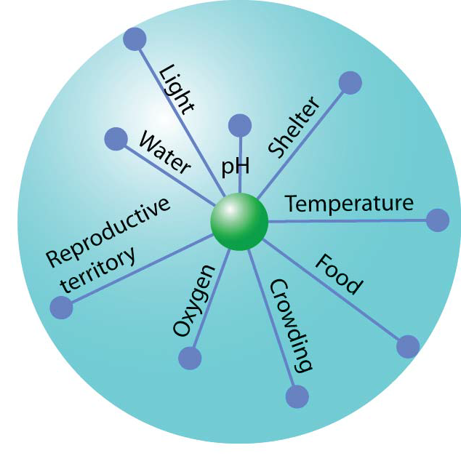

Slide 17
In ponds large enough to thermally stratify, a pro fundal zone exists. The pro fundal zone is usually a stable environment except during periods of pond turn over. Oxygen levels are low or absent and there is little light penetration and no plant growth. Water temperature is usually cool and fluctuates little. The pro fundal zone is composed of detritus, and the bacteria and other organisms that feed on and decompose this material.
The open water is known as the pelagic zone. Plankton and other free swimming or drifting plants and animals inhabit this region as well as fish and other large, mobile organisms.

