Slide 1
Antigen-Antibody
reactions (3)

Slide 2
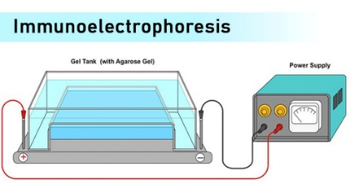
Immunoelectrophoresis (IEP)
Immunoelectrophoresis refers to precipitation in agar under
an electric field.
In electro-immunodiffusion, diffusion is combined with electrophoresis
Electrophoresis separates antigen molecules according to differences in their electrical charges and molecular weight
then specific antibodies diffuse and react with separated antigen forming precipitin bands.
20

Slide 3
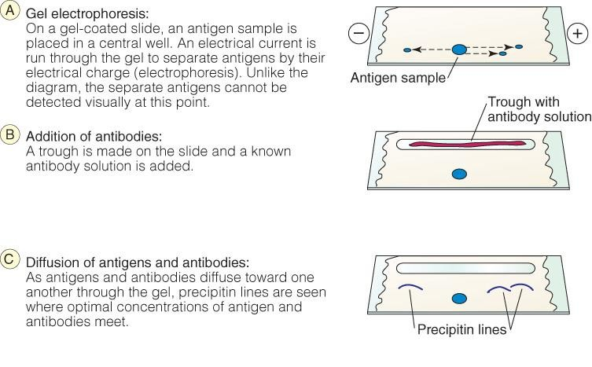
Immunoelectrophoresis
Immunoelectrophoresis (FL-Immuno/59) (youtube.com)

Slide 4
In gel: Precipitation
(immunodiffusion)
(d)
(IEP)

Slide 5
Interpreting results
(+) Watch for any signs of elliptical precipitin arcs as they indicate antigen-antibody interaction.
(-)There is no reaction if no precipitation is formed.

Slide 6
In gel: Precipitation
(immunodiffusion)
(e)
(3 techniques)
1.
Advantage: This technique is much faster (15-20 mins) than the normal immunodiffusion techniques, where the diffusion is solely based on the concentration.
6
Notes:
Electro immunodiffusion
Counter immunoelectrophoresis(CIE)

Slide 7
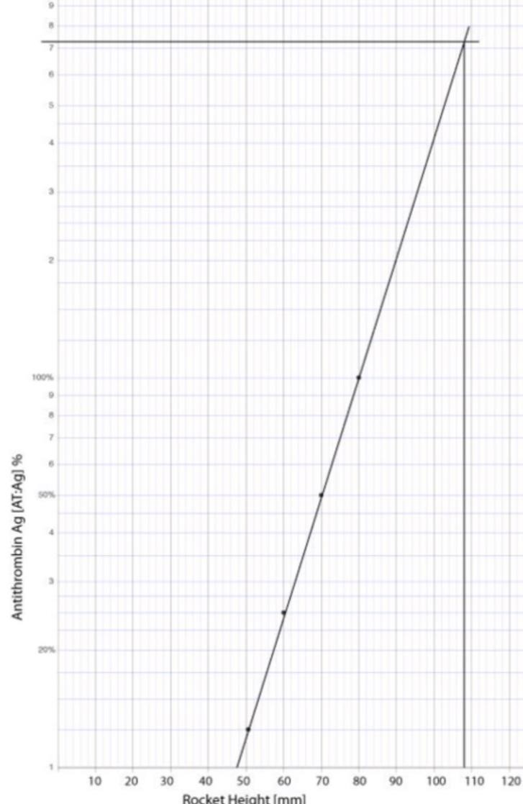
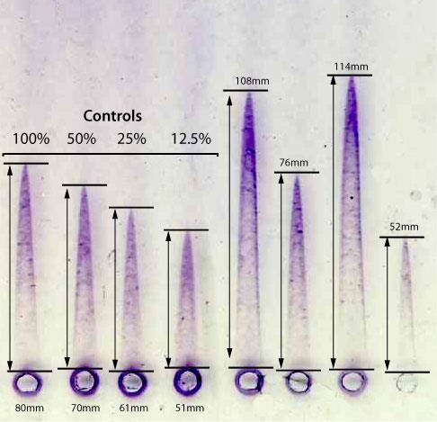
In gel: Precipitation
(immunodiffusion)
(f)
2.
The height of the rocket is directly proportional to the antigen concentration.
7

Slide 8
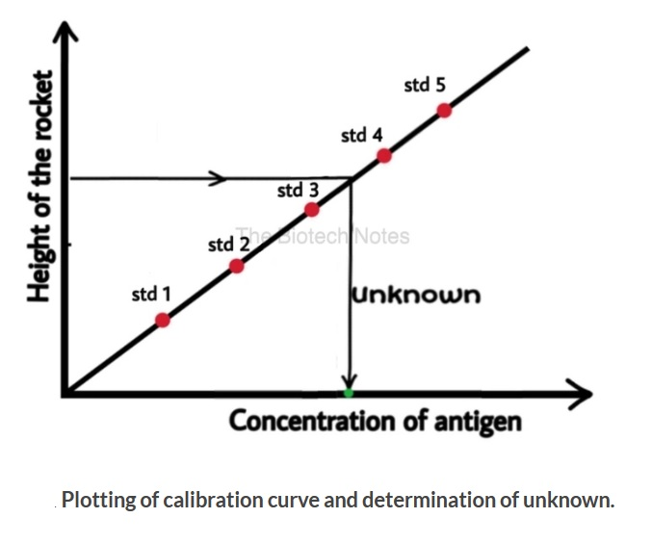
Results
The rocket height is plotted on one axis and the concentration on the other
The heights of rockets formed by the antigen samples with known concentration are plotted in the graph to obtain the calibration curve.
The concentration of the unknown antigen sample can be determined with help of the calibration curve
8

Slide 9
Advantages of Rocket Immunoelectrophoresis
Simple, quick, and reproducible method.
Several unknown samples can be analyzed on a single plate.
Small Concentrations of proteins can be measured.

Slide 10
In gel: Precipitation
(immunodiffusion)
3- Laurell’s-Two Dimensional Immunoelectrophoresis
This assay involves two different electrophoresis steps:
a normal electrophoresis and rocket electrophoresis
The first electrophoresis step separates the antigen mix into its individual components
In the second step the antigens react with antibody and are specifically detected by the immunoprecipitation.

Slide 11
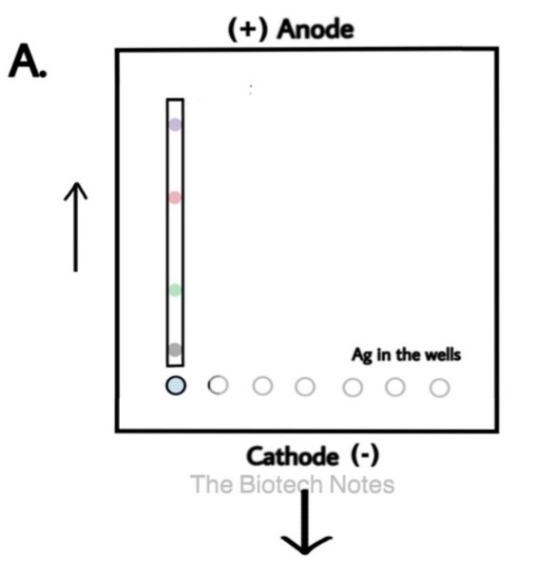
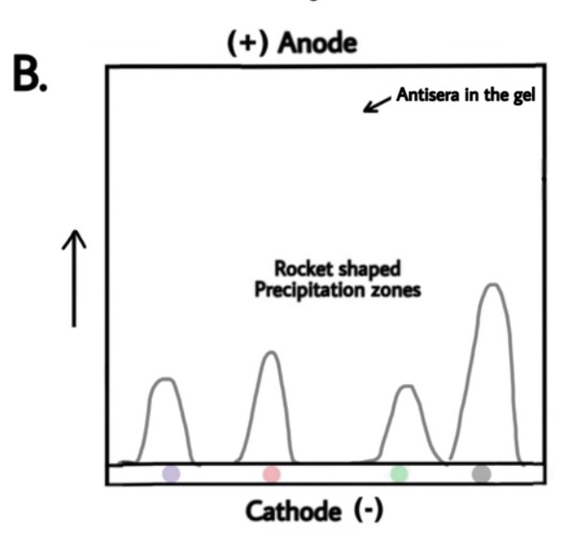
the antigens in the mixture is separated using the electrophoresis.
A section of gel is selected, sliced and placed on a glass plate.
A layer of agar with antiserum is poured onto the glass plate adjoining the slice of gel at one end.
The gel slice end is placed towards the cathode and the rocket electrophoresis is performed at the perpendicular direction as the first run.
As the electrophoresis advances, the antigens from the gel slice enters into the antisera containing agar and the precipitin arcs are formed at zone of equivalence.

Slide 12
In gel: Precipitation
(immunodiffusion)
(g)
3.
(2)
(1)
12

Slide 13
Measurement of Precipitation by Light
Antigen-antibody complexes, when formed, will precipitate in a solution resulting in a turbid or cloudy appearance that can be measured by:
Turbidimetry
Nephelometry
Passing light through a cloudy solution. the intensity of light transmitted through the sample is measured.
the intensity of the scattered light is measured
Amount of light scattered correlates to the concentration of the solution
26
Notes:
Nephelometry

