Slide 1
Precipitation
Antigen-Antibody
reactions (2)
1

Slide 2
“Quotations are commonly printed as a means of inspiration
and to invoke philosophical
thoughts from the reader.
Soluble antigens combine with soluble antibodies at suitable temperature and pH to form insoluble visible complex
Liquid
Gel
4

Slide 3
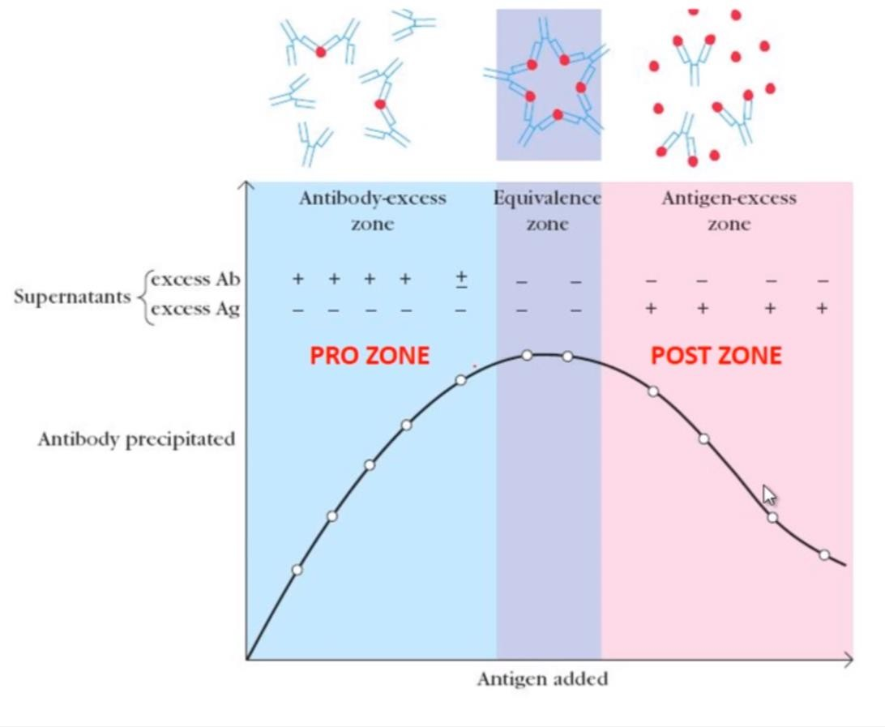
Precipitation Curve
Zone of antibody excess (Prozone):
precipitation is inhibited, and antibody not bound to antigen can be detected in the supernatant
Equivalence Zone
Maximal precipitation in which antibody and antigen form large insoluble complexes and neither antibody nor antigen can be detected in the supernatant;
Zone of antigen excess (Postzone) Precipitation is inhibited & Ag. not bound to Ab. can be detected in the supernatant
3

Slide 4
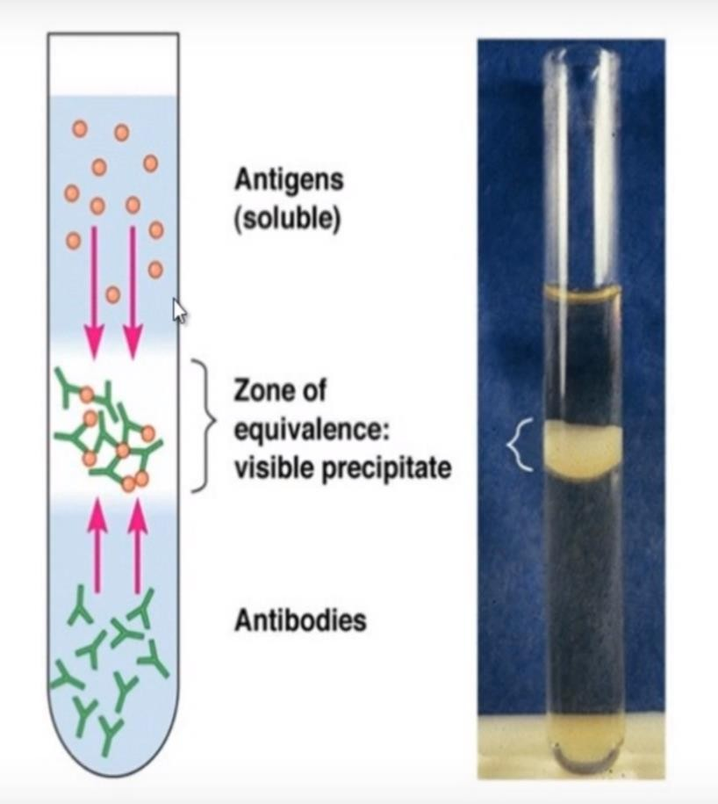
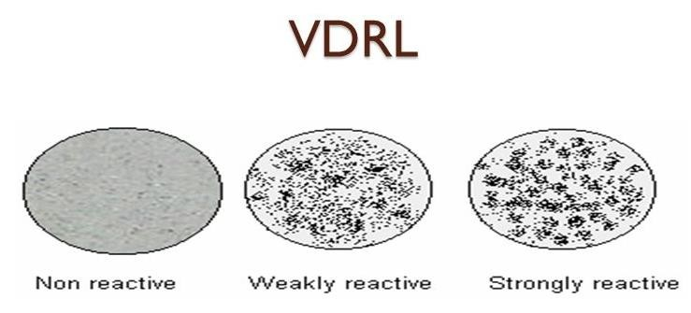
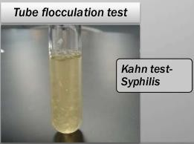
Precipitation tests
(a)
In Liquid
Flocculation test
Ring test
Lancefield grouping
Slide
flocculation
Tube flocculation

Slide 5
In liquid: Precipitation
(a) Ring Precipitate:
Anthrax
Qualitative test for the presence of antigen–antibody complexes

Slide 6
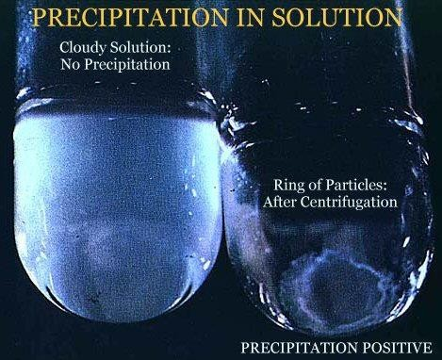
In liquid: Precipitation
Bottom Precipitate
Occurs when Soluble Ag interact with soluble Ab and form a visible precipitate that give bottom Precipitation after centrifugation.

Slide 7
In liquid: Precipitation
(b) Flocculation test:
1- Slide Flocculation test
To detect Abs in the blood
(The venereal disease research laboratory)
Notes:
To detect Abs in the blood

Slide 8
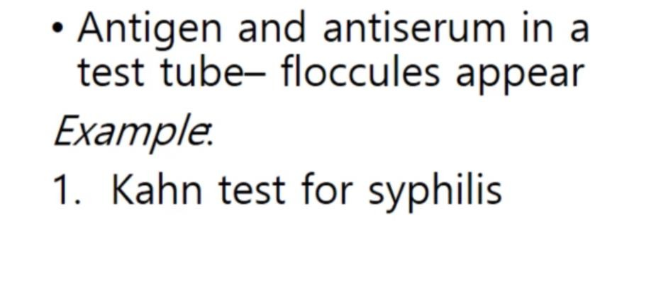
In liquid: Precipitation
(b) Flocculation test:
1- Tube Flocculation test
Notes:
floccules

Slide 9
In gel: Precipitation
(immunodiffusion)
Why?
Visible and distinct band of precipitation ( preserved for a long period of time)
Different Ags can be observed (Each Ag will form a different band)
.
Notes:
Visible and distinct band of precipitation
Different Ags can be observed

Slide 10
In gel: Precipitation
(immunodiffusion)
(a)

Slide 11
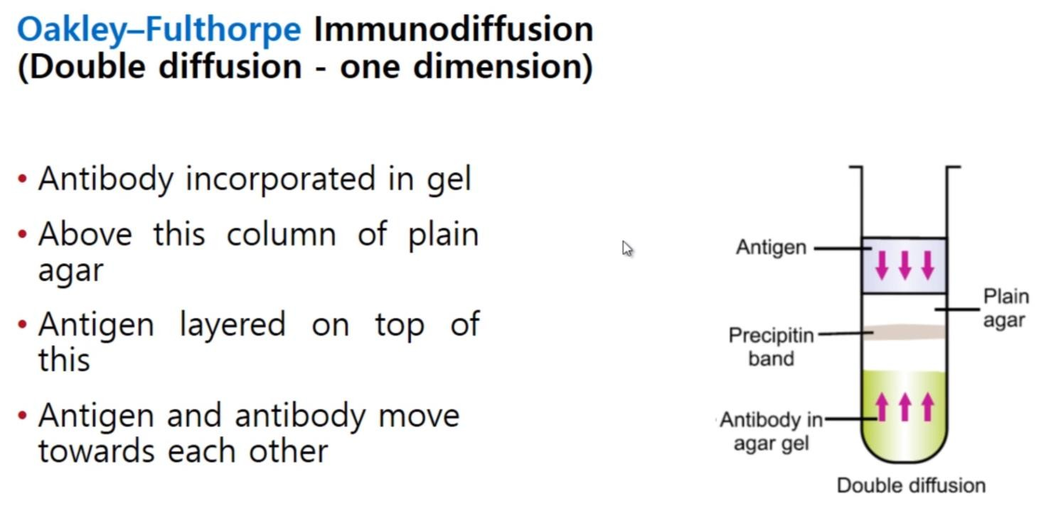
In gel: Precipitation
(immunodiffusion)
(b)
Notes:
Oakley-Fulthorpe Immunodiffusion

Slide 12
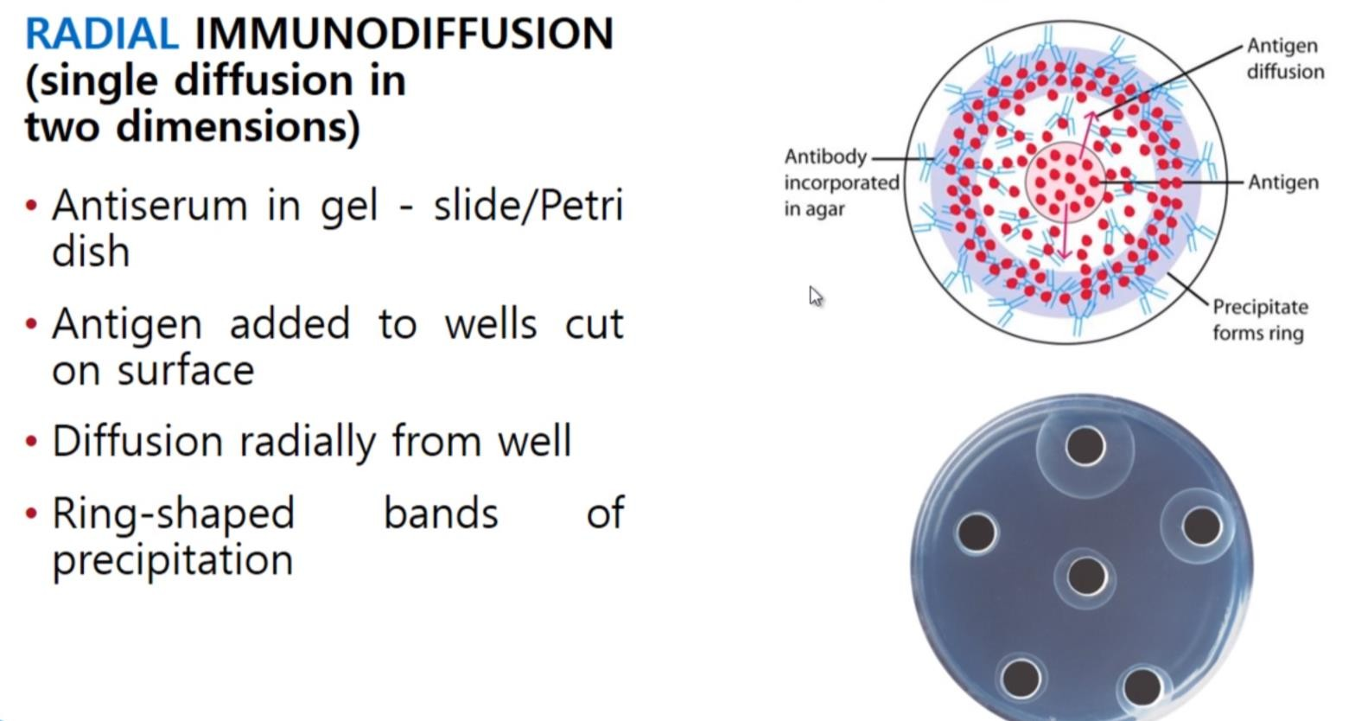
In gel: Precipitation
(immunodiffusion)
(c)
Zone of equivalent

Slide 13
In gel: Precipitation
(immunodiffusion)
(d)
Ab
Ag
Notes:
ouchterlony

Slide 14
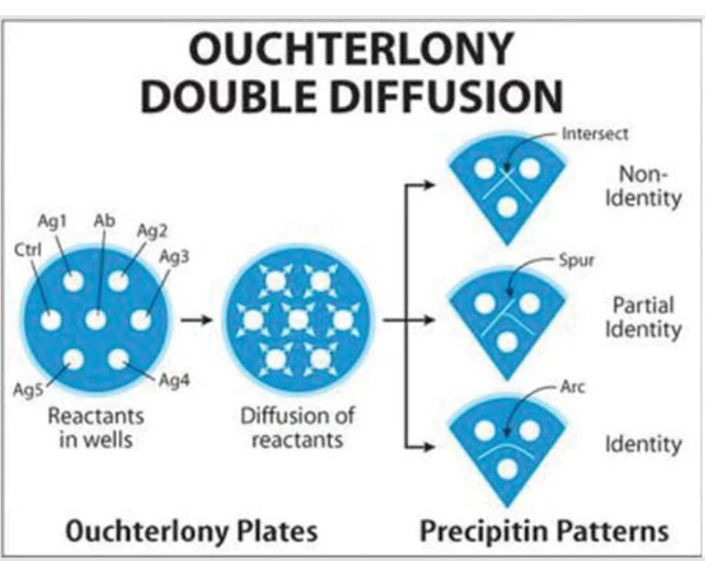
If the wells contain different antigens, the precipitate lines don’t fuse but cross.
If the wells contain partially similar antigens, spur formation can be seen.
If the wells contain similar antigens, the precipitate lines get fused.

Slide 15
Topics for presentation/HW
Ascoli’s thermo precipitation test
Lancefield grouping test
VDRL
Khan test

