Slide 1
Antigen-Antibody
reactions (1)

Slide 2
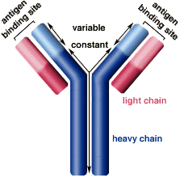
Key Terminology:
Antibodies:
Specialized soluble proteins produced by B cells and plasma cells that
interacts with antigen; also called immunoglobulin (Ig).
Each B-cell makes its own distinct antibody in response to a specific antigen.
Each antibody is designed to bind to a specific surface binding site or
epitope on the antigen.
There are millions of different types of antibodies circulating in an individual’s bloodstream and they are based on exposure to antigens in his/her environment.

Slide 3
3
Notes:
Which immunoglobulin

Slide 4
4
Notes:
Found in pentameric form

Slide 5
Key Terminology:
Antigens:
Substances that when introduced into the body stimulates the production of an antibody.
Antigens = “non-self” molecules and cells
such as:
foreign proteins
viruses
environmental pollutants
bacteria and parasites (Protista, Fungi, Plantae, and Animalia cells).
foreign transplanted tissue

Slide 6
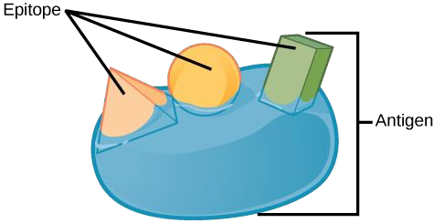
Key terms:
Epitope: also known as (antigenic determinant), is the part of an antigen that is recognized by the immune system, specifically by antibodies, B cells, or T cells.
Paratope:
also called an (antigen-binding site), is a part of an antibody which recognizes and binds to an antigen.

Slide 7
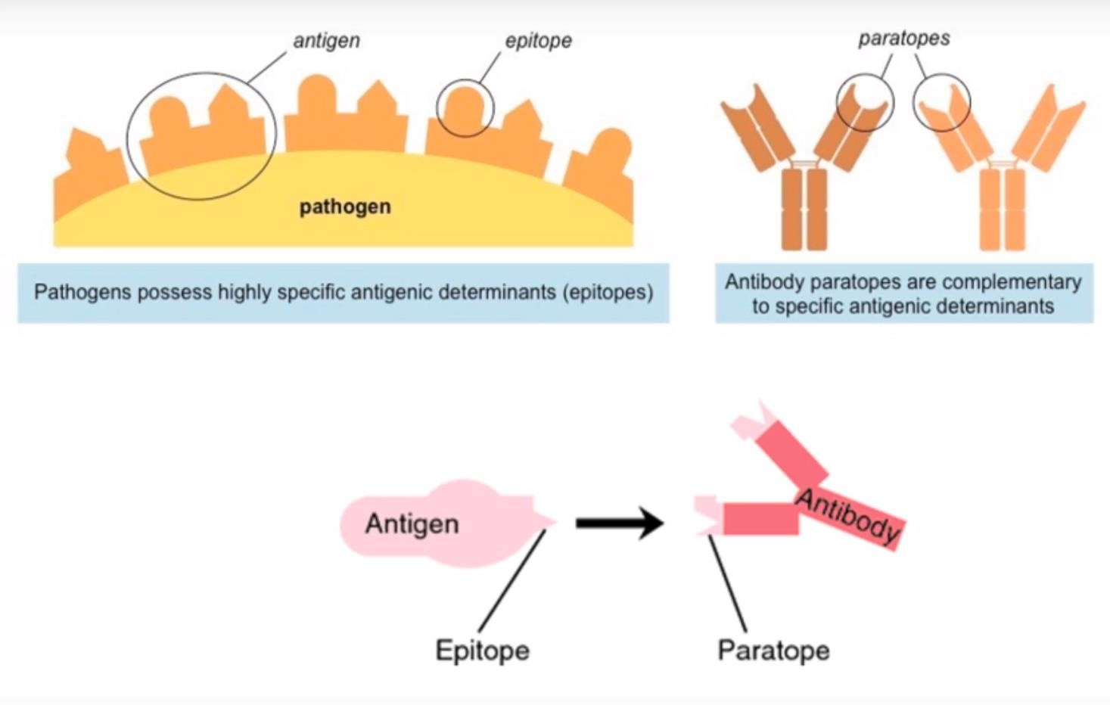

Slide 8
Key terms:
Affinity:
measures the strength of interaction between an epitope and an antibody binding site (Paratope).

Slide 9
Key terms:
Avidity:
is a measure of the overall stability of the complex between antibodies and antigens
Governed by
the intrinsic affinity of the antibody for the epitope,
the valency of the antibody and antigen,

Slide 10
Key terms:
Valency of antibody:
refers to the number of antigenic determinants (Epitopes) that an individual antibody molecule can bind.

Slide 11
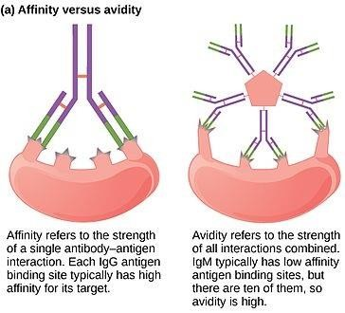

Slide 12
Key terms:
In immunological tests
Sensitivity:
Ability to detect minute quantities of antigen/ antibody.
Specificity:
Ability to detect homologous antigen and no other.

Slide 13
When Ag-Ab reactions occur invitro, they are known as serological reactions.
The reactions between Ag and Ab occur in three stages.
In first stage the reaction involves formation of Ag-Ab complex.
The second stage leads to visible events like precipitation, agglutination etc.
The third stage includes destruction of Ag or its neutralization

