Slide 1
Analytic Hierarchy Process (AHP)

Slide 2
Analytic Hierarchy Process (AHP) is one of Multi Criteria decision making method that was originally developed by Prof. Thomas L. Saaty.
In short, it is a method to derive ratio scales from paired comparisons

Slide 3
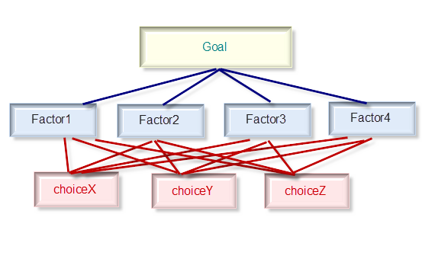

Slide 4
Level 0 is the goal of the analysis. Level 1 is multi criteria that consist of several factors . Level 2 in is the alternative choices.
The input of AHP can be obtained from actual measurement such as price, weight etc., or from subjective opinion such as satisfaction feelings and preference.
AHP allow some small inconsistency in judgment because human is not always consistent.

Slide 5
Pair-Wise Comparison
Now let me explain what paired comparison is
Suppose we have two fruits Apple and Banana. I would like to ask you, which fruit you like better than the other and how much you like it in comparison with the other

Slide 6
. Let us make a relative scale to measure how much you like the fruit on the left (Apple) compared to the fruit on the right (Banana).
For instance I strongly favor banana to apple then I give mark like this

Slide 7
Now suppose you have three choices of fruits. Then the pair wise comparison goes as the following
You may observe that the number of comparisons is a combination of the number of things to be compared. Since we have 3 objects (Apple, Banana and Cheery), we have 3 comparisons.

Slide 8
Table below shows the number of comparisons.

Slide 9
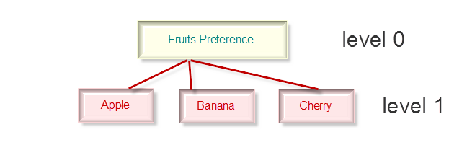
Example of Analytic Hierarchy Process
For example John has 3 kinds of fruits to be compared

Slide 10
In level 1 you will have one comparison matrix corresponds to pair-wise comparisons between 3 factors with respect to the goal. Thus, the comparison matrix of level 1 has size of 3 by 3.

Slide 11
Making Comparison Matrix
We have 3 by 3 matrix
The diagonal elements of the matrix are always 1 and we only need to fill up the upper triangular matrix.
How to fill up the upper triangular matrix is using the following rules:
If the judgment value is on the left side of 1, we put the actual judgment value.
If the judgment value is on the right side of 1, we put the reciprocal value .

Slide 12
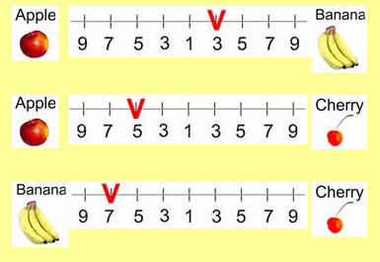
John made subjective judgment on which fruit he likes best, like the following

Slide 13
Comparing apple and banana, John slightly favor banana, thus we put 1/3 in the row 1 column 2 of the matrix.
Comparing Apple and Cherry, John strongly likes apple, thus we put actual judgment 5 on the first row, last column of the matrix.
Comparing banana and cherry, banana is dominant. Thus we put his actual judgment on the second row, last column of the matrix. Then based on his preference values above, we have a reciprocal matrix like this

Slide 14
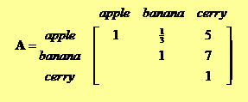
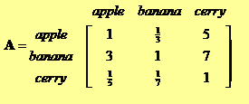

Slide 15
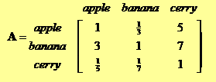
Priority Vector
The priority vector shows relative weights among the things that we compare.
Suppose we have 3 by 3 reciprocal matrix from paired comparison

Slide 16
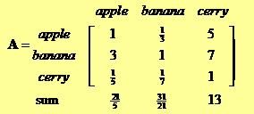
We sum each column of the reciprocal matrix to get

Slide 17
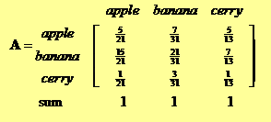
Then we divide each element of the matrix with the sum of its column, we have normalized relative weight. The sum of each column is 1.

Slide 18
The normalized principal Eigen vector can be obtained by averaging across the rows
The normalized principal Eigen vector is also called priority vector

Slide 19
In our example above,
Apple is 28.28%, Banana is 64.34% and Cherry is 7.38%.
John most preferable fruit is Banana, followed by Apple and Cheery

