Slide 1
Determination of the Kinetic activity of beta-fructofuranosidase and the Mechanism of Inhibition by Copper (II) Sulfate

Slide 2
Type of Inhibitors
There exist a number of molecular species which, in the presence of an enzyme and its substrate, have the effect of binding to the enzyme (or to the enzyme-substrate complex) and totally or partially inhibiting the reaction.
In those cases where the binding is irreversibly, the reaction is inalterably inhibited and not subject to kinetic analysis.
If the binding is reversible, however, the specific type of inhibition can be determined by kinetic analysis.

Slide 3
Types of reversible Enzyme inhibitors
The three types of revisable inhibitors that can be clearly distinguished in this manner are :
competitive, noncompetitive, and uncompetitive.
Experimentally, these are distinguished by amount of the inhibitor at ever-increasing concentrations of the substrate.
When the inhibited reaction is compared with the normal reaction using the graphic analyses of Michaelis and Menten or Lineweaver and Burke, the type of inhibition is clearly indicated.

Slide 4
1-Competitive inhibitor
In the case of competitive inhibition, high substrate concentrations wipe out the inhibitory effect and the V_{MAX} for the inhibited reaction is identical to that for the uninhibited reaction
The K_{M} of the inhibited reaction (K_{M}) is significantly higher than that of the reaction run in the absence of inhibitor, which indicates an apparent decrease I the affinity of the enzyme for its substrate
Competitive inhibitor and substrate compete for the same active site. Only ES complex leads to production on formation

Slide 5
In competitive inhibition , the substrate and inhibitor cannot bind to the enzyme at the same time, This usually results from the inhibitor having an affinity for the active site of an enzyme where the substrate also binds; the substrate and inhibitor compete for access to the enzyme's active site.
This type of inhibition can be overcome by sufficiently high concentrations of substrate (V max remains constant), i.e., by out-competing the inhibitor. However, the apparent Km will increase as it takes a higher concentration of the substrate to reach the Km point, or half the V max. Competitive inhibitors are often similar in structure to the real substrate

Slide 6
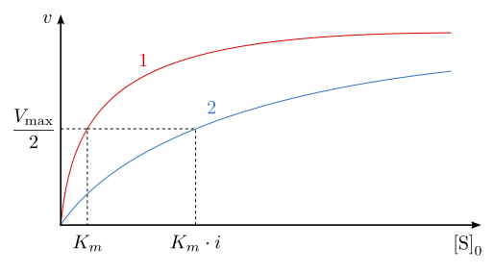
1-Competitive inhibition

Slide 7
2- Noncompetitive inhibition
Noncompetitive inhibition yields the curve indicated, with a lower V_{MAX} and a K_{M} identical to the reaction in the absence of inhibitor.
The inhibitor bind to the free enzyme or enzyme-substrate complex and reduces Enzyme activity ,but does not affect the binding of substrate
V max will decrease due to the inability for the reaction to proceed as efficiently, but Km will remain the same as the actual binding of the substrate, by definition, will still function properly
Noncompetitive inhibitor binds to a site other than the active site or the ES complex. The (ESI) complex does not lead to product.

Slide 8
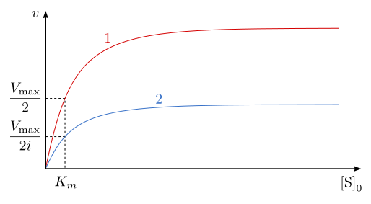
2-Non-competitive inhibition

Slide 9
3-Uncompetitive inhibition
Uncompetitive inhibition is characterized by a low V_{MAX}, a lower K_{M} and a Michaelis-Menten curve similar to that of noncompetitive inhibition. The best way to distinguish the three types of inhibition graphically is to use the Lineweaver-Burk plot
Notice that in the case of uncompetitive inhibition the slope of the inhibited curve (K_{M}/ V_{MAX}) is the same as that of the noninhibited curve, whereas in the other two types of inhibition, the slope of the inhibited plot is greater

Slide 10
In uncompetitive inhibition, the inhibitor binds only to the substrate-enzyme complex; it should not be confused with non-competitive inhibitors. This type of inhibition causes V max to decrease (maximum velocity decreases as a result of removing activated complex) and Km to decrease (due to better binding efficiency thus decreasing the Km which indicates a higher binding affinity).
Uncompetitive inhibitor binds only to the ES complex. The (ESI) complex does not lead to product.

Slide 11
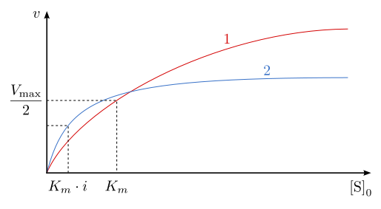
3-Uncompetitive inhibition

Slide 12
Principle
Sucrose is a disaccharide composed of -glucose and -fructose joined by an -1,4-glycosidic linkage.
This bond can be hydrolyzed by fructofuranosidase, an enzyme commonly known as invertase, to yield glucose and fructose in equal proportions .
In this experiment, the kinetic parameters of -fructofuranosidase, a yeast enzyme that catalyzes the break-down of sucrose, were quantized through dinitrosalicylic acid assay .
The presence of heavy metal ions such as Cu2+ may inhibit the activity of invertase. This is due to the high affinity of the sulfhydryl group on cysteine and methionine residues in a protein for the Cu2+ ion.

Slide 13
Principle
When copper ions form complexes with sulfhydryl groups in amino acid residues, disulde bridges are disrupted, modifying the enzyme's tertiary structure. Since the functions of an enzyme are highly correlated with its form, a change in the tertiary structure of invertase would likely inhibit its function

Slide 14
Principle
Competitive inhibition refers to the type of inhibition in which an inhibitor binds to an enzyme's active site and lowers the affinity of the enzyme for its substrate.
Competitive inhibition does not change the maximal rate of reaction, measured as Vmax, due to the fact that the presence of a large amount of substrate can saturate the active sites, preventing the inhibitor from binding.

Slide 15
Materials
Solutions :
0.05M Sodium Acetate buffer , pH 4.7 .
0.25 M Sucrose
Reducing sugar (0.005M glucose + 0.005M fructose)
ß- Fructofuranosidase enzyme extract from yeast.
DNS (dinitrosalicylicacid )Reagent .
Sodium Bicarbonate .
Anhydrous copper sulfate

Slide 16
Method
Prepare two sets of test tubes SET 1 WITHOUT INHIBITOR :
Prepare 7 tubes of different substrate(sucrose) concentrations by following the table provided.
Tube | Distilled water (ml) | 0.25M Sucrose (ml) | Concentration of sucrose M
Blank | 2.0 | 0.0
A | 1.8 | 0.2
B | 1.6 | 0.4
C | 1.2 | 0.8
D | 1.0 | 1.0
E | 0.5 | 1.5
F | 0.0 | 2.0
Mix each tube properly then add 1.0ml of the Acetate buffer to each tube mix well

Slide 17
Prepare SET2 WITH INHIBITOR :
Tube | Distilled water (ml) | 0.25M Sucrose (ml)
Blank Inhibitor | 2.0 | 0.0
G | 1.8 | 0.2
H | 1.6 | 0.4
I | 1.2 | 0.8
J | 1.0 | 1.0
K | 0.5 | 1.5
L | 0.0 | 2.0
Mix each tube properly then add 1.0ml of the Inhibitor (copper sulphate ) to each tube mix well .

Slide 18
Incubate two sets of test tubes at 40˚C for 5min.
Start the reaction by adding 0.05ml of diluted enzyme to all tubes , mix and start the stop clock immediately , incubate each tube for 10min , then stop the reaction by adding 2.0ml of the DNS reagent to each tube and mix well (follow table 2 for adding enzyme and DNS to tubes )
Note : Mix each tube frequently during the incubation time .

Slide 19
Tube | Start Time (min) | Stop by adding 2.0ml DNS . (min)
Blank | 0 | 10
A | 1.0 | 11
B | 2.0 | 12
C | 3.0 | 13
D | 4.0 | 14
E | 5.0 | 15
F | 6.0 | 16
Blank Inhibitor | 7.0 | 17
G | 8.0 | 18
H | 9.0 | 19
I | 10 | 20
J | 11 | 21
K | 12 | 22
L | 13 | 23

Slide 20
Mix properly , cover each tube by aluminium foil and place in a boiling water bath for 5min to allow the color to develop .
Remove from water bath cool under tap water , add 20ml of distilled water to each tube , mix properly then measure the absorbance at 540nm .

Slide 21
Results
Record the absorbance of each test tube.
Convert the Absorbance reading obtained to micromoles of sucrose hydrolyzed making use of the standard reducing sugars calibration curve.
Determine the velocity for each tube and record all in table 3
drawing a graph between the initial velocity v_{i} and substrate concentration .
Determine the Km value of the enzyme/ substrate pair .

Slide 22
Results
Calculate the reciprocals of velocity (1/v) and substrate concentration (1/[S]).
Prepare the double-reciprocal plot of Lineweaver and Burk and determine the Vmax and Km from the x and y intercepts.

Slide 23
Results
Tube 3 | Absorbance 540nm | Concentration of sucrose * | µmoles of sucrose hydrolyzed | µmoles of sucrose hydrolyzed/min
A
B
C
D
E
F

Slide 24
Discussion
Prepare Michaelis-Menten and Lineweaver-Burke plots that compare the inhibited reaction with the uninhibited reaction.
Determine the K_{M} and V_{MAX} in the presence of anhydrous copper sulfate

Slide 25
Question
Did the presence of copper sulfate affect the enzyme activities? If so, is it a competitive, a noncompetitive, or an uncompetitive inhibitor? (Base your argument on appropriate plots, e.g., Lineweaver-Burk plots.)

Slide 26
Thank You
&
Good Luck

